Slide 1


Mikel Lazcano
19 November 2024

Slide 2

Outline
Executive Summary
Introduction
Methodology
Results
Conclusion
Appendix

Slide 3
Executive Summary
Summary of methodologies
Data collection through API
Data collection with Web Scraping
Data Wrangling
Exploratory Data Analysis with SQL
Exploratory Data Analysis with Data Visualization
Interactive Visual Analytics with Folium
Machine Learning Prediction
Summary of all results
Exploratory Data Analysis result
Interactive analytics in screenshots
Predictive Analytics result

Slide 4
Introduction
Project background and context
SpaceX advertises Falcon 9 rocket launches on its website with a cost of 62 million dollars; other providers cost upward of 165 million dollars each, much of savings is because SpaceX can reuse the first stage. Therefore, if we can determine if the first stage will land, we can determine the cost of a launch. This information can be used if an alternate company wants to bid against SpaceX for a rocket launch. In this project, we will try to predict if the Falcon 9 first stage will land successfully.
Problems you want to find answers
What factors determine the succesfull landing of the rocket?
The interaction amongst various features that determine the success rate of a landing.
What operation conditions needs to be in place to ensure a succesful landing program.

Slide 5

Section 1

Slide 6
Methodology
Executive Summary
Data collection methodology:
  Data was collected using SpaceX API and web scraping from Wikipedia
Perform data wrangling
  One-hot enconding was applied to categorical feautes
Perform exploratory data analysis (EDA) using visualization and SQL
Perform interactive visual analytics using Folium and Plotly Dash
Perform predictive analysis using classification models
  How to build, tune, evaluate classification models

Slide 7
Data Collection
• The data was collected using various methods:
Data collection was done using GET requests to the SpaceX API
Next, the response content was decoded as JSON format using .json() call and turned into a pandas dataframe using .json_normalice().
Then the data was cleaned, checked for missing values and filled in missing values where necessary.
Additionaly web scraping was performed from Wikipedia with BeautifulSoup.
The objetive was to extract the launch records as HTML table, parse and convert it to a pandas dataframe for future analysis.

Slide 8
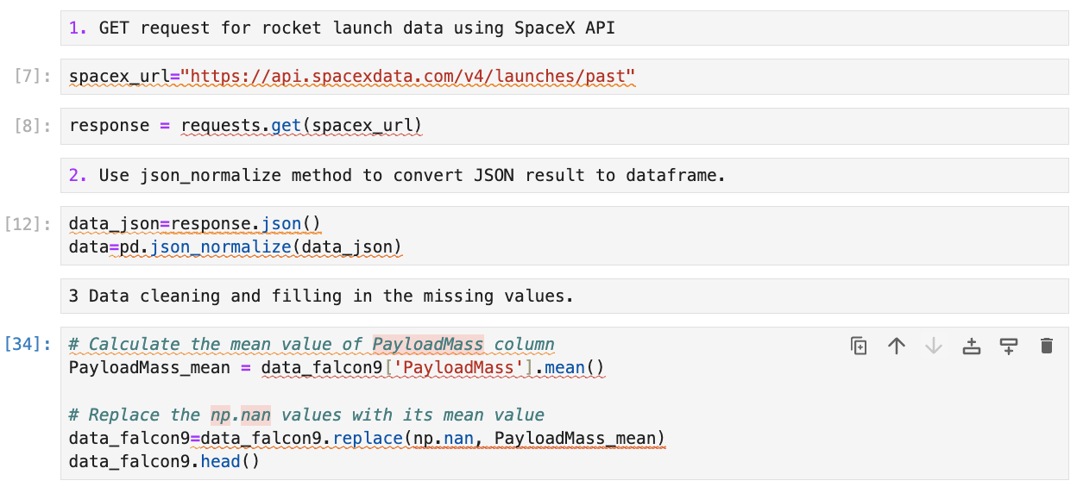
Data Collection – SpaceX API
Collecting data using the SpaceX API.
Converting JSON result to dataframe.
Data cleaning and filling in the missing values.
Link to notebook
Place your flowchart of SpaceX API calls here

Slide 9
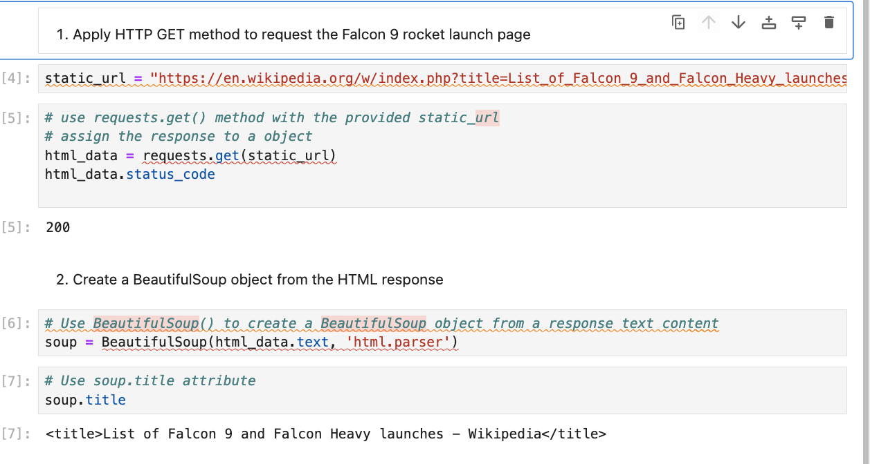
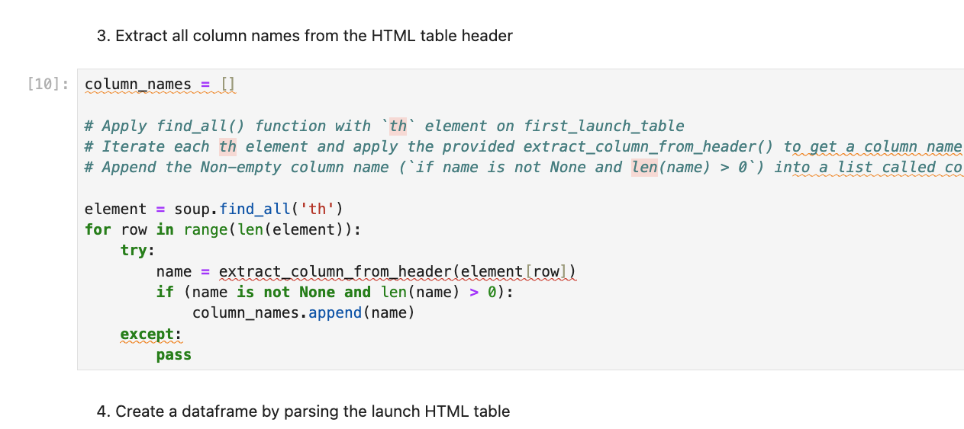
Data Collection - Scraping
Webscrapping Falcon 9 launch records with BeutifulSoup
Parsing the table and converting it into pandas dataframe
Link to notebook
Place your flowchart of web scraping here

Slide 10
Data Wrangling
Calculating the number of launches on each site
Calculating the number and occurrence of each orbit
Calculating the number and occurence of mission outcome per orbit type
Creating a landing outcome label from Outcome column
Link to notebook

Slide 11
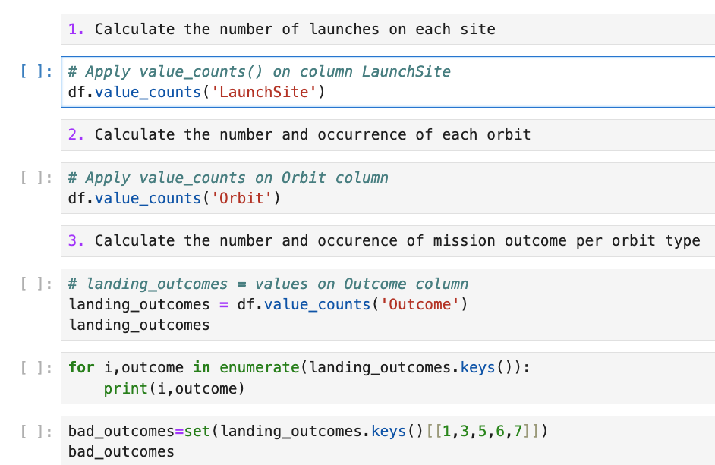
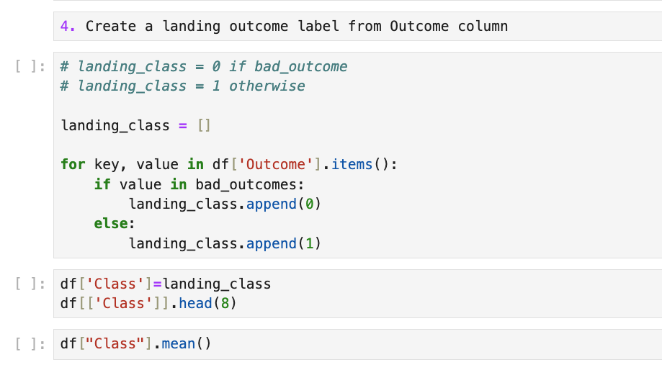

Slide 12
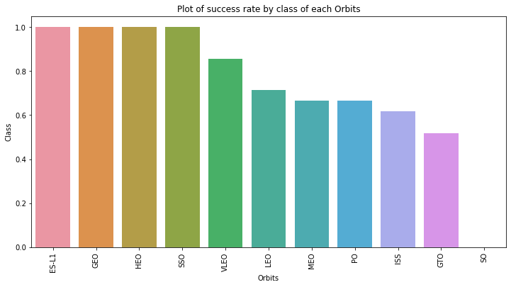
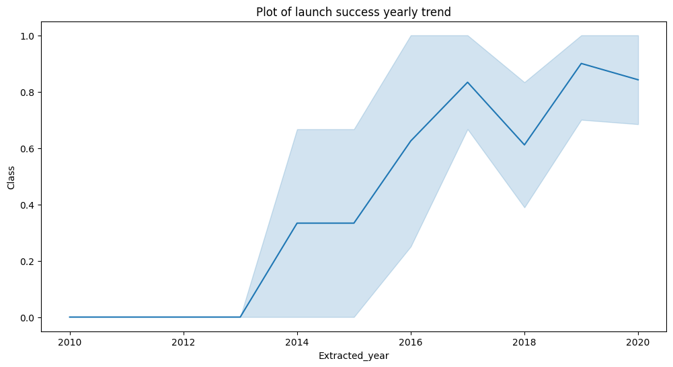
EDA with Data Visualization
Exploratory data analysis by visualizing the relationship between flight number and launch Site, payload and launch site, success rate of each orbit type, flight number and orbit type, the launch success yearly trend.
Link to notebook

Slide 13
EDA with SQL
•Loading the SpaceX dataset into a PostgreSQL database without leaving the jupyter notebook.
• Applying EDA with SQL to get insight from the data. Writing queries to find out for instance:
The names of unique launch sites in the space mission.
The total payload mass carried by boosters launched by NASA (CRS)
The average payload mass carried by booster version F9 v1.1
The total number of successful and failure mission outcomes
The failed landing outcomes in drone ship, their booster version and launch site names.
•Link to notebook

Slide 14
Build an Interactive Map with Folium
Marking all launch sites and adding map objects such as markers, circles, lines to mark the success or failure of launches for each site on the folium map.
Assigning the feature launch outcomes (failure or success) to class 0 and 1.i.e., 0 for failure, and 1 for success.
Using the color-labeled marker clusters, identified which launch sites have relatively high success rate.
Calculating the distances between a launch site to its proximities. We answered some question for instance:
- Are launch sites near railways, highways and coastlines.
- Do launch sites keep certain distance away from cities.
Link to notebook

Slide 15
Build a Dashboard with Plotly Dash
• Building an interactive dashboard with Plotly dash
• Plotting pie charts showing the total launches by a certain sites
• Plotting scatter graph showing the relationship with Outcome and Payload Mass (Kg) for the different booster version.
Link to notebook

Slide 16
Predictive Analysis (Classification)
Loading the data using numpy and pandas, transforming the data, spliting our data into training and testing.
Building different machine learning models and tuning different hyperparameters using GridSearchCV.
Using accuracy as the metric for our model, improving the model using
feature engineering and algorithm tuning.
Link to notebook

Slide 17
Results
Exploratory data analysis results
Interactive analytics demo in screenshots
Predictive analysis results

Slide 18

Section 2

Slide 19
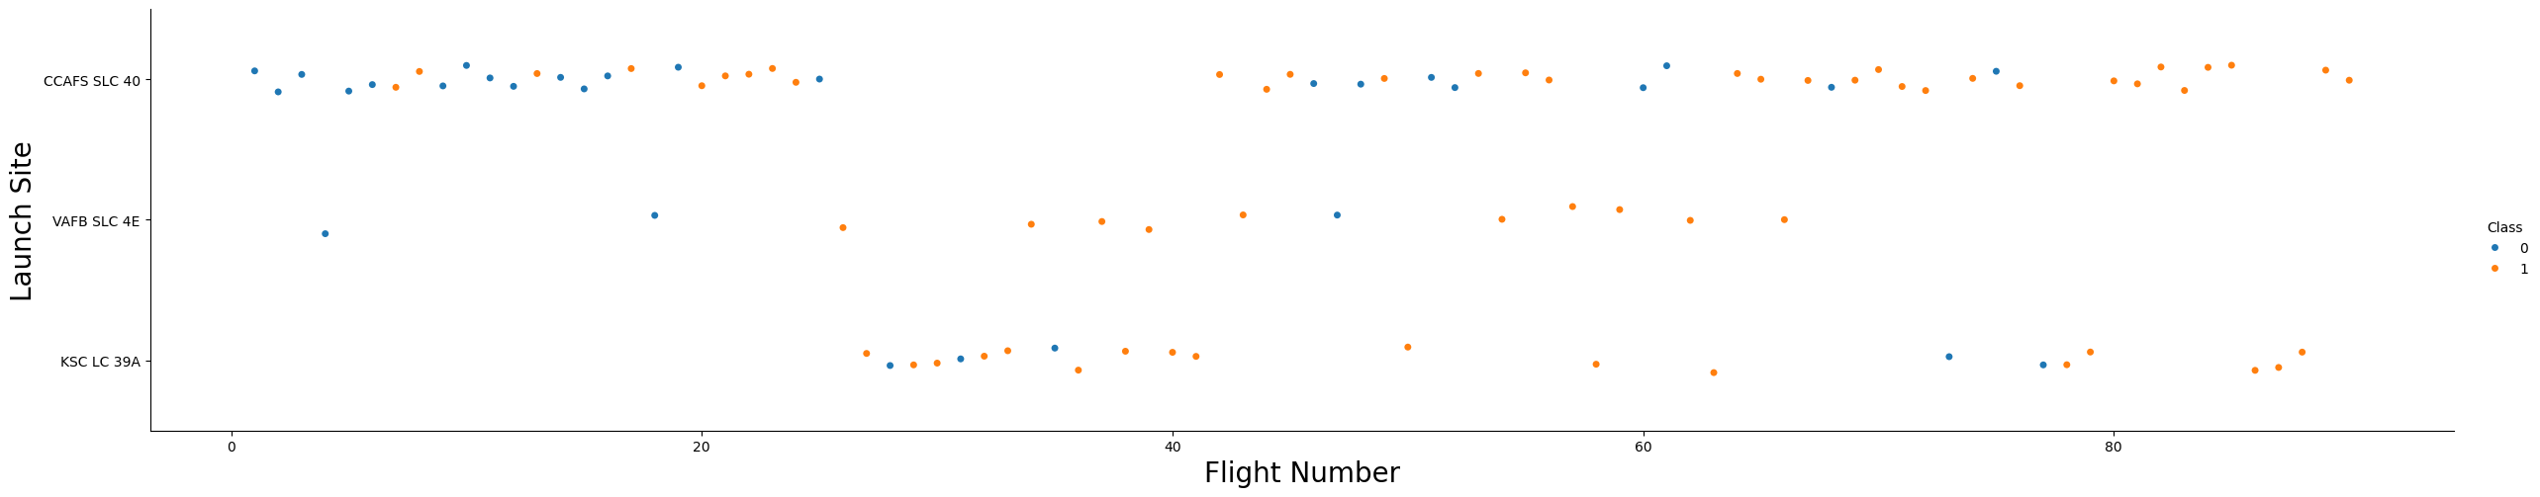
Flight Number vs. Launch Site
From the plot, it can be seen the larger the flight amount at a launch site, the greater
the success rate at a launch site.

Slide 20
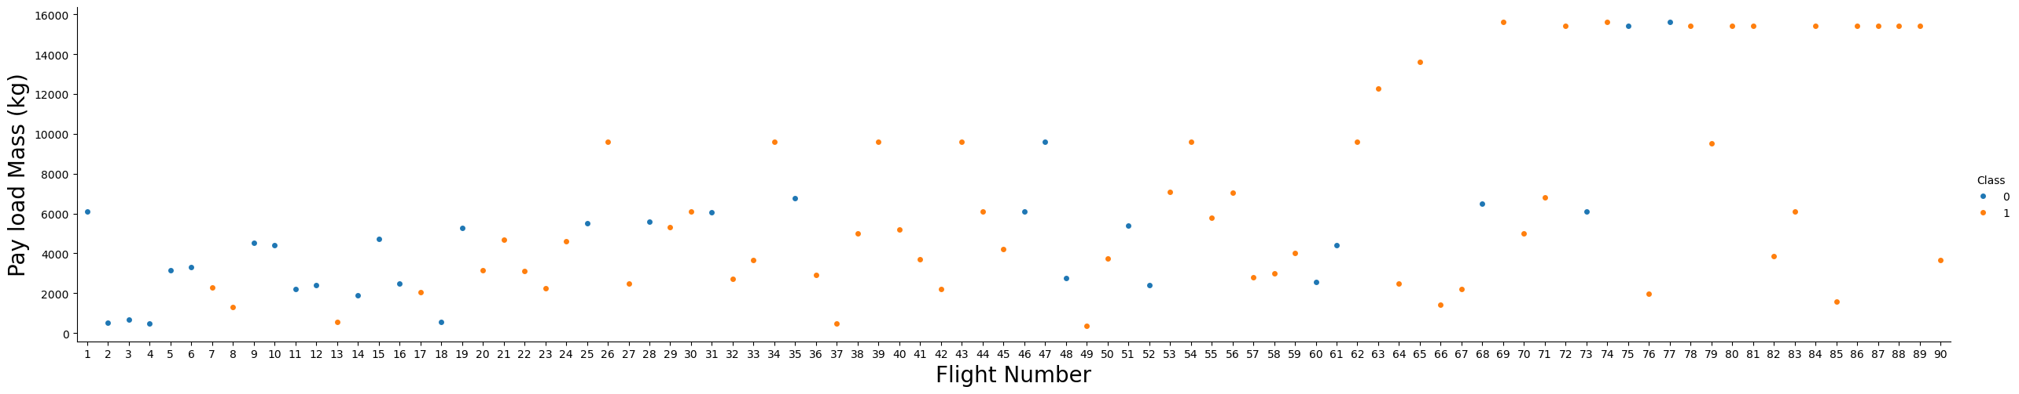
Payload vs. Launch Site
It can be seen that as the flight number increases, the first stage is more likely to land successfully. The payload mass also appears to be a factor; even with more massive payloads, the first stage often returns successfully.

Slide 21
Success Rate vs. Orbit Type
From the plot, we can see that ES-L1, GEO, HEO, SSO, VLEO had the most success rate.

Slide 22
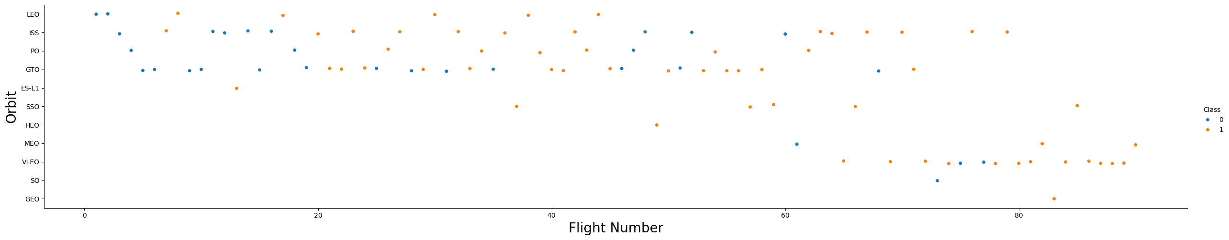
Flight Number vs. Orbit Type
The plot below shows the Flight Number vs. Orbit type. It can be observed that in the LEO orbit, success is related to the number of flights whereas in the GTO orbit, there is no relationship between flight number and the orbit.

Slide 23
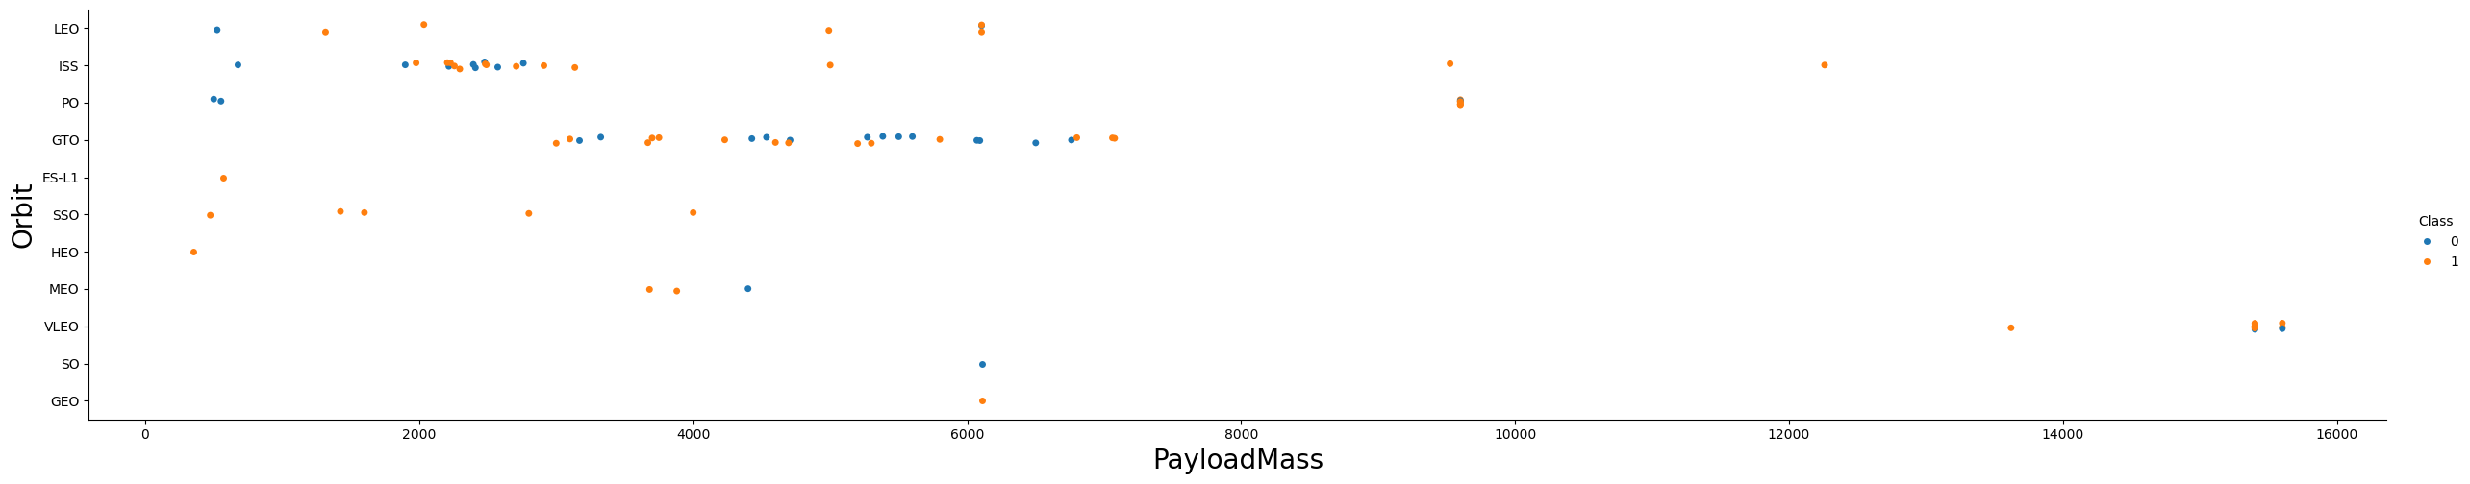
Payload vs. Orbit Type
It can be observed that with heavy payloads, the successful landing are more for PO, LEO and ISS orbits

Slide 24
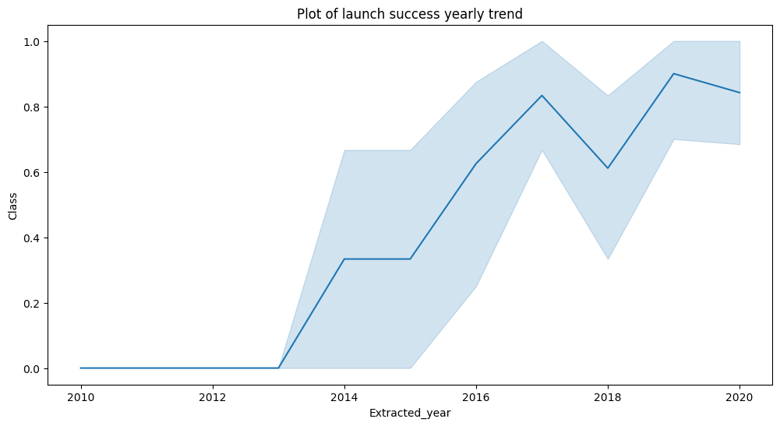
Launch Success Yearly Trend
From the plot, it can be
observed that success rate
since 2013 kept on
increasing till 2020.

Slide 25
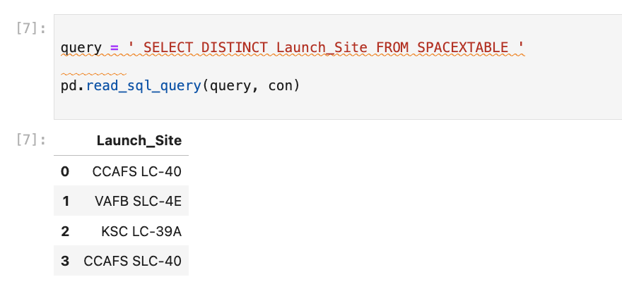
All Launch Site Names
Using the key word DISTINCT to show only unique launch sites from the SpaceX data.

Slide 26
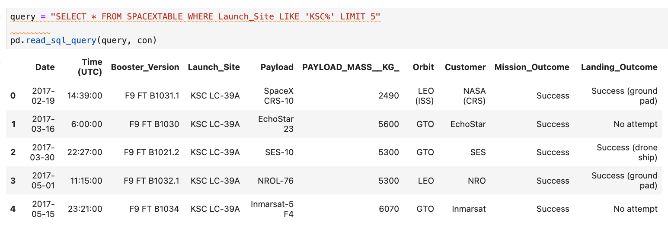
Launch Site Names Begin with 'KSC'
Using the query below to display 5 records where launch sites begin with `KSC`

Slide 27
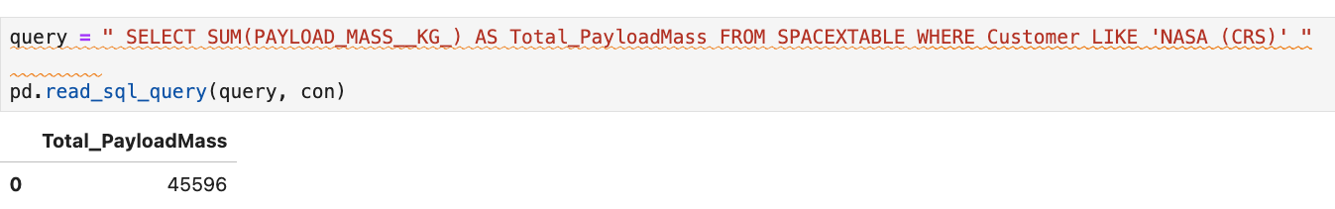
Total Payload Mass
Calculating the total payload carried by boosters from NASA as 45596 using the query below

Slide 28
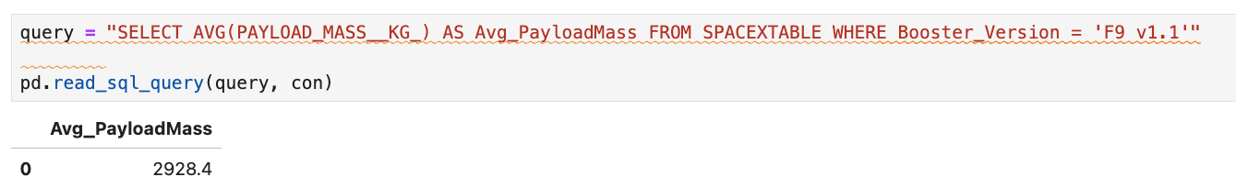
Average Payload Mass by F9 v1.1
Calculating the average payload mass carried by booster version F9 v1.1 as 2928.4

Slide 29
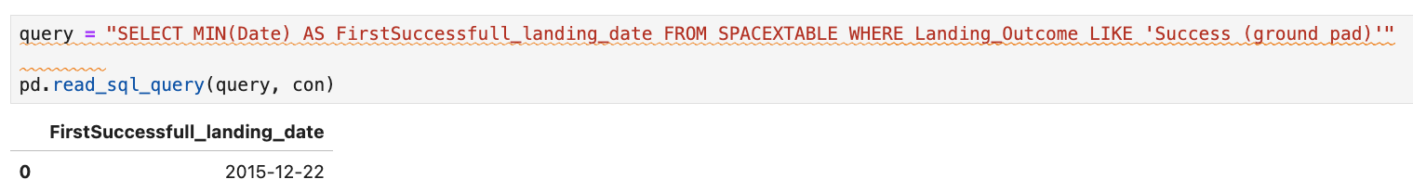
First Successful Ground Landing Date
It can be observed that the dates of the first successful landing outcome on ground pad was 22nd December 2015

Slide 30
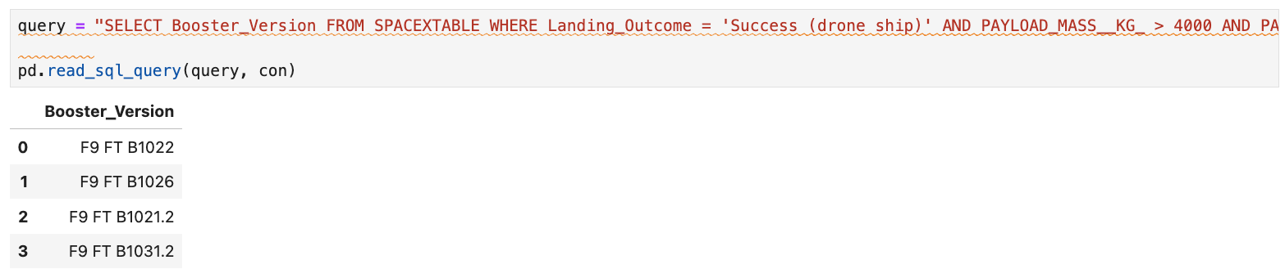
Successful Drone Ship Landing with Payload between 4000 and 6000
Using the WHERE clause to filter for boosters which have successfully landed on drone ship and applied the AND condition to determine successful landing with payload mass greater than 4000 but less than 6000

Slide 31
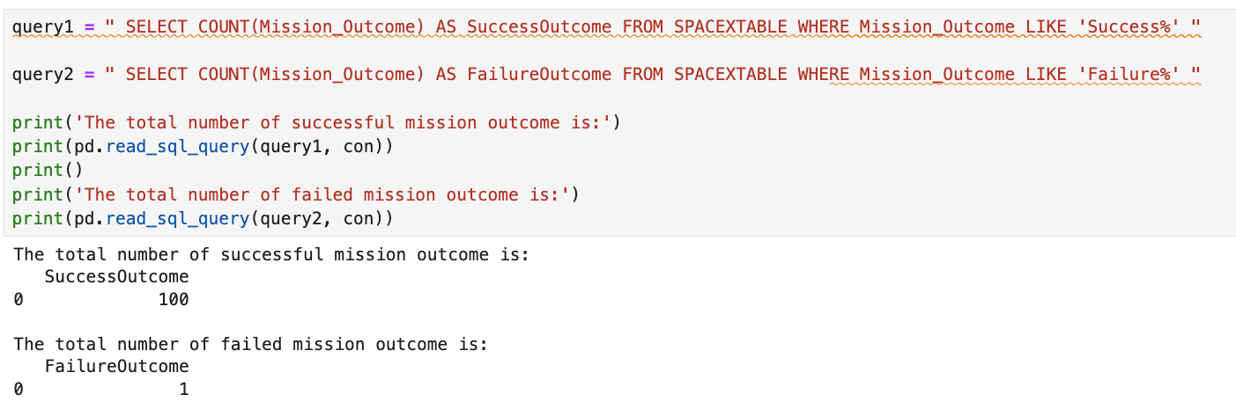
Total Number of Successful and Failure Mission Outcomes
Using wildcard like ‘%’ to filter for WHERE MissionOutcome was a success or a failure.

Slide 32
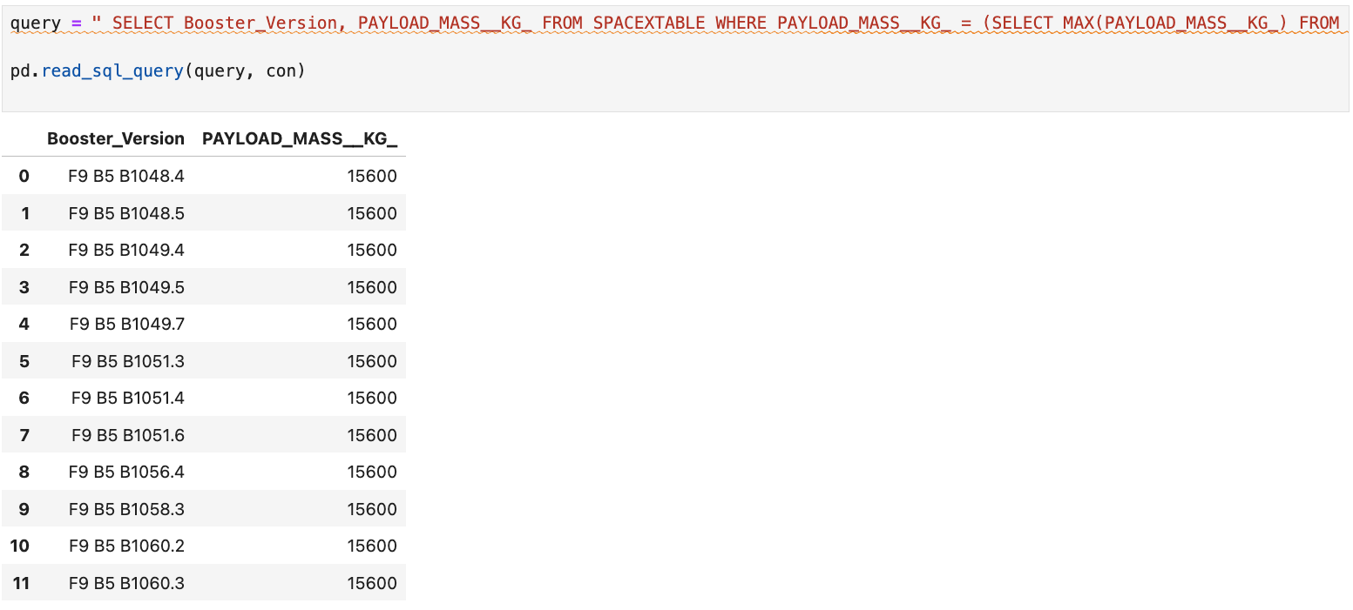
Boosters Carried Maximum Payload
Determining the booster that have carried the maximum payload using a subquery in the WHERE clause and the MAX() function.

Slide 33
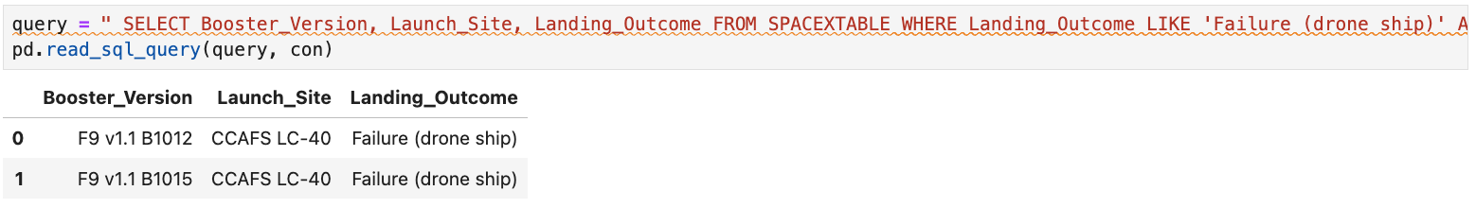
2015 Launch Records
Using a combinations of the WHERE clause, LIKE, AND, and BETWEEN conditions to filter for failed landing outcomes in drone ship, their booster versions, and launch site names for year 2015

Slide 34
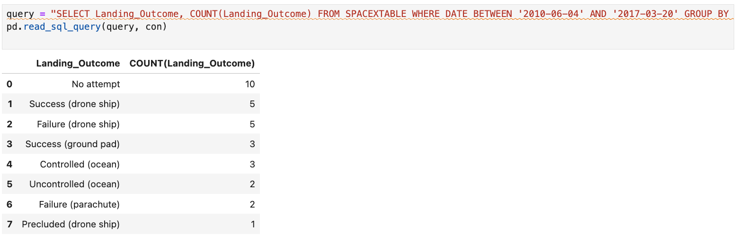
Rank Landing Outcomes Between 2010-06-04 and 2017-03-20
Selecting Landing outcomes and the COUNT of landing outcomes from the data and using the WHERE clause to filter for landing outcomes BETWEEN 2010-06-04 to 2017-03-20.
Applying the GROUP BY clause to group the landing outcomes and the ORDER BY clause to order the grouped landing outcome in descending order.

Slide 35

Section 3

Slide 36
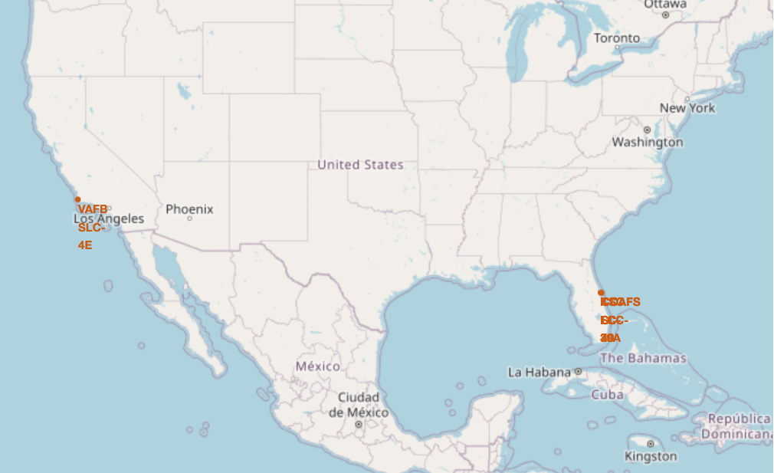
All launch sites global map markers
It can be seen that the SpaceX launch sites are in the USA coasts, Florida and California.

Slide 37
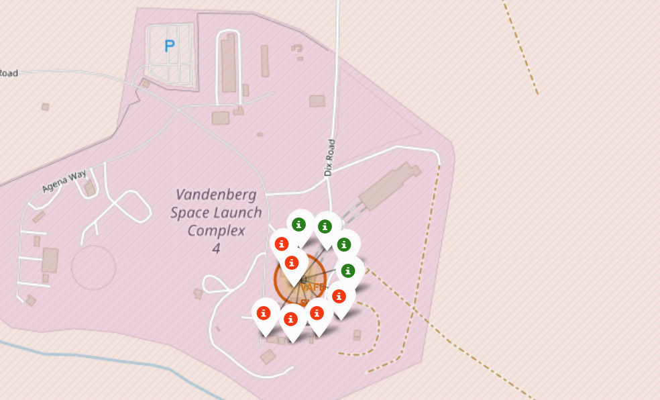
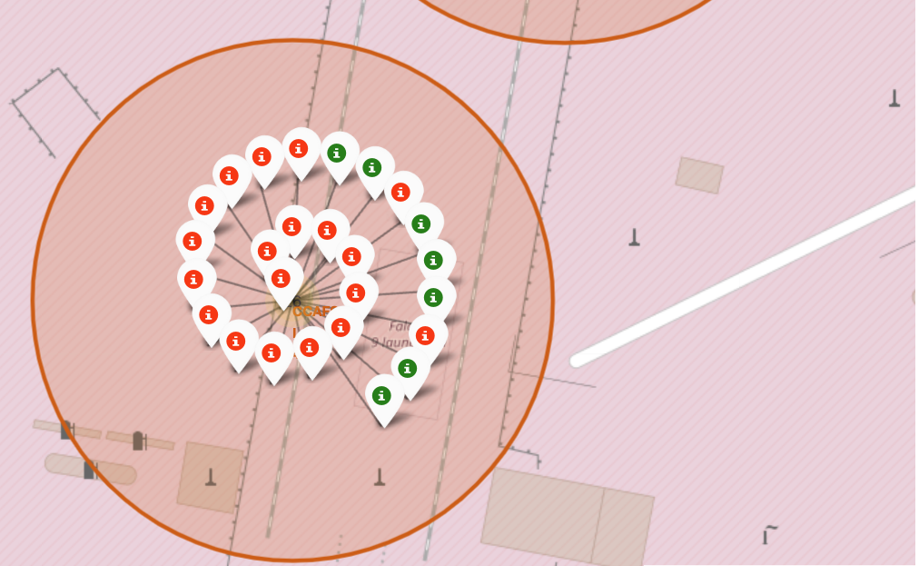
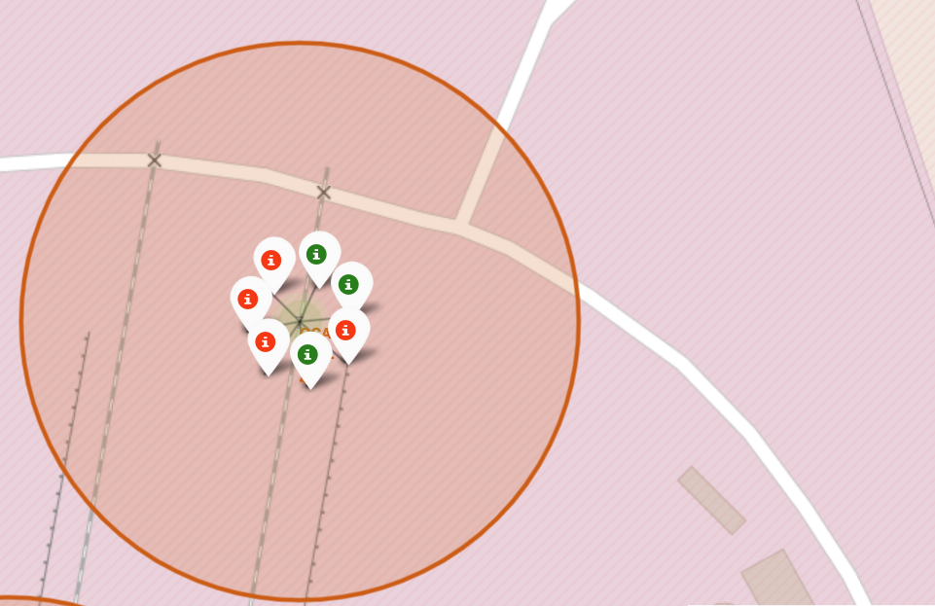

Markers showing launch sites with color labels
Green markers show succesful Launches and Red markers show failures.
California launch site:
Florida Launch sites:

Slide 38
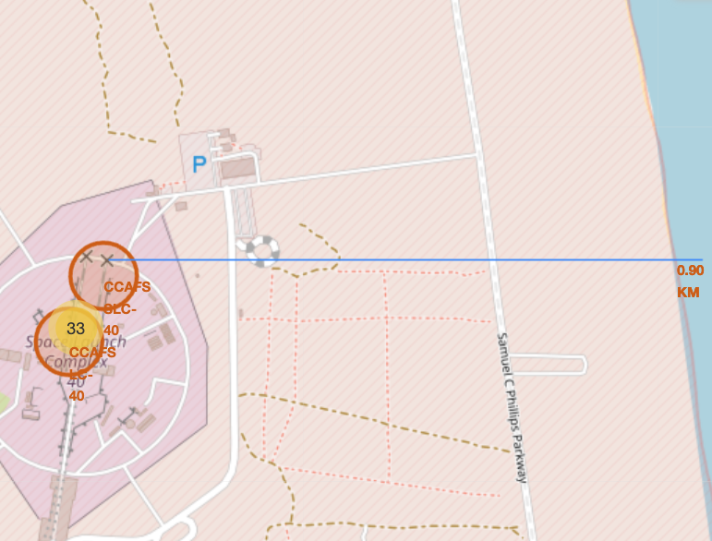
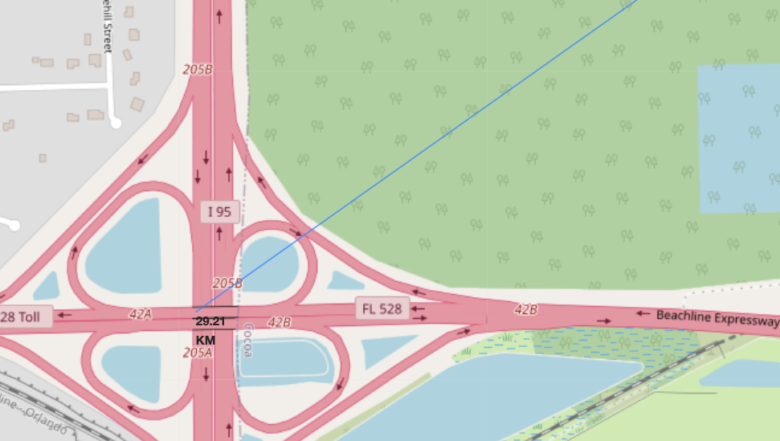
Launch Site distance to landmarks 1
Distance to Coastline: Distance ho closest Highway:

Slide 39
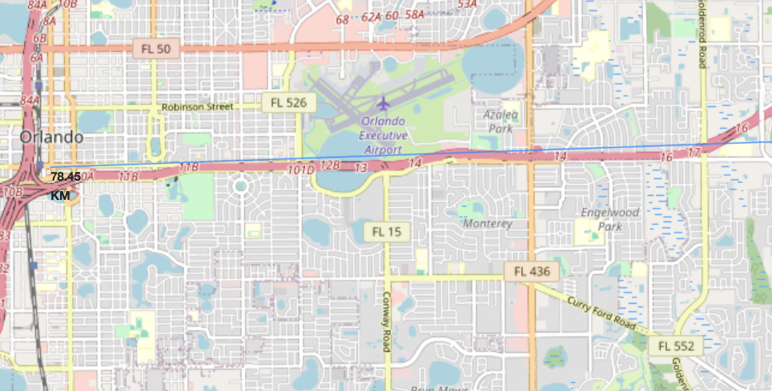
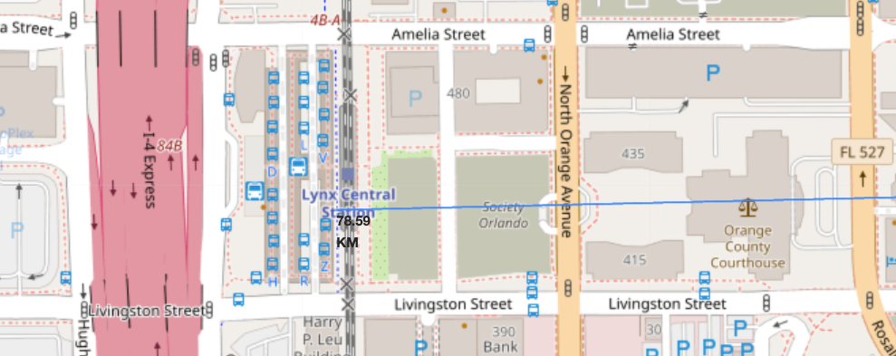
Launch Site distance to landmarks 2
Distance to city: Distance to Railway station:
Are launch sites in close proximity to railways? No
Are launch sites in close proximity to highways? No
Are launch sites in close proximity to coastline? Yes
Do launch sites keep certain distance away from cities? Yes

Slide 40

Section 4

Slide 41
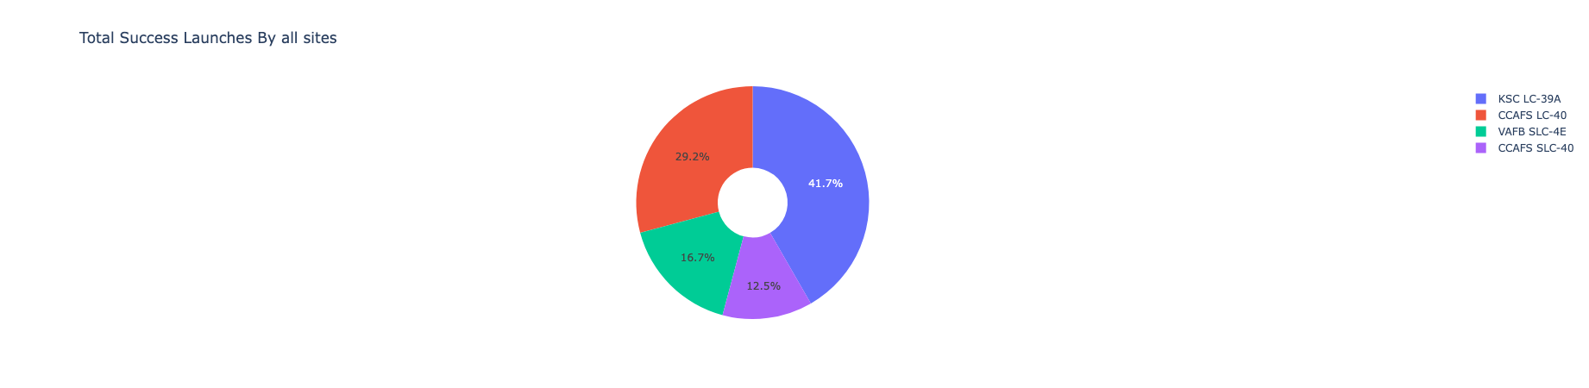
Pie chart showing the success percentage achieved by each launch site
It can be seen that KSC LC-39A had the most succesful launches from all the sites

Slide 42
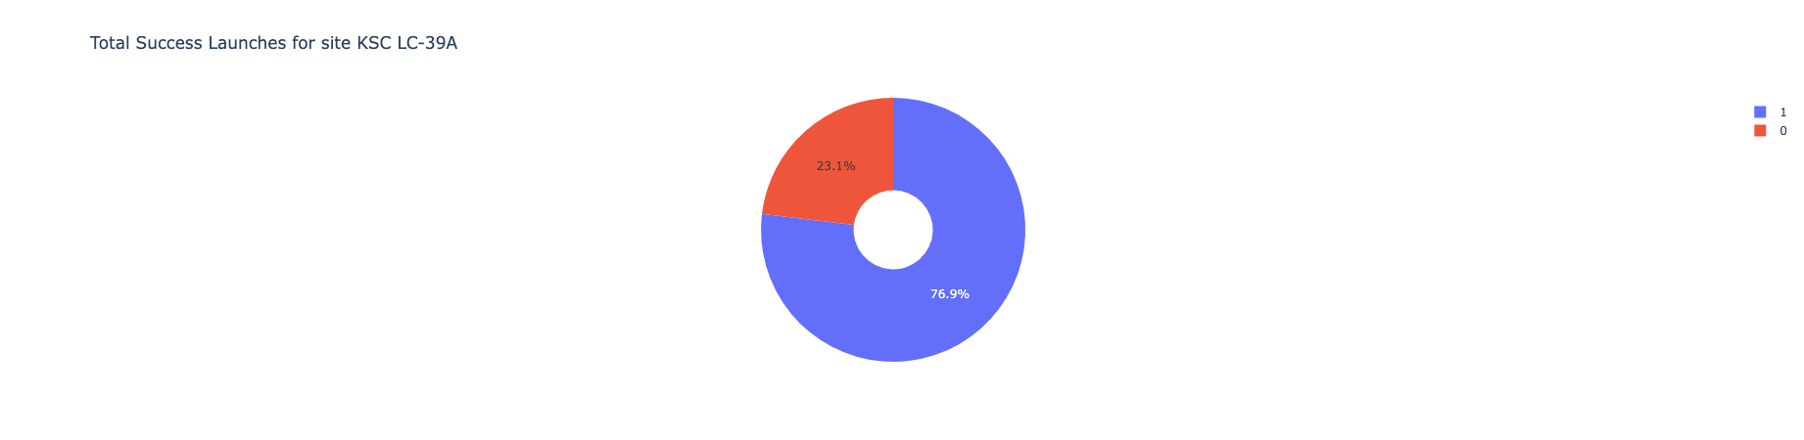
Pie chart showing the Launch site with the highest launch success ratio
KSC LC-39A achieved a 76.9% success rate while getting a 23.1% failure rate.

Slide 43
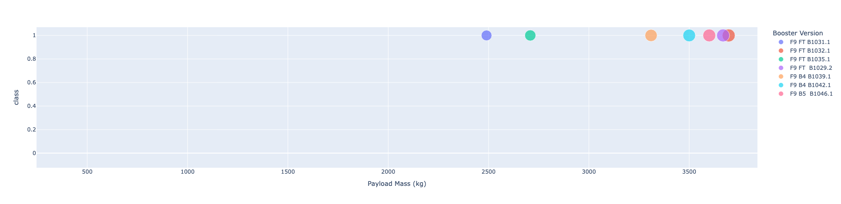
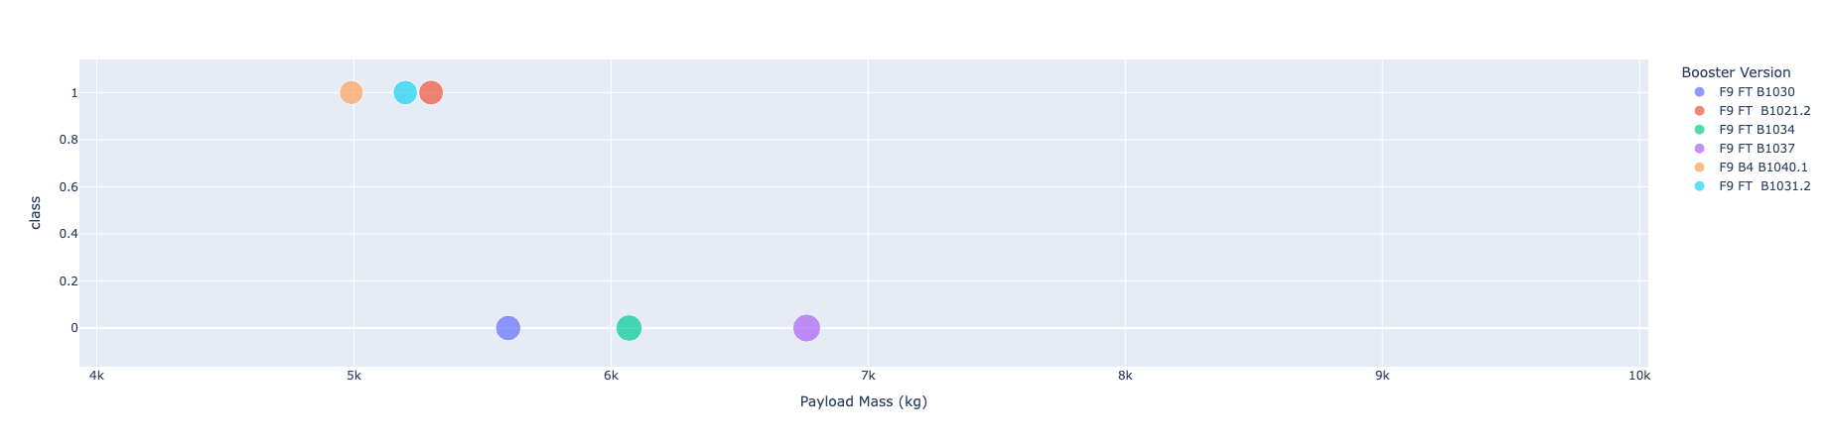
Scatter plot of Payload vs Launch Outcome for all sites, with different
payload selected in the range slider
It can be seen the success rates for low weighted payloads is higher than the heavy weighted payloads.
Low weighted Payload 0kg-4000kg Heavy Weighted Payload 4000kg-10000kg

Slide 44

Section 5

Slide 45
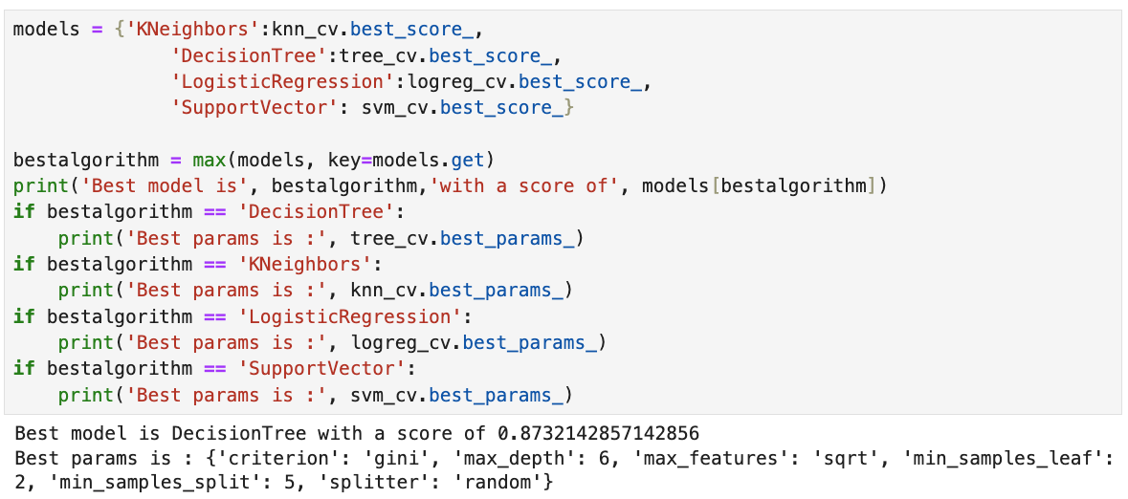
Classification Accuracy
The decision tree classifier is the model with the highest classification accuracy

Slide 46
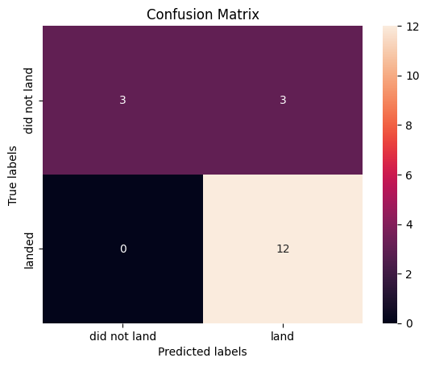
Confusion Matrix
The confusion matrix for the decision tree classifier shows that the classifier can distinguish between the different classes. The major problem is the false positives .i.e., unsuccessful landing marked as successful landing by the classifier.

Slide 47
Conclusions
It can be concluded that:
• The larger the flight amount at a launch site, the greater the success rate at a launch
site.
• Launch success rate started to increase in 2013 till 2020.
• Orbits ES-L1, GEO, HEO, SSO, VLEO had the most success rate.
• KSC LC-39A had the most successful launches of any sites.
• The Decision tree classifier is the best machine learning algorithm for this task.

Slide 48


