Slide 1

HiNote
Michael Stewart, Cameron O’Leary, Richard Mishaan, Matthijs Taselaar

Slide 2
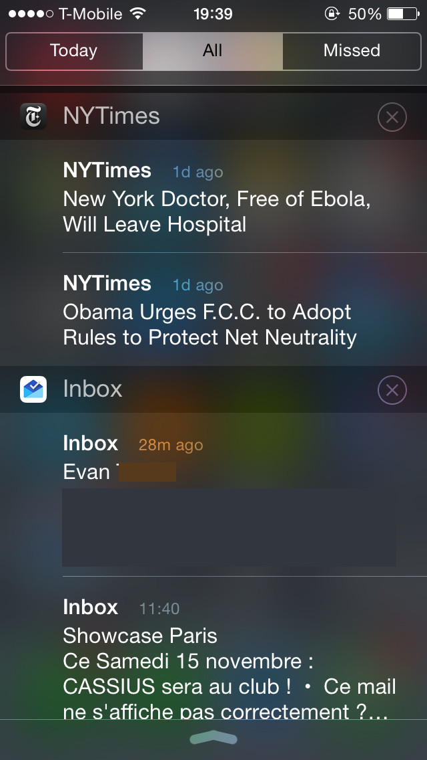
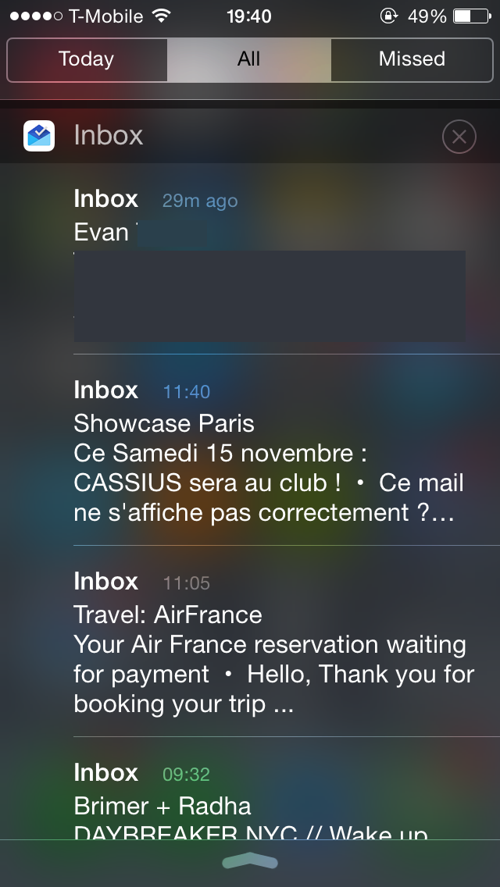

Slide 3



#

Slide 4
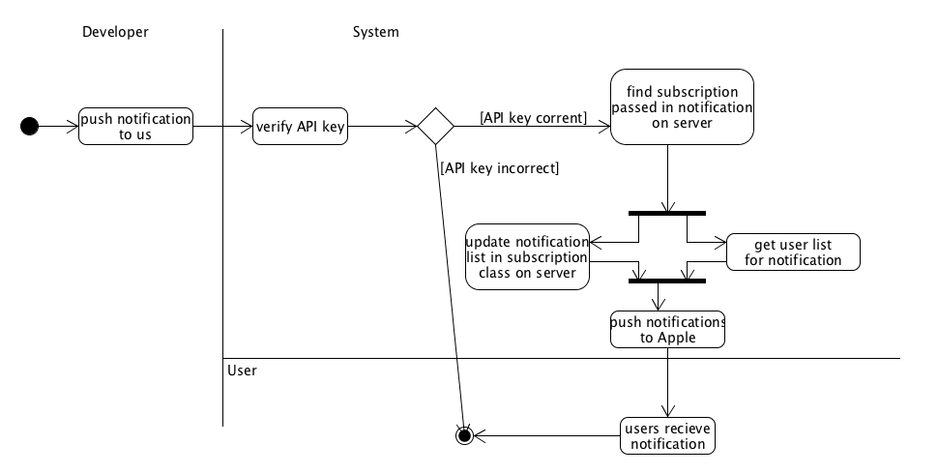

Slide 5
Demo

Slide 6




Slide 7
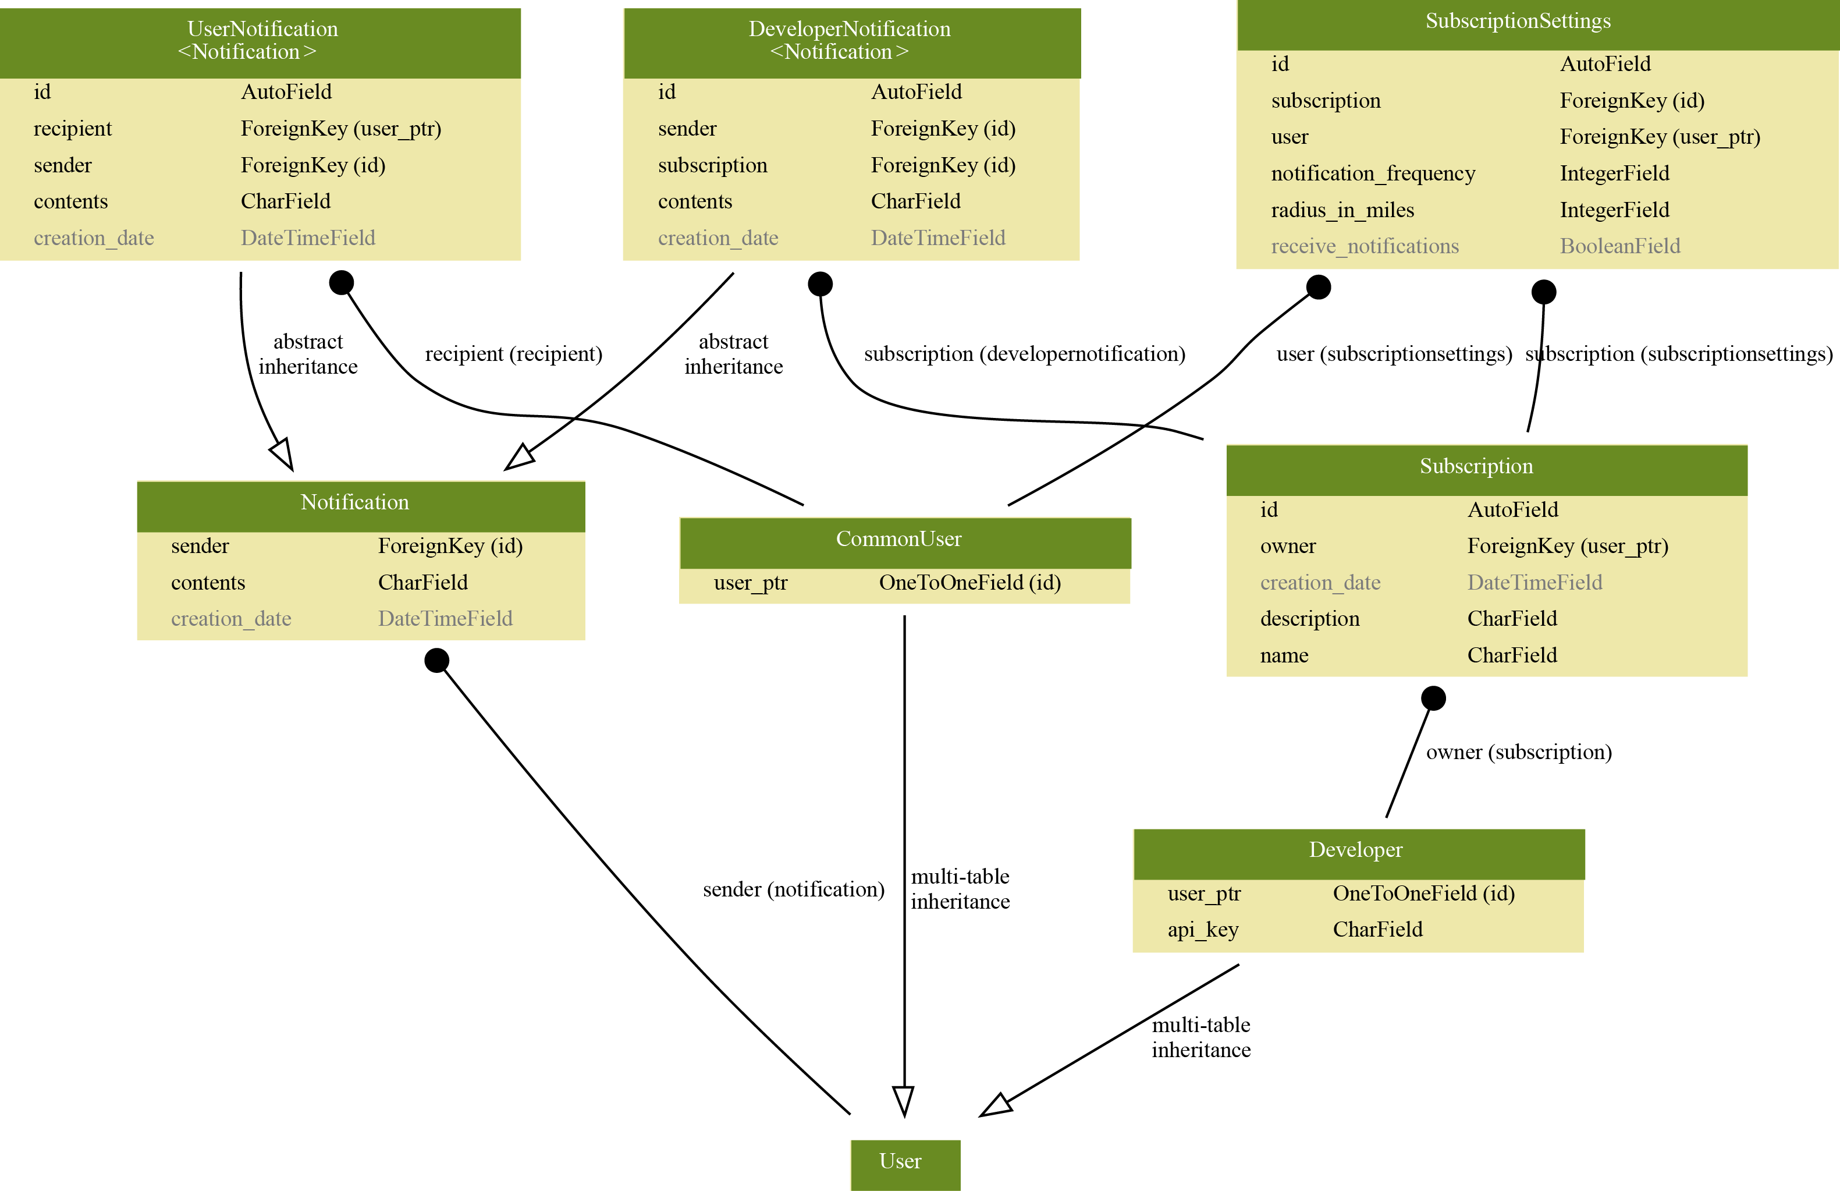

Slide 8
PROTOCOLS AND
COMPLEX ALGORITHMS
Notes:
1) Json – using this for server → iOS communication
2) We will have a standard HTTP REST API to which our iOS client app can make requests
3) Developers will be able to perform all actions aside from initially creating their account from our REST API

Slide 9



Expanded Features List
S&P gains 500 points

