Slide 1

HiNote
Michael Stewart, Cameron O’Leary, Richard Mishaan, Matthijs Taselaar

Slide 2
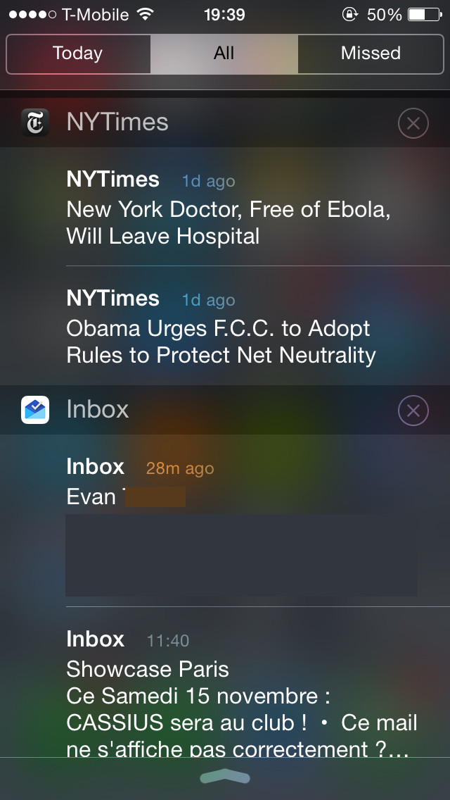


Slide 3



#

Slide 4
Demo

Slide 5
Describe the high-level deployment architecture, in particular any distribution, web interaction, database used, etc.

Slide 6




Slide 7
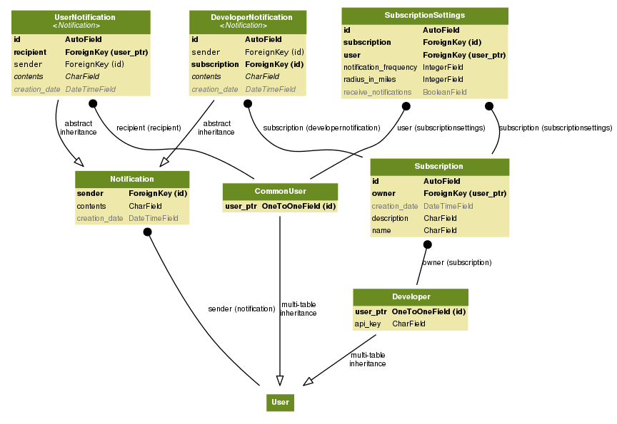

Slide 8
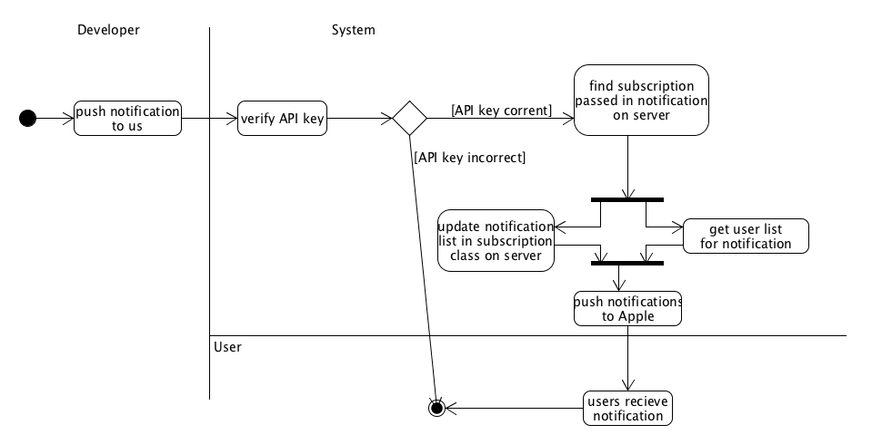

Slide 9
PROTOCOLS AND
COMPLEX ALGORITHMS

Slide 10



Expanded Features List
S&P gains 500 points

