Slide 1

HiNote
Michael Stewart, Cameron O’Leary, Richard Mishaan, Matthijs Taselaar

Slide 2



Slide 3



#

Slide 4
Demo

Slide 5




Slide 6
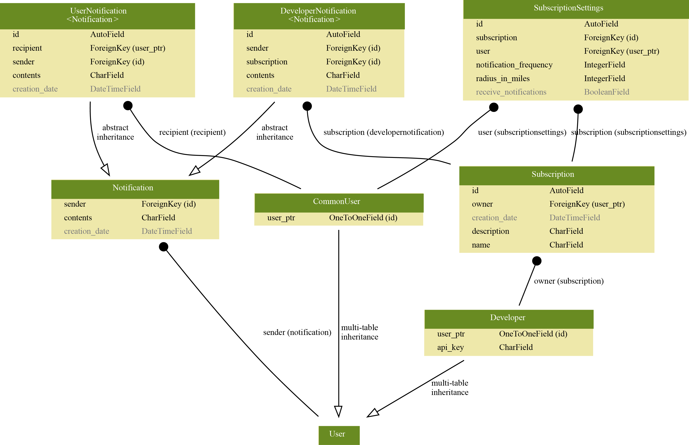

Slide 7
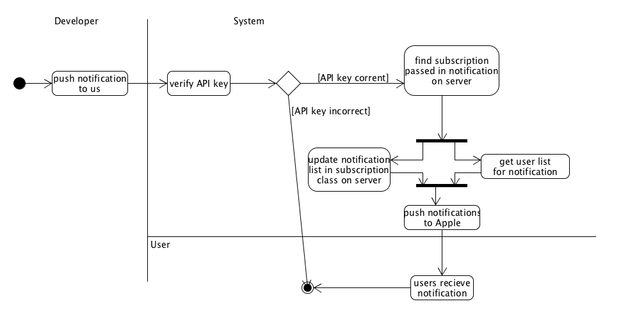

Slide 8
PROTOCOLS AND
COMPLEX ALGORITHMS

Slide 9



Expanded Features List
S&P gains 500 points

