Slide 1

HiNote
Michael Stewart, Cameron O’Leary, Richard Mishaan, Matthijs Taselaar

Slide 2
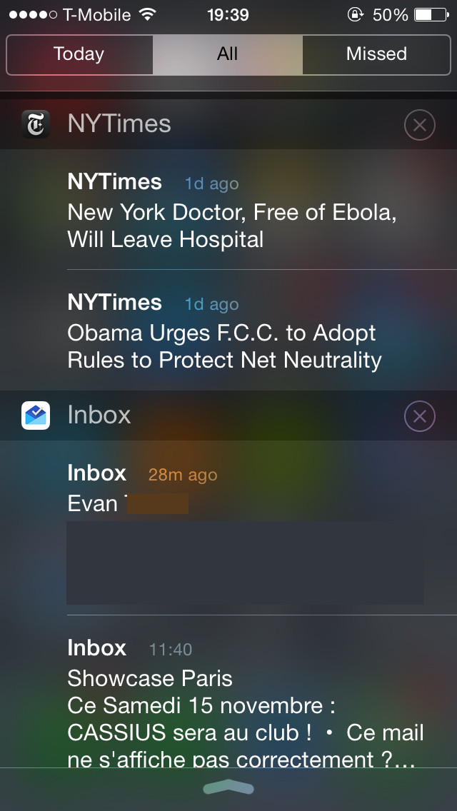
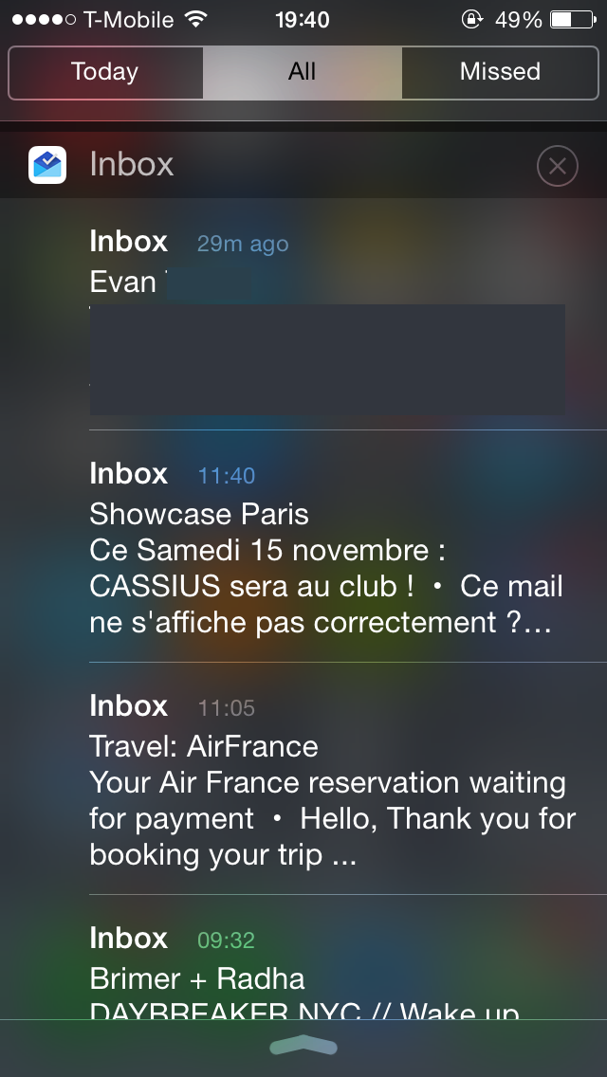

Slide 3



#

Slide 4
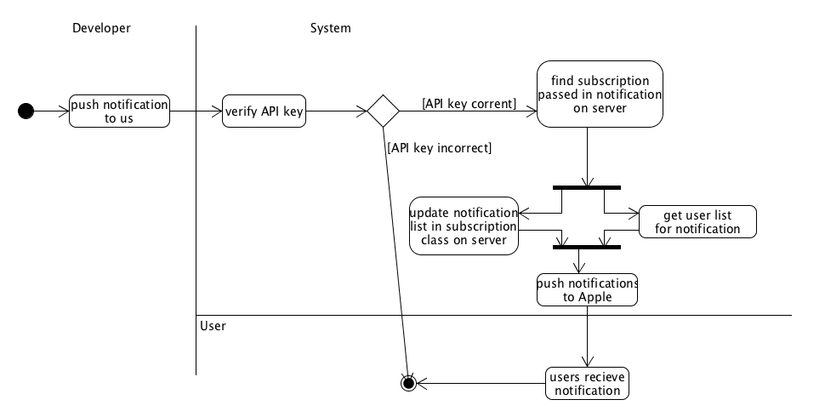

Slide 5
Demo

Slide 6




Slide 7
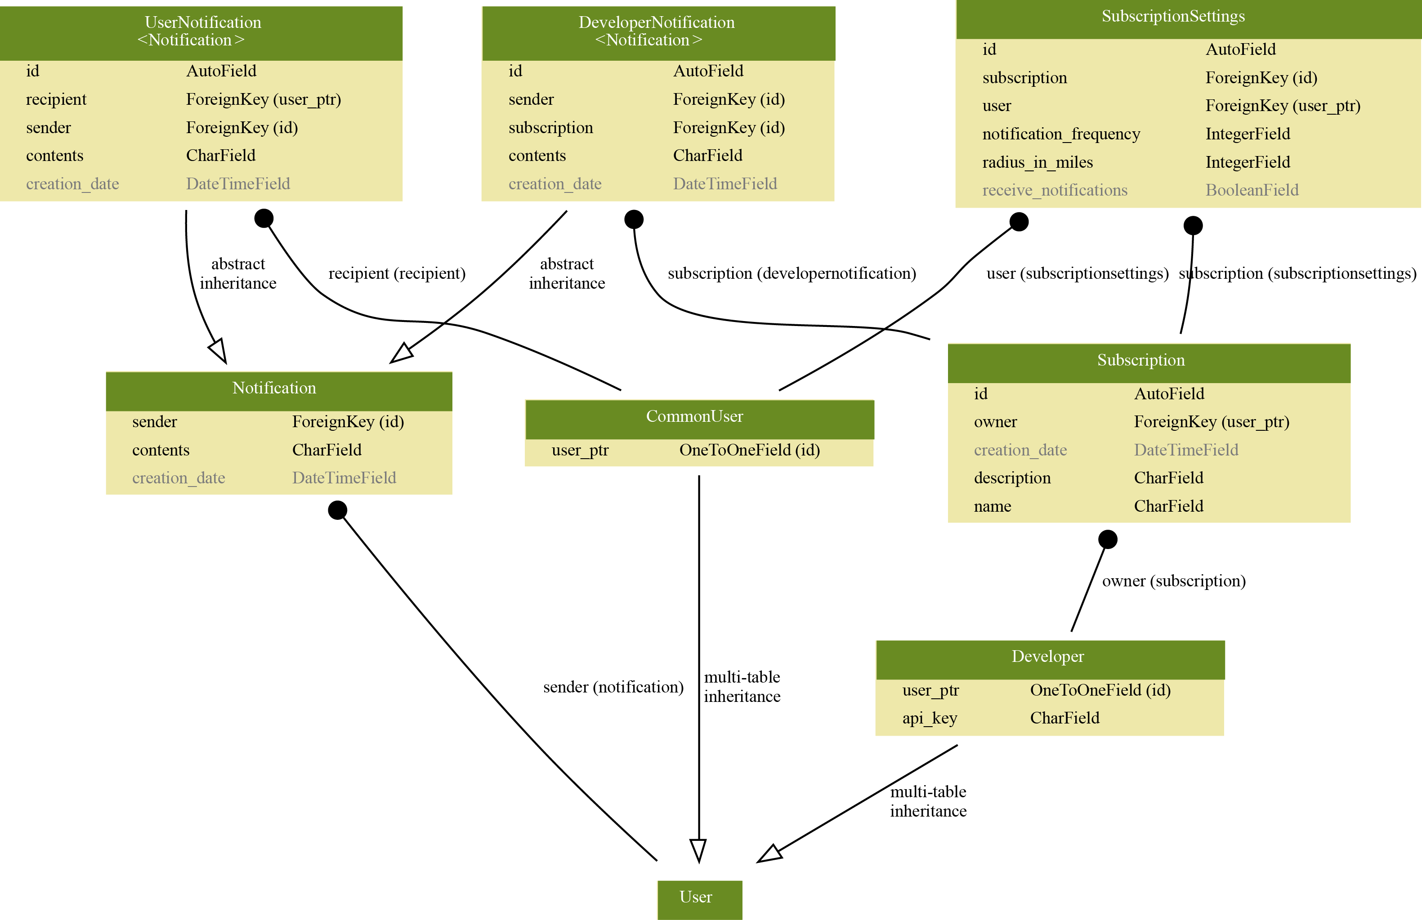

Slide 8
PROTOCOLS AND
COMPLEX ALGORITHMS
Notes:
PROTOCOLS:
1) We will have a standard HTTP REST API to which our iOS client app can make requests
2) Developers will be able to perform all actions aside from initially creating their account from our REST API
COMPLEX ALGORITHM:
1) Calculate distances from notifications → User’s location if they have a radius turned on

Slide 9



Expanded Features List
S&P gains 500 points
Notes:
Sponsor notifications
Extended geographical features
Customization of notification action buttons
Statistic collection for Developers

Slide 10
Questions?

