Slide 1

HiNote
Michael Stewart, Cameron O’Leary, Richard Mishaan, Matthijs Taselaar
Notes:
Overview

Slide 2
Overview
Problem with current iOS notification system:
Not Centralized
Unappealing
Not Customizable
Notifications cannot be sent between Common Users

Slide 3
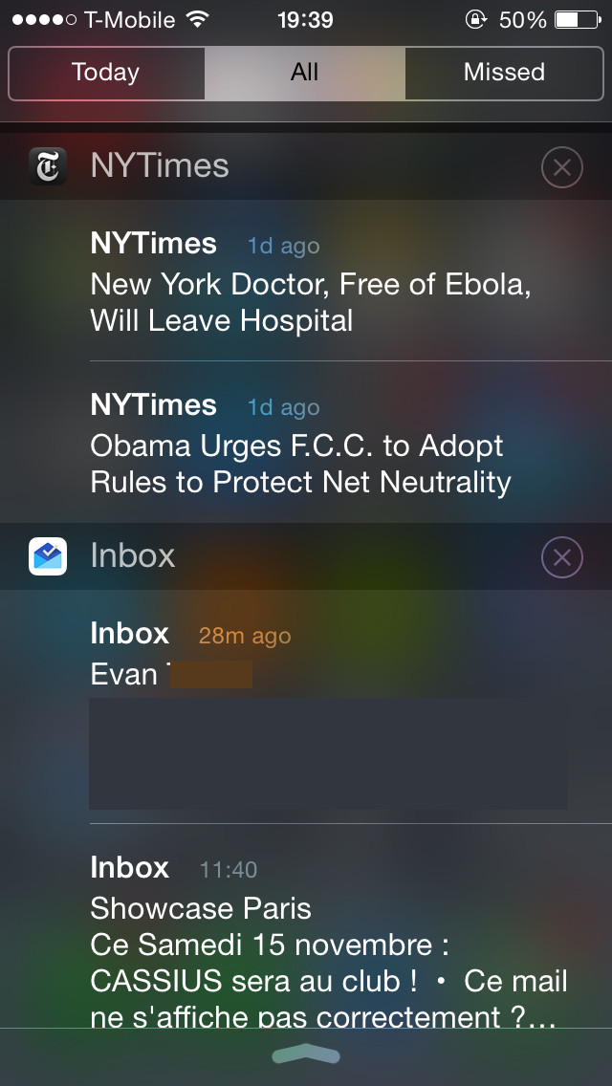
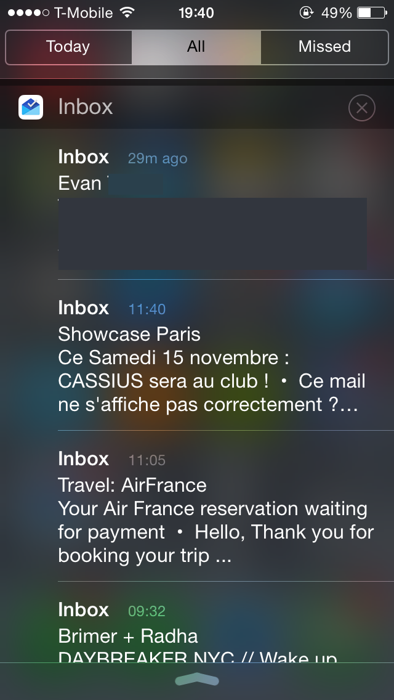

Slide 4
Goals
Create a centralized, customizable Notification Center
User-Friendly for both Developers and Common Users
Create simple REST API for publishing notifications
Give Users more control over personal notifications

Slide 5
High Level Architecture
Server- Django, MySQL, JSON
Developer Sign-Up Web Form
Custom Headlist API
iOS Application for Common Users- Swift

Slide 6




Slide 7
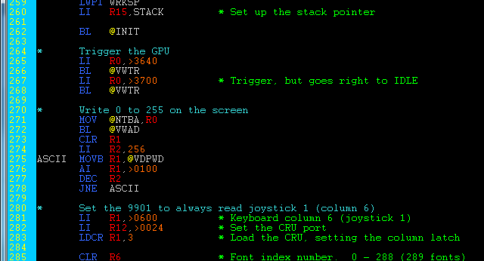
Code Overview

Slide 8
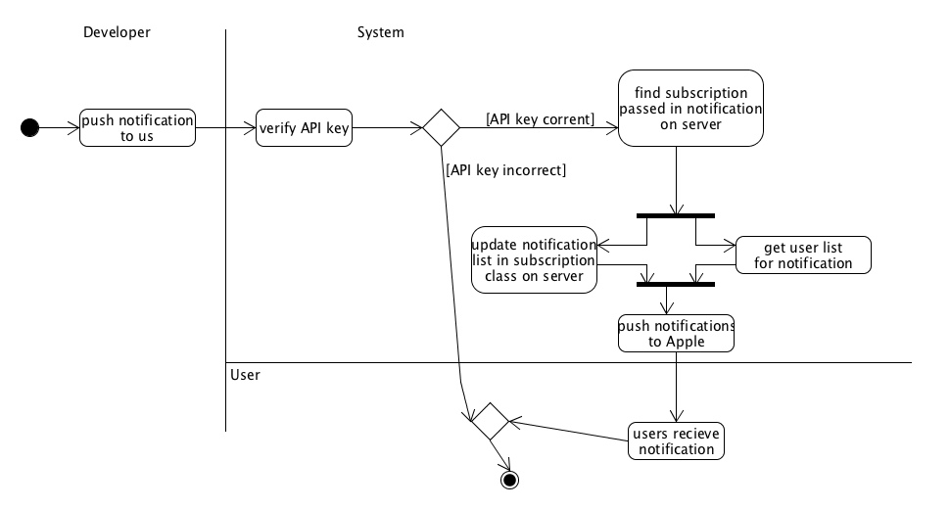

Slide 9
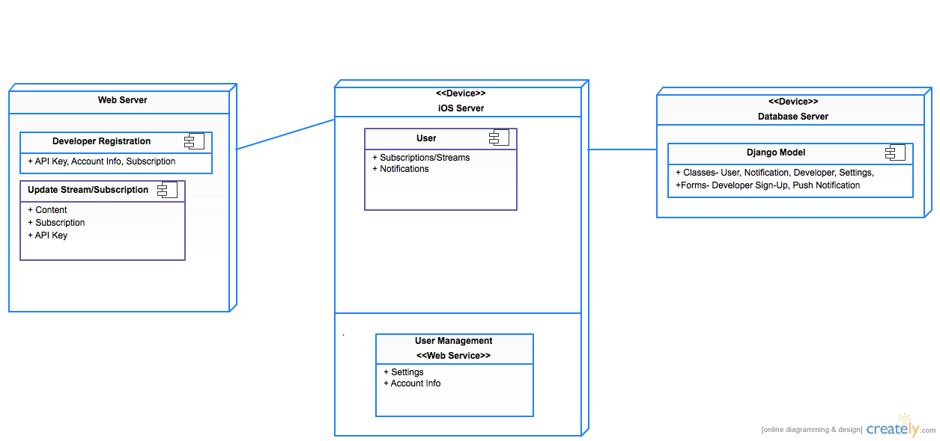

Slide 10
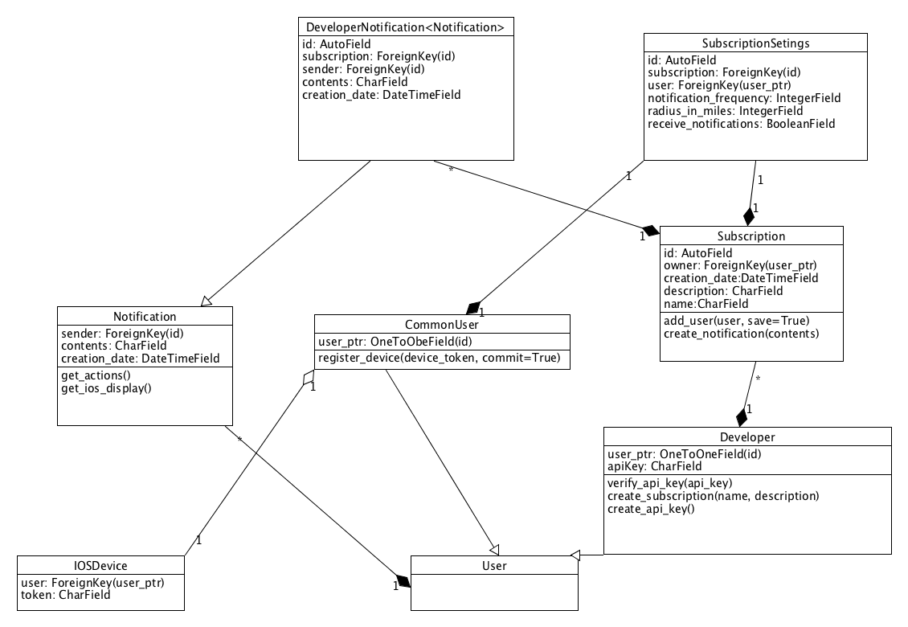

Slide 11
Demo

Slide 12
Implementation Status
Created Server-side
Developer Sign-up
Push Notification (Developer to Common User)
Store User Preferences
Implemented iOS notification app
Register, Log-in and Subscribe
Browse by topic
Interact with notifications
Customize Settings

Slide 13
Features
Developer Features
Create dev account
Create streams by topic
Push notifications to subscribers
User Features
Follow/Subscribe
Customize
Interact
Send to others

Slide 14

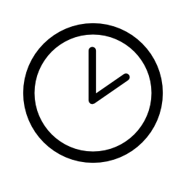

#

Slide 15
Problems Overcome
Connecting to home server
Securing connection iOS App to Django Back-end
Getting an Apple Dev Account
Location-Based

Slide 16
PROTOCOLS AND
COMPLEX ALGORITHMS
Notes:
PROTOCOLS:
1) We will have a standard HTTP REST API to which our iOS client app can make requests
2) Developers will be able to perform all actions aside from initially creating their account from our REST API
COMPLEX ALGORITHM:
1) Calculate distances from notifications → User’s location if they have a radius turned on

Slide 17



Expanded Features List
S&P gains 500 points
Notes:
Sponsor notifications
Extended geographical features
Customization of notification action buttons
Statistic collection for Developers

Slide 18
Questions?

