Slide 1

Prototyping and Demonstrating 5G Verticals: The Smart Manufacturing Case Manuel Peuster, Stefan Schneider, Daniel Behnke, Marcel Müller, Patrick-Benjamin Bök, Holger Karl
@ManuelPeuster

Slide 2
Demonstration Highlights
Realistic smart manufacturing use case
Multiple cloud-native NFV services
Emulated large-scale network topology
Lightweight prototyping framework [1]
End-to-end service lifecycle: Packaging, on-boarding, instantiation, …
Injection molding machine simulator
All components are open-source and available on GitHub
[1] M. Peuster, H. Karl and S. V. Rossem: MeDICINE: Rapid Prototyping of Production-Ready Network Services in Multi-PoP Environments, in IEEE NFV-SDN, 2016.

Slide 3
Involved Network Services and VNFs
Two network services
NS1: Factory edge service
NS2: Machine interconnection service
Each service consists of 2-5 VNFs
CC: Cloud connector
EAE: Edge analytics engine
MDC: Machine data collector
RTR: Router
IMMS: Injection molding machine simulator
Involved IoT/industry protocols
Euromap63
MQTT

Slide 4
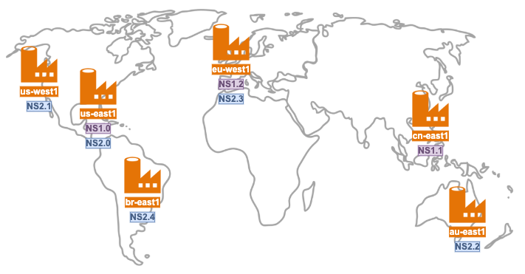
Demonstration Scenario
6 points-of-presence (PoPs)
(factory sites)
Realistic delays emulated between PoPs
Azure IoT Hub / Power BI-based enterprise cloud backend
5ms
30ms
35ms
15ms
>= 1 NS deployed per PoP
10ms
> 25 VNFs deployed on our prototyping platform (vim-emu)

Slide 5
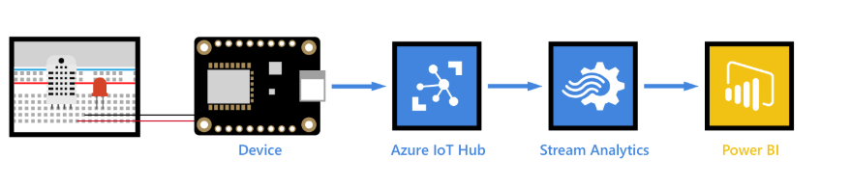
Enterprise cloud backend

Slide 6
Demonstration

Slide 7
Step 1: Start vim-emu

Slide 8
Step 2: Package services

Slide 9
Step 3: On-board services

Slide 10
Step 4: Instantiate services

Slide 11
Step 5: Access edge analytics

Slide 12
Step 6: Instantiate more services

Slide 13
Step 7: Check enterprise cloud backend

Slide 14
That’s it!

Slide 15


5G DEVELOPMENT AND VALIDATION PLATFORM FOR GLOBAL INDUSTRY-SPECIFIC NETWORK SERVICES AND APPS
TANGO advertisement
5G DEVELOPMENT AND VALIDATION PLATFORM FOR GLOBAL INDUSTRY-SPECIFIC NETWORK SERVICES AND APPS

