Slide 1
Smart Manufacturing Pilot SDK: VNFDs, NSDs, Packaging, On-boarding

Slide 2
SDK Demo workflow
NS1: Factory Edge Service
Show VNFDs and NSD
Package & On-board
NS2: Machine Interconnection Service
Show VNFDs and NSD
Package & On-board

Slide 3
NS1: Factory Edge Service
Architecture

Slide 4
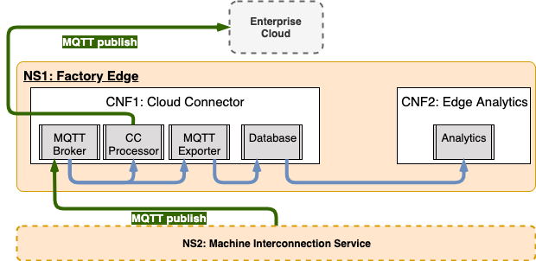
NS1 Architecture

Slide 5
NS1: Factory Edge Service
VNFDs & NSD

Slide 6
NS1: Factory Edge Service
Packaging & On-boarding

Slide 7
NS2: Machine Interconnection Service
Architecture

Slide 8
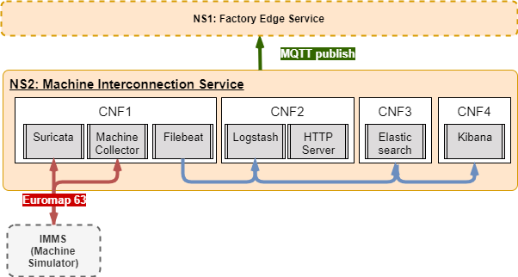
NS2 Architecture

Slide 9
NS2: Machine Interconnection Service
VNFDs & NSD

Slide 10
NS2: Machine Interconnection Service
Packaging & On-boarding

Slide 11
Thanks!

