Slide 1
Smart Manufacturing Pilot Use Case 2: Threat Detection & Isolation

Slide 2
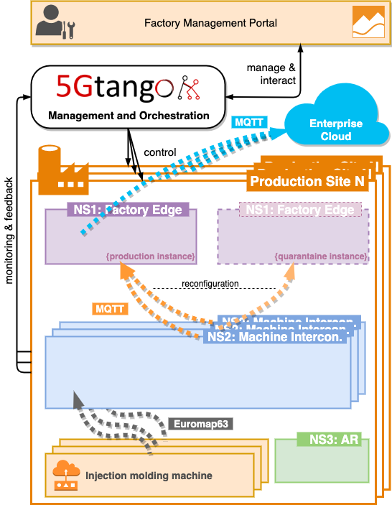
High-Level Architecture

Slide 3
UC2 Demo workflow
Starting point:
Normal & Quarantine NS1 running
NS2 running and machine connected, sending data
Manual isolation:
Use FMP to manually isolate machine and send data to quarantine NS1
De-isolate and send data back to normal NS1
Automatic threat detection & isolation:
Intrusion attempt by outside attacker
IDS notices intrusion and triggers alert
NS2 is reconfigured to send data into quarantine NS1

Slide 4
Demo time!
Preparation: Starting IMMS, receiving data

Slide 5
Demo time!
Manual isolation/deisolation with FMP

Slide 6
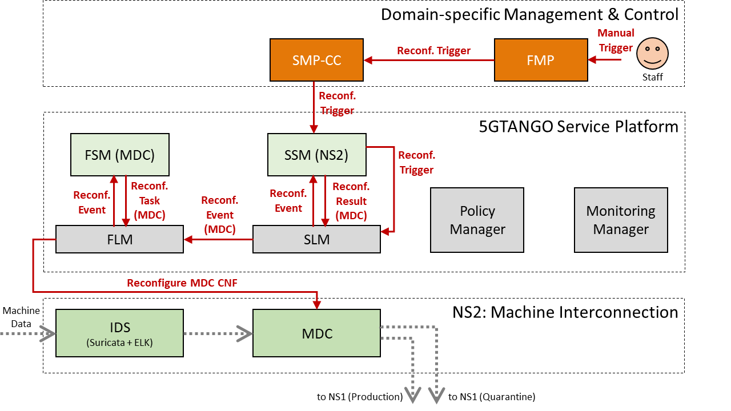
Manual Reconfiguration

Slide 7
Manual Isolation
Manual isolation of machine via FMP

Slide 8
Manual Deisolation
Manual deisolation of machine via FMP

Slide 9
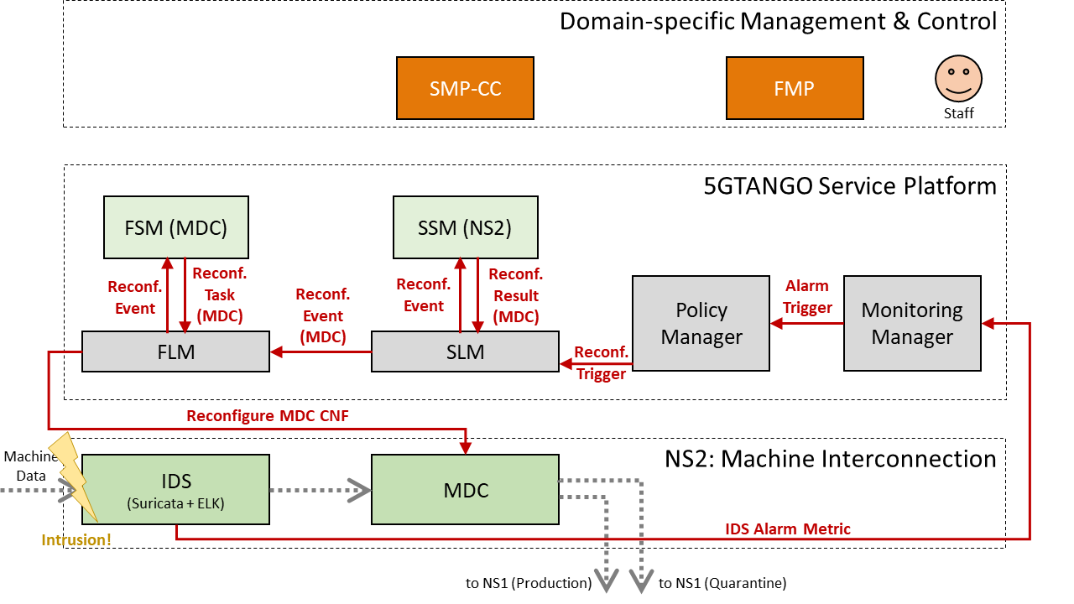
Automatic Reconfiguration

Slide 10
Demo time!
Starting point: Machine data arriving in normal NS1

Slide 11
Intrusion attempt by attacker

Slide 12
IDS Detects Intrusion
Intrusion attempt shown in IDS logs

Slide 13
Alert triggered
Alert triggered through IDS, monitoring system, policies

Slide 14
NS2 reconfigured
To send data to quarantine NS1

Slide 15
Thanks!

