Slide 1
Storage

Slide 2
Phase 1 – Supervised Learning
No reproduction of papers
Characterise storage demand of VNFs from different categories
How do applications from different categories behave?
Cache – upper bound for total storage resources?
Database – steadily growing demand?
Message Broker – based on retention period, requests/s (incoming and outgoing data)?

Slide 3

Phase 1 – Supervised Learning
Create building blocks as containers to collect data on storage resource demand
Model resource demand by using supervised ML
Verify accuracy of predictions
Example: How much storage do I need to allocate to Kafka (message broker) if there are x requests/s?
Retention time? Delay between data ingestion and retrieval? ...
Data Generator
VNF
User
Machine Data from Digital Twin

Slide 4
Next Steps
Familiarise with tools
Docker, Kubernetes, GlusterFS
Kafka, suitable databases & caches
Decide on profiling scenarios
Which parameters to vary?
Which ML method to use?
Develop containers and collect data
Train models and verify results

Slide 5
Phase 2 – Resource Allocation
Train agent to minimise response time and maximise datarate
Machine Data
User
Message Broker
Database
Cache
Decide when to
Add more Storage (costs, downtime)
Relocate available storage to other components (downtime)
Satisfy constraints
Response time requirement
Datarate
Notes:
costs = opex + capex

Slide 6
Phase 2 – Bonus
Investigate Tradeoffs
Compression (lossy/lossless; during transmission/on disk)
Impact on
Required Storage
Network Load
CPU Utilisation
Data Access Latency

Slide 8
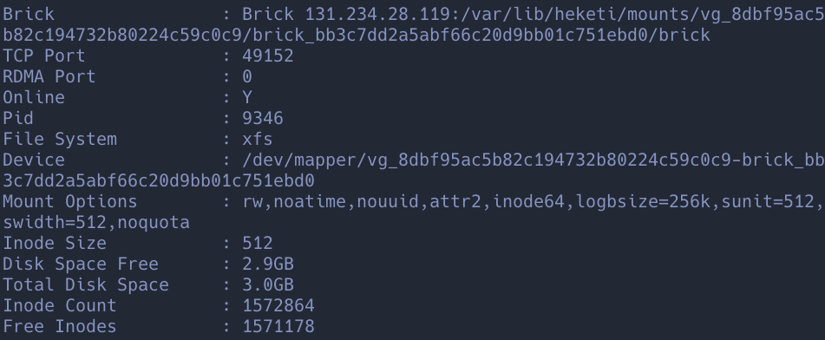
Useful
gluster volume status <vol_name> detail
Filtering for the important value:
gluster volume status <vol_name> detail | grep 'Disk Space Free' | cut -f2 -d":" | sed 's/^ *//g' | head -n1

