Slide 1
Smart Manufacturing Pilot Use Case 1: Machine Interconnection

Slide 2
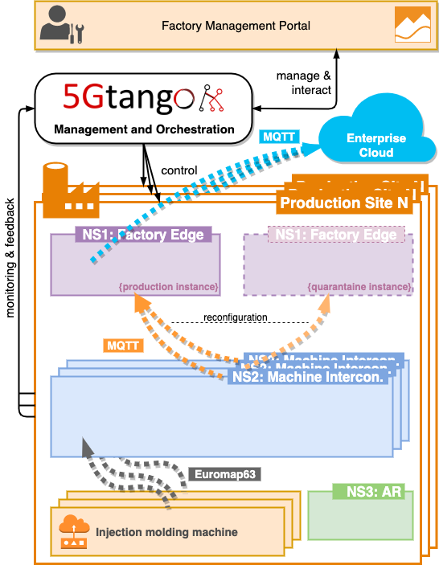
High-Level Architecture

Slide 3
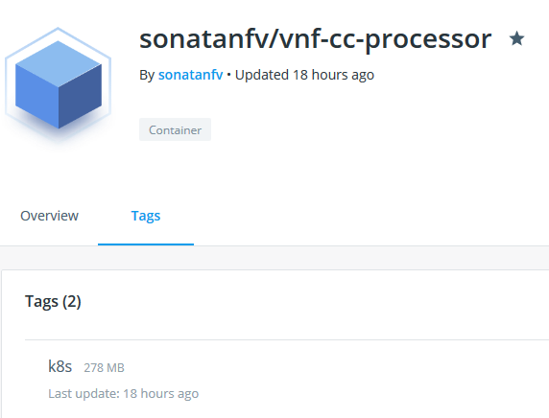
Demo starting point
Running at factory: 5GTANGO SP with Kubernetes VIM
NS1 Normal + NS1 Quarantine running
All container images on Docker Hub
All CNFDs and NSDs available locally
5GTANGO SDK tools installed locally

Slide 4
UC1 Demo workflow
Create a new machine park:
Package and onboard NS1
Start NS1 (normal + quarantine) in Kubernetes using the 5GTANGO SP
Configure NS2 to connecting to NS1’s MQTT broker
Add a new machine to the park:
Use the FMP to create a new machine and start NS2
Connect the IMMS to NS2 and start it
Use the services:
Access the EAE’s dashboard and see incoming machine data

Slide 5
Demo time!

Slide 6
Create a new machine park
Prepare & start NS1

Slide 7
Create a new machine park
Configure NS2

Slide 8
Add a new machine to the park
Start NS2 from the FMP & start the IMMS

Slide 9
Use the service
Watch generated machine data in the EAE

Slide 10
Thanks!

