Slide 1
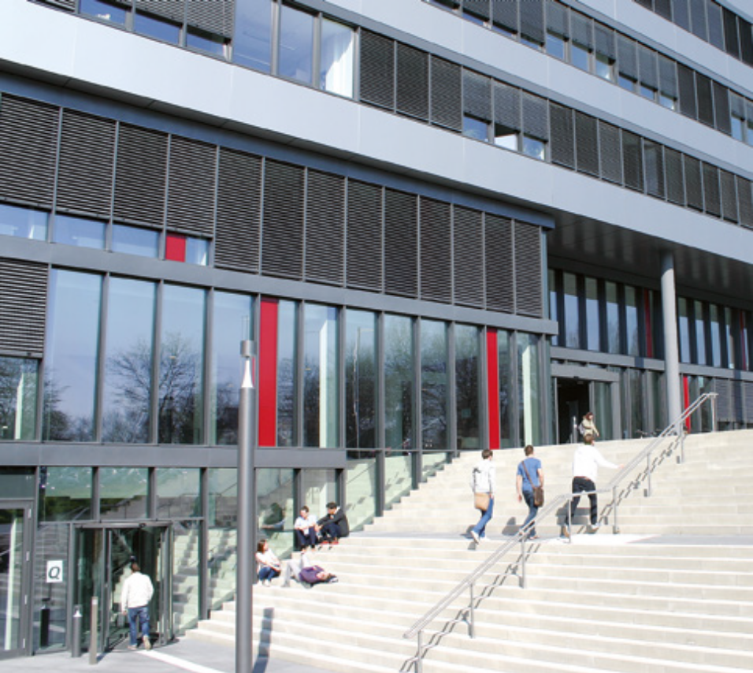
Task 2 - Routing Environment Solution
Project Group : Artificial Intelligence for Computer Networks
Group members:
Aluri Jagan Mohini
Chethan M L
Priyanka Giri
Tejas Ravindra Dhawale

Slide 2
Environment
Approach 1:
      Using same source and destination for all the episodes
      Graph with 8 nodes
      Implemented using library “networkx”
      Metric - Delay
Approach 2:
      Randomly selecting the source and the destination for each episode
      Random Graph with 8 nodes
      Implemented using library “networkx”
      Metric - Delay

Slide 3
MDP for Approach 1
State: All the nodes in the network
      8 states
Action: All the nodes in the network
      8 actions
Reward:
      Action valid and the next node is sink: reward along the path – edge weight + 100
      Action valid and the next node is not sink: reward along the path – edge weight
      Action not valid: -9999

Slide 4
MDP for Approach 2
State: ( node , destination)
      64 states
Action: All the nodes in the network
      8 actions
Reward:
      Reaching Destination: +100
      Each next node: reward along the path - edge weight
      Node with no path to destination: -100

Slide 5
RL Agent
Q-Learning:
      Simple discrete environment
      Helpful to test the new environment as internal working steps are known

Slide 6
THANK YOU

