Slide 1
Wireless Team
Advisor: Haitham Afifi
Chethan Lokesh Mariyaklla
Pavitra Basappa Gudimani
Priyanka Giri

Slide 2
Problem Statement & Solution
Problem Statement
Wireless transmission in a network with multiple collision domains and defect nodes
Solution
DRL agent is used to route packets from source to destination by avoiding collisions and defect nodes in wireless networks

Slide 3




Wireless Network
Range 1
Range 2

Slide 4
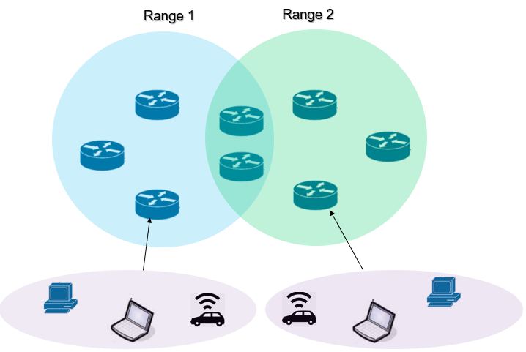

Challenges in Wireless Networks
1. Interference

Slide 5

Challenges in Wireless Networks
2. Hidden terminal problem

Slide 6
Challenges in Wireless Networks
3. Defect node in routing path
Source: Node 1
Packet Dropped
Destination: Node 6
Defect Node

Slide 7
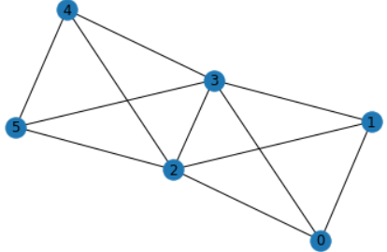
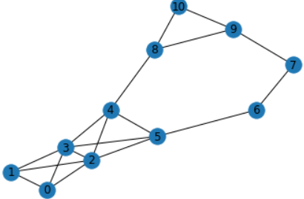
Network Topology
Smaller network
2 collision domains
6 nodes
Larger network
6 collision domains
11 nodes

Slide 8
Centralized - State, Action and Rewards
State
Destination of a packet at each node
Defect node
State space for 6 nodes
MultiDiscrete ( [7, 7, 7, 7, 7, 7, 6] )
Action
Next hop of each node within range and transmit/wait (T/W) status
Action space for 6 nodes
MultiDiscrete ( [4, 4, 6, 6, 4, 4] )
Example - [1, 1, 2, 3, 4, 5] = [T, W, W, W, W, W]

Slide 9
Centralized - State, Action and Rewards
Rewards
Transmission of packet
Collision (-1)
Transmit to defect node (-1)
Packet reaching destination (+1)
Routing
- (Hop_count * 0.01)

Slide 10
Baseline
Destination Sequenced Distance Vector (DSDV) with TDMA

Slide 11
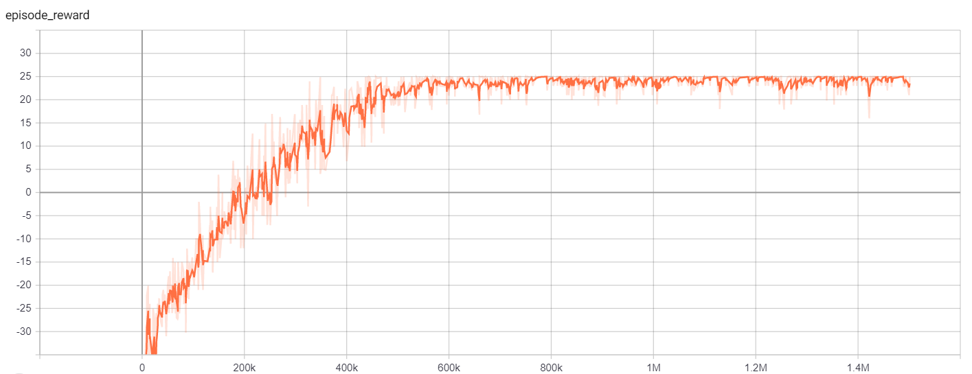
Training Results
Smaller network with dynamic defect node
Reward convergence graph
Timesteps

Slide 12
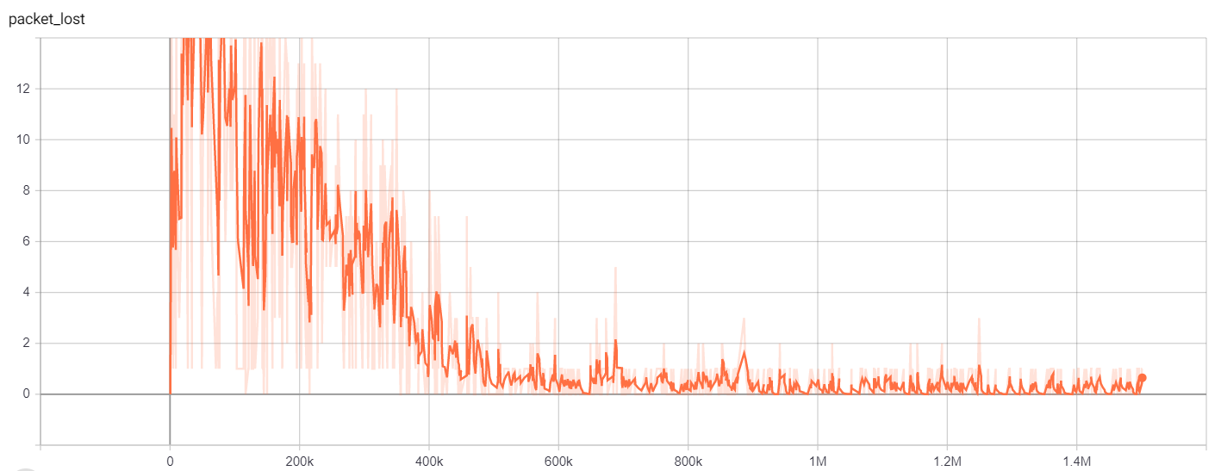
Training Results
Smaller network with dynamic defect node
Packet loss graph (Total 25 packets)
Timesteps

Slide 13
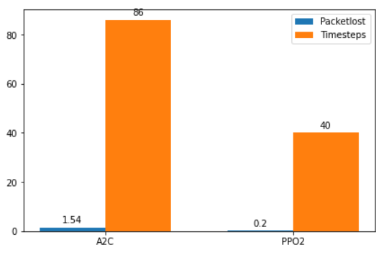
Evaluation
PPO2 Vs A2C

Slide 14
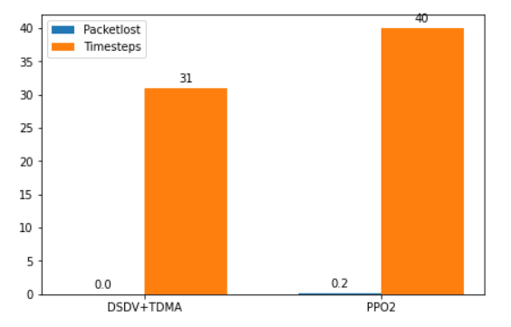
Evaluation
Baseline Vs PPO2

Slide 15
Work in Progress – Decentralized Network
Decentralized wireless network
Each node acts as a agent

Slide 16
Decentralized - State, Action and Rewards
State
Destination of a packet at each node
Queue status
Defect node
State space for each 6 nodes
MultiDiscrete ( [7, 7, 7, 7, 7, 7, 30, 30, 30, 30, 30, 30, 6] )
Action
Next hop of each node within range and transmit/wait (T/W) status
Action space for each node
{0:[4],1:[4], 2:[6], 3:[6], 4:[4], 5:[5]}

Slide 17
Decentralized - State, Action and Rewards
Rewards
Transmission of packet
Collision (-1)
Transmit to defect node (-1)
Packet reaching destination (+1)
Routing
- (Hop_count * 0.01)

Slide 18
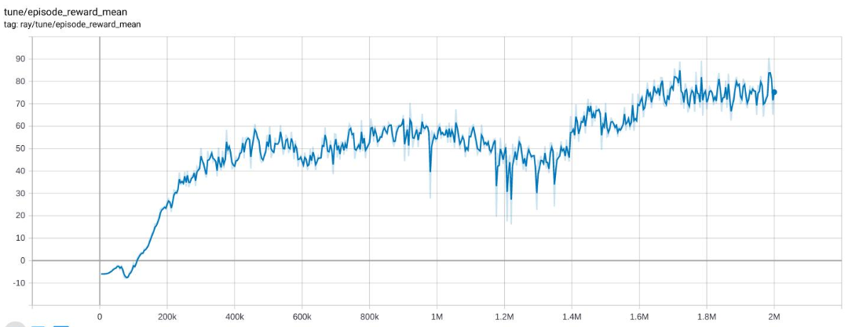
Decentralized Network Results
Smaller network without fault node
Reward convergence graph
Timesteps

Slide 19
Challenges Faced
Tuning

Slide 20
References
[1]. X. Guo, H. Lin, Z. Li and M. Peng, "Deep reinforcement learning based qos-aware secure routing for sdn-iot", IEEE Internet of Things Journal, 2019.
[2]. Yiding Yu, Taotao Wang, Soung Chang Liew, "Deep-Reinforcement Learning Multiple Access for Heterogeneous Wireless Networks", Selected Areas in Communications IEEE Journal on, 2019.

Slide 21
THANK YOU!

