Slide 1
Loadgen
Workload
In(En)queue class
Workload
Dataset class
Run.py
Workload
Backend class
For questions/suggestions:
Thomas: Thomas.atta-fosu@intel.com
Srujana: Srujana.Gattupalli@intel.com

Slide 2
argParser
InputItem
enqueueObj
datasetObj
OutputItem
backendObj
InputData
Consumer
Input_queue
Implementation
by:
User
Instance 1
Instance 2
Instance 3
…
Instance n
Run.py

Slide 3
argParser
Defines input flags
Global parameters: --workoad-name, --scenario, --mlperf_conf, --user_conf, Run-configuration (--num-socket, --processes-per-socket, --cores-per-process, --cores-per-instance)
workload
--workload-config: This is a json/yml file with workload related parameters. Contains following:
"import_path": Path to workload Dataset, Backend & InQueue classes (relative to directory of run.py)
“dataset-params”: Defines keyword-value pairs required for creating a datasetObj – an instance users’ Dataset class (e.g total samples, path to dataset etc) “backend-params”: Defines keyword-value pairs required for creating backendObj – an instance of users’ Backend class (e.g model paths, input and output node names of model etc) “enqueue-params”: Defines keyword-value pairs required for creaging enqueueObj – an instance of users’ Enqueue class. If provided, the keyword-value pairs of “buckets” (see below) are also used to instantiate enqueueObj
“num_out_queues”: (Optional) Specifies number of response queues to loadgen. By default this is one if not provided in the config
“buckets”: (Optional) Specifies workload buckets. Has fixed keywords. See example for resnet50 below. This is also used to create enqueueObj (users should check the keyword names)

Slide 4
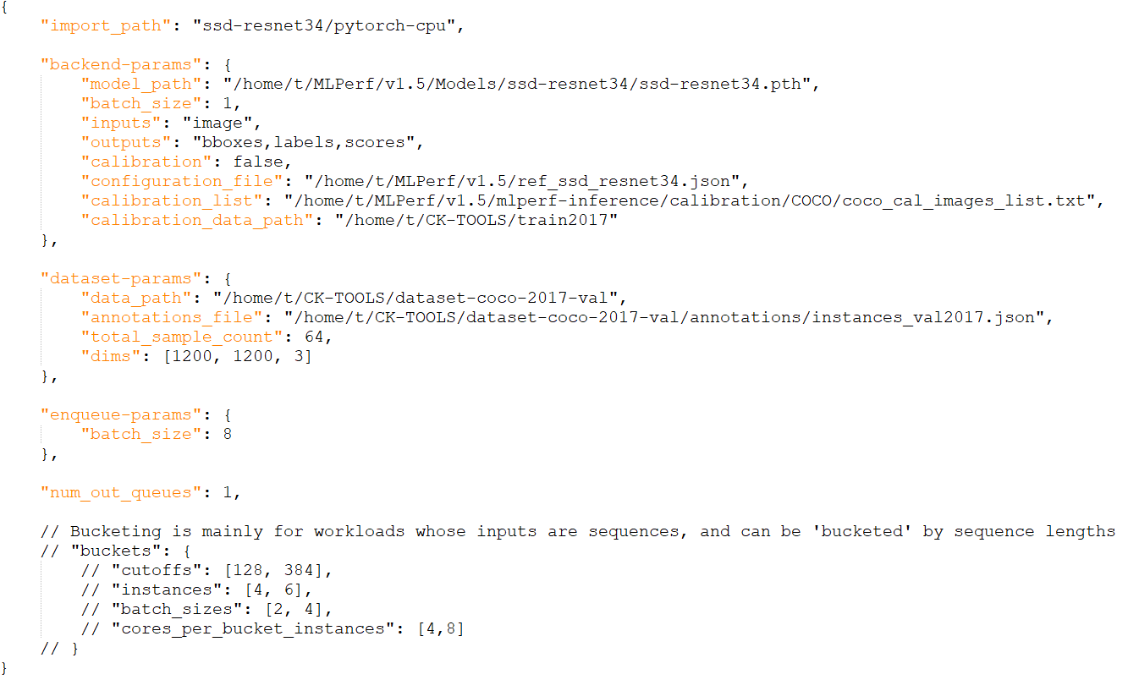
argParser
Workload config (json) file looks like below

Slide 5
InputItem
Wraps query ids and sample indexes (batched if desired). Optional receipt time of query
Instantiation: Requires list of query ids and sample indexes coalesced into single item
__init__(query_ids: list[int], sample_idx_list : list[int], recept_time=0) -> None:
InputData
Wraps input data (for inference)
Instantiation: Requires input data (of framework time).
__init__(data : <torch.tensor/numpy.array/user-defined>, data_shape=None, sequence_len=None) -> None:
OutputItem
Wraps post-processed sample together with query ids and array object type to send to loadgen
Instantiation: Requires output result, corresponding query ids, and array type code.
__init__(query_id_list: list[int], result : <torch.tensor/numpy.array/user-defined>, array_type_code : str) -> None:
NB: For possible values of array_type_code, see here: https://docs.python.org/3/library/array.html#module-array

Slide 6
Dataset-Class
Dataset class implements key methods for loading, processing (pre and post), and fetching samples given list of query index
Depends: OutputItem, InputData class
Instantiation: Any required input at instantiation should should be added to <workload-config>.json
Required member objects:
count – total number of samples that is loaded
Required methods:
load_dataset: loads available samples into memory (this can be a `dud` if load_query_samples is implemented or samples are loaded at instantiation). This is called by consumer instances, and has no return value signature: load_dataset()->None
load_query_samples: loads dataset into memory and called by loadgen to load samples into memory before it sends a query (can be `dud` if load_dataset is implemented). signature: load_query_samples(sample_idx_list: list[int]) -> None
unload_query_samples: unloades/deletes data loaded into memory by loadgen (`dud` if load_query_samples is not implemented) signature: unload_query_samples(sample_idx_list: list[int]) -> None

Slide 7
Dataset-Class
Required methods:
get_samples: responsible for fetching/processing batch of requested samples. Should return an InputIData object containing data ready for inference signature: get_samples(query_sample_idx_list : list[int]) -> data_item: InputData
get_warmup_samples: responsible for fetching samples for warmup. This should return a list of InputData objects each containing data ready for inference. Each instance perform warmup on these samples signature: get_warmup_samples() -> samples : list<InputData>
post_process: Responsible for post-processing inference results. It also wraps query_ids (and sample indexes if needed) and post-processed results in an outputItem object signature: post_process(query_ids: list[int], sample_index_list: list[int], result : <torch.tensor/numpy.array/user>) -> out : OutputItem

Slide 8
In(En)queue-Class
InQueue class is responsible for processing received queries (in batches) and adding them to a producer queue for consumer instances.
Depends: InputItem class; Accepts a (list of) multiprocessing.JoinableQueue object at instantiation.
Instantiation: Should accept (list of) producer queue for consumer instances
__init__(self, input_queues: mp.JoinableQueue/list[mp.JoinableQueue], **kwargs)
NB: Care must be taken for workloads that have different InQueue classes for different scenarios. See example implementations
Required methods:
put: Main interface with loadgen’s issue_query. Receives query_samples as list, and receipt_time as inputs, process queries (in batches if desired), and adds them to the producer queue (for ‘consumer’/instances). The batched queries and receipt_time are wrapped in InputItem object before adding to ‘producer’ queue. signature: put(query_samples: list[int], receipt_time: time.time) -> None

Slide 9
Backend-Class
Backend class implements interface between consumer instances and the framework backend. It implements key methods for loading models and running inference.
Depends:
Instantiation: Required input keywords must be populated in the <workload-config>.json file. E.g model_path, input and output node names, etc
__init__(self, [args], **kwargs)-> None
Required methods:
load_model: This method loads the input model for each consumer signature: load_model() -> None
predict: Accepts InputData object for inference, and return inference results. (It may be the case for some workloads to post-process the inference results here, in which case dataset class’ post_process should only wrap the result in OutputItem object) signature: predict(data: <torch.tensor/numpy.array/user>) -> output : <torch.tensor/numpy.array/user>

Slide 10
Status on PR-71
Multi-process-multi-instance integrated into loadgen bridge. This allows creation of multiple instances sharing the same data & model resources, minimizing memory requirements. Initial test indicates improved performance over previous loadgen-bridge
Enable bucketing logic in the updated bridge: This is required for Bert and RNNT.
Setup instructions (Can repurpose instructions for previous loadgen-bridge)

Slide 11
Backup

Slide 12
Input
Run.py
Output
Caller
argParser
sutSanitizer
InputItem
OutputItem
datasetSanitizer
responseQueue
InQueue
supportedProfiles
sut
Consumer
LoadGen
qsl
dataset

