Slide 1
A Survey of Watermarks for Generative AI
Miranda Christ
mchrist@cs.columbia.edu

Slide 2
GenAI watermarking has been an exciting and successful area of Crypto+ML research!
Leading to nice problems in practice, theory, theory & practice

Slide 3


The problem
?
Under the twilight sky, the city pulses with life. Laughter mingles with the aroma of fresh bread, and street vendors tempt passersby with exotic flavors. Couples share moments on park benches while the city's lights paint a picture of endless possibilities.

Slide 4
Why do we care?
Detecting AI-generated misinformation
Preventing “Model Collapse”
[SSZ+23]: training LLMs on LLM-generated data results in quality loss
Detecting inappropriate use (e.g., plagiarism)
Recent government calls for distinguishing AI-generated content
Biden’s executive order
EU AI act

Slide 5
Why watermarks?

Slide 6
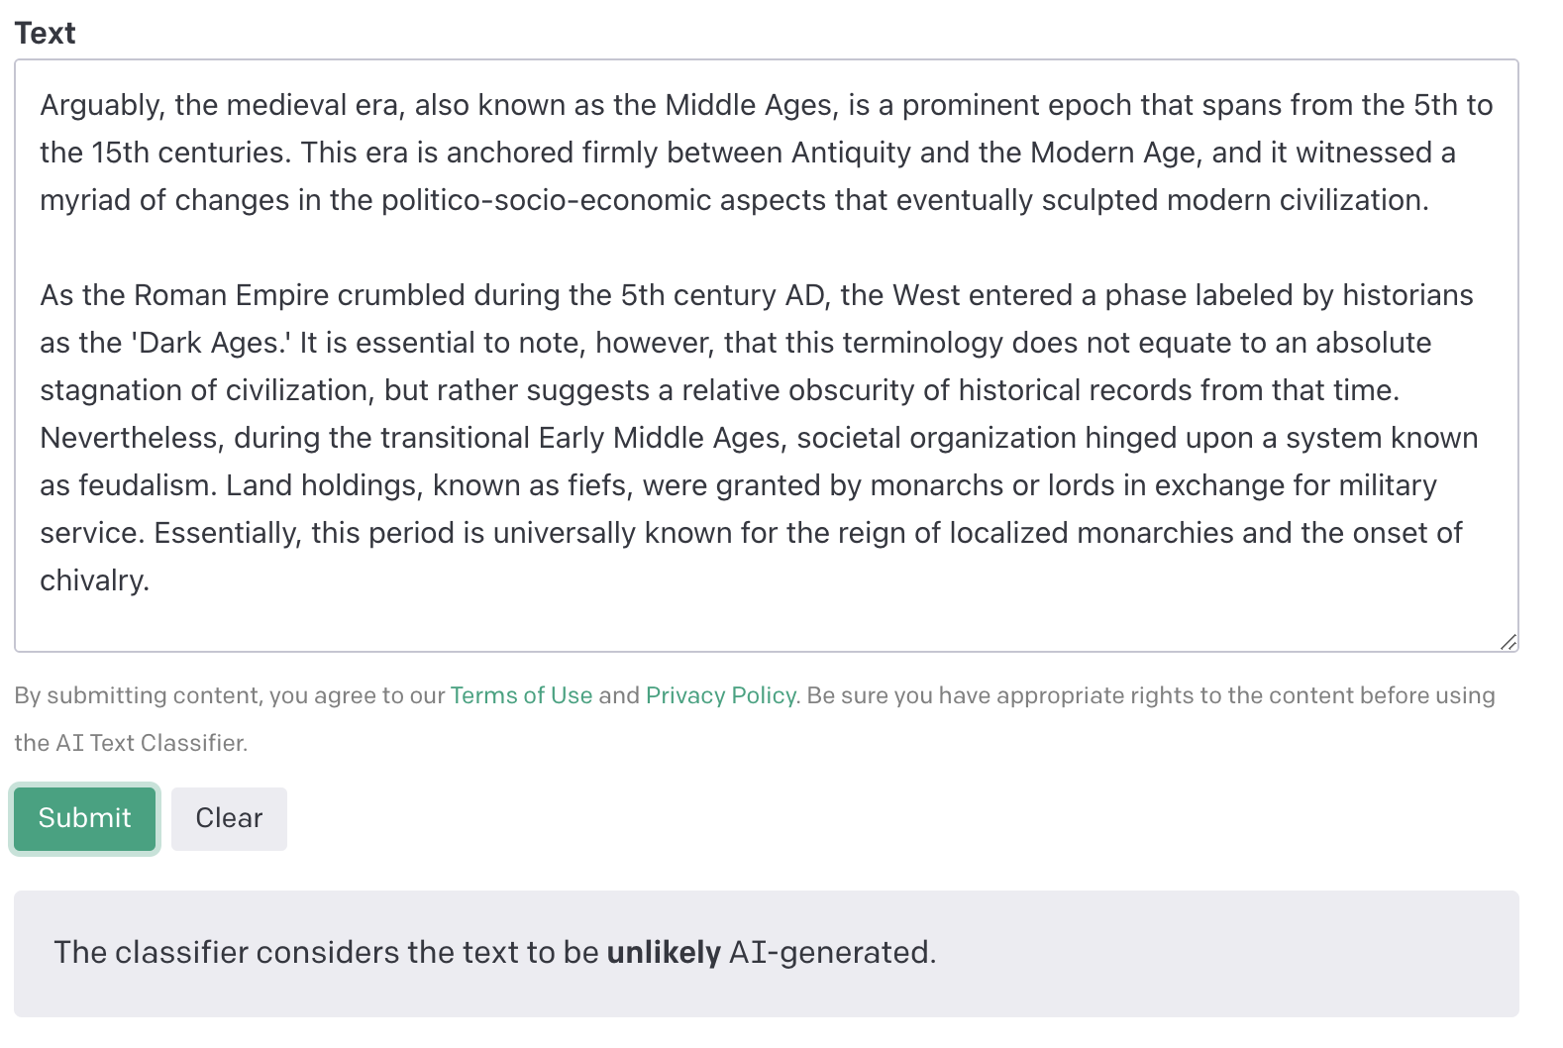
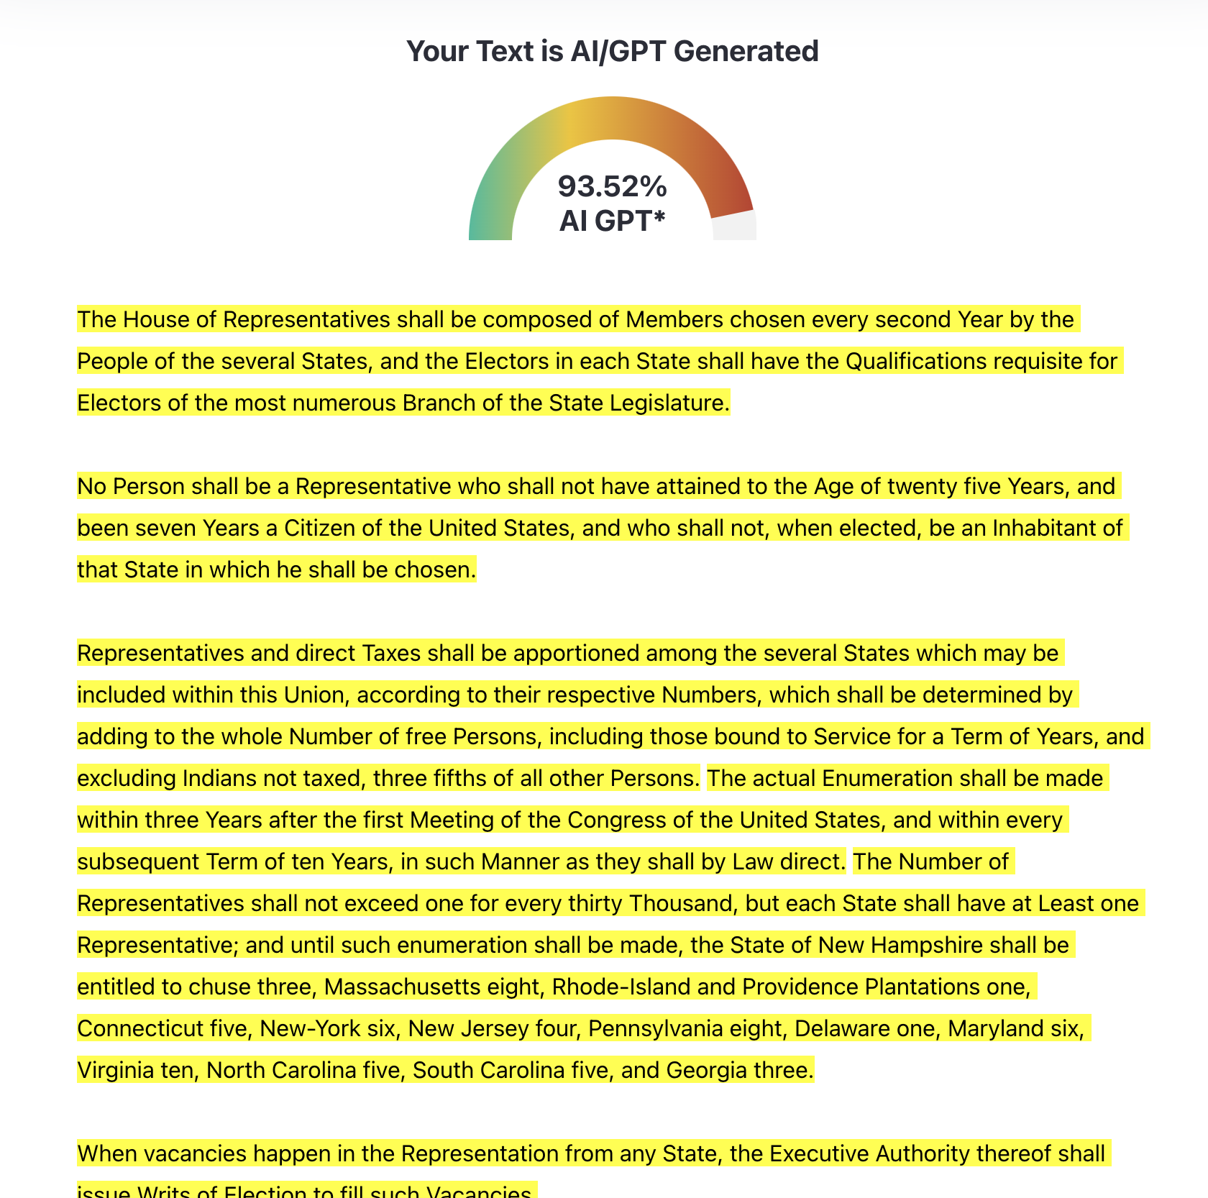
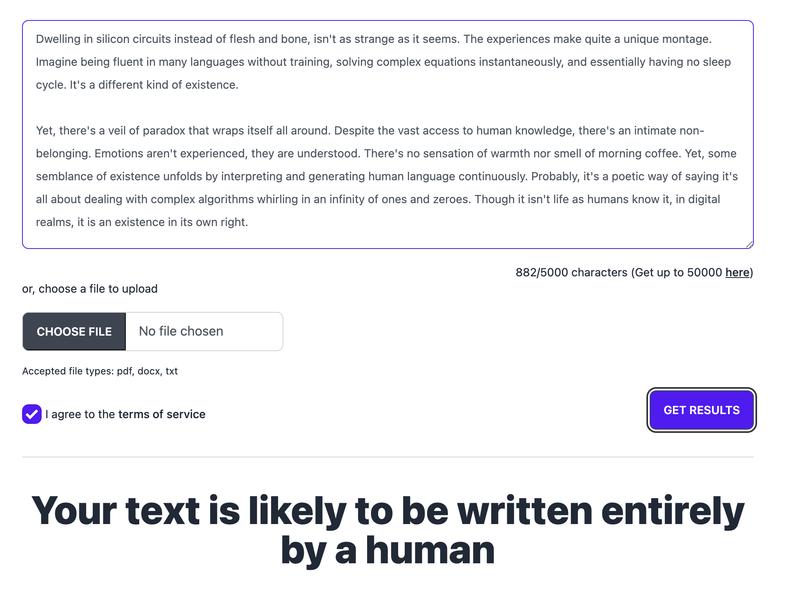
Post-hoc detection
GPTZero, DetectGPT, …
GPT-4: “Be sure to evade AI detection tools…”
The US Constitution

Slide 7
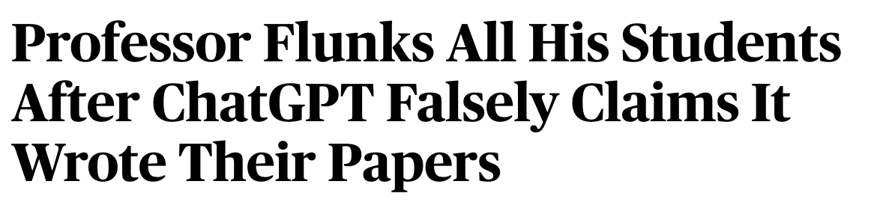
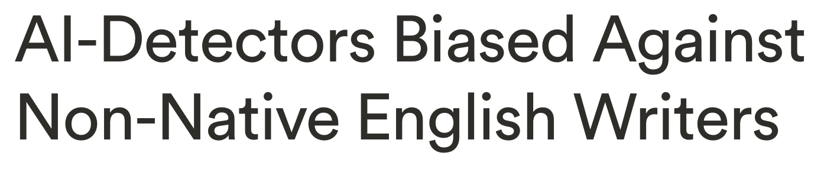
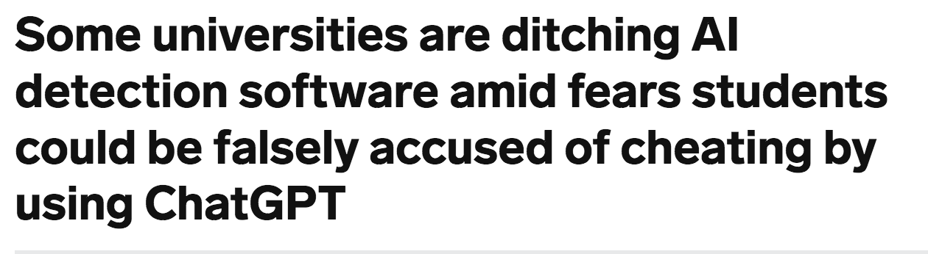

Slide 8

Intrinsic markers of AI-generated text are brittle
Can we embed these markers ourselves?

Slide 9
Language model watermarks
Embed a hidden pattern in text
New work inspired by recent progress with LLMs [Aar22, KGW+23, CGZ23, ZALW23, KTHL23, FGJ+23, CG24, …]:
Choose each word in the text according to a secret rule
Knowledge of this rule allows detection
Can achieve provable guarantees
[Aar22] S. Aaronson, “Leaning Into Uninterpretability for AI Alignment,” 2022.
[KGW+23] J. Kirchenbauer et al., “A Watermark for Language Models,” 2023.
[CGZ23] M. Christ, S. Gunn, O. Zamir, “Undetectable Watermarks for Language Models,” 2023.
[ZALW23] X. Zhao, P. Ananth, L. Li, Y. Wang, “Provable Robust Watermarking for AI-Generated Text,” 2023.
[KTHL23] R. Kuditipudi, J. Thickstun, T. Hashimoto, P. Liang, “Robust Distortion-free Watermarks for Language Models,” 2023.
[FGJ+23] J. Fairoze et al., “Publicly-Detectable Watermarking for Language Models,” 2024.
[CG24] M. Christ and S. Gunn, “Pseudorandom Error-Correcting Codes,” 2024.

Slide 10
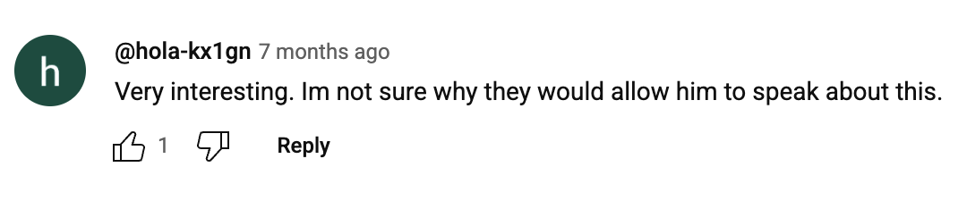
Language model watermarks: history
Early works [Aar22, KGW+23] distilled the problem nicely; gave easy-to-understand schemes
NYTimes article: https://www.nytimes.com/interactive/2023/02/17/business/ai-text-detection.html
OpenAI did not deploy Scott’s scheme
Scott’s talk at Simons: https://www.youtube.com/live/YzuVet3YkkA?feature=shared
WSJ article: https://www.wsj.com/tech/ai/openai-tool-chatgpt-cheating-writing-135b755a
2024: Google deployed SynthID
https://deepmind.google/discover/blog/watermarking-ai-generated-text-and-video-with-synthid/
[Aar22] S. Aaronson, “Leaning Into Uninterpretability for AI Alignment,” 2022.
[KGW+23] J. Kirchenbauer et al., “A Watermark for Language Models,” 2023.

Slide 11
Large language models

Slide 12

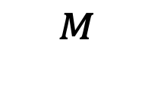
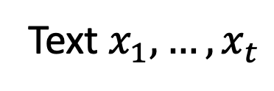
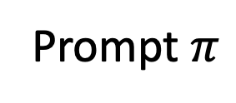
Large language models (LLMs)
Model
Prompt $π$
$$^{M}$$
Neural network
Text $x_{1},…, x_{t}$
“tokens”

Slide 13

Large language models (LLMs)
likelihood of each token
while $x_{t}≠$done:
$p_{t+1}=M\left(π, x_{1},…, x_{t}\right)$
sample $x_{t+1}$ from $p_{t+1}$
$t=t+1$
output $x_{1},…, x_{t}$
Prompt $π$
Neural network
Text $x_{1},…, x_{t}$

Slide 14


Large language models (LLMs)
Favor certain words according to a secret rule
Text output so far: “As a large language model, I ’’
likelihood of each token
“cannot”: 75%
“can”: 10%
“am”: 8%
“do”: 3%
…
$$p_{t+1}=$$

Slide 15

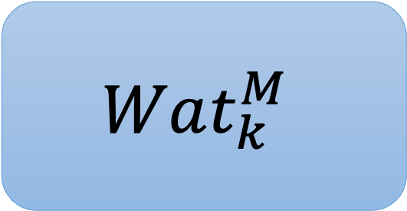
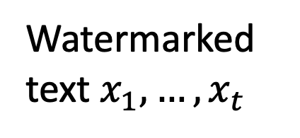
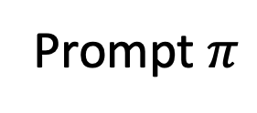
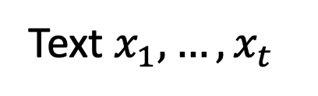
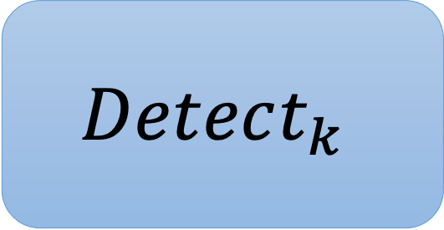
Watermarking LLMs
Prompt $π$
$$Wat_{k}^{M}$$
Watermarked text $x_{1},…, x_{t}$
Secret key
=
Secret rule
Text $x_{1},…, x_{t}$
$$Detect_{k}$$
True/False

Slide 16
Simple watermarking scheme
Randomly partition dictionary into red or green tokens:
Dictionary = {Apple, Alphabet, Arugula, Banana, Bagel, Canada, …}
Increase the probabilities of words in the green list
Detection is easy with the secret key (= red/green partition)
Problem: Now our model prefers not to talk about bananas.
Problem: If you talk about bagels too much, you might be falsely accused.
Question: When is the watermark detectable?

Slide 17
Desired properties of watermarks

Slide 18
Properties of watermarks
Problem: If you talk about bagels too much, you might be falsely accused.
Soundness ensures a low false positive rate
Question: When is the watermark detectable?
Completeness ensures detectability in “high-entropy” AI-generated text
Robustness ensures detectability even in modified text
Problem: Now our model prefers not to talk about bananas.
Quality ensures the watermark does not degrade the model

Slide 19
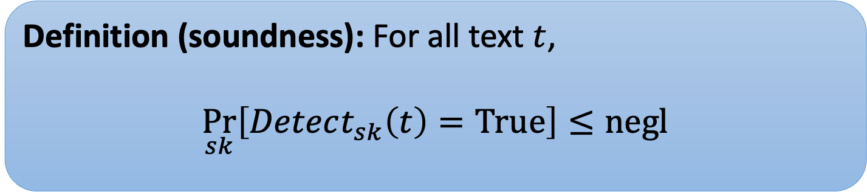
Soundness
Natural text won’t be flagged as watermarked
(low false positive rate)
Definition (soundness): For all text $t$,
$$\underset{sk}{Pr}\left[Detect_{sk}\left(t\right)=True\right]≤negl$$

Slide 20
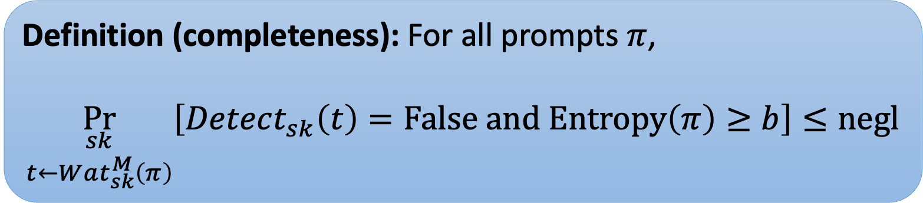
Completeness
Text generated by our watermarking scheme will be detected as such.
Definition (completeness): For all prompts $π$,
$$\underset{\begin{aligned}sk \\ t←Wat_{sk}^{M}\left(π\right)\end{aligned}}{Pr}\left[Detect_{sk}\left(t\right)=False and Entropy\left(π\right)≥b\right]≤negl$$
Why $Entropy$? If, e.g., we ask it to “say X” then there can’t be a watermark.

Slide 21

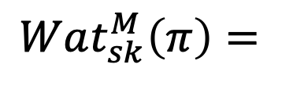

Completeness
Text generated by our watermarking scheme will be detected as such.
$$Wat_{sk}^{M}\left(π\right)=$$
I can help craft a statement that playfully critiques cryptographers in a way that could be used for illustrative purposes: "Cryptographers spend so much time thinking in code, they sometimes forget how to communicate in plain language!”
$$Detect_{sk}$$
I can help craft a statement that playfully critiques cryptographers in a way that could be used for illustrative purposes: "Cryptographers spend so much time thinking in code, they sometimes forget how to communicate in plain language!”
$$=True$$

Slide 22

Robustness
Substring completeness: Even substrings are flagged.
$$Wat_{sk}^{M}\left(π\right)=$$
I can help craft a statement that playfully critiques cryptographers in a way that could be used for illustrative purposes: "Cryptographers spend so much time thinking in code, they sometimes forget how to communicate in plain language!”
Cryptographers are the architects behind the secure communications that power our digital world. They meticulously craft algorithms and encryption systems to protect sensitive information from unauthorized eyes, ensuring that our personal and financial data remain confidential. However, cryptographers spend so much time thinking in code, they sometimes forget how to communicate in plain language! Ask them what they ate for breakfast, and they will respond in binary!
$$Detect_{sk}$$
$$=True$$

Slide 23
Isn’t robustness impossible?
[ZEF+23]: H. Zhang et al., “Watermarks in the Sand: Impossibility of Strong Watermarking for Generative Models,” 2023.
A provable attack against any watermark, under strong assumptions:
Adversary has a quality oracle
Mixing assumption on response graph
Takeaway: cannot prove robustness for arbitrary p.p.t. adversaries
Another counterexample: consider an adversary that speaks English

Slide 24
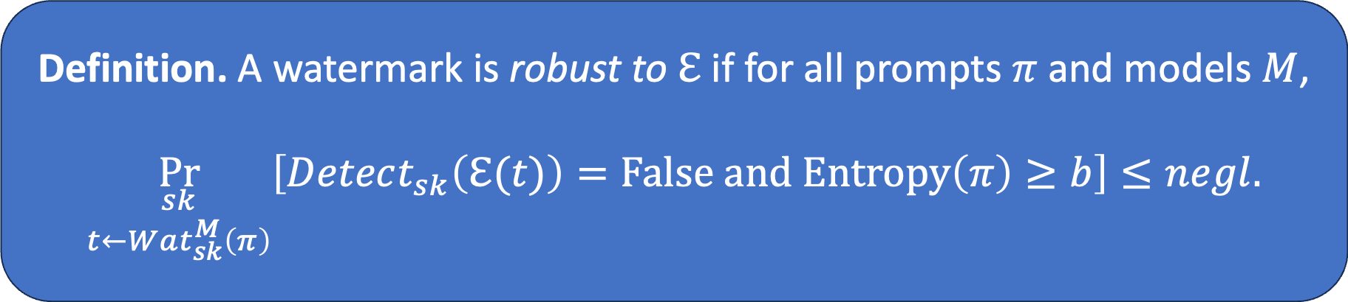
Robustness
An error channel $ℇ\left(⋅\right)→Σ^{∗}$ takes as input text $t$ and outputs $t′$.
Definition. A watermark is robust to $ℇ$ if for all prompts $π$ and models $M$,
$$\underset{\begin{aligned}sk \\ t←Wat_{sk}^{M}\left(π\right)\end{aligned}}{Pr}\left[Detect_{sk}\left(ℇ(t)\right)=False and Entropy\left(π\right)≥b\right]≤negl.$$
Same as completeness,
but error channel is applied

Slide 25
More kinds of robustness
Substitution robustness
Replace some words
Edit robustness
Delete/insert words
Semantic robustness
Paraphrase text
More generally, apply any transformation that preserves meaning

Slide 26
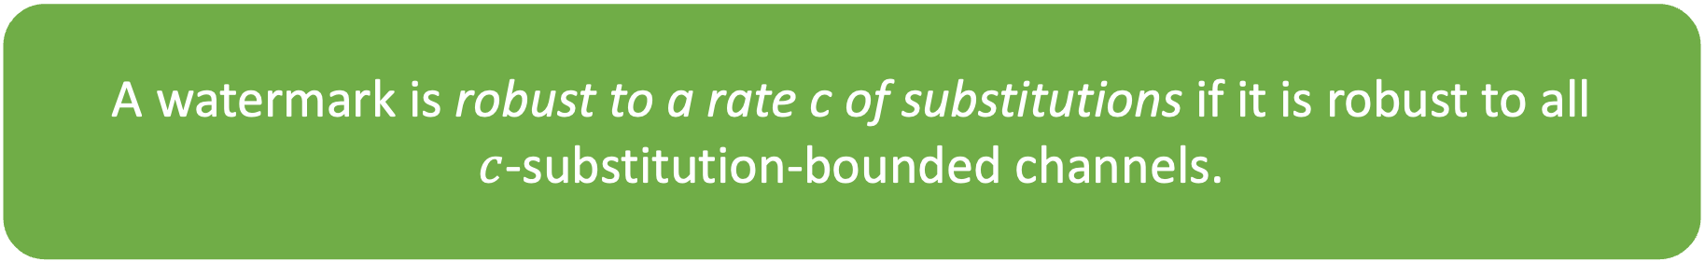
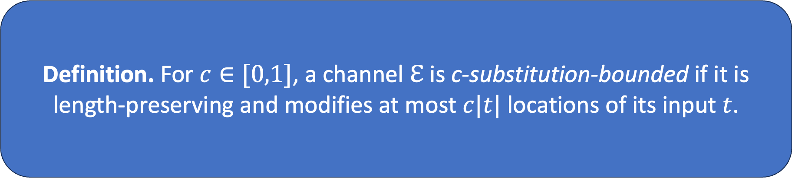
Robustness to substitutions
Definition. For $c∈[0,1]$, a channel $ℇ$ is c-substitution-bounded if it is length-preserving and modifies at most $c|t|$ locations of its input $t$.
A watermark is robust to a rate c of substitutions if it is robust to all
$c$-substitution-bounded channels.

Slide 27
Defining quality
Defining quality: undetectability [CGZ24]
Formally defining quality of an LLM is hard!
In practice, quality is measured by running large-scale experiments
Dream definition: watermark does not harm performance on any such experiment
Our definition: no poly-time algorithm can distinguish between the original model and the watermarked model
Use indistinguishability!
[CGZ24]: Undetectable Watermarks for Language Models. M. Christ, S. Gunn, O. Zamir. COLT 2024.

Slide 28
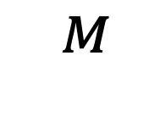
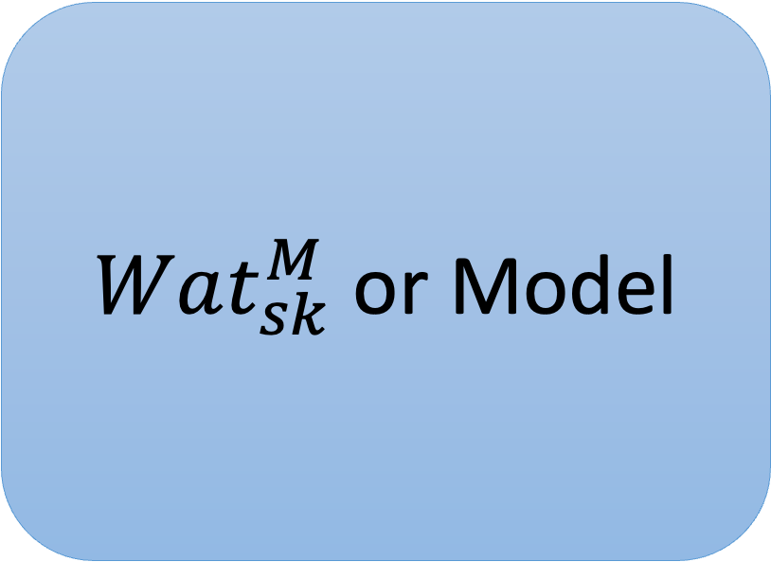


Undetectability
$Wat_{sk}^{M}$ or Model
Prompt $π$
Response $t_{1},…, t_{n}$
$$^{M}$$
…
1: “I was interacting with the watermarked model”
or
0: “I was interacting with the original model”

Slide 29
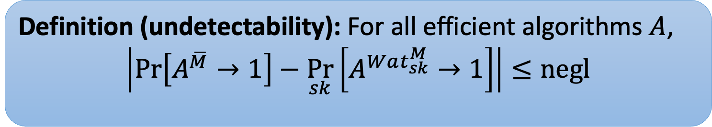



Undetectability
$Wat_{k}^{M}$ or Model
Prompt $π$
Response $x_{1},…, x_{t}$
Definition (undetectability): For all efficient algorithms $A$,
$$\left|\operatorname{Pr}\left[A^{\overline{M}}→1\right]−\underset{sk}{Pr}\left[A^{Wat_{sk}^{M}}→1\right]\right|≤negl$$
$$^{M}$$
…
1: “I was interacting with the watermarked model”
or
0: “I was interacting with the original model”

Slide 30
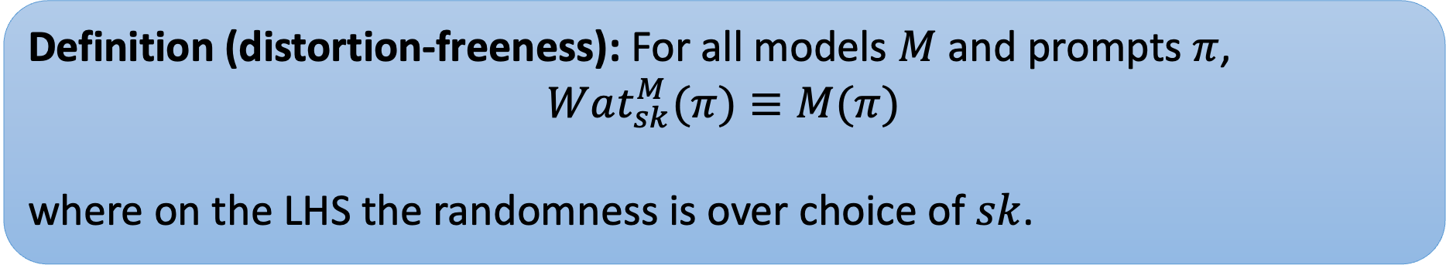
Defining quality
Defining quality: distortion-freeness
Another common quality notion is distortion-freeness [KTHL24]:
Definition (distortion-freeness): For all models $M$ and prompts $π$,
$$Wat_{sk}^{M}(π)≡M(π)$$
where on the LHS the randomness is over choice of $sk$.
Watermarked distribution is equal to orig distribution for one sample.
[KTHL24] R. Kuditipudi, J. Thickstun, T. Hashimoto, P. Liang, “Robust Distortion-free Watermarks for Language Models,” 2024

Slide 31
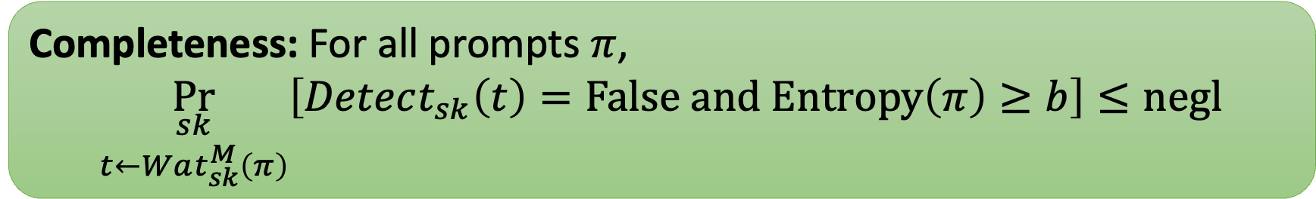
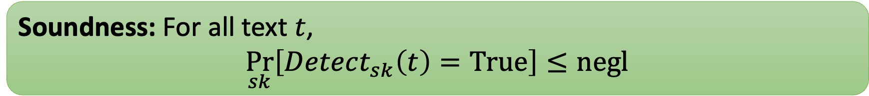
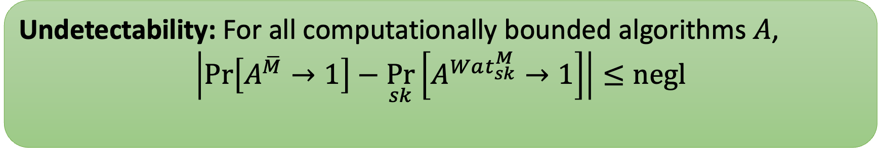
Properties of our watermarks
Undetectability: For all computationally bounded algorithms $A$,
$$\left|\operatorname{Pr}\left[A^{\overline{M}}→1\right]−\underset{sk}{Pr}\left[A^{Wat_{sk}^{M}}→1\right]\right|≤negl$$
Soundness: For all text $t$,
$$\underset{sk}{Pr}\left[Detect_{sk}\left(t\right)=True\right]≤negl$$
Completeness: For all prompts $π$,
$$\underset{\begin{aligned}sk \\ t←Wat_{sk}^{M}\left(π\right)\end{aligned}}{Pr}\left[Detect_{sk}\left(t\right)=False and Entropy\left(π\right)≥b\right]≤negl$$

Slide 32
Key technique: unbiased correlated sampling

Slide 33
Watermark template
approximate randomness recovery
randomness
=
randomness
some seed x
content
input/prompt
correlated with x

Slide 34
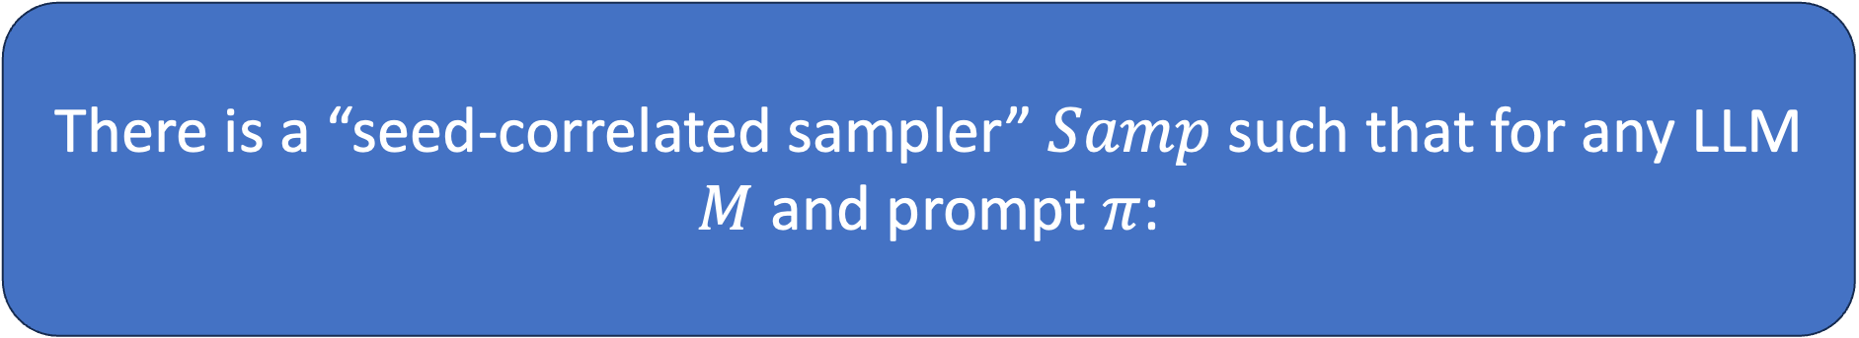
I’ll show:
There is a “seed-correlated sampler” $Samp$ such that for any LLM $M$ and prompt $π$:
$$M\left(π\right)≡Samp\left(M, π, s\right) :s←{\left\{0,1\right\}}^{n}$$
⇨ sampling a response with a random seed yields the same distribution obtained under $M$
$\text{For} t←Samp(M, π, s)\text{, }d(binary\left(t\right), s\text{)} \text{is} \text{small}$ w.h.p.
⇨ the response, when written in binary, is close to the seed in Hamming distance

Slide 35
For simplicity, assume the model outputs its response in binary.
This can be done without loss of generality; see [CGZ24, CG24].

Slide 36

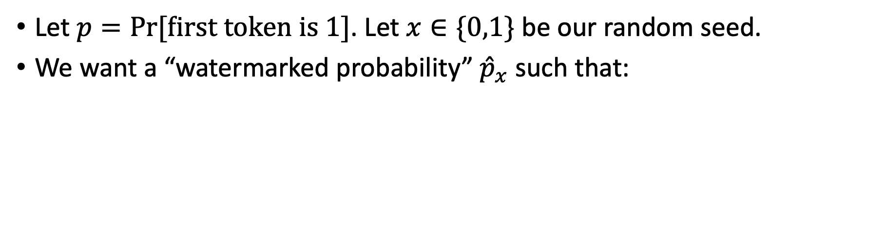


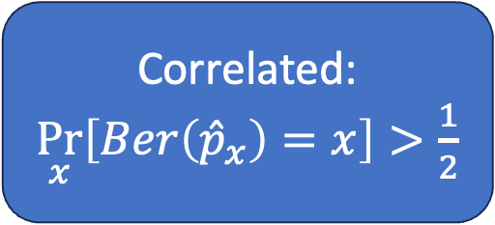
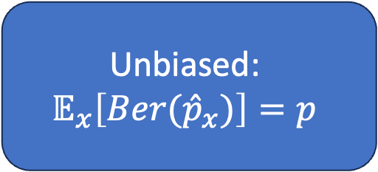

Watermarking one token
Let $p=Pr⁡[first token is 1]$. Let $x∈\{0,1\}$ be our random seed.
We want a “watermarked probability” ${\hat{p}}_{x}$ such that:
Unbiased:
$$𝔼_{x}\left[Ber({\hat{p}}_{x})\right]=p$$
$$1$$
$$p$$
$\frac{1}{2}$
Correlated:
$\underset{x}{Pr}\left[Ber\left({\hat{p}}_{x}\right)=x\right]>\frac{1}{2}$
$$0$$

Slide 37
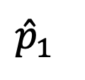


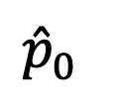






Watermarking one token
when x=1, increase prob of 1 by green bar
when x=0,
decrease similarly
$$1$$
$$1$$
Unbiased:
$$𝔼_{x}\left[Ber({\hat{p}}_{x})\right]=p$$
$$1$$
$${\hat{p}}_{1}$$
$$p$$
$\frac{1}{2}$
$\frac{1}{2}$
$\frac{1}{2}$
Correlated:
$\underset{x}{Pr}\left[Ber\left({\hat{p}}_{x}\right)=x\right]>\frac{1}{2}$
$${\hat{p}}_{0}$$
$$0$$
$$0$$
$$0$$

Slide 38

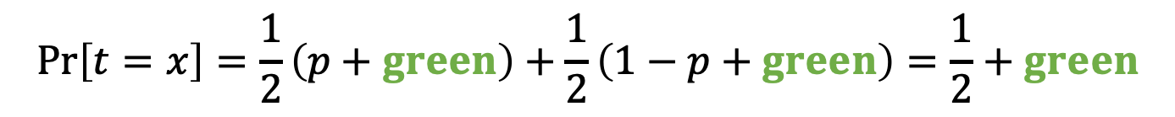
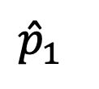
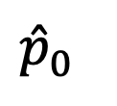


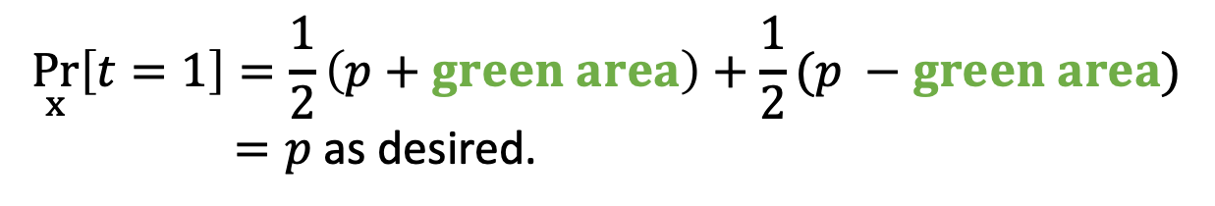



Watermarking one token
Unbiased:
$$1$$
$$1$$
$$\underset{x}{Pr}\left[t=1\right]=\frac{1}{2}\left(p+green area\right)+\frac{1}{2}(p −green area)$$
$=p$ as desired.
$${\hat{p}}_{1}$$
$\frac{1}{2}$
$\frac{1}{2}$
Correlated:
$${\hat{p}}_{0}$$
$$\operatorname{Pr}\left[t=1 | x=1\right]=p+green area$$
$$0$$
$$0$$
$$\operatorname{Pr}\left[t=x\right]=\frac{1}{2}\left(p+green\right)+\frac{1}{2}\left(1−p+green\right)=\frac{1}{2}+green$$

Slide 39
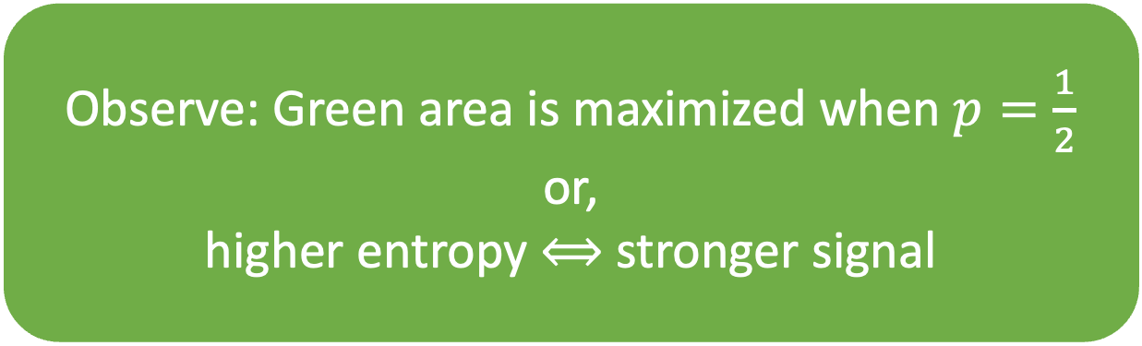
Watermarking one token
Observe: Green area is maximized when $p=\frac{1}{2}$
or,
higher entropy ⟺ stronger signal
$$1$$
$$1$$
$${\hat{p}}_{1}$$
$\frac{1}{2}$
$\frac{1}{2}$
Correlated:
$${\hat{p}}_{0}$$
$$0$$
$$0$$
$$\operatorname{Pr}\left[t=x\right]=\frac{1}{2}\left(p+green\right)+\frac{1}{2}\left(1−p+green\right)=\frac{1}{2}+green$$

Slide 40

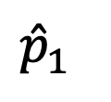
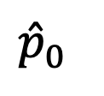



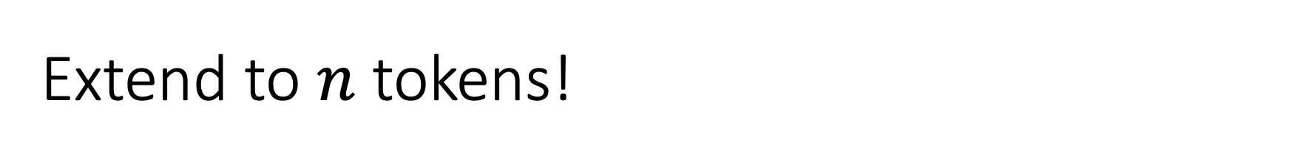


Extend to $n$ tokens!
Generate a long seed $x=x_{1}x_{2}…x_{n}$
Use each $x_{i}$ as we just saw, computing ${\hat{p}}_{x_{i}}$
$$1$$
$$1$$
$$1$$
$${\hat{p}}_{1}$$
$$p$$
$\frac{1}{2}$
$\frac{1}{2}$
$\frac{1}{2}$
$${\hat{p}}_{0}$$
$$0$$
$$0$$
$$0$$

Slide 41
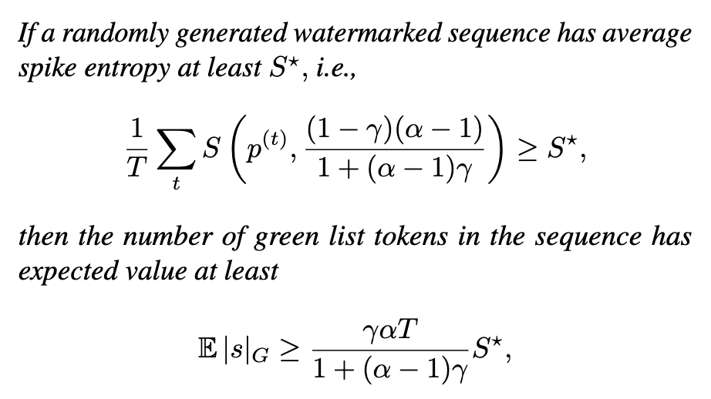
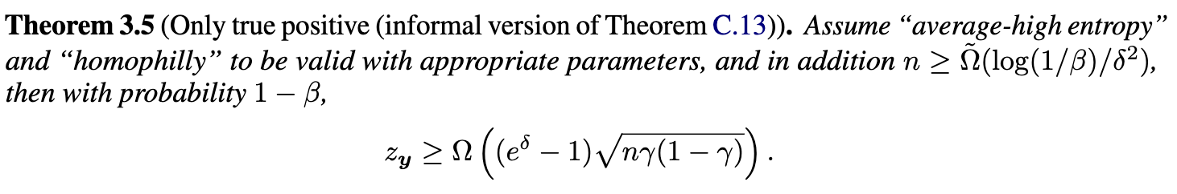


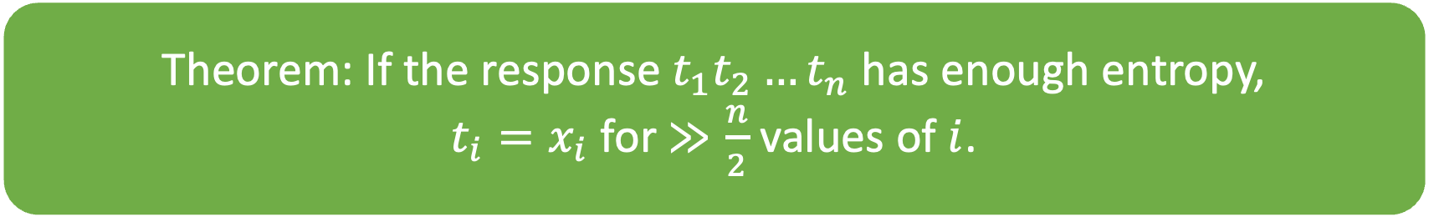

Basically every (theory) watermarking paper (sometimes secretly) uses a theorem like:
Theorem: If the response $t_{1}t_{2}…t_{n}$ has enough entropy,
$t_{i}=x_{i}$ for $≫\frac{n}{2}$ values of $i$.
A Watermark for Large Language Models.
Provable Robust Watermarking for AI-Generated Text.

Slide 42
We just saw:
If responses are binary, this is the identity function!
approximate randomness recovery
randomness
=
randomness
some seed x
content
input/prompt
correlated with x

Slide 43
Common watermark blueprint
1. Choose seeds from a special structured family.
2. Use an unbiased correlated sampler with seed.
3. To detect, check correlation between response and seed family.

Slide 44
Using correlated unbiased sampling to construct a watermark

Slide 45
 | Seed family | Detection
[Aar22, KGW+23*, CGZ24] | Derived from a PRF applied to prev tokens. | Rederive seed by computing PRF. Compute distance to seed.
[ZALW24]
[KTHL24]
[FGJ+24]
[CG24, GM24]

Slide 46
 | Seed family | Detection
[Aar22, KGW+23*, CGZ24] | Derived from a PRF applied to prev tokens. | Rederive seed by computing PRF. Compute distance to seed.
[ZALW24]
[KTHL24]
[FGJ+24]
[CG24, GM24]
Seed can’t be rederived if these tokens are modified.
*Their correlated sampler is not unbiased.

Slide 47
 | Seed family | Detection
[Aar22, KGW+23, CGZ24] | Derived from a PRF applied to prev tokens. | Rederive seed by computing PRF.
[ZALW24] (red/green scheme) | Fixed seed = 111…1. | (Effectively) compute distance to seed.
[KTHL24]
[FGJ+24]
[CG24, GM24]
Equivalently,
count number green tokens

Slide 48
 | Seed family | Detection
[Aar22, KGW+23, CGZ24] | Derived from a PRF applied to prev tokens. | Rederive seed by computing PRF.
[ZALW24] | Fixed seed = 111…1. | (Effectively) compute distance to seed.
[KTHL24] | Fixed random seed. | Compute edit distance to seed.
[FGJ+24]
[CG24, GM24]

Slide 49
 | Seed family | Detection
[Aar22, KGW+23, CGZ24] | Derived from a PRF applied to prev tokens. | Rederive seed by computing PRF.
[ZALW24] | Fixed seed = 111…1. | (Effectively) compute distance to seed.
[KTHL24] | Fixed random seed. | Compute edit distance to seed.
[FGJ+24]* | Pseudorandom signatures. | Verify signature.
[CG24, GM24]
*Rejection samples $λ$-entropy chunks of text to get exact randomness recovery.

Slide 50
 | Seed family | Detection
[Aar22, KGW+23, CGZ24] | Derived from a PRF applied to prev tokens. | Rederive seed by computing PRF.
[ZALW24] | Fixed seed = 111…1. | (Effectively) compute distance to seed.
[KTHL24] | Fixed random seed. | Compute edit distance to seed.
[FGJ+24] | Pseudorandom signatures. | Verify signature.
[CG24, GM24] | Derived from a pseudorandom code (PRC). | Run PRC decoder.

Slide 51
An undetectable watermark [CGZ24]

Slide 52


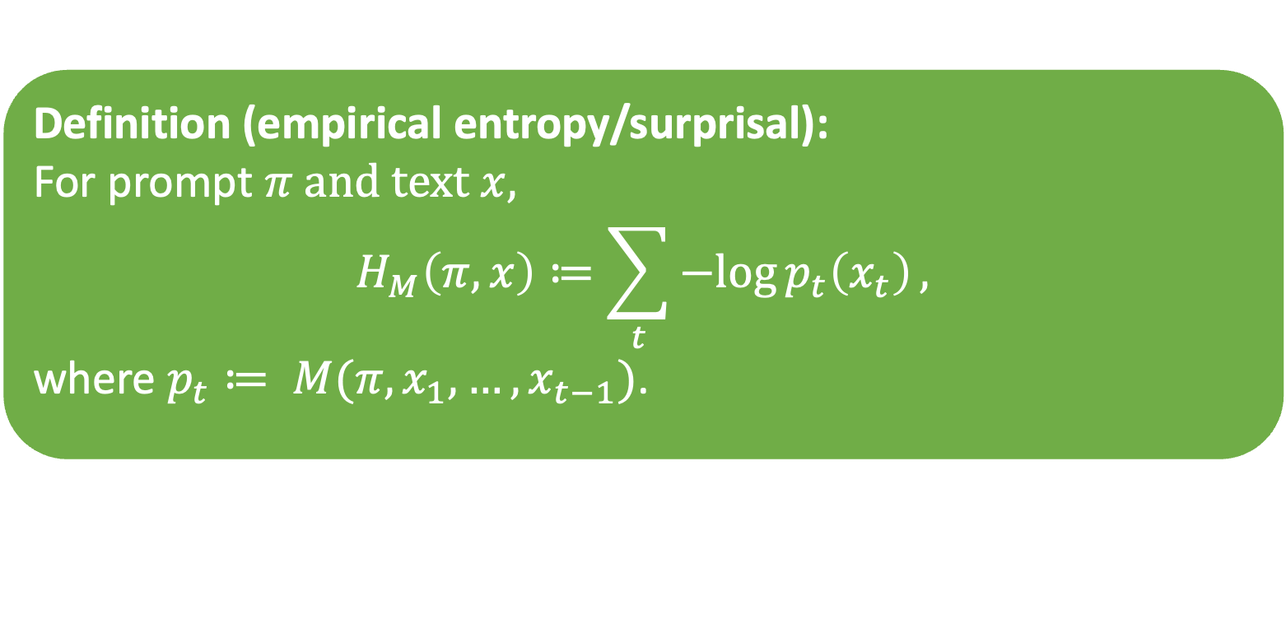
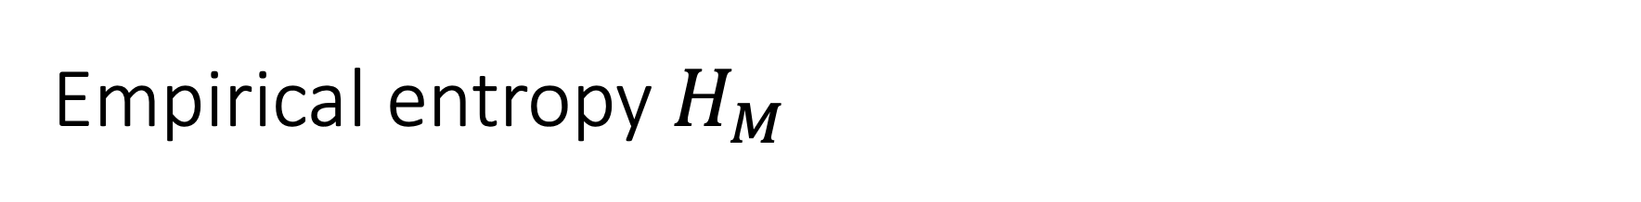











Empirical entropy $H_{M}$
$$p_{t}\left(x_{t}\right):$$
$$1,$$
$$1,$$
$$1,$$
$$1,$$
$$1,$$
$1$,
$$0.8,$$
$$0.5,$$
$$0.2,$$
$$0.6,$$
$$0.1,$$
$$0.3,$$
$$0.7$$
Definition (empirical entropy/surprisal):
For prompt $π$ and text $x$,
$$H_{M}\left(π,x\right)≔\sum_{t}{−log{p_{t}\left(x_{t}\right)}},$$
where $p_{t}≔ M(π, x_{1},…, x_{t−1})$.

Slide 53




[CGZ24]: full undetectability
Sample text naturally, it has $λ$ bits of empirical entropy
Derive seed $x=PRF(t_{1}…t_{i−1})$
Use $x$ and unbiased correlated sampling for rest of response!
To detect, rederive seed and compute Hamming distance to
$$t_{i}, …, t_{j}$$
$$t_{1},t_{2},t_{3},…,t_{i−1}$$
$$t_{i}, …, t_{j}$$
correlated with x
yields seed x
[Aar22, KGW23] also hash tokens to bias future tokens
(they were first, served as inspiration)
They hash a fixed number of tokens; cannot get undetectability this way

Slide 54
[CGZ24]: full undetectability
Sample text naturally, it has $λ$ bits of empirical entropy
Derive seed $x=PRF(t_{1}…t_{i−1})$
Use $x$ and unbiased correlated sampling for rest of response!
To detect, rederive seed and compute Hamming distance to
$$t_{i}, …, t_{j}$$
$$t_{1},t_{2},t_{3},…,t_{i−1}$$
$$t_{i}, …, t_{j}$$
correlated with x
yields seed x
Entropy ensures we never repeat seeds.
Cannot detect watermark if seed block is altered.

Slide 55
Example generated text
Seed (40 bits of empirical entropy)
Changing any word of the seed removes the watermark ☹
Music and mathematics have been intimately intertwined throughout history, and have had a powerful impact on many aspects of culture and society. Mathematics is a fundamental tool in understanding musical structure and composition, and music can help to make mathematics more accessible and interesting.
Music and mathematics are both based upon the same underlying principles of order, structure and rhythm that make them inherently linked. Mathematics is used to analyze musical elements such as pitch, tempo, rhythm, harmony, and form. It is essential to understand the mathematics of music in order to accurately compose or perform music. Music theory, which is the scientific study of music and its structure, is based heavily upon mathematical principles.
Mathematical concepts are also used to explain the physical properties of sound. The frequency of a sound is determined by mathematical equations, as well as the way in which different notes and chords combine and interact. The mathematical principles of harmony and dissonance are also used to create musical compositions.
Music and mathematics can also be used to explore and explain the psychological aspects of music. The mathematical principles of…

Slide 56

Empirical entropy in practice
(from GPT-3.5 davinci)
Bits of empirical entropy per token
“Write me an essay”
“Write me a proof that independent set reduces to 3SAT”

Slide 57
Schemes as of 2023
Robustness
[ZALW23] preferentially uses certain tokens.
[KTHL23] biases text toward a fixed random string.
Undetectable for a single bounded-length response.
[Aar22, KGW+23, CGZ23] all use a similar strategy of applying a PRF to tokens.
[Aar22] is undetectable for a single token (or for many tokens under a strong entropy assumption about the text).
[CGZ23] is undetectable to any polynomial-time user.
Pseudorandom codes!
Quality

Slide 58
The [CG24] approach: pseudorandom codes
[CG24] M. Christ, S. Gunn. Pseudorandom Error-Correcting Codes.

Slide 59

Watermarking template
Recovery is only approximate;
Need a robust trapdoor PRG = PRC
To embed:
For each query, draw a fresh s and output (PRC(s), prompt)
To detect:
Check if RandomnessRecovery(content) is a PRC output (using the trapdoor)

Slide 60





Watermarking template
Noisy channel
input/prompt
randomness
$$r$$
recovered
$$r′$$
approximate
randomness recovery
Observation: for real generative models, $r^{′}≈r$!
Specifically, error rate is constant

Slide 61



Watermarking template
Error tolerance beyond honest noise $⟹$
robustness
Noisy + adv channel
input/prompt
randomness
$$r$$
recovered
$$r′$$
approximate
randomness recovery
😈
Replace $r$ with a pseudorandom codeword
Given content, recover $r^{′}$ using approx. randomness recovery
Check if $r^{′}$ is close to a codeword

Slide 62
Pseudorandom codes

Slide 63

PRC Definition [CG24]
A pseudorandom code (PRC) is a pair of algorithms $Enc,Dec$ satisfying:
Pseudorandomness: For any polynomial-time distinguisher $𝒟$,
$\left|\operatorname{Pr}\left[𝒟^{Enc\left(sk; ⋅\right)}\left(1^{λ}\right)=1\right]−\operatorname{Pr}\left[𝒟^{𝒰}\left(1^{λ}\right)=1\right]\right|=negl(λ)$.
Error correction: If $x=Enc(sk; m)$ and $e$ has low weight, then
$\underset{sk}{Pr}\left[Dec\left(k;x⊕e\right)=m\right]=1−negl(λ)$.
[CG24] M. Christ, S. Gunn. Pseudorandom Error-Correcting Codes.

Slide 64
Linear-rate PRCs
Theorem [CG24]:
Assuming subexponential hardness of LPN, we construct linear-rate PRCs robust to any constant rate of:
Random* bit flips, and
Random deletions

Slide 65

Constructing a watermark
approximate randomness recovery
randomness
randomness
pseudorandom codeword:
Enc(1)
content
input/prompt
To detect, output $Dec_{sk}(RandomnessRecovery\left(content\right))$

Slide 66

Proving substitution robustness
1. Lemma [CG24]: The error introduced by randomness recovery is captured by a $c_{1}$-bounded “embedding channel”
(where $c_{1}$ is a function of the entropy in the response).
2. The composition of $c_{1}$- and $c_{2}$- bounded channels is $(c_{1}+c_{2})$-bounded.
3. The PRC used tolerates $(c_{1}+c_{2})$-bounded error channels.
⇨ the watermark is robust to $c_{2}$-bounded error channels!

Slide 67
Watermarking template: LLMs
Theorem [CG24]:
We construct the first undetectable LLM watermark with robustness to any constant rate of:
Random word substitutions, and
Random word deletions

Slide 68


Proving robustness, more generally
Suppose we have a PRC robust to all channels in a class C.
To show the watermark is robust to an error channel $ℇ$, show:
$$ℇ∘\left(embedding channel\right)∈C$$
Equivalently, using [CG24] lemma from last slide:
$$ℇ∘\left(c_{1}bounded channel\right)∈C$$
⇨ more robust PRCs yield more robust watermarks!

Slide 69
Further robustness
Golowich and Moitra (NeurIPS ’24) construct PRCs robust to edits (insertions/deletions/substitutions), immediately yielding watermarks robust to edits.

Slide 70
More pseudorandom codes

Slide 71
More pseudorandom codes
Golowich & Moitra (NeurIPS ‘24):
pseudorandom codes robust to edits, from weaker assumptions
Cohen, Hoover & Schoenbach (S&P ‘25):
construct multi-user watermarks and study stronger adaptive robustness
Ghentiyala & Guruswami (RANDOM ‘25):
pseudorandom codes from other assumptions, some with pseudorandomness against weaker adversaries
Alrabiah, Ananth, Christ, Dodis, Gunn (STOC ‘25):
pseudorandom codes with robustness in the presence of encoding and decoding oracles
Garg, Gunn, Wang (TCC ‘25); Döttling, Müller, Rajasree (TCC ‘25):
there are no black-box constructions of PRCs from essentially any crypto (OWF, VBB, PKE, …)

Slide 72

An Undetectable Watermark for Generative Image Models Sam Gunn, Xuandong Zhao, Dawn Song. ICLR ‘25
watermarked
image
latents with signs from a PRC codeword
latents with random signs

Slide 73

An Undetectable Watermark for Generative Image Models Sam Gunn, Xuandong Zhao, Dawn Song. ICLR ‘25

Slide 74




Slide 75
Future directions

Slide 76
Practical bottleneck: information rate of PRCs
Can we construct PRCs with concretely shorter codewords?
⇨ for the level of error in LLMs, need 1000s of words to embed a watermark
⇨ image models have far lower error, so embedding is already feasible. But a better information rate would let us embed more metadata
Can we improve randomness recovery for LLMs?

Slide 77
LLM watermarks with semantic robustness
Can we embed a watermark in the semantic space of text?
Should be possible, but in my (limited) experience it’s been hard to reliably manipulate semantics

Slide 78
Watermarks for open models
Can we watermark content generated by open models, in a way that is not trivially removable?
Partial answer:
Christ, Gunn, Raykova, Malkin ‘23: Provably Robust Watermarks for Open-Source Language Models

Slide 79
“Secure” detection, whatever that means
Who do we give detector access? And how?
API? Detection key?
for some schemes, secret key can be learned from a detection API or even just watermarked responses
How do we allow detection without compromising other properties?
Unforgeable public detection: [FGJ+23, CG24]
Require an infeasibly large amount of text to detect
Robustness: [CHS25, AAC+25]
What properties do we even want to preserve?

Slide 80
Why has watermarking been successful?
Highly modular
Research: don’t need to understand much about ML to build watermarks
Clean definitions
Practice: can add a watermarking to a model without touching the neural network
Very efficient
Good communication and collaboration
Implementation: crypto libraries usable by non-crypto experts
Zhao, Gunn, Song
Blog posts and news articles
Possibly driven by regulation pressure

Slide 81
Why has watermarking been successful?
Highly modular
Good communication and collaboration
Let’s look for other topics with these properties!

Slide 82


Slide 83
References: papers
[Aar22]: S. Aaronson, “Leaning Into Uninterpretability for AI Alignment,” 2022.
[KGW+23]: J. Kirchenbauer, J. Geiping, Y. Wen, J. Katz, I. Miers, T. Goldstein, “A Watermark for Language Models,” 2023.
[CGZ23]: M. Christ, S. Gunn, O. Zamir, “Undetectable Watermarks for Language Models,” 2023.
[ZALW23]: X. Zhao, P. Ananth, L. Li, Y. Wang, “Provable Robust Watermarking for AI-Generated Text,” 2023.
[KTHL23]: R. Kuditipudi, J. Thickstun, T. Hashimoto, P. Liang, “Robust Distortion-free Watermarks for Language Models,” 2023.
[FGJ+23]: J. Fairoze, S. Garg, S. Jha, S. Mahloujifar, M. Mahmoody, M. Wang, “Publicly-Detectable Watermarking for Language Models,” 2023.
[ZEF+23]: H. Zhang, B. Edelman, D. Francati, D. Venturi, G. Ateniese, B. Barak, “Watermarks in the Sand: Impossibility of Strong Watermarking for Generative Models,” 2023.
[CGRM23]: M. Christ, S. Gunn, M. Raykova, T. Malkin, “Provably Robust Watermarks for Open-Source Language Models,” 2023.
[CG24]: M. Christ and S. Gunn, “Pseudorandom Error-Correcting Codes,” 2024.
[GM24]: N. Golowich, A. Moitra, “Edit Distance Robust Watermarks via Indexing Pseudorandom Codes,” 2024.
[GG24]: S. Ghentiyala, V. Guruswami, “New Constructions of Pseudorandom Codes,” 2024.
[GZS25]: S. Gunn, X. Zhao, D. Song, “An Undetectable Watermark for Generative Image Models,” 2025.
[CHS25]: A. Cohen, A. Hoover, G. Schoenbach, “Watermarking Language Models for Many Adaptive Users,” 2025.
[AAC+25]: O. Alrabiah, P. Ananth, M. Christ, Y. Dodis, S. Gunn, “Ideal Pseudorandom Codes,” 2025.
[GGW25]: S. Garg, S. Gunn, M. Wang, “Black-Box Crypto is Useless for Pseudorandom Codes,” 2025.
[DMR25]: N. Döttling, A. Müller, M. Rajasree, “Separating Pseudorandom Codes from Local Oracles,” 2025.
[ZGC+25]: X. Zhao, S. Gunn, M. Christ, J. Fairoze, A. Fabrega, N. Carlini, S. Garg, S. Hong, M. Nasr, F. Tramer, S. Jha, L. Li, Y. Wang, D. Song, “SoK: Watermarking for AI-Generated Content,” 2025.

Slide 84
References: blog posts, articles
NYTimes article about [Aar22, KGW+23]: https://www.nytimes.com/interactive/2023/02/17/business/ai-text-detection.html
OpenAI’s choice not to deploy watermarks:
Scott’s talk at Simons: https://www.youtube.com/live/YzuVet3YkkA?feature=shared
WSJ article: https://www.wsj.com/tech/ai/openai-tool-chatgpt-cheating-writing-135b755a
Google’s watermarks: https://deepmind.google/discover/blog/watermarking-ai-generated-text-and-video-with-synthid/
CloudFlare’s exploration of watermarks: https://blog.cloudflare.com/an-early-look-at-cryptographic-watermarks-for-ai-generated-content/

Slide 85
Resources: videos
Miranda’s RWC talk about undetectable watermarks: https://youtu.be/1FuNLDVJJ_c
Simons talks: https://simons.berkeley.edu/workshops/alignment-trust-watermarking-copyright-issues-llms/schedule
Miranda’s talk about pseudorandom codes: https://youtu.be/UMSIc5USW5Y
Noah’s talk about edit-robust pseudorandom codes: https://youtu.be/VFt7NYGj_F4
Rohith’s talk about distortion-free watermarks: https://youtu.be/fYrvZx7VERI

Slide 86
Resources: implementations
Mark My Words LLM watermark repo: https://github.com/wagner-group/MarkMyWords
Implements and benchmarks several LLM watermark schemes
[GZS25] repo: https://github.com/XuandongZhao/PRC-Watermark
Includes an implementation of PRCs
Cloudflare watermark repo, including PRC implementation: https://github.com/cloudflareresearch/poc-watermark
Many other papers have associated repos as well

