Slide 1
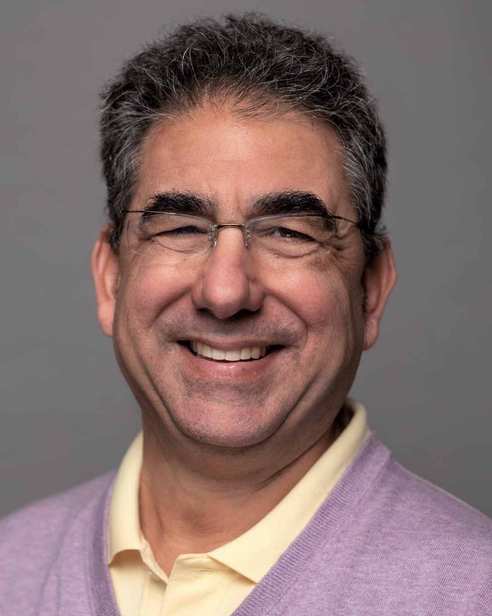
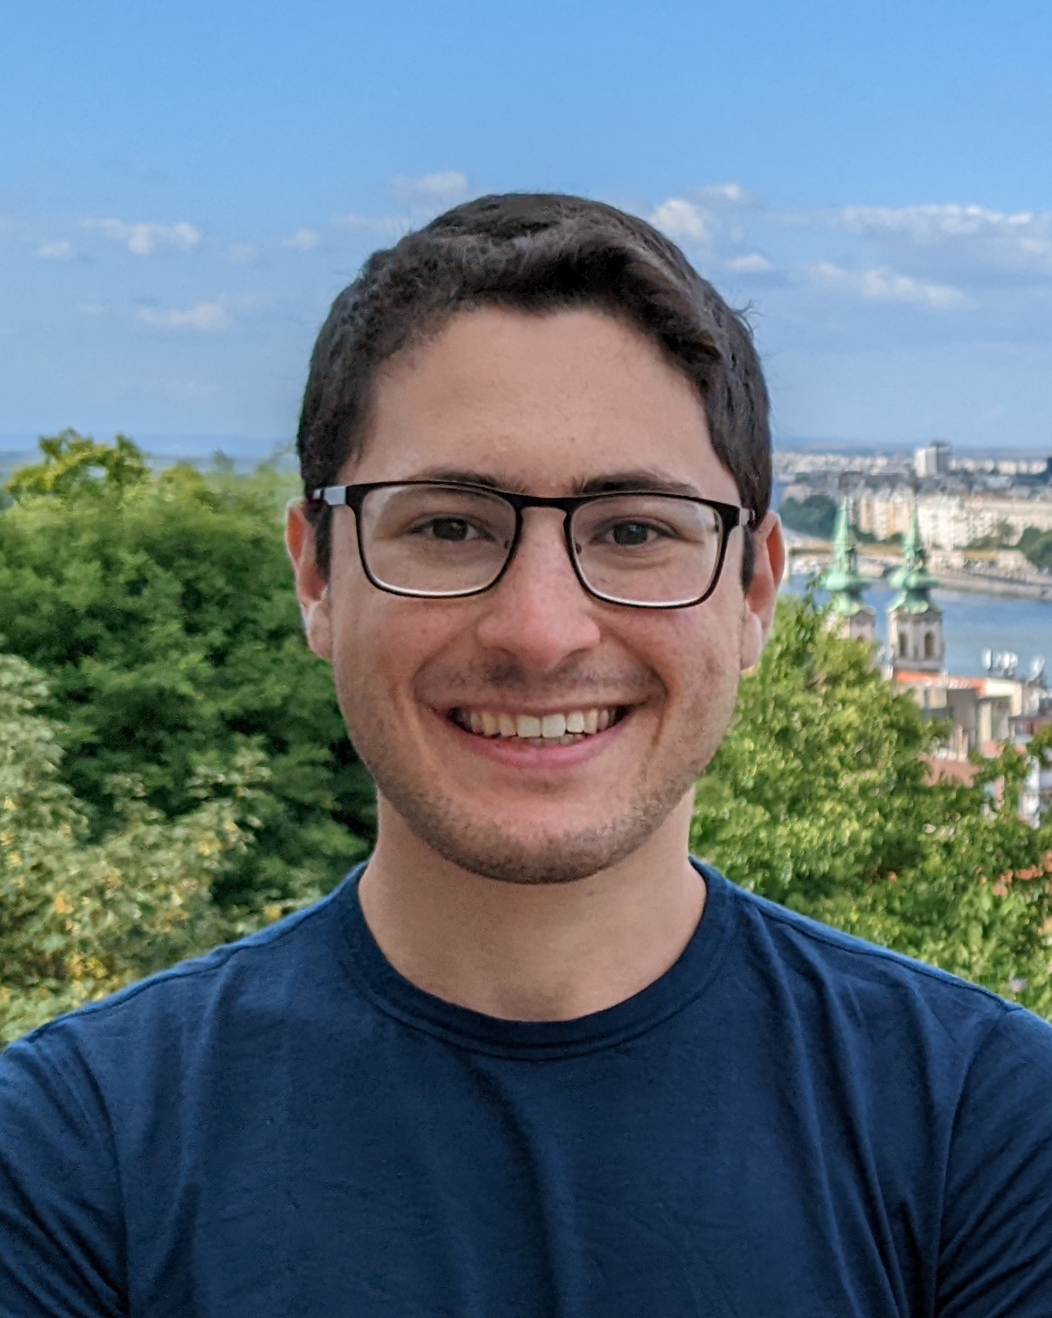
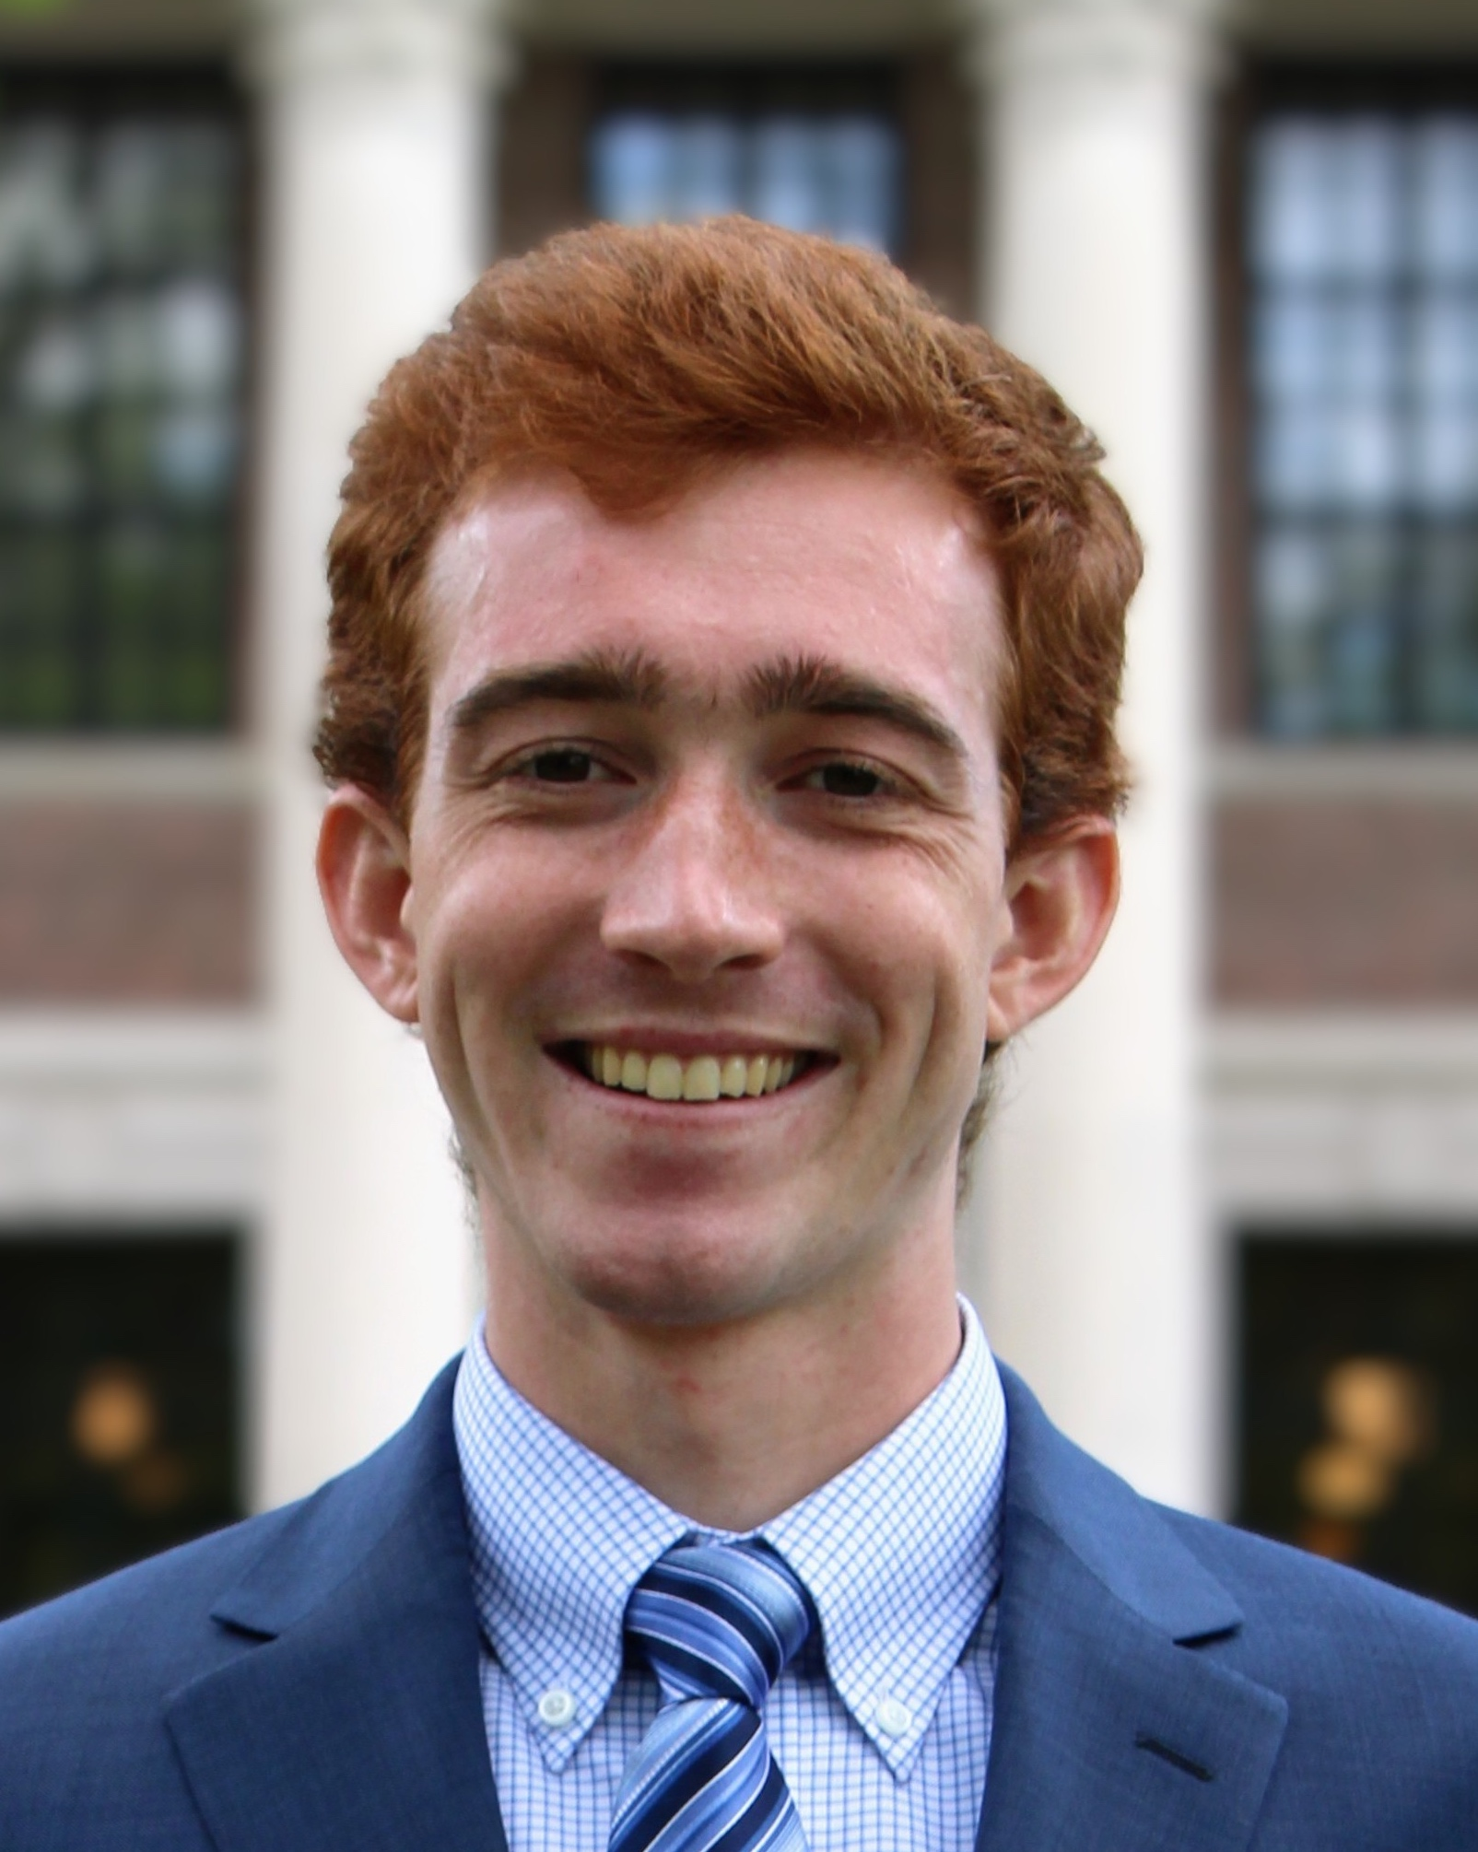

Refereed Learning
Ran Canetti, Ephraim Linder, and Connor Wagaman
{canetti, ejlinder, wagaman} @ bu.edu

Slide 2


Background
Modern machine learning models are huge
Training takes lots of computation
(Untrusted) third parties train these models
How can a verifier with few resources determine the accuracy of ML models?

Slide 3




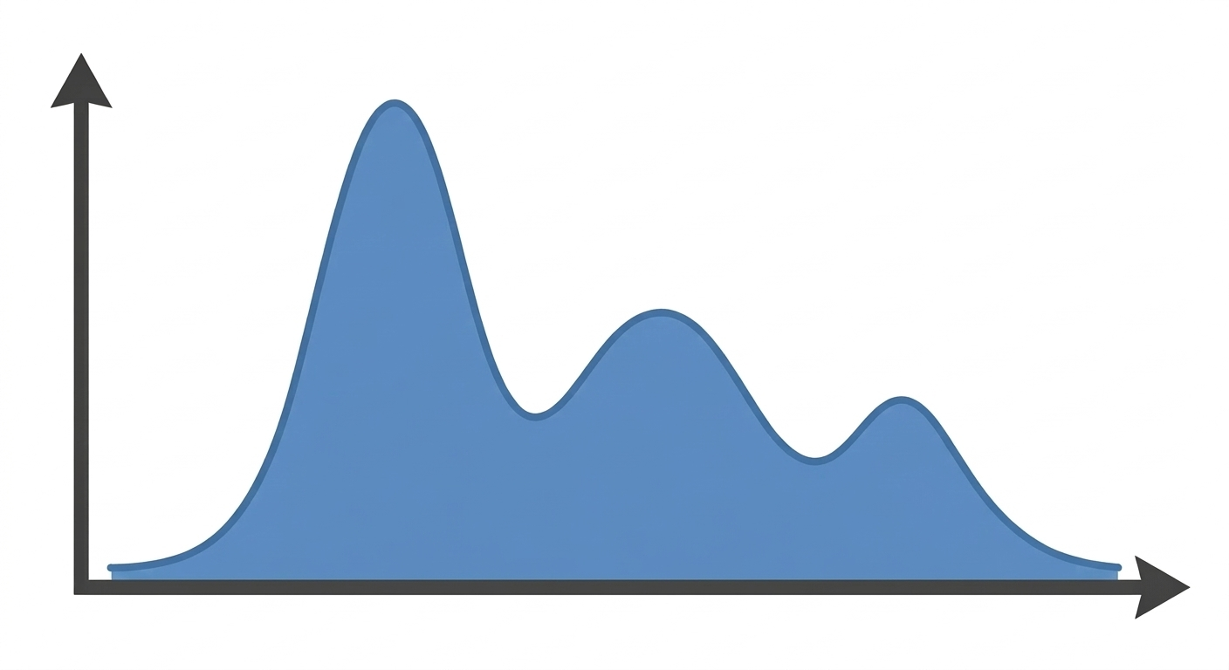

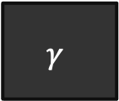
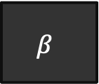
A Motivating Example
Scientist wants to determine which protein structure-prediction model (BetaFold or GammaFold) is better:
Knows the distribution over proteins of interest (e.g., the proteins involved in a specific metabolic pathway)
Has (expensive) method for obtaining labels (purify proteins, image with Cryo-EM).
Goal: minimize verifier experiments (queries to labeling function), running time.
$$β$$
$$γ$$

Slide 4
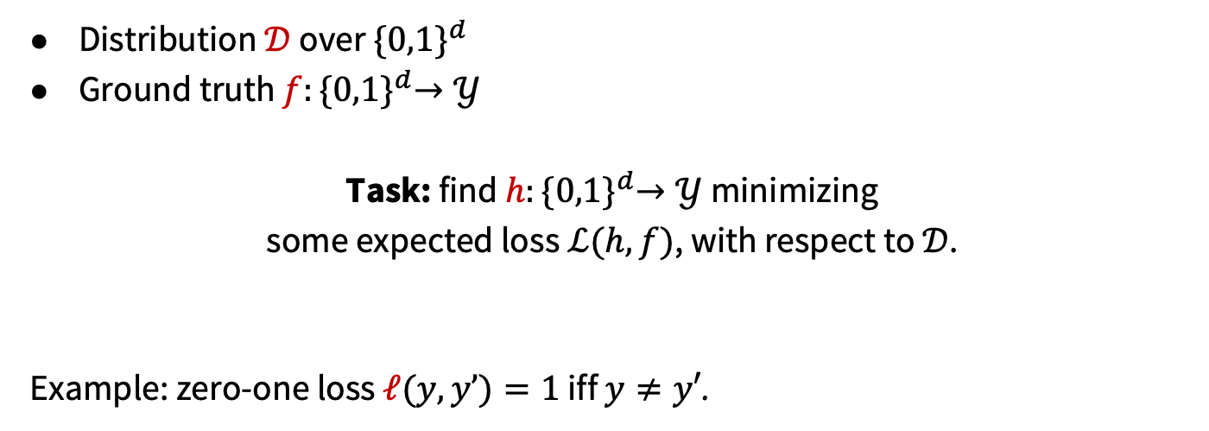
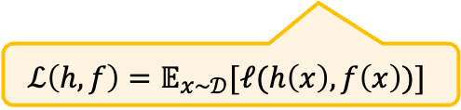
Background: The Learning Task
Distribution $𝒟$ over ${\{0,1\}}^{d}$
Ground truth $f:{\{0,1\}}^{d}→𝒴$
Task: find $h:{\{0,1\}}^{d}→𝒴$ minimizing some expected loss$ℒ(h,f)$, with respect to $𝒟$.
Example: zero-one loss $ℓ(y,y’)=1$ iff $y≠y′$.
$$ℒ\left(h,f\right)=𝔼_{x∼𝒟}[ℓ(h\left(x\right),f\left(x\right))]$$
Notes:
Call attention to the fact that ell is a metric. Example: any absolute loss.

Slide 5
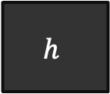
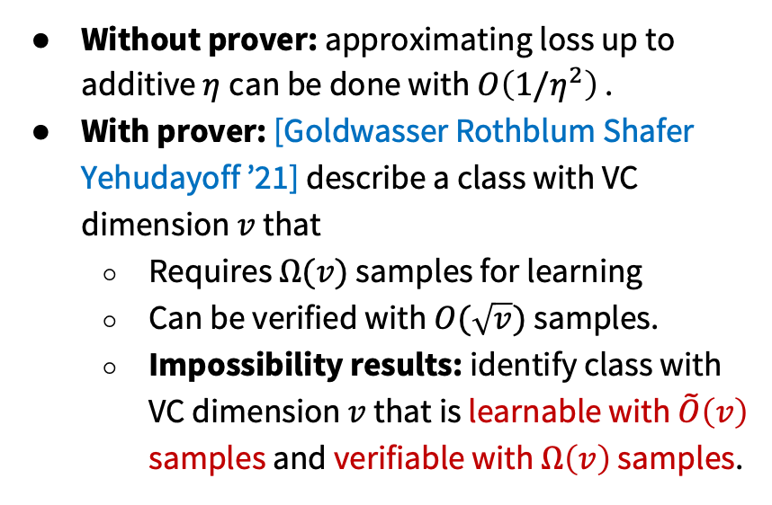
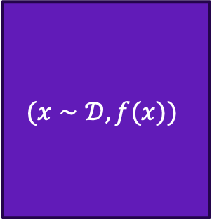
Background: Verifiable Learning
$$(x∼𝒟,f(x))$$
Without prover: approximating loss up to additive $η$can be done with $O\left(1/η^{2}\right)$ .
With prover: [Goldwasser Rothblum Shafer Yehudayoff ’21] describe a class with VC dimension $v$ that
Requires $Ω(v)$ samples for learning
Can be verified with $O(\sqrt{v})$ samples.
Impossibility results: identify class with VC dimension $v$ that is learnable with $\tilde{O}\left(v\right)$ samples and verifiable with $Ω\left(v\right)$ samples.
$$h$$

Slide 6
Our Contributions
Initiate an investigation of refereed learning: a model for verifiable machine learning in the two-prover setting.
Define the model
Algorithmic toolkit for refereed learning
Refereed learning protocols via the toolkit
Impossibility results and extensions
Notes:
To build up to our model, I’m going to review the following concepts.

Slide 7
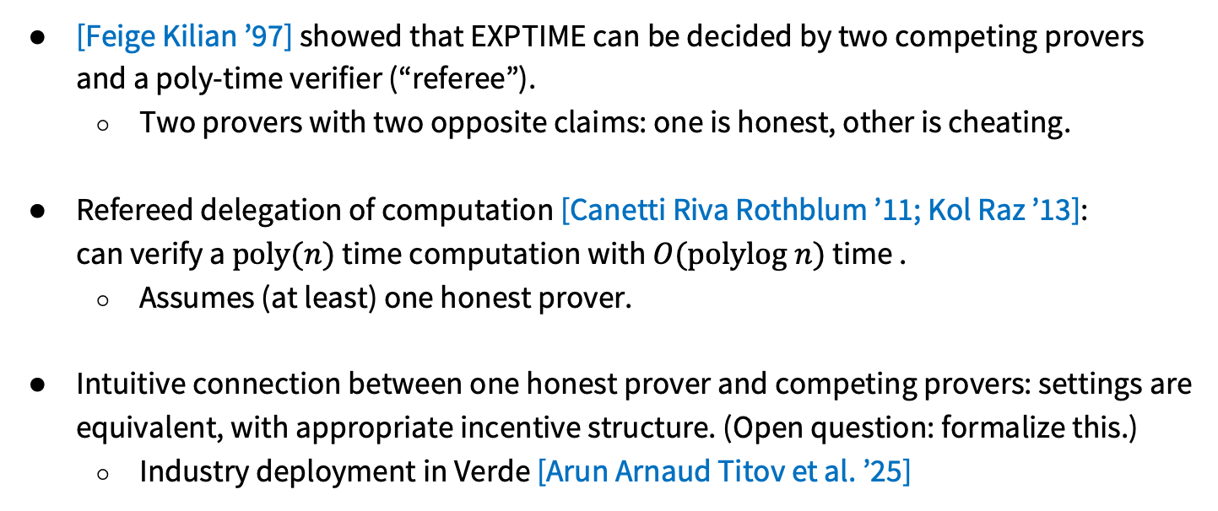
Prior Work with Two Provers
[Feige Kilian ’97] showed that EXPTIME can be decided by two competing provers and a poly-time verifier (“referee”).
Two provers with two opposite claims: one is honest, other is cheating.
Refereed delegation of computation [Canetti Riva Rothblum ’11; Kol Raz ’13]: can verify a $poly(n)$ time computation with $O(polylog n)$ time .
Assumes (at least) one honest prover.
Intuitive connection between one honest prover and competing provers: settings are equivalent, with appropriate incentive structure. (Open question: formalize this.)
Industry deployment in Verde [Arun Arnaud Titov et al. ’25]
Notes:
Formalizing things is an interesting open question. Here, where things are probabilistic, formalizing incentive structure could be worthwhile.”

Slide 8
Limitations
Prior work only considers verifying fully-specified, deterministic computations.
Refereed delegation of computation [Canetti Riva Rothblum ’11]: verifier specifies the desired computation with a Turing machine.
[Feige Kilian ’97] tests for membership in a language.
Mismatched with verifiable learning: models often given as a black box.
Desired computation unspecified—just “train an accurate model”.
Many aspects possibly black box: training procedure, access to model, access to distribution.
Sample/query access to ground truth not specified by circuit or TM.

Slide 9
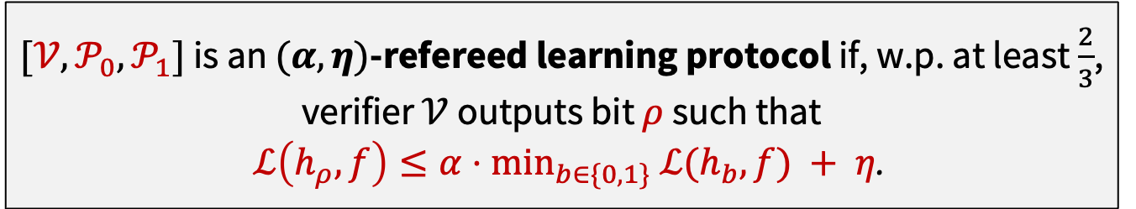
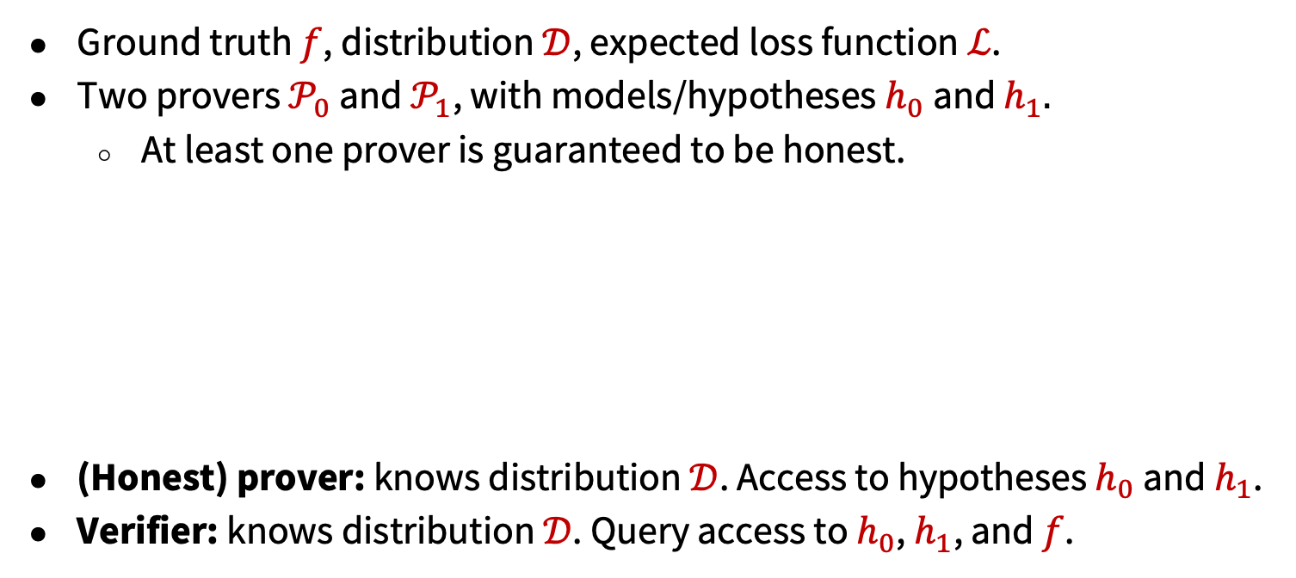

Our Model: Refereed Learning
More general definition in the paper!
Ground truth $f$, distribution $𝒟$, expected loss function $ℒ$.
Two provers $𝒫_{0}$ and $𝒫_{1}$, with models/hypotheses $h_{0}$ and $h_{1}.$
At least one prover is guaranteed to be honest.
(Honest) prover: knows distribution $𝒟$. Access to hypotheses $h_{0}$ and $h_{1}$.
Verifier: knows distribution $𝒟$. Query access to $h_{0}$, $h_{1}$, and $f$.
$[{𝒱,𝒫}_{0},𝒫_{1}]$ is an $(α,η)$-refereed learning protocol if, w.p. at least $\frac{2}{3}$, verifier $𝒱$ outputs bit $ρ$ such that
$ℒ\left(h_{ρ},f\right)≤α⋅min_{b∈\{0,1\}}$ $ℒ(h_{b},f) + η$.
Query access to PMF of $𝒟$.

Slide 10






Our Model: Refereed Learning
More general definition in the paper!
$[{𝒱,𝒫}_{0},𝒫_{1}]$ is an $(α,η)$-refereed learning protocol if, w.p. at least $\frac{2}{3}$, verifier $𝒱$ outputs bit $ρ$ such that
$ℒ\left(h_{ρ},f\right)≤α⋅min_{b∈\{0,1\}}$ $ℒ(h_{b},f) + η$.
PMF of $𝒟$
$$h_{0},h_{1}$$
$$f$$
$$h_{0},h_{1}$$
$$h_{0},h_{1}$$
$$ρ$$

Slide 11
Our Model: Refereed Learning
More general definition in the paper!
Ground truth $f$, distribution $𝒟$, expected loss function $ℒ$.
Two provers $𝒫_{0}$ and $𝒫_{1}$, with models/hypotheses $h_{0}$ and $h_{1}.$
At least one prover is guaranteed to be honest.
(Honest) prover: knows distribution $𝒟$. Access to hypotheses $h_{0}$ and $h_{1}$.
Verifier: knows distribution $𝒟$. Query access to $h_{0}$, $h_{1}$, and $f$.
$[{𝒱,𝒫}_{0},𝒫_{1}]$ is an $(α,η)$-refereed learning protocol if, w.p. at least $\frac{2}{3}$, verifier $𝒱$ outputs bit $ρ$ such that
$ℒ\left(h_{ρ},f\right)≤α⋅min_{b∈\{0,1\}}$ $ℒ(h_{b},f) + η$.
Query access to PMF of $𝒟$.

Slide 12
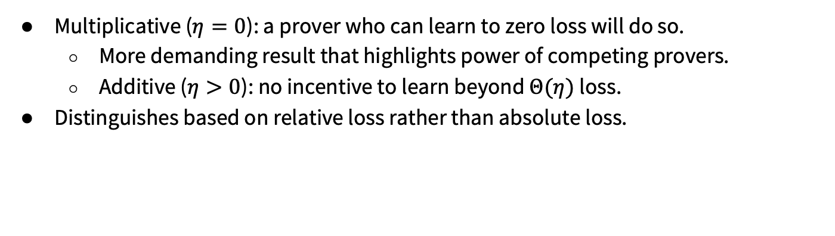
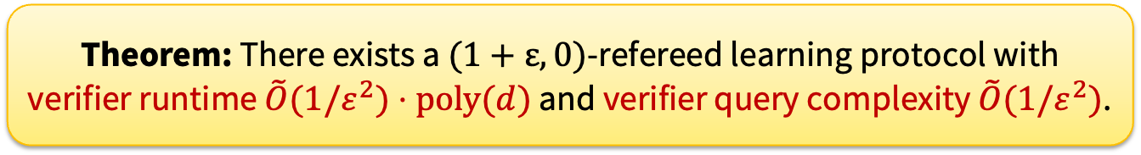
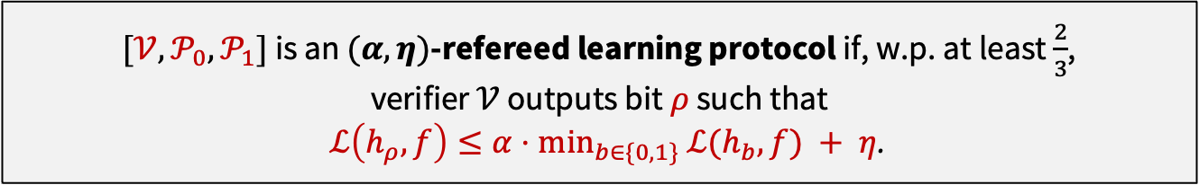
Our Focus: Purely Multiplicative Error ($η=0)$
$[{𝒱,𝒫}_{0},𝒫_{1}]$ is an $(α,η)$-refereed learning protocol if, w.p. at least $\frac{2}{3}$, verifier $𝒱$ outputs bit $ρ$ such that
$ℒ\left(h_{ρ},f\right)≤α⋅min_{b∈\{0,1\}}$ $ℒ(h_{b},f) + η$.
Multiplicative ($η=0$): a prover who can learn to zero loss will do so.
More demanding result that highlights power of competing provers.
Additive ($η>0$): no incentive to learn beyond $Θ(η)$ loss.
Distinguishes based on relative loss rather than absolute loss.
1 prover: selecting hypothesis with better relative loss can take arbitrarily many queries.
Theorem: There exists a $(1+ε,0)$-refereed learning protocol with verifier runtime $\tilde{O}(1/ε^{2})⋅poly(d)$ and verifier query complexity $\tilde{O}(1/ε^{2})$.

Slide 13
Our Contributions
Initiate an investigation of refereed learning: a model for verifiable machine learning in the two-prover setting.
Define the model
Algorithmic toolkit for refereed learning
Protocols via the toolkit
Impossibility results and extensions
Notes:
To build up to our model, we need to review several concepts.

Slide 14
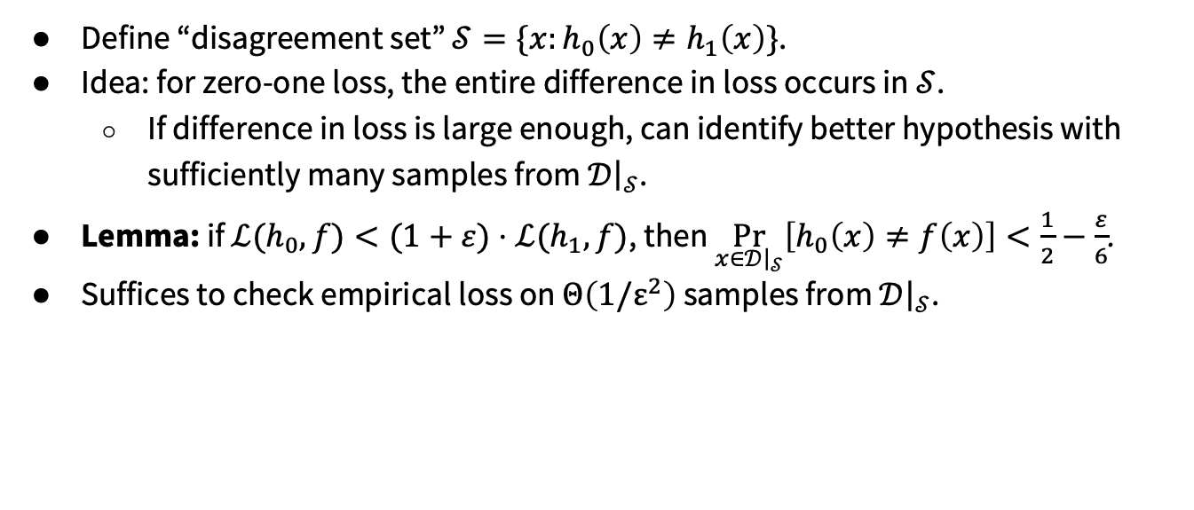
Ideas: Refereed Learning for zero-one loss
Define “disagreement set” $𝒮=\{x:h_{0}\left(x\right)≠h_{1}\left(x\right)\}$.
Idea: for zero-one loss, the entire difference in loss occurs in $𝒮$.
If difference in loss is large enough, can identify better hypothesis with sufficiently many samples from $𝒟{\left.​\right|}_{𝒮}$.
Lemma: if $ℒ(h_{0},f)<(1+ε)⋅ℒ(h_{1},f)$, then $\underset{x∈𝒟{\left.​\right|}_{𝒮}}{Pr}\left[h_{0}\left(x\right)≠f\left(x\right)\right]<\frac{1}{2}−\frac{ε}{6}$.
Suffices to check empirical loss on $Θ\left(1/ε^{2}\right)$ samples from $𝒟{\left.​\right|}_{𝒮}$.

Slide 15
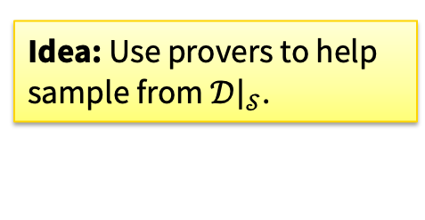

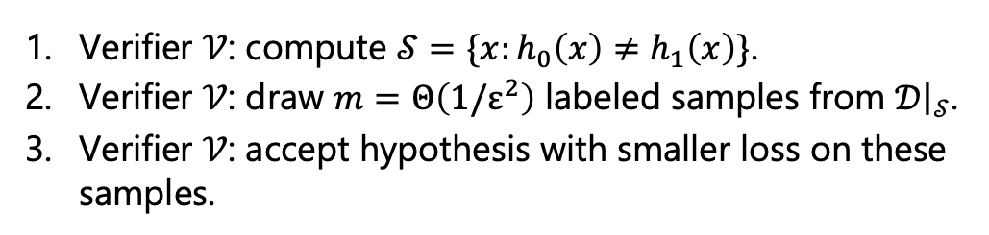
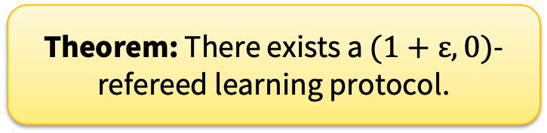
Inefficient Verifier: Refereed Learning for zero-one loss
Suffices to check empirical loss on $Θ\left(1/ε^{2}\right)$ samples from $𝒟{\left.​\right|}_{𝒮}$.
Refereed Learning (Parameters: dimension $d$, distribution $𝒟$)
Verifier $𝒱$: compute $𝒮=\{x:h_{0}\left(x\right)≠h_{1}\left(x\right)\}$.
Verifier $𝒱$: draw $m=Θ\left(1/ε^{2}\right)$ labeled samples from $𝒟{\left.​\right|}_{𝒮}$.
Verifier $𝒱$: accept hypothesis with smaller loss on these samples.
Arbitrarily large and arbitrarily sparse!
Theorem: There exists a $(1+ε,0)$-refereed learning protocol.
Idea: Use provers to help sample from $𝒟{\left.​\right|}_{𝒮}$.
Notes:
As a starting point, we conceptualize the following inefficient verifier.

Slide 16
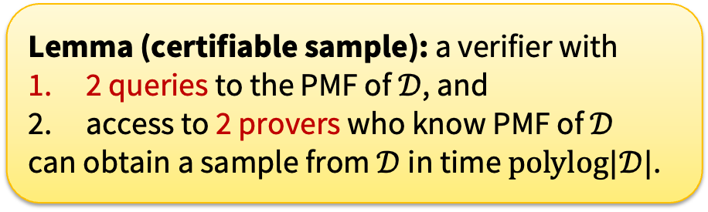
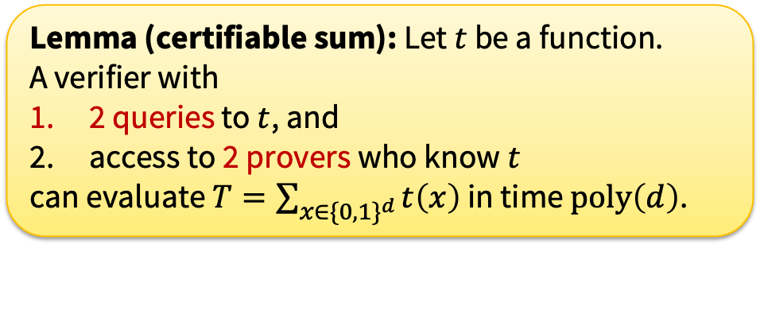
Overview: Our Tools
Lemma (certifiable sum): Let $t$ be a function. A verifier with
2 queries to $t$, and
access to 2 provers who know $t$
can evaluate $T=\sum_{x∈{\{0,1\}}^{d}}{t\left(x\right)}$ in time $poly\left(d\right)$.
Lemma (certifiable sample): a verifier with
2 queries to the PMF of $𝒟$, and
access to 2 provers who know PMF of $𝒟$
can obtain a sample from $𝒟$ in time $polylog|𝒟|$.

Slide 17
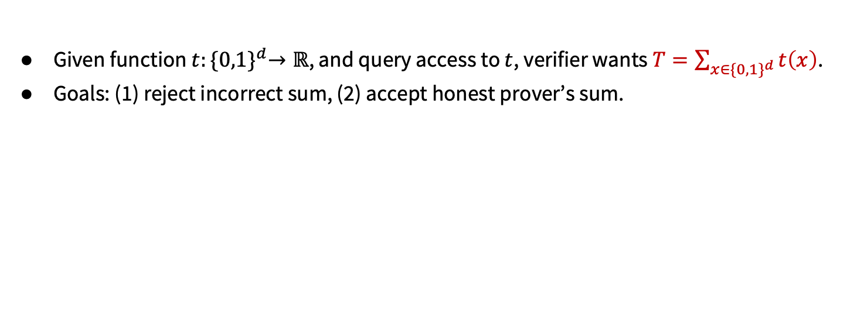
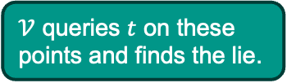
Protocol: Certifiable Sum
Given function $t:{\{0,1\}}^{d}→ℝ$, and query access to $t$, verifier wants $T=\sum_{x∈{\{0,1\}}^{d}}{t\left(x\right)}$.
Goals: (1) reject incorrect sum, (2) accept honest prover’s sum.
Intuition: A prover who lies about the sum over an entire domain lies about a sum over at least one half of the domain.
Honest prover says: “Look here!”
…
$𝒱$ queries $t$ on these points and finds the lie.

Slide 18
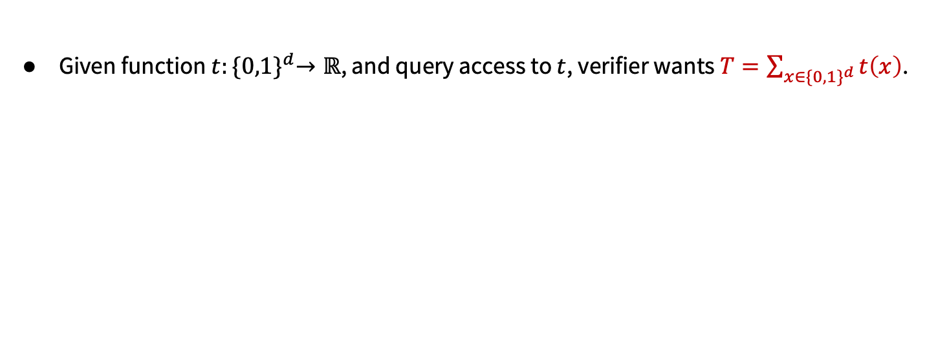
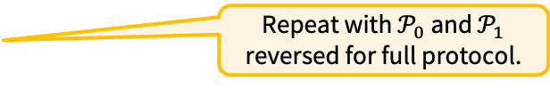
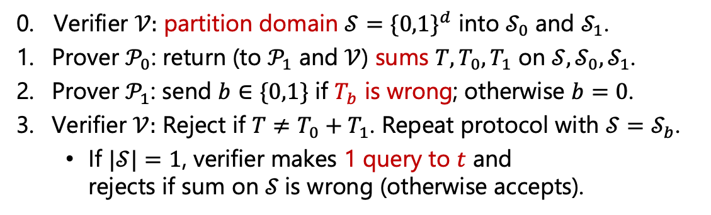
Protocol: Certifiable Sum
Given function $t:{\{0,1\}}^{d}→ℝ$, and query access to $t$, verifier wants $T=\sum_{x∈{\{0,1\}}^{d}}{t\left(x\right)}$.
Certifiable sum (Parameters: dimension $d$, function $t$)
Repeat with $𝒫_{0}$ and $𝒫_{1}$ reversed for full protocol.
0. Verifier $𝒱:$ partition domain $𝒮={\{0,1\}}^{d}$ into $𝒮_{0}$ and $𝒮_{1}$.
Prover $𝒫_{0}$: return (to $𝒫_{1}$ and $𝒱$) sums $T,T_{0},T_{1}$ on $𝒮,𝒮_{0},𝒮_{1}$.
Prover $𝒫_{1}$: send $b∈\{0,1\}$ if $T_{b}$ is wrong; otherwise $b=0$.
Verifier $𝒱:$ Reject if $T≠T_{0}+T_{1}$. Repeat protocol with $𝒮=𝒮_{b}$.
If $|𝒮|=1$, verifier makes 1 query to $t$ and rejects if sum on $𝒮$is wrong (otherwise accepts).
…

Slide 19


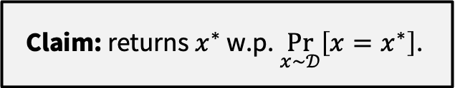
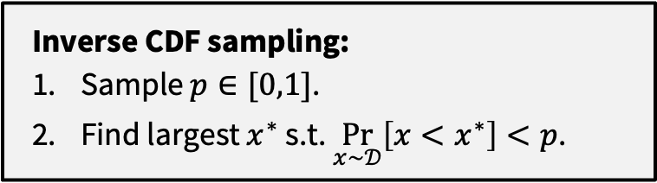



Protocol: Certifiable Sample
Verifier can use “inverse CDF sampling” to obtain random samples from a distribution.
CDF of $𝒟$
Inverse CDF sampling:
Sample $p∈[0,1]$.
Find largest $x^{∗}$ s.t. $\underset{x∼𝒟}{Pr}\left[x<x^{∗}\right]<p$.
1
$$p$$
$$\underset{x∼𝒟}{Pr}\left[x=x^{∗}\right]$$
Claim: returns$x^{∗}$ w.p. $\underset{x∼𝒟}{Pr}\left[x=x^{∗}\right]$.
…
$$x^{∗}$$
$$x∈{\left\{0,1\right\}}^{d}$$

Slide 20
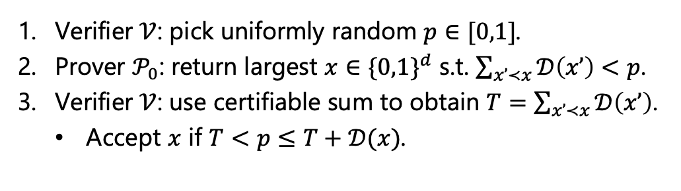
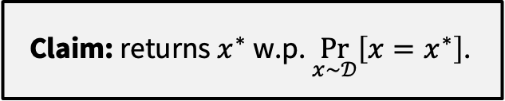
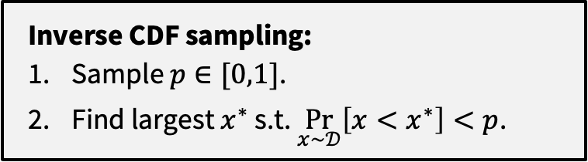
Protocol: Certifiable Sample
Inverse CDF sampling:
Sample $p∈[0,1]$.
Find largest $x^{∗}$ s.t. $\underset{x∼𝒟}{Pr}\left[x<x^{∗}\right]<p$.
Claim: returns$x^{∗}$ w.p. $\underset{x∼𝒟}{Pr}\left[x=x^{∗}\right]$.
Certifiable sample (Parameters: distribution $𝒟$)
Verifier $𝒱$: pick uniformly random $p∈[0,1]$.
Prover $𝒫_{0}$: return largest $x∈{\{0,1\}}^{d}$ s.t. $\sum_{x’≺x}{𝒟\left(x’\right)}<p$.
Verifier $𝒱$: use certifiable sum to obtain $T=\sum_{x’≺x}{𝒟\left(x’\right)}$.
Accept $x$ if $T<p≤T+𝒟(x)$.
* Thanks to Noam Mazor for simplifying this protocol!

Slide 21
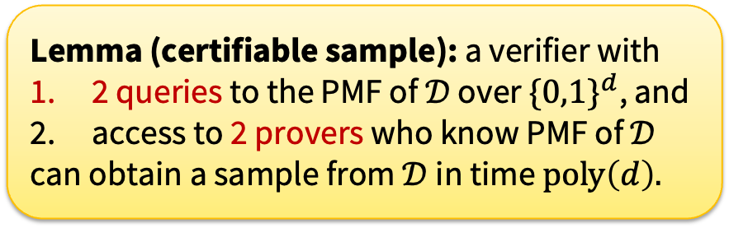
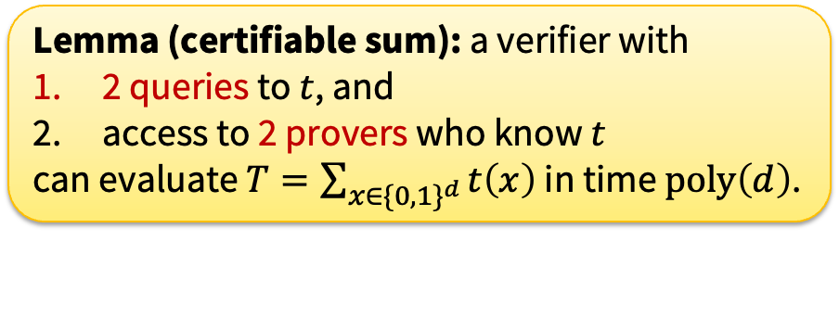
Overview: Our Tools
Lemma (certifiable sum): a verifier with
2 queries to $t$, and
access to 2 provers who know $t$
can evaluate $T=\sum_{x∈{\{0,1\}}^{d}}{t\left(x\right)}$ in time $poly\left(d\right)$.
Lemma (certifiable sample): a verifier with
2 queries to the PMF of $𝒟$ over $\{{0,1\}}^{d}$, and
access to 2 provers who know PMF of $𝒟$
can obtain a sample from $𝒟$ in time $poly\left(d\right).$

Slide 22
Our Contributions
Initiate an investigation of refereed learning: a model for verifiable machine learning in the two-prover setting.
Define the model
Algorithmic toolkit for refereed learning
Protocols via the toolkit
Impossibility results and extensions
Notes:
To build up to our model, we need to review several concepts.

Slide 23
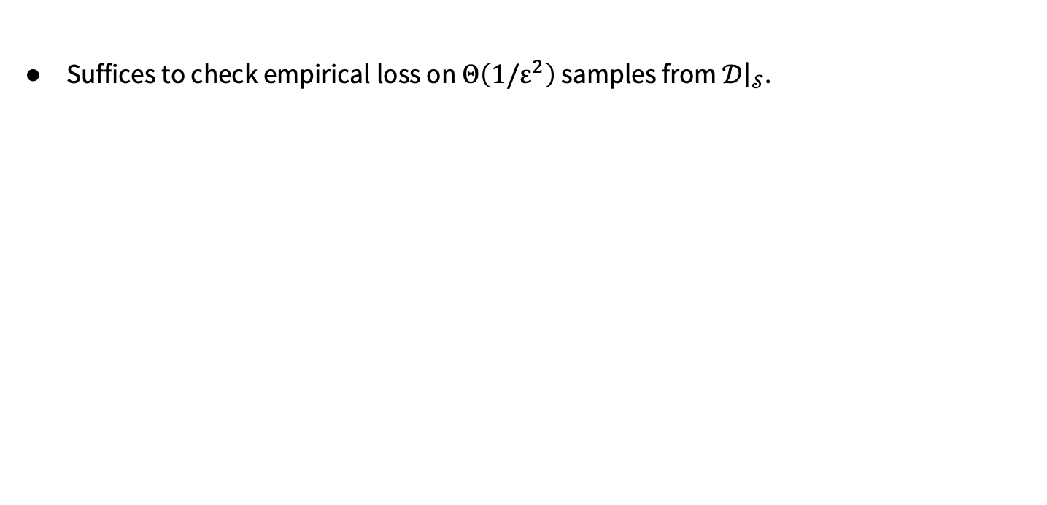
Inefficient Verifier: Refereed Learning for zero-one loss
Suffices to check empirical loss on $Θ\left(1/ε^{2}\right)$ samples from $𝒟{\left.​\right|}_{𝒮}$.
Theorem: There exists a $(1+ε,0)$-refereed learning protocol.
Refereed Learning (Parameters: dimension $d$, distribution $𝒟$)
Verifier $𝒱$: compute $𝒮=\{x:h_{0}\left(x\right)≠h_{1}\left(x\right)\}$.
Verifier $𝒱$: draw $m=Θ\left(1/ε^{2}\right)$ labeled samples from $𝒟{\left.​\right|}_{𝒮}$.
Verifier $𝒱$: accept hypothesis with smaller loss on these samples.
Arbitrarily large and arbitrarily sparse!
Notes:
As a starting point, we conceptualize the following inefficient verifier.

Slide 24
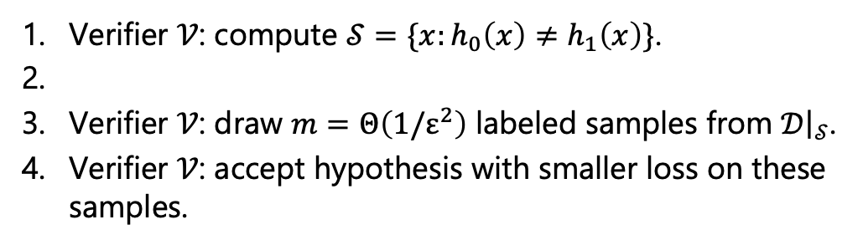
Inefficient Verifier: Refereed Learning for zero-one loss
Suffices to check empirical loss on $Θ\left(1/ε^{2}\right)$ samples from $𝒟{\left.​\right|}_{𝒮}$.
Theorem: There exists a $(1+ε,0)$-refereed learning protocol.
Refereed Learning (Parameters: dimension $d$, distribution $𝒟$)
Verifier $𝒱$: compute $𝒮=\{x:h_{0}\left(x\right)≠h_{1}\left(x\right)\}$.
Verifier $𝒱$: draw $m=Θ\left(1/ε^{2}\right)$ labeled samples from $𝒟{\left.​\right|}_{𝒮}$.
Verifier $𝒱$: accept hypothesis with smaller loss on these samples.
Arbitrarily large and arbitrarily sparse!
Notes:
As a starting point, we conceptualize the following inefficient verifier.

Slide 25
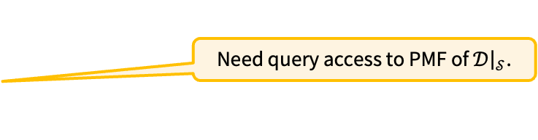
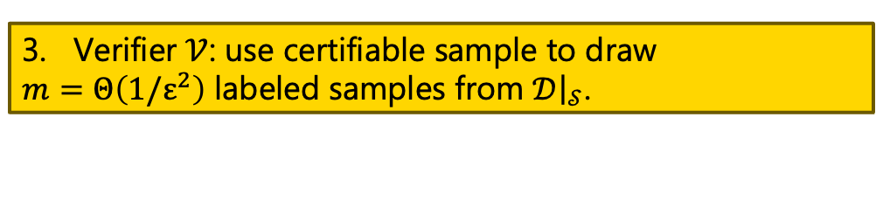
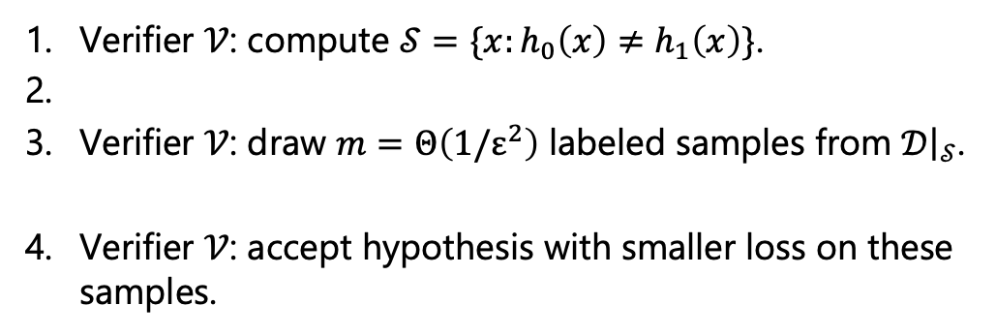
Inefficient Verifier: Refereed Learning for zero-one loss
Suffices to check empirical loss on $Θ\left(1/ε^{2}\right)$ samples from $𝒟{\left.​\right|}_{𝒮}$.
Theorem: There exists a $(1+ε,0)$-refereed learning protocol.
Refereed Learning (Parameters: dimension $d$, distribution $𝒟$)
Provers:
Verifier $𝒱$: compute $𝒮=\{x:h_{0}\left(x\right)≠h_{1}\left(x\right)\}$.
Verifier $𝒱$: draw $m=Θ\left(1/ε^{2}\right)$ labeled samples from $𝒟{\left.​\right|}_{𝒮}$.
Verifier $𝒱$: accept hypothesis with smaller loss on these samples.
2. Verifier $𝒱$: use certifiable sum to obtain $p_{𝒮}=𝒟(𝒮)$.
3. Verifier $𝒱$: use certifiable sample to draw $m=Θ\left(1/ε^{2}\right)$ labeled samples from $𝒟{\left.​\right|}_{𝒮}$.
Need query access to PMF of $𝒟{\left.​\right|}_{𝒮}$.
Notes:
As a starting point, we conceptualize the following inefficient verifier.

Slide 26
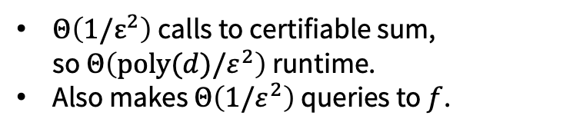
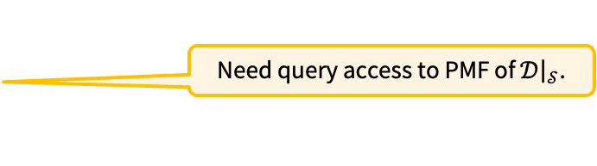
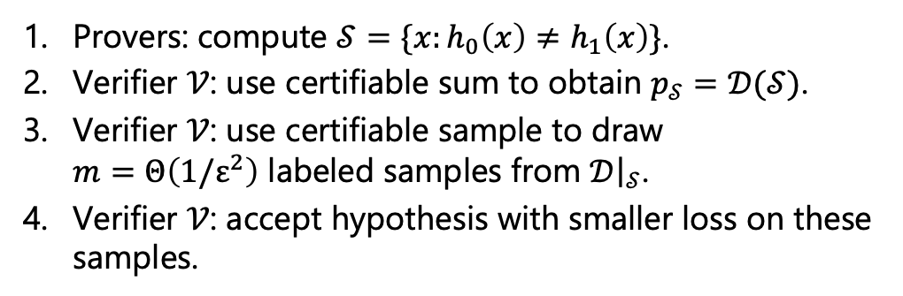
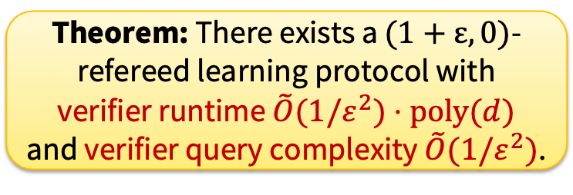
Inefficient Verifier: Refereed Learning for zero-one loss
Suffices to check empirical loss on $Θ\left(1/ε^{2}\right)$ samples from $𝒟{\left.​\right|}_{𝒮}$.
Theorem: There exists a $(1+ε,0)$-refereed learning protocol.
Refereed Learning (Parameters: dimension $d$, distribution $𝒟$)
Provers: compute $𝒮=\{x:h_{0}\left(x\right)≠h_{1}\left(x\right)\}$.
Verifier $𝒱$: use certifiable sum to obtain $p_{𝒮}=𝒟(𝒮)$.
Verifier $𝒱$: use certifiable sample to draw $m=Θ\left(1/ε^{2}\right)$ labeled samples from $𝒟{\left.​\right|}_{𝒮}$.
Verifier $𝒱$: accept hypothesis with smaller loss on these samples.
Need query access to PMF of $𝒟{\left.​\right|}_{𝒮}$.
Theorem: There exists a $(1+ε,0)$-refereed learning protocol with verifier runtime $\tilde{O}(1/ε^{2})⋅poly(d)$ and verifier query complexity $\tilde{O}(1/ε^{2})$.
$Θ\left(1/ε^{2}\right)$ calls to certifiable sum, so $Θ\left(poly(d)/ε^{2}\right)$ runtime.
Also makes $Θ\left(1/ε^{2}\right)$ queries to $f$.
Notes:
As a starting point, we conceptualize the following inefficient verifier.

Slide 27





Extension: Offloading Queries to the Provers
Theorem: There exists a $(1+ε,0)$-refereed learning protocol with verifier runtime $\tilde{O}(1/ε^{2})⋅poly(d)$ and verifier query complexity $\tilde{O}(1/ε^{2})$.
Problem: our scientist still needs to purify and image some proteins.
We can offload $f$ queries to the provers!
Idea: verifier simulates each query to $f$ via an “offloaded” call to each prover.
Verifier obtains two sets of query answers (one per prover)
If answers match, done! Queries are correct.
Otherwise, issue a single query to $f$to identify liar.
$$O(1)$$
$$γ$$
$$β$$
a single query

Slide 28
Our Contributions
Initiate an investigation of refereed learning: a model for verifiable machine learning in the two-prover setting.
Define the model
Algorithmic toolkit for refereed learning
Protocols via the toolkit
Impossibility results and extensions

Slide 29




Impossibility results
Intuition: A protocol with a purely multiplicative guarantee must distinguish zero-loss and small-loss inputs.
Lemma (impossibility results: sample complexity).
If the verifier instead has either
no query access to $f$, or
no query access to the PMF of $𝒟$,
then for all $α≥1$ and $η∈\left(0,1\right)$, every $(α,η)$-refereed learner requires verifier sample complexity $Ω(c/η$).
$$\text{can} \text{only} \text{obtain} \text{labels} \text{on} x∼𝒟,not arbitrary x$$
$$\text{can} \text{sample} x∼𝒟$$
Lemma (impossibility results: prover runtime).
Let $T_{SAT}\left(d,m\right)$ be the runtime of deciding SAT, w.p. at least 2/3, on $d$ variables and $m$ clauses. A prover in an $\left(α,0\right)$-refereed learning protocol for arbitrary $f$ must have running time $Ω(T_{SAT}(d,m−1)/m$).

Slide 30


Impossibility: Query Access
Lemma (impossibility results: sample complexity).
If the verifier instead has either
no query access to $f$, or
no query access to the PMF of $𝒟$,
then for all $α≥1$ and $η∈\left(0,1\right)$, every $(α,η)$-refereed learner requires verifier sample complexity $Ω(c/η$).
Proof sketch (1): let $h_{0}=h_{1}$, except on the all-0s input. Let $f∈\left\{h_{0},h_{1}\right\}$.
Need to sample from $f$ until we obtain that input.
Proof sketch (2): $h_{0}=h_{1}=0$, except $h_{0}(0^{d})=1$ and $h_{1}(1^{d})=1$. Let $f=0$.
Let $𝒟$ uniform, except mass 0 on $0^{d}$ or $1^{d}$.
Need to sample from $𝒟$ until either get $0^{d}$ or $1^{d}$.

Slide 31


Impossibility: Runtime
Lemma (impossibility results: prover runtime).
Let $T_{SAT}\left(d,m\right)$ be the runtime of deciding SAT, w.p. at least 2/3, on $d$ variables and $m$ clauses. A prover in an $\left(α,0\right)$-refereed learning protocol for arbitrary $f$ must have running time $Ω(T_{SAT}(d,m−1)/m$).
Proof sketch: given CNF formula $φ$ with $m$ clauses and $d$ variables.
Create instances $φ_{0}\left(x\right)=φ\left(x\right)∧x_{1}$and $φ_{1}\left(x\right)=φ\left(x\right)∧{(x}_{1}⊕1)$.
Set $f∈\{φ_{0},φ_{1}\}$ u.a.r.
If $φ$ is SAT: then outputs the formula corresponding to $f$ w.p. at least 2/3 (nonzero loss on at least one input to $φ_{b}≠f$).
If $φ$ is not SAT: outputs uniformly random formula (no loss).

Slide 32
Conclusion and Future Work
We take the refereed model beyond fully-specified, deterministic computations.
Show this framework gives us strong guarantees for comparing ML models.
Doubly efficient protocols? Partial answer here!
Can this refereed model be applied to other settings?
Property testing
Learning with a noisy ground truth
Refereed learning for generative models
Formalizing connections between honest-prover and competing prover settings.
On arXiv
arxiv.org/abs/2510.05440

