Slide 1
Video pitch
The video pitch can be found from this link.
https://youtu.be/GUtOqoN_MKQ

Slide 2
ABC Customer Lifetime Value Initiative
32513 – Machine Learning
Ma Luisa ‘Joy’ Curva
10885123
MaLuisa.Curva@student.uts.edu.au

Slide 3
Overview
business problem
Objective of the Project
CLV Methodology
Budget and Timeline

Slide 4
Business PROBLEM
Develop an approach to measure the Customer Lifetime Value (CLV) of a customer in a ﬁnancial institution called ‘ABC Bank’.
The aim is to understand the worth of the customer during the entire relationship with the bank.
Knowing the CLV of the customer will help the business develop the best strategies for customer acquisition and retention, and at the same time, improve the company’s proﬁt margin.
The value of the customer is determined by customer behaviour and the revenue contribution of the customer. The cost of delivering the product to the customer is not considered in the existing Features and Model Engine.

Slide 5
OBJECTIVE OF THE PROJECT
The bank offers different products to the customers such as Home Loans, Personal Loans, Credit Cards and Transactional accounts. Different teams manage each product. The current challenge is that the customer data across all products are not well integrated.
This initiative aims to
• Understand the data requirements for CLV analysis.
• Integrate all data required for CLV analysis into a common data platform.
• Determine the customer’s CLV across all product portfolio based on customer engagement and behaviour, revenue, and cost of delivering the product to the customer.

Slide 6
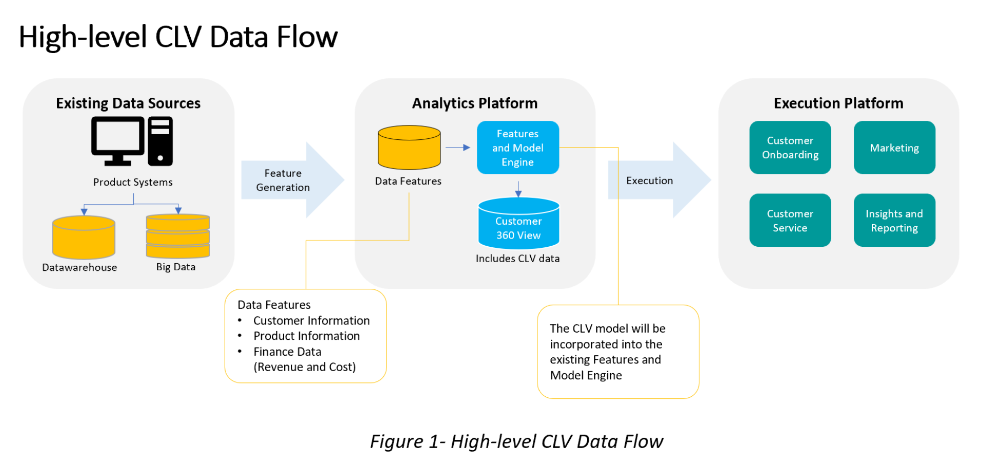
High-level data flow

Slide 7
CLV methodology
The CLV will be calculated based on the following approach
Calculate the proﬁtability of the customer based on current revenue and cost.
Determine lifetime value of the customer using different retention and churn rate of the customer.
The project will start with a basic formula of
CLV = Average Lifetime in Years ∗ Profitability of the customer

Slide 8
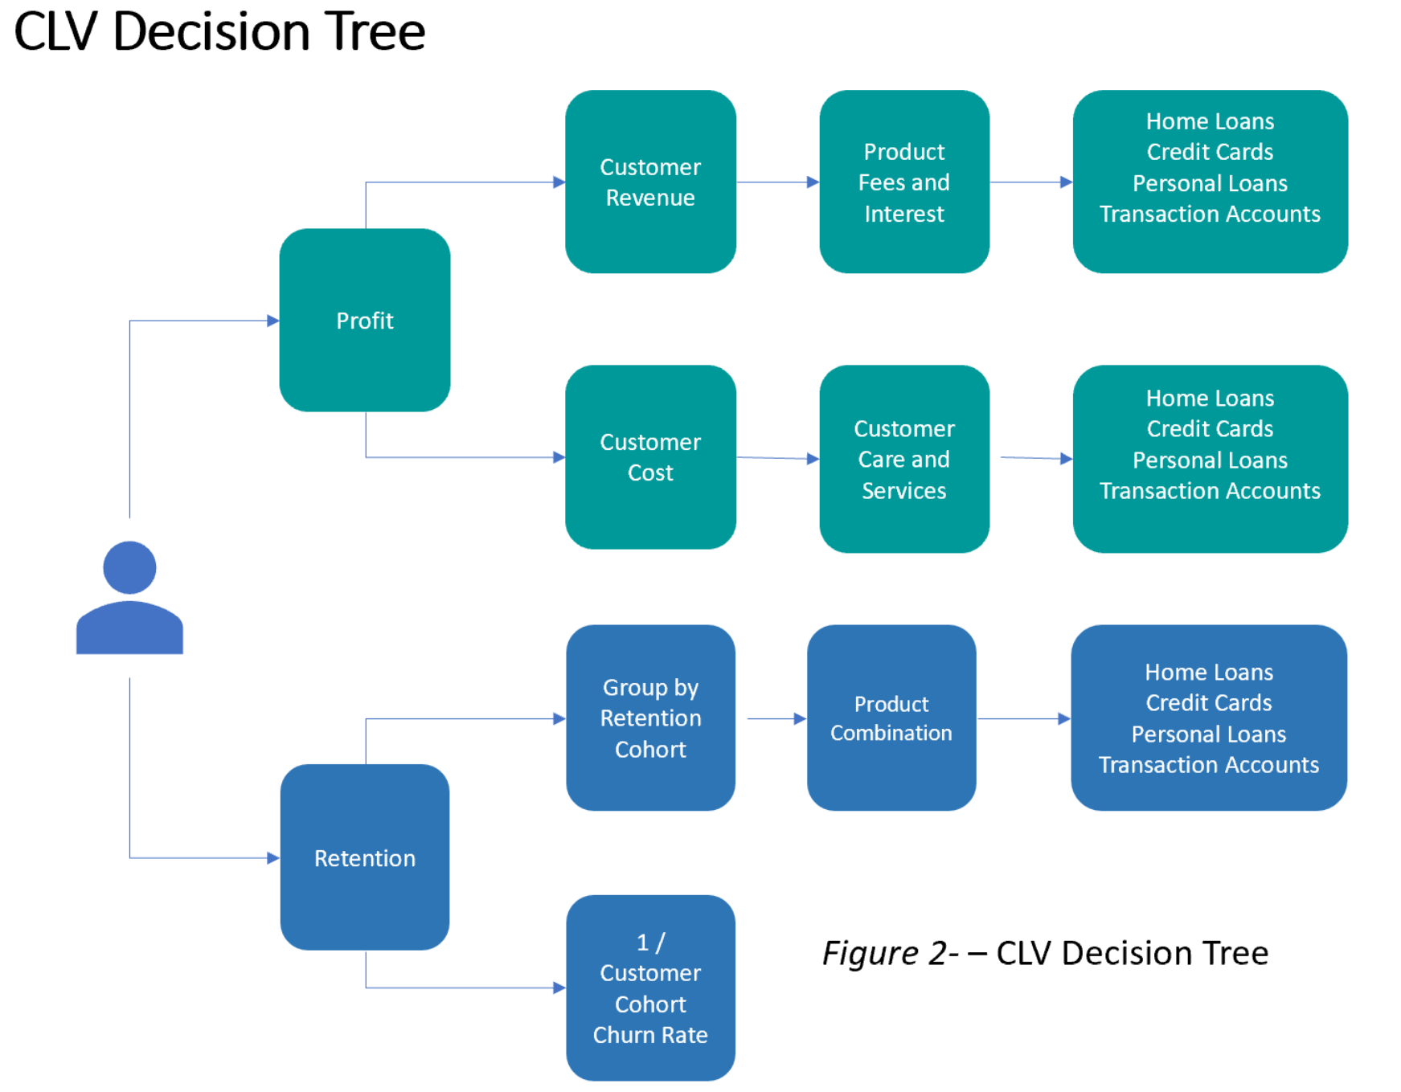
CLV methodology

Slide 9
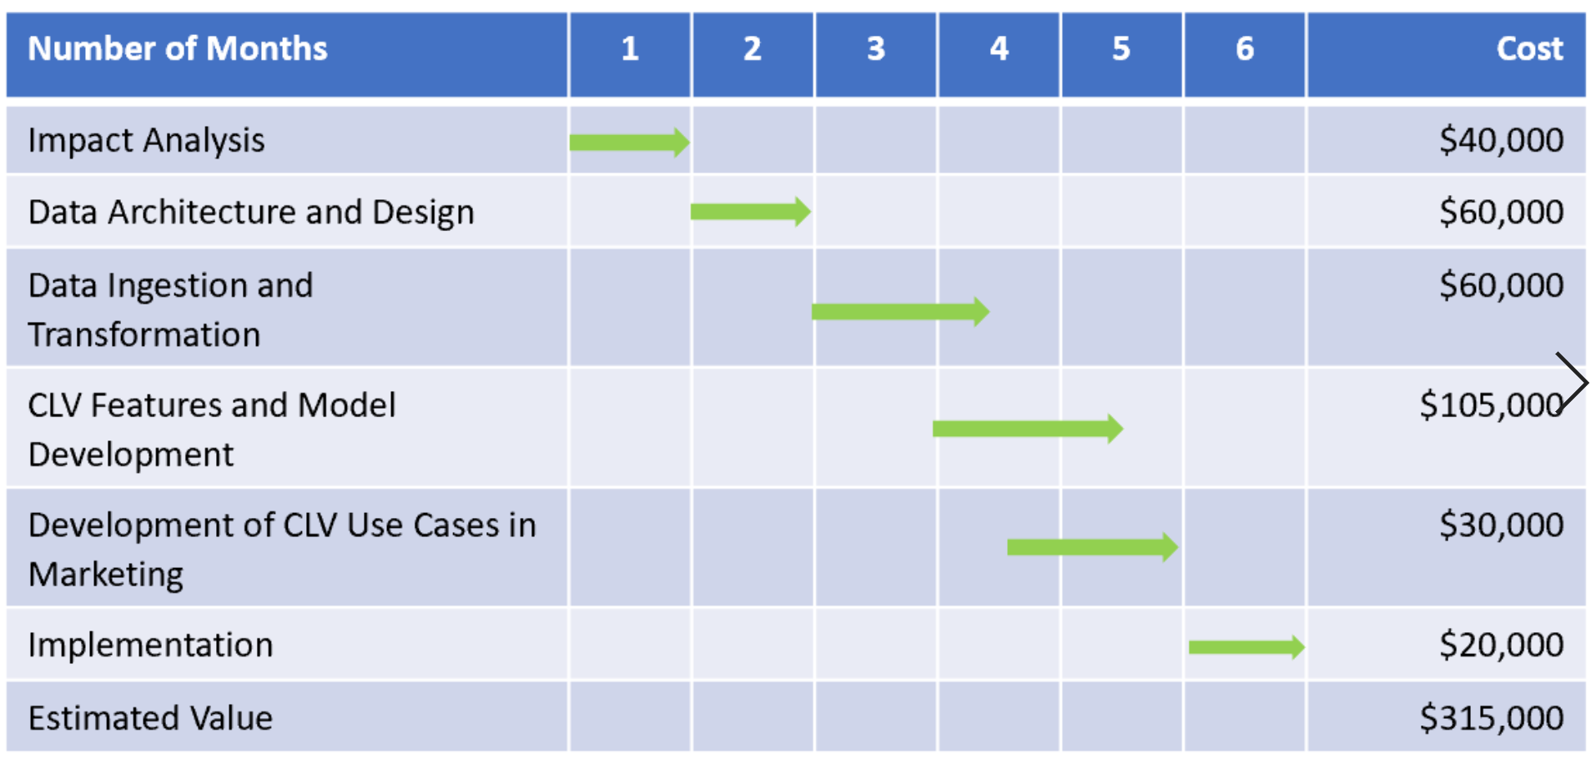
Budget and timeline

