Slide 1

Python Libraries
--make coding more convenient

Slide 2
Table of Contents
Numpy: operations of matrices and vectors
Pandas: data loading & processing
Matplotlib: data visualization

Slide 3
Numpy

Slide 4

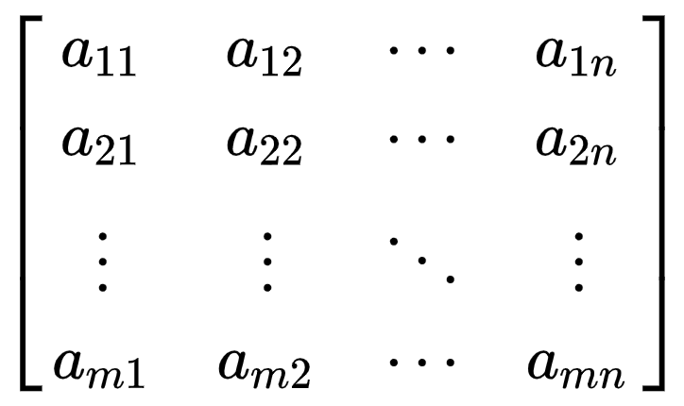
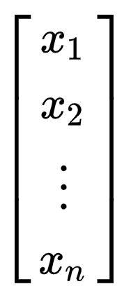
Vectors & Matrices
Vector:
Matrix:
one row or one column
with rows and columns
vec_x = np.array([ [1, 2, 3] ])
mat_Y = np.array([ [1,2,3],
[4,5,6],
[7,8,9]] )
vec_x = np.array([ [1],[2],[3] ])

Slide 5
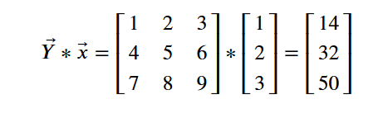
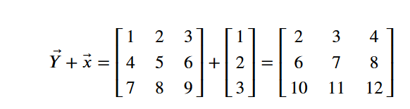
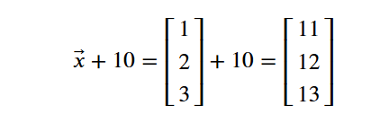
Operations
Multiplication
Element-wise number operators
Transpose
Broadcasting
np.dot(mat_Y, vec_x)
vec_x.transpose()
mat_Y + vec_x
vec_x + 10

Slide 6
Pandas

Slide 7
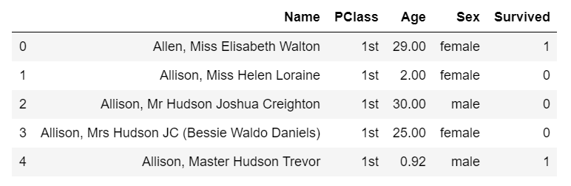
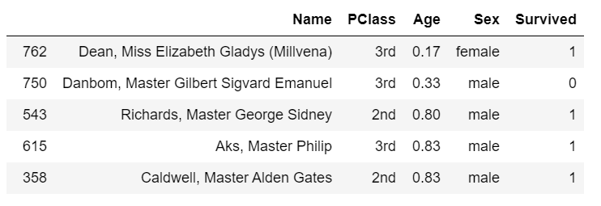
Pandas attributes
Preview of data
Drop missing values
Sorting
Data Selection
data.head()
data.trail()
data.sort_values(by='Age', ascending=True)
data = data.dropna()
data[0:3]
data['Name']
data.iloc[2:5, 0:3]

Slide 8
Matplotlib

Slide 9
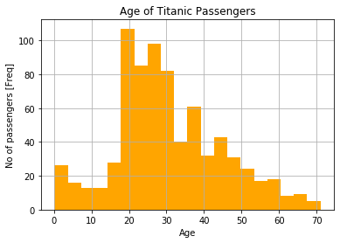
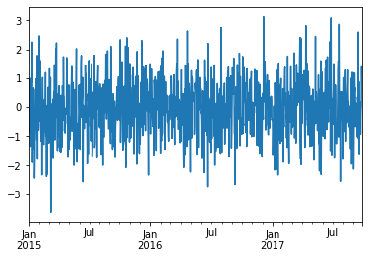
Matplotlib.pyplt attributes
Plot line graph
Plot bar graph
s_cum.plot()
data['Age'].hist(bins=20, color = 'orange')

Slide 10
THANKS!

