Slide 1
Severe Weather Dashboard
Mike DeBaker
Sean Leftwich

Slide 2
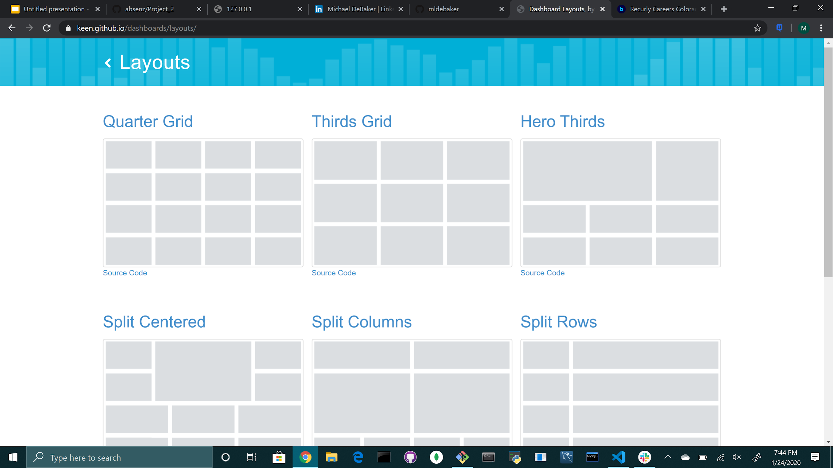
Keen Layouts

Slide 3
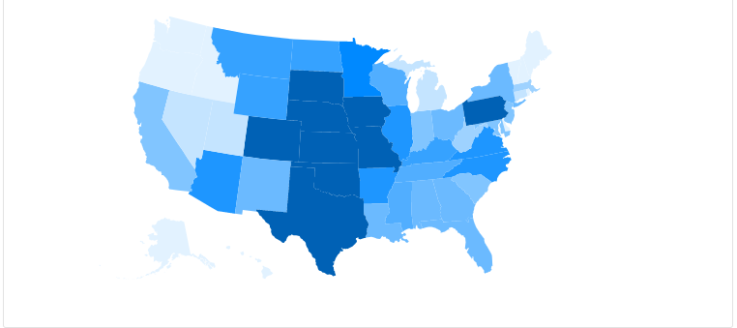
Choropleth

Slide 4
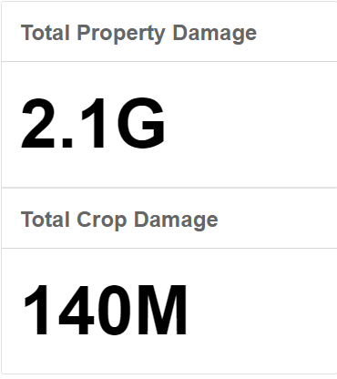
Total Property & Crop Damage

Slide 5
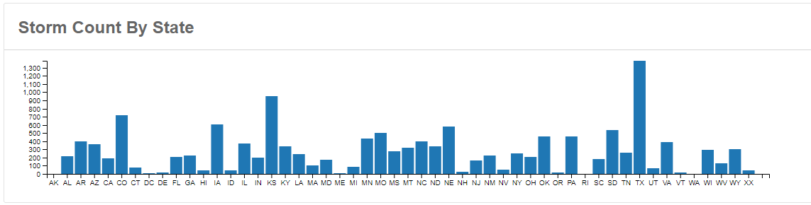
Bar Chart

Slide 6
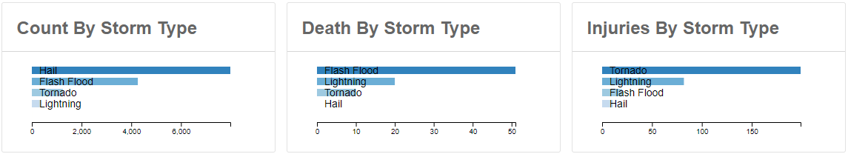
Storm Type Data

Slide 7
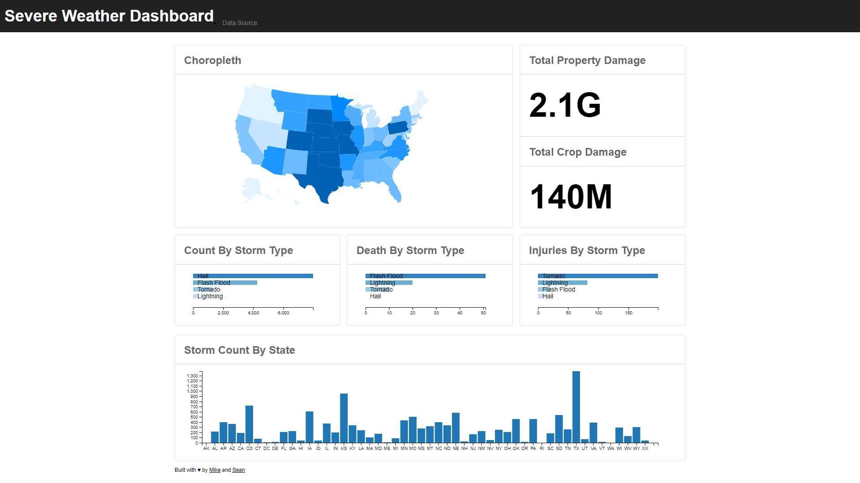
Severe Weather Dashboard

