Slide 1
Clarifying the amino-acid sequence of coding VNTRs
Sara Rahiminejad
Milad Mortazavi
CSE 280A

Slide 2
Data Simulation
VNTR chosen:
Build RU=4 and RU=6 by modifying chr21.fa
Obtain reads from ART with these two RU counts
Mix the two type reads
Map the reads to hg19 and generate SAM files with bwa
Generate BAM files with samtools
Chromosome | Start | End | VNTR-id | Gene | Motif | Def RU
ch21 | 45196323 | 45196359 | 301645 | CSTB | GCGCGGGGCGGG | 3

Slide 3
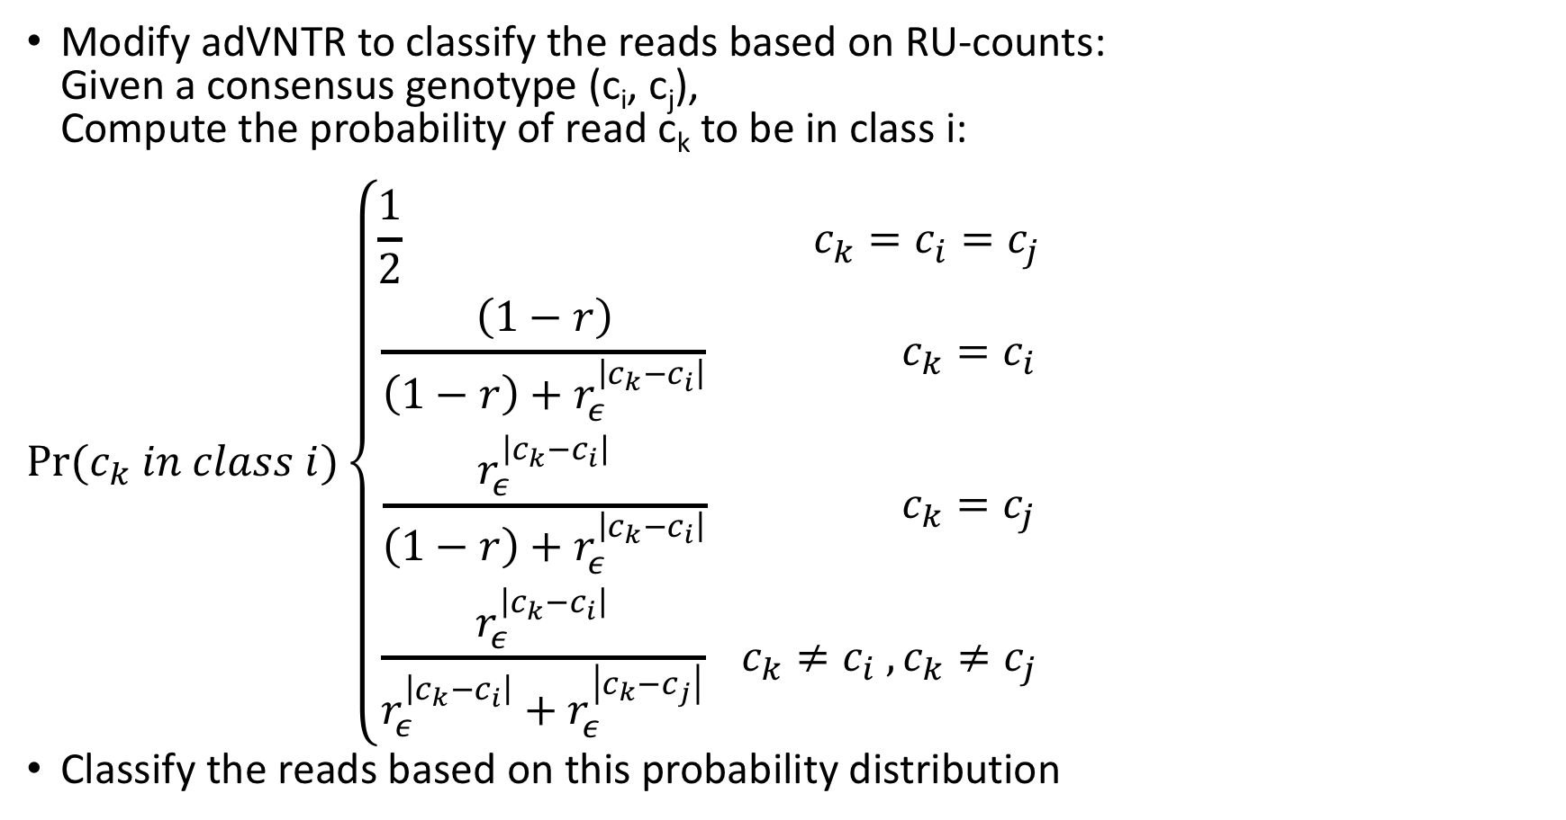
Using adVNTR to Detect RU-counts and Classify
Modify adVNTR to classify the reads based on RU-counts: Given a consensus genotype (c_{i}, c_{j}), Compute the probability of read c_{k} to be in class i:
$$Pr⁡(c_{k} in class i)\left\{\begin{aligned}{{\frac{1}{2} c}_{k}=c}_{i}=c_{j} \\ \frac{\left(1−r\right)}{\left(1−r\right)+r_{ε}^{\left|c_{k}−c_{i}\right|}} c_{k}=c_{i} \\ {\frac{r_{ε}^{\left|c_{k}−c_{i}\right|}}{\left(1−r\right)+r_{ε}^{\left|c_{k}−c_{i}\right|}} c}_{k}=c_{j} \\ {\frac{r_{ε}^{\left|c_{k}−c_{i}\right|}}{r_{ε}^{\left|c_{k}−c_{i}\right|}+r_{ε}^{\left|c_{k}−c_{j}\right|}} c}_{k}≠c_{i} , c_{k}≠c_{j}\end{aligned}\right.$$
Classify the reads based on this probability distribution

Slide 4
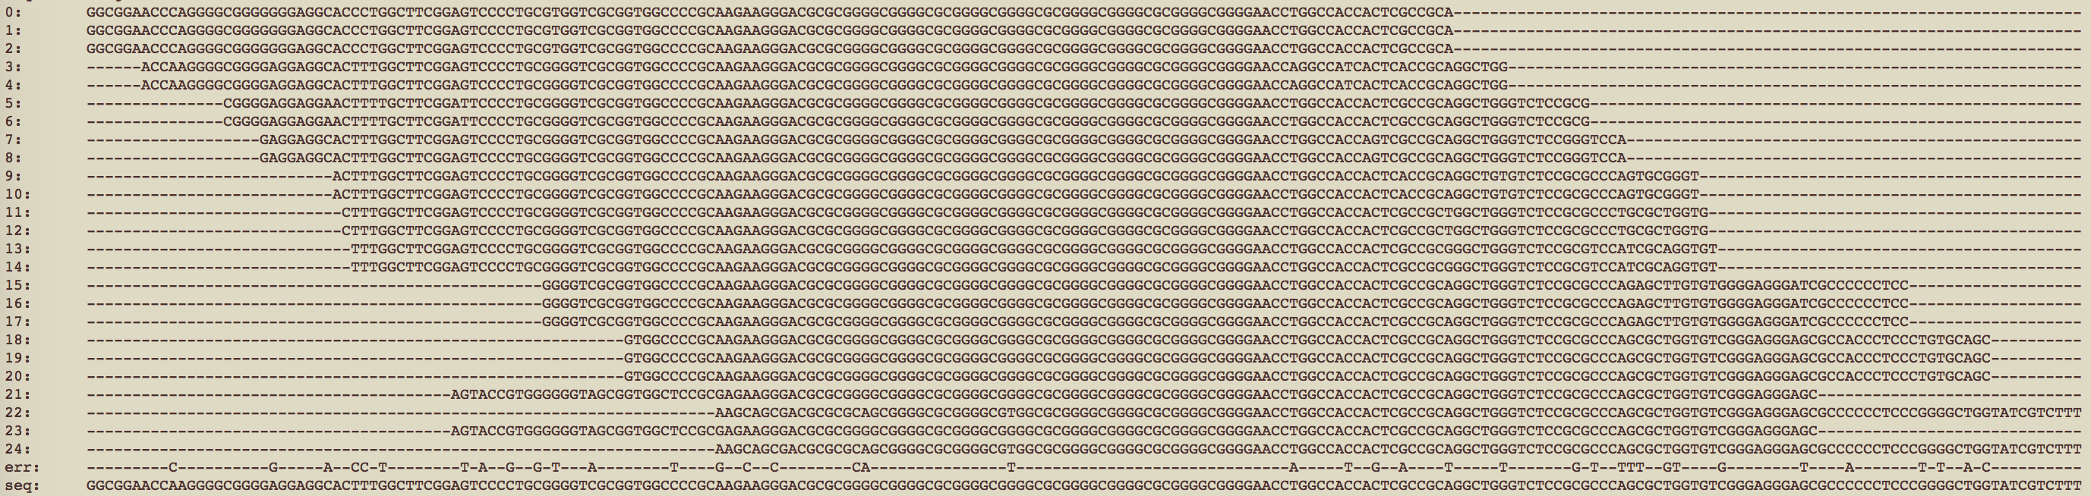
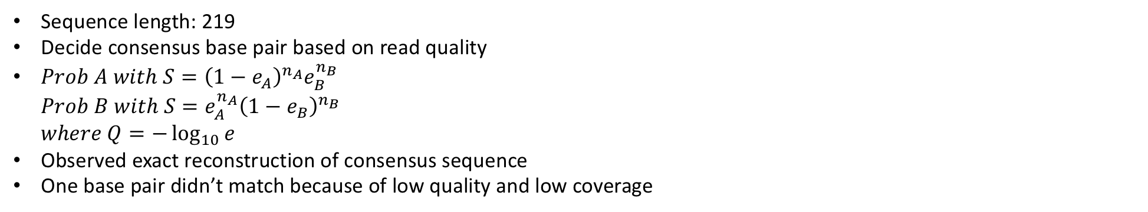
Alignment of Multiple Reads
Sequence length: 219
Decide consensus base pair based on read quality
$Prob A with S={\left(1−e_{A}\right)}^{n_{A}}e_{B}^{n_{B}}$ $Prob B with S={e_{A}^{n_{A}}\left(1−e_{B}\right)}^{n_{B}}$ $where Q=−\log_{10}{e}$
Observed exact reconstruction of consensus sequence
One base pair didn’t match because of low quality and low coverage

Slide 5
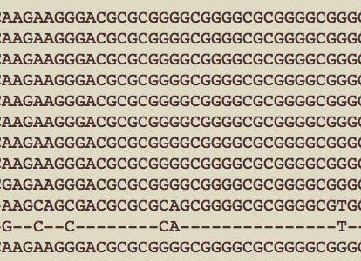
Distinguish Mutations from Sequence Errors
Sequence errors are low quality reads and will be eliminated

Slide 6
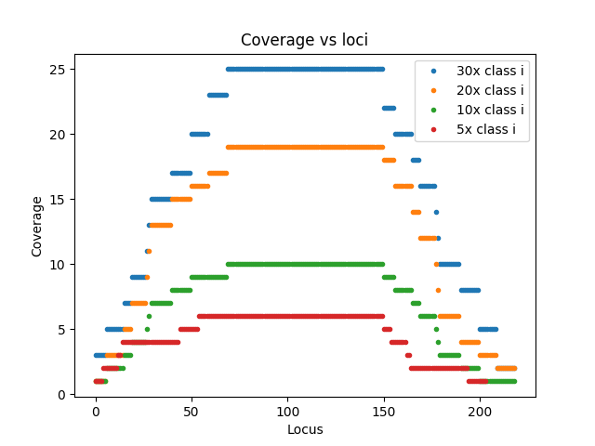
Coverage Variation along Sequence

Slide 7
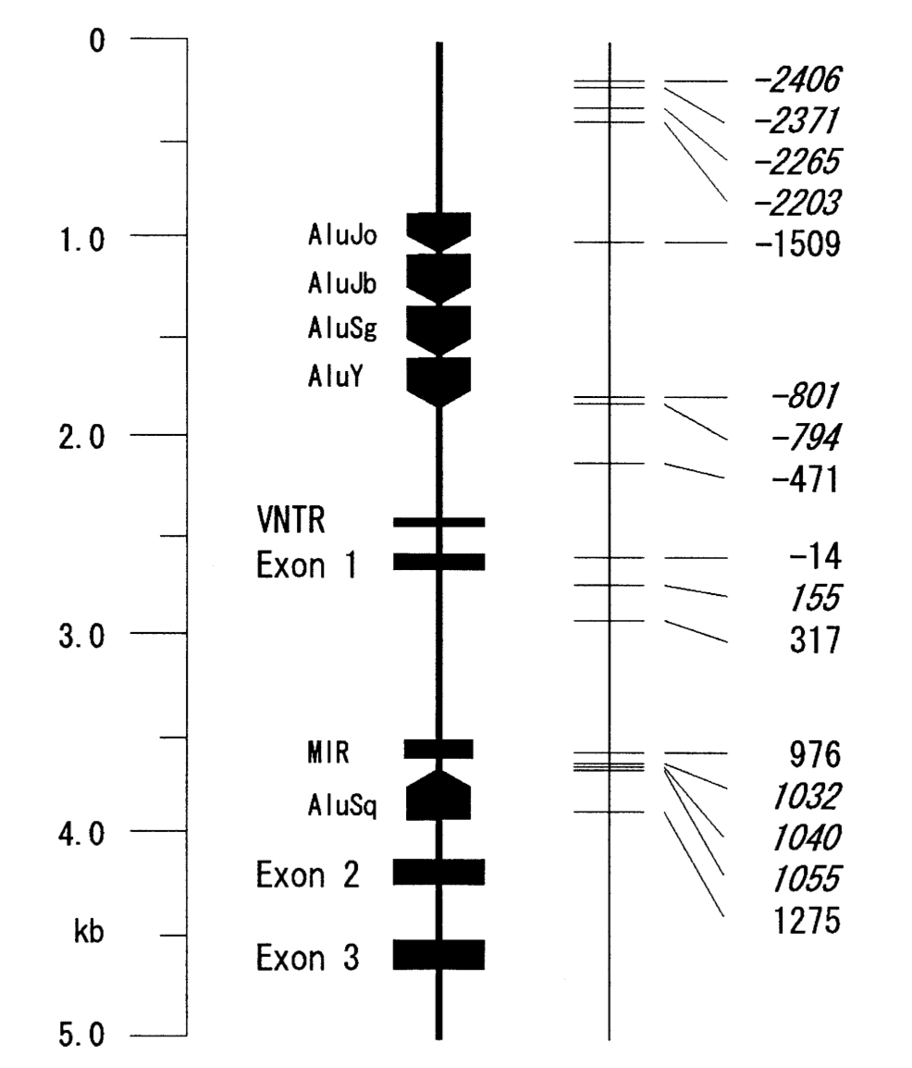
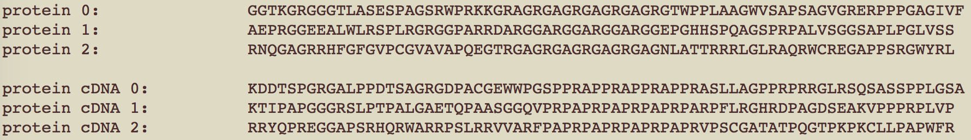
Relation to CSTB Gene

Slide 8
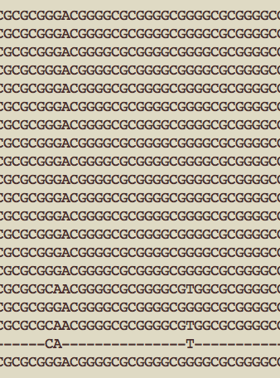
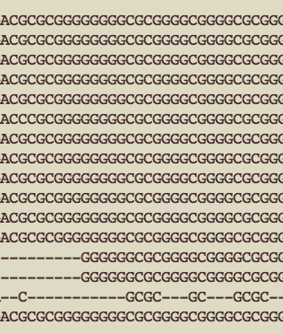
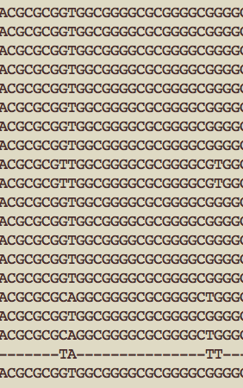
Indel Detection vs Sequencing Errors
Switch
Delete
Insert
12 bp
12 bp
13 bp
12 bp
11 bp
12 bp

Slide 9
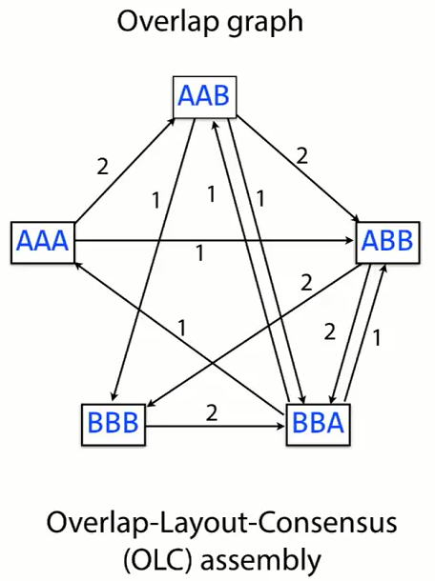
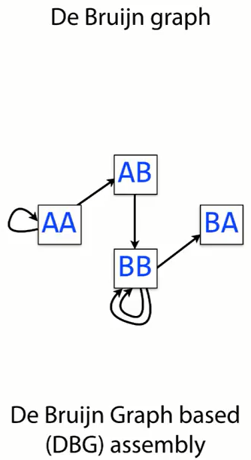
Two Approaches to Short Read Assembly:
Overlap Layout Consensus (OLC) assembly
De Brujin Graph (DBG) assembly:
Constructing k-mer graph from reads (left and right (k-1) mers)
Draw a directed edge from each left (k-1) mer to the corresponding right (k-1) mer
Follow the path in the graph to assemble

Slide 10
Using SPAdes for Assembly
Coverage: 10x | k mer size: 21 | k mer size: 33 | k mer size: 55 | k mer size: 77
Class i: 5 samples | Failed | Failed | Failed | Failed
Class j: 3 samples | Failed | Failed | Failed | Failed
Coverage: 20x | k mer size: 21 | k mer size: 33 | k mer size: 55 | k mer size: 77
Class i: 10 samples | Failed | Failed | Failed | Failed
Class j: 8 samples | Failed | Failed | Failed | Failed
Coverage: 30x | k mer size: 21 | k mer size: 33 | k mer size: 55 | k mer size: 63
Class i: 12 samples | Failed | Failed | Successful
Class j: 16 samples | Failed | Failed | Failed | Successful
Failed: giving no results or giving assemblies that do not cover the VNTRs.
Successful: giving an assembly with a reasonable size and having the exact size VNTR

Slide 11
Difficulties with Using SPAdes
Low coverage of the region of VNTR
Non-uniform coverage: more coverage in the VNTR region discarding flanking reads
Nominal coverage | Actual mean coverage Class J
10X | ~ 2X
20X | ~ 5X
30X | ~ 10X

Slide 12
Further Steps
Find consensus DNA sequence near the VNTR region
Distinguish between mutation and sequencing errors
Study sensitivity of method to indel/mutation
Translate consensus DNA and sensitivity of resulting protein to indel/mutation
Compare performance of SPAdes and multiple-alignment methods

