Slide 1
Created Using R!
This is an example file creating using the Modern Swiss template by Nancy Duarte
Generated 04 March 2019
Created by Do-Artie

Slide 2
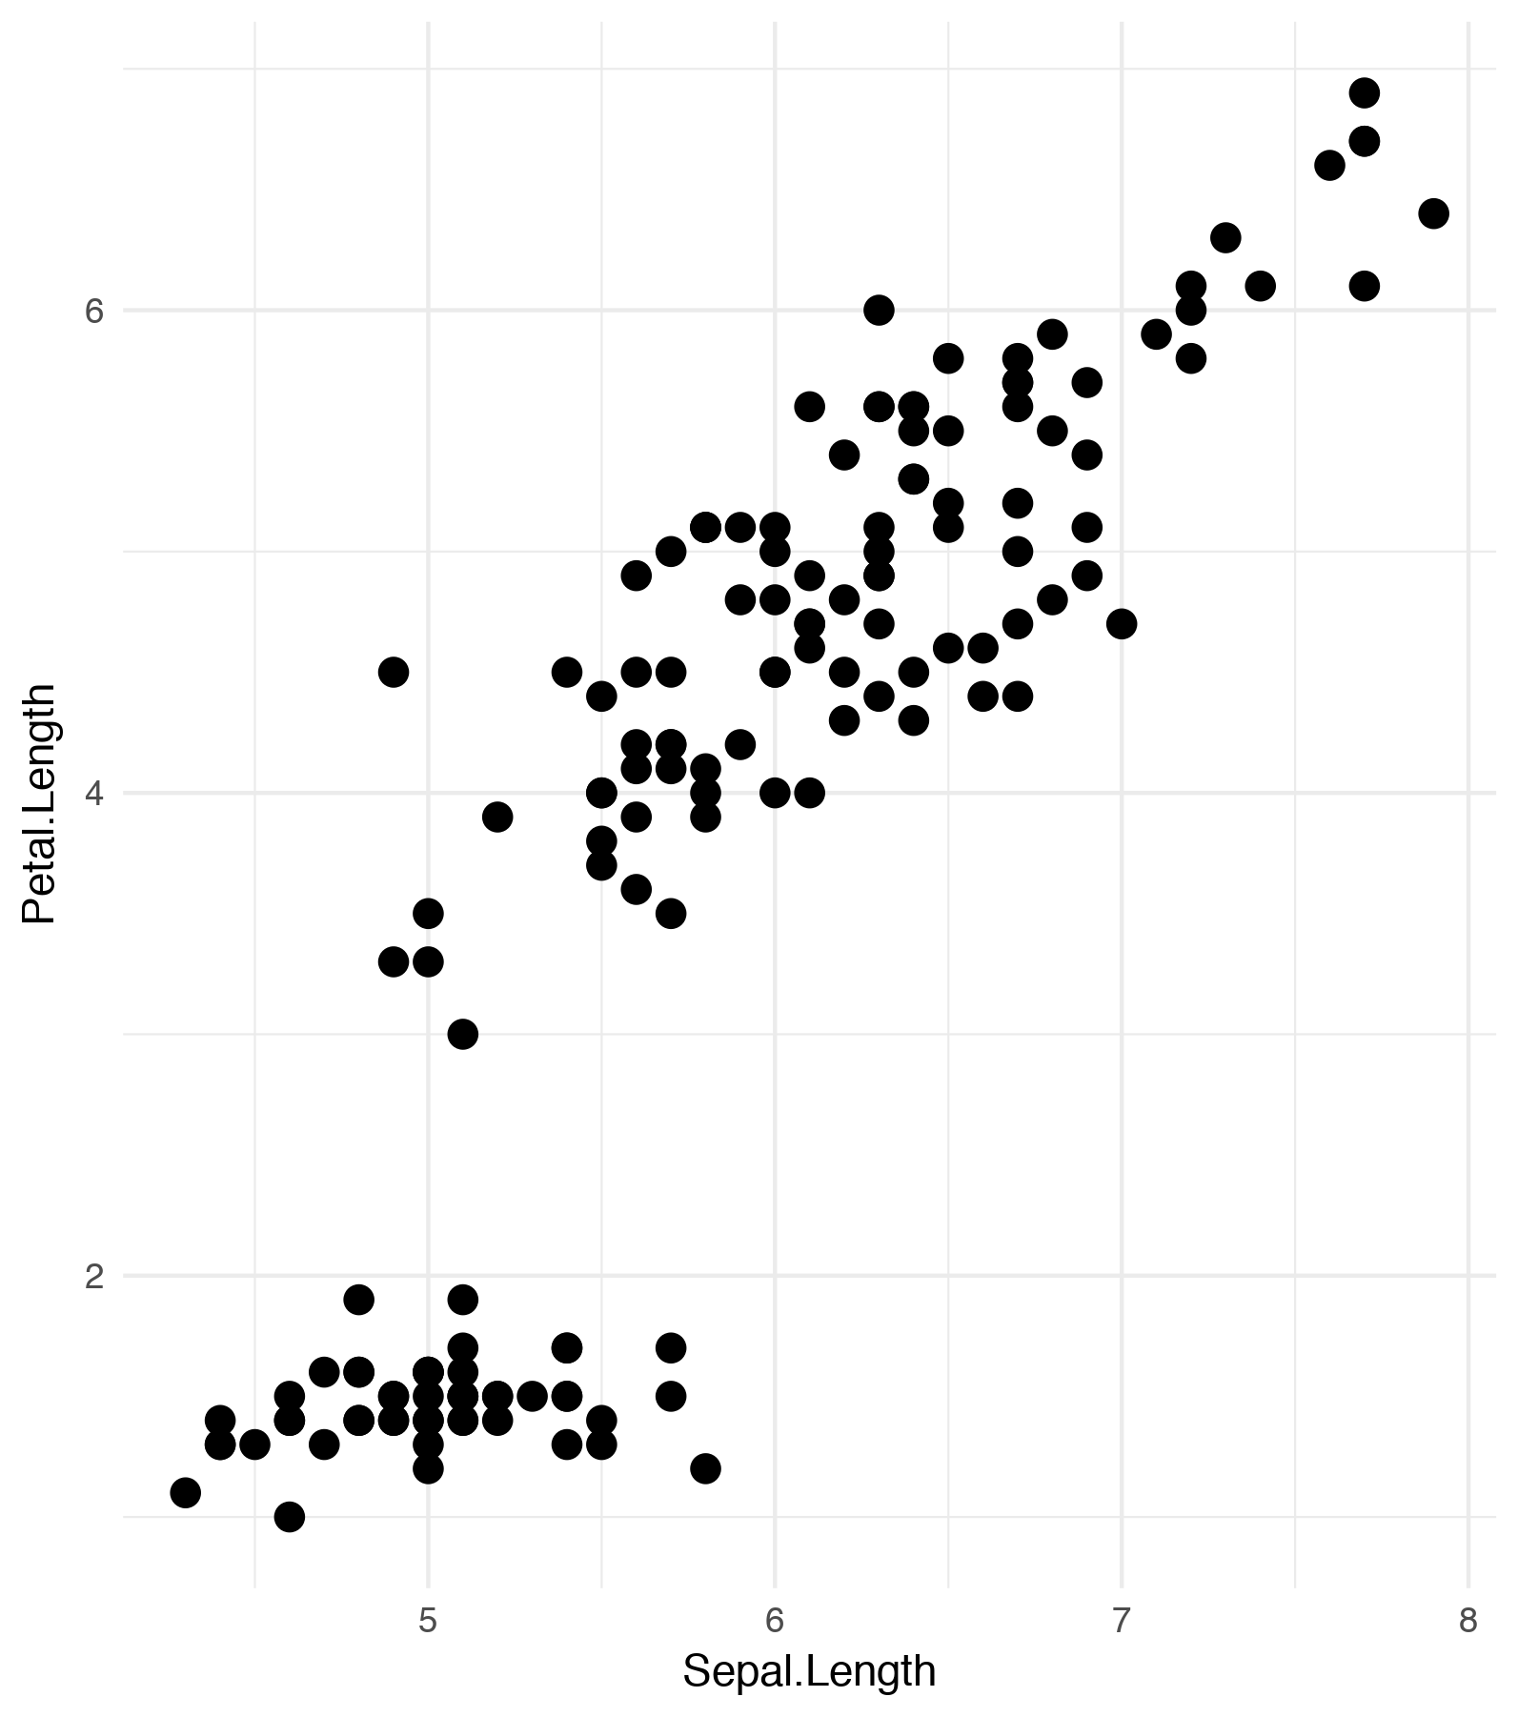
Bullet points and charts
Steps
Get Label Index
Use ph_with_ul

Slide 3
Formatted tables
Sepal |  | Petal |  | Species
Length | Width | Length | Width | Species
5.10 | 3.5000 | 1.400 | 0.200 | setosa
4.90 | 3.0000 | 1.400 | 0.200 | setosa
4.70 | 3.2000 | 1.300 | 0.200 | setosa
4.60 | 3.1000 | 1.500 | 0.200 | setosa
5.00 | 3.6000 | 1.400 | 0.200 | setosa
5.40 | 3.9000 | 1.700 | 0.400 | setosa

