Slide 1




SEALAB : Drone + Trailer
By:
Bastien Bessou, Noël Bouenk-abeso, Tom-loup Tisseur, Mayeul Le Moniès de Sagazan, Noé Decombas, Bouabdellah Khadar, Erwan Prevost, Martin Zoberman
De la classe de TSTI2D du lycée Charles Renouvier de Prades

Slide 2
Summary
The teams
The project
Specifications
Project evolution
The components
SIN part

Slide 3
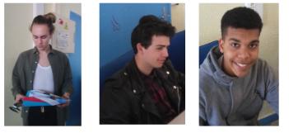


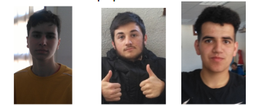
The teams
Drone team
ITEC
SIN
Trailer
team
ITEC

Slide 4
The project
Collect a water sample and make several temperature readings at specific GPS points dynamically defined by scientists.
To answer this problem, we decided to make a marine drone with a trailer.

Slide 5
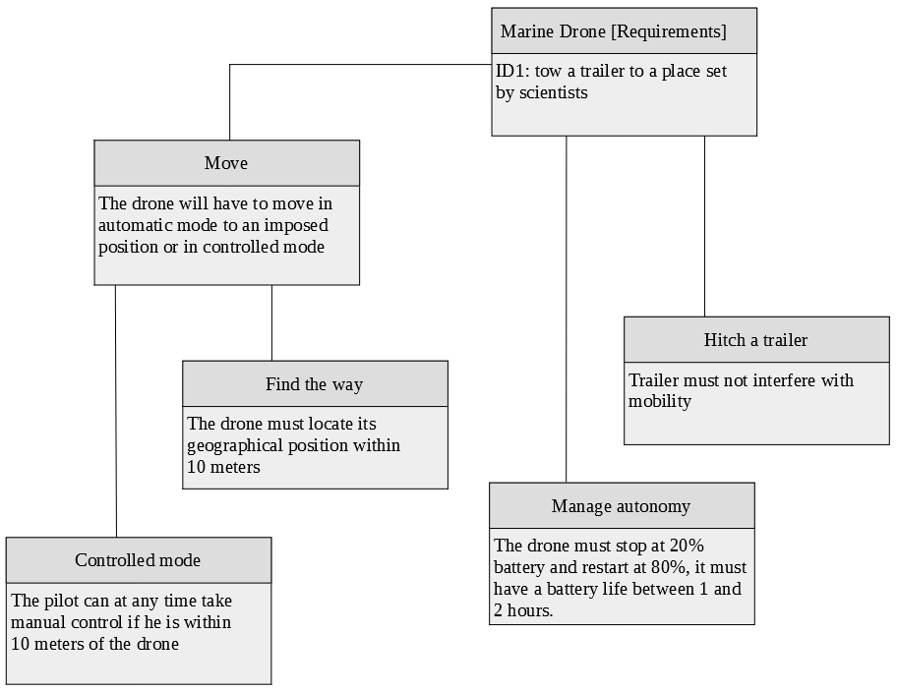
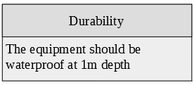

Requirements : diagram
5

Slide 6
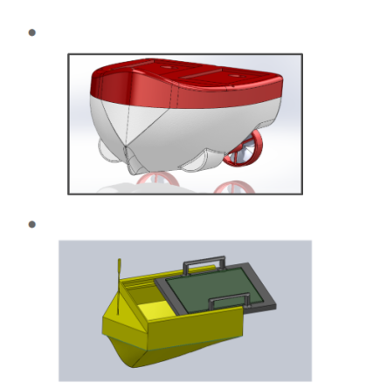

Project evolution : the ideas
The drone: propulsion / control
Project in 2 parts :
The trailer: analysis / sensors

Slide 7
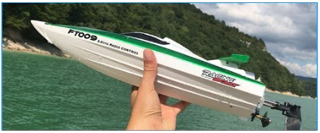
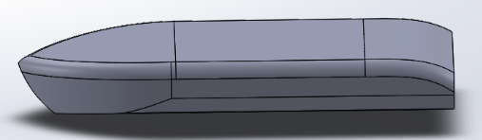
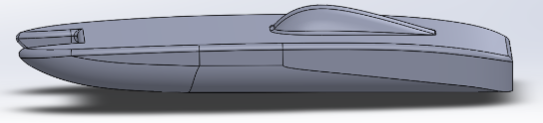
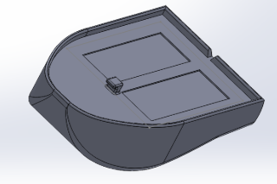
Project evolution : The drone (1)
Inspiration and first model

Slide 8
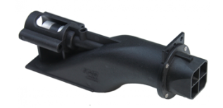
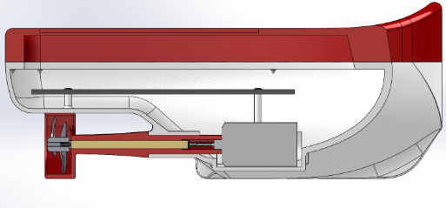

Project evolution : The drone (2)
Jet turbine drone
Propeller Drone
Choix de la technologie de propulsion

Slide 9
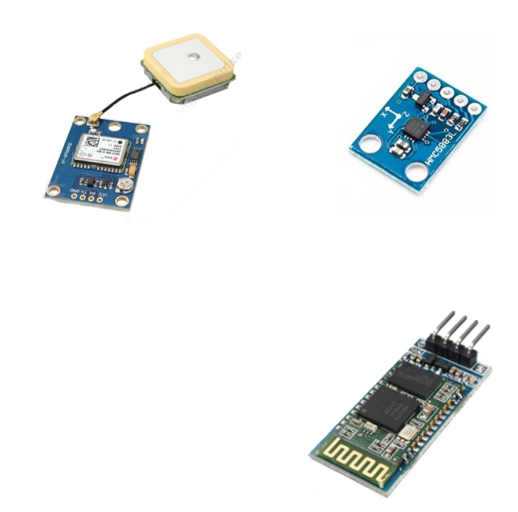
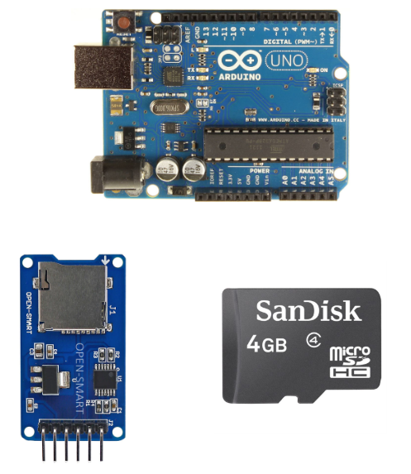
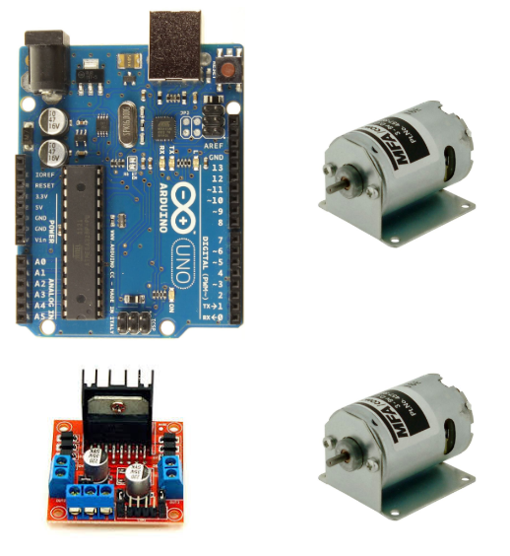
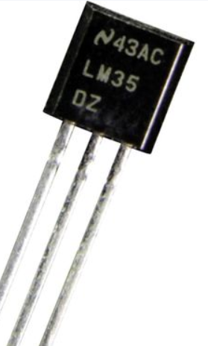
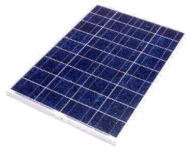
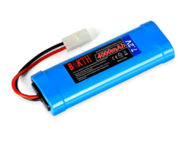
The components
Drone
Trailer

Slide 10
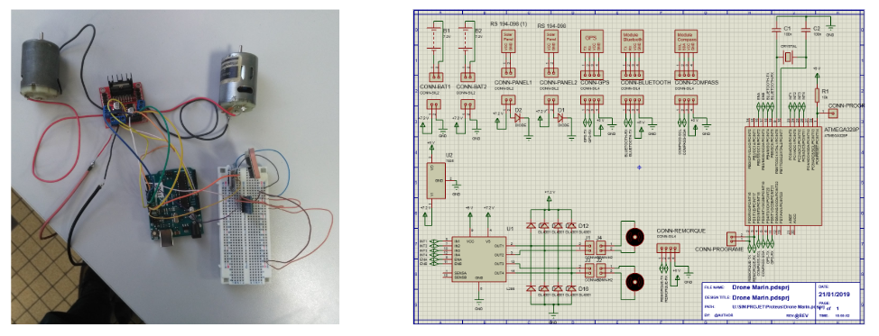
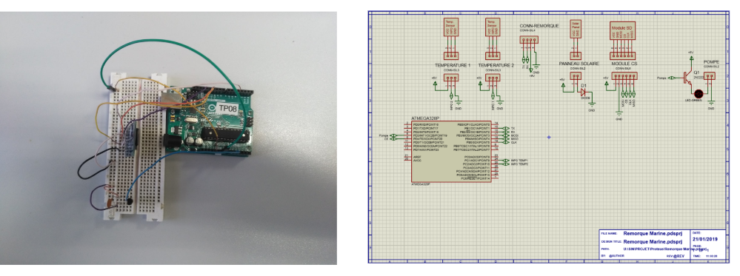
SIN part: electronic circuits
Drone
Trailer

Slide 11
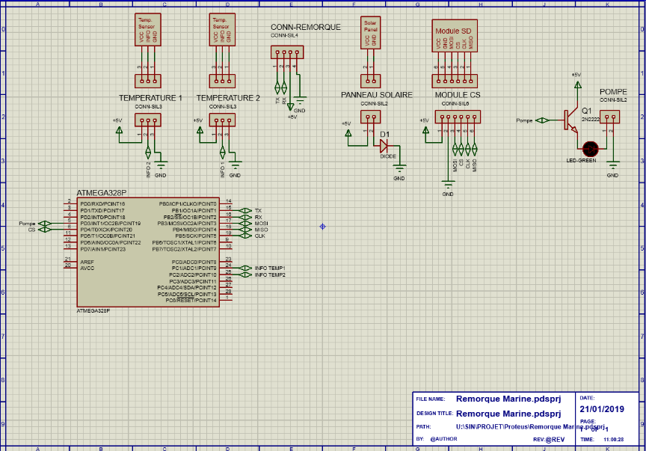
SIN part: Zoom on one of the proteus sketchs

Slide 12
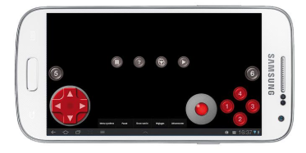
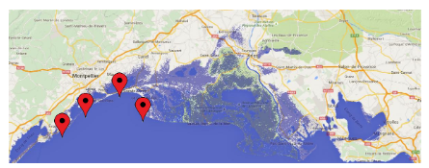
SIN part: Mobile app
2 way to use the drone with the mobile application:
Manual mode
Autonomous mode

Slide 13
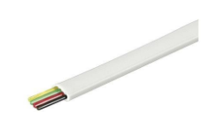
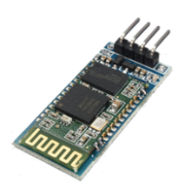
SIN part: communication technologies
Wired Drone / buoy communication
Bluetooth Smartphone / drone communication

Slide 14
SIN part: my part
To understand the technologies
→ create small arduino files
→ merge then
Bluetooth
module
Reading
SD card
Use
pump
Compass
Trailer
code
Drone
code
Automous
mode
logic
Writing
SD card
Temperature
Sensor
GPS
General
controller
General
controller
Arduino Code

Slide 15
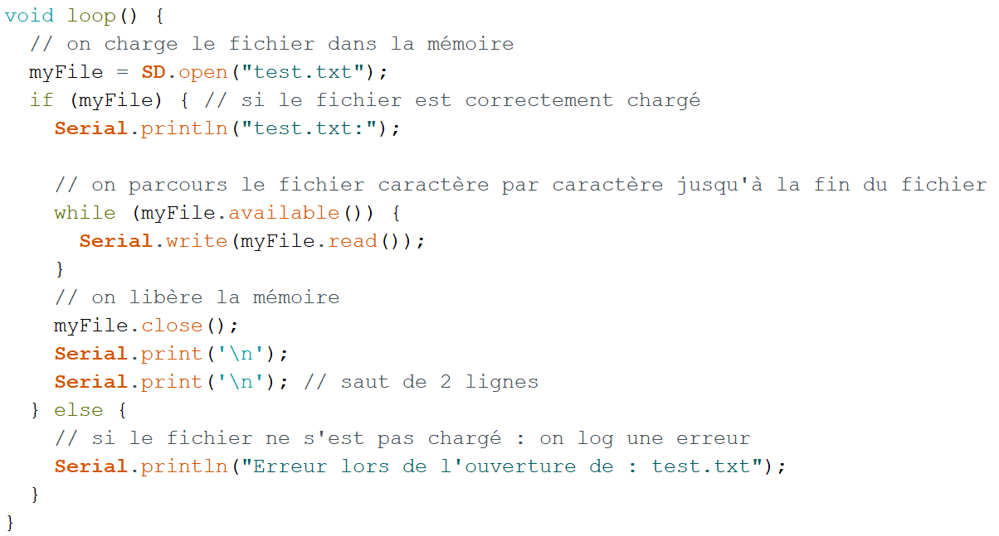
SIN part: my part → example
SD card reading code

Slide 16
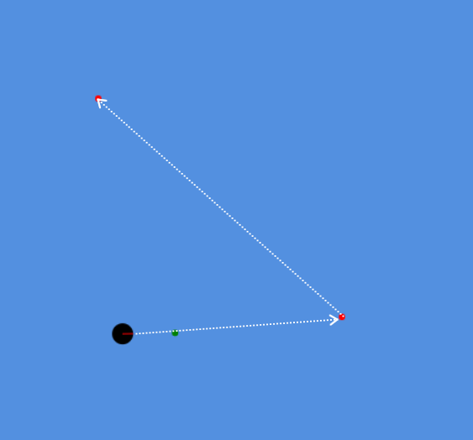
SIN part: my part → simulation
https://renouv.art/simulation

