Slide 1
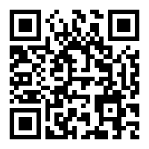
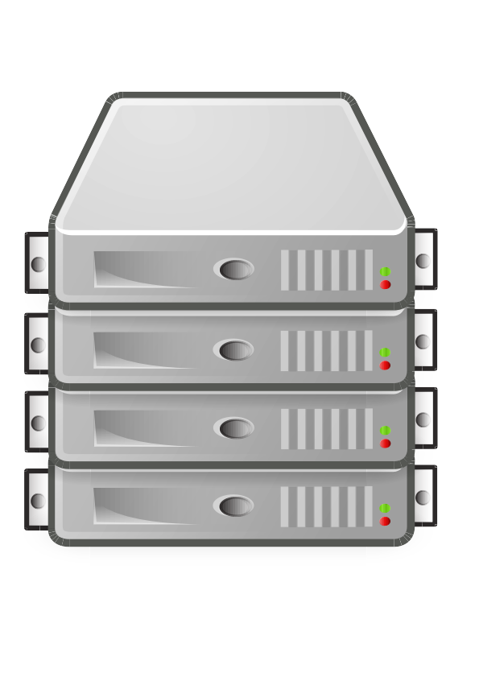
Manage interactions. Process QRCodes
Acquire QRCode
Phone
Cam
Provide required pages and contents. Receive JSON data from filled forms
Activity
HTML5
display
and
interactions
Database manager
External
servers
SQLite
Manage offline data, data fetching, URL interveption
Files
Hybrid storage. Big contents mist be stored as files.
Display contents. Allow recovery of entered data.

Slide 2
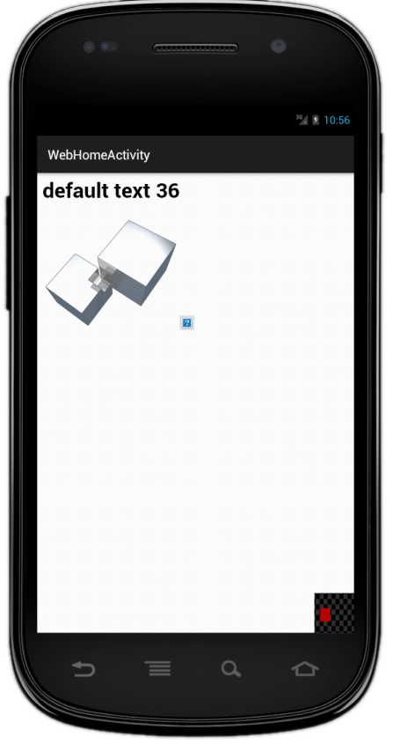
Single GUI interface (except settings)
HTML5 Content with customized capabilities
QRCode capture preview

