Slide 1
PulSonify
sounds to the tempo of your heartbeat:
an iPhone / Apple Watch app
Marissa Le Coz
MUS 103 Final Presentation
March 13, 2018

Slide 2
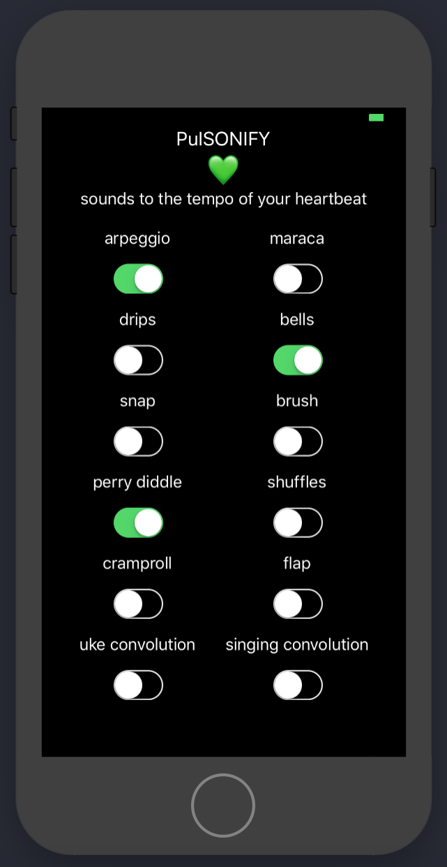
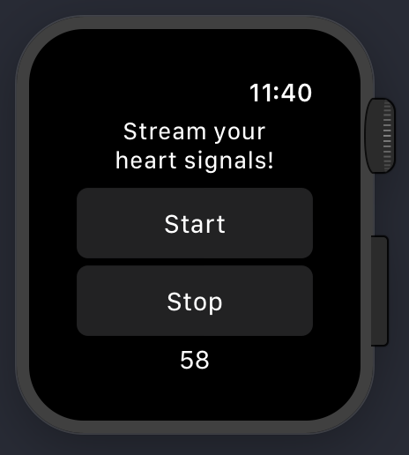
The Concept
The user toggles sounds that play at a rate proportional to the user’s heartbeat, as read by their Apple Watch.

Slide 3
The Concept
Conscious control
User toggles sounds
Unconscious control
User’s heartbeat controls tempo
An interesting tension
Audio feedback impacts both conscious and unconscious means of control

Slide 4
The Concept
The app is a sort of instrument, and the user is a sort of artist.

Slide 5
The Sounds
Repeating C-Major Arpeggio (generated by AudioKit) that changes notes on each heartbeat
Maraca sound (generated by AudioKit), played on every heartbeat
Bell sound (generated by AudioKit), played on every 3rd heartbeat
Plays a series of water dripping sounds (generated by AudioKit) on every other heartbeat
A recording of me making brushing sounds against the wood floor with my metal tap, played every 3rd heartbeat
A recording of me snapping, played every 3rd heartbeat
A recording of me doing 2 consecutive shuffles (a tap dance move), played every 5th heartbeat
A recording of me doing a tap dance move (on wood) called a perry diddle, played on every 4th heartbeat
A recording of me doing a tap dance move called a flap, played on every other heartbeat
A recording of me doing a tap dance move called a cramproll, played on every 3rd heartbeat
A recording of me playing the chords C, G, Am, F on the ukulele – clip gets played on every heartbeat (equivalent to convolution because each heartbeat can be thought of as an impulse response of amplitude 1, which, convolved with the sound, is the sound itself)
A recording of me singing the first few words of a Latin hymn called “O Salutaris Hostia”. Also a convolution. Used a Latin song because I thought it’d sound less like garbled speech with the convolution, since I’m not fluent in Latin.

Slide 6
LIVE DEMO
(because I like to live dangerously)

Slide 7

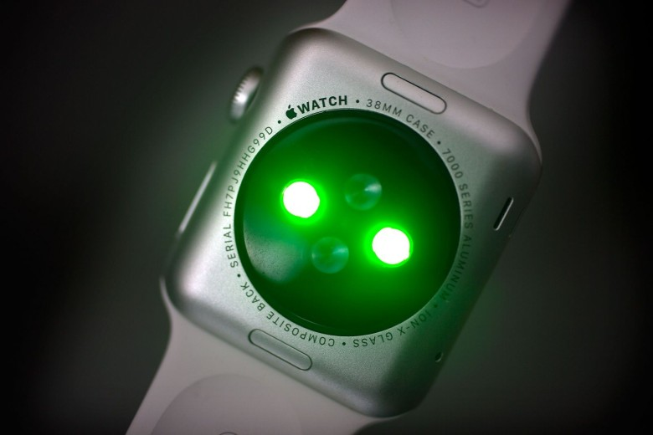
How It Works
CloudKit
PulSonify iPhone App
PulSonify Apple Watch app
Images: https://www.cultofmac.com/449199/apple-watch-use-heart-rate-sensor-id/, https://blog.propellerlabs.co/upgrading-an-ios-app-from-local-storage-to-cloudkit-59f88f02ad59

Slide 8
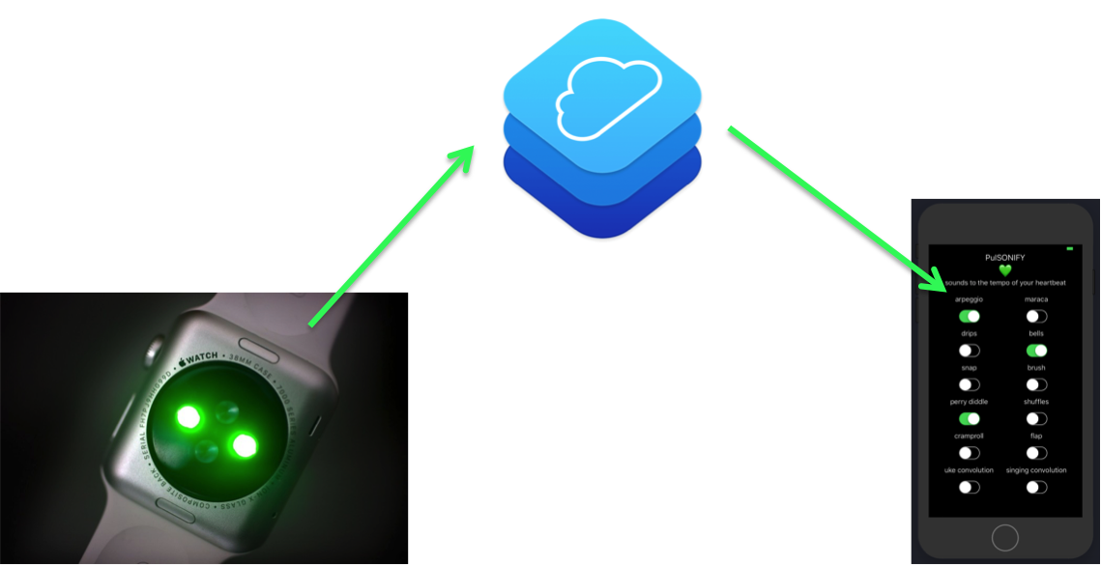
How It Works
Apple Watch PPG sensors
[behind the scenes] Shines green light onto skin and determines blood flow information based on green light absorption. BPM determined from here.
As a developer, you can’t access raw PPG data.
But you can access BPM data.
When the user taps “Start” in the PulSonify Watch app, an “HKWorkoutSession” is initiated, which causes BPM data to be read more frequently by the Watch.
Images: https://www.cultofmac.com/449199/apple-watch-use-heart-rate-sensor-id/, https://blog.propellerlabs.co/upgrading-an-ios-app-from-local-storage-to-cloudkit-59f88f02ad59

Slide 9
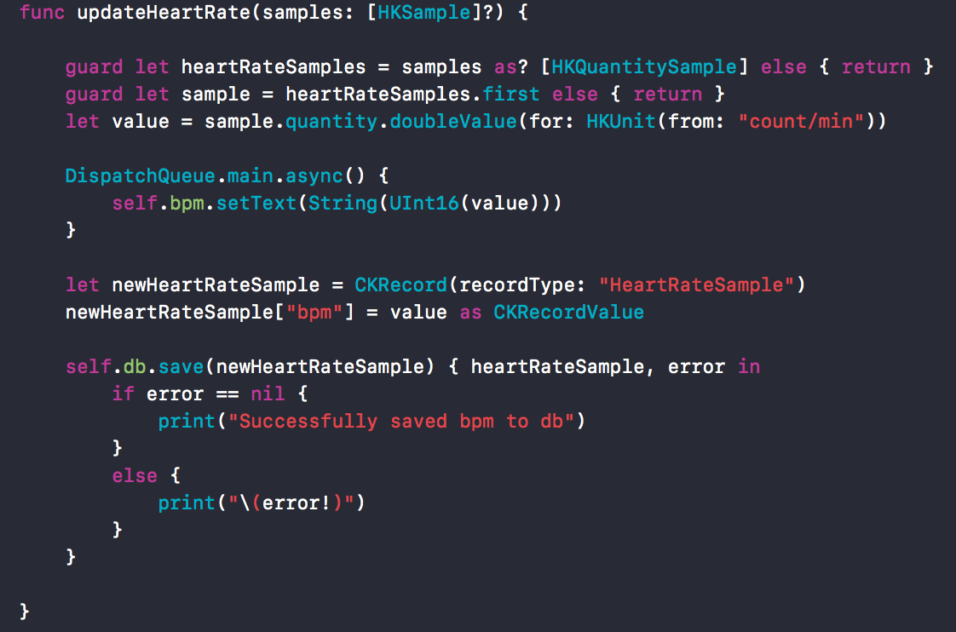
How It Works
Whenever new heart rate data is read by the Apple Watch (which is every couple of seconds), it saves the new sample to PulSonify’s CloudKit database.
CloudKit is Apple’s built-in cloud database for iOS.
Images: https://www.cultofmac.com/449199/apple-watch-use-heart-rate-sensor-id/, https://blog.propellerlabs.co/upgrading-an-ios-app-from-local-storage-to-cloudkit-59f88f02ad59

Slide 10
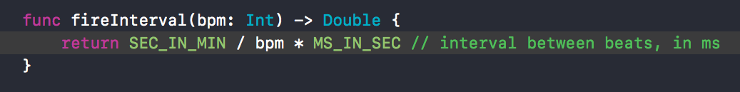
How It Works
Every 1 second, the PulSonify iPhone app polls the CloudKit database to see if any new heart rates have been saved.
Multiple new heart rates => just take the most recent.
BPM measurement is converted to what I call a “fire interval.”
The number of milliseconds between heartbeats.
Round to the nearest 100 ms, for reasons described shortly.
Images: https://www.cultofmac.com/449199/apple-watch-use-heart-rate-sensor-id/, https://blog.propellerlabs.co/upgrading-an-ios-app-from-local-storage-to-cloudkit-59f88f02ad59

Slide 11
How It Works
The PulSonify iPhone app has a Timer that is invoked every 100 ms. The rounded fire interval is a multiple of 100 ms, so the heart beats every x number of Timer invocations, where x is some (positive) whole number.
So, if the rounded fire interval is 700 ms and the user has turned on a sound that should be played on every other heart beat, then the sound should be played on every 14th invocation of the Timer code.
Images: https://www.cultofmac.com/449199/apple-watch-use-heart-rate-sensor-id/, https://blog.propellerlabs.co/upgrading-an-ios-app-from-local-storage-to-cloudkit-59f88f02ad59

Slide 12
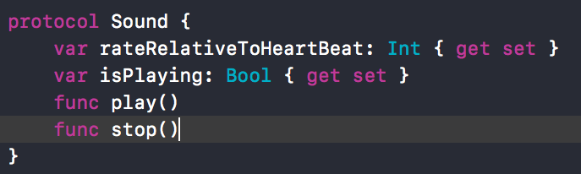
How It Works
Each sound is a class that implements an interface (Swift “protocol”) called Sound...
rateRelativeToHeartBeat = 2 means every other heartbeat
isPlaying = true means the user has turned on that sound’s switch
Images: https://www.cultofmac.com/449199/apple-watch-use-heart-rate-sensor-id/, https://blog.propellerlabs.co/upgrading-an-ios-app-from-local-storage-to-cloudkit-59f88f02ad59

Slide 13
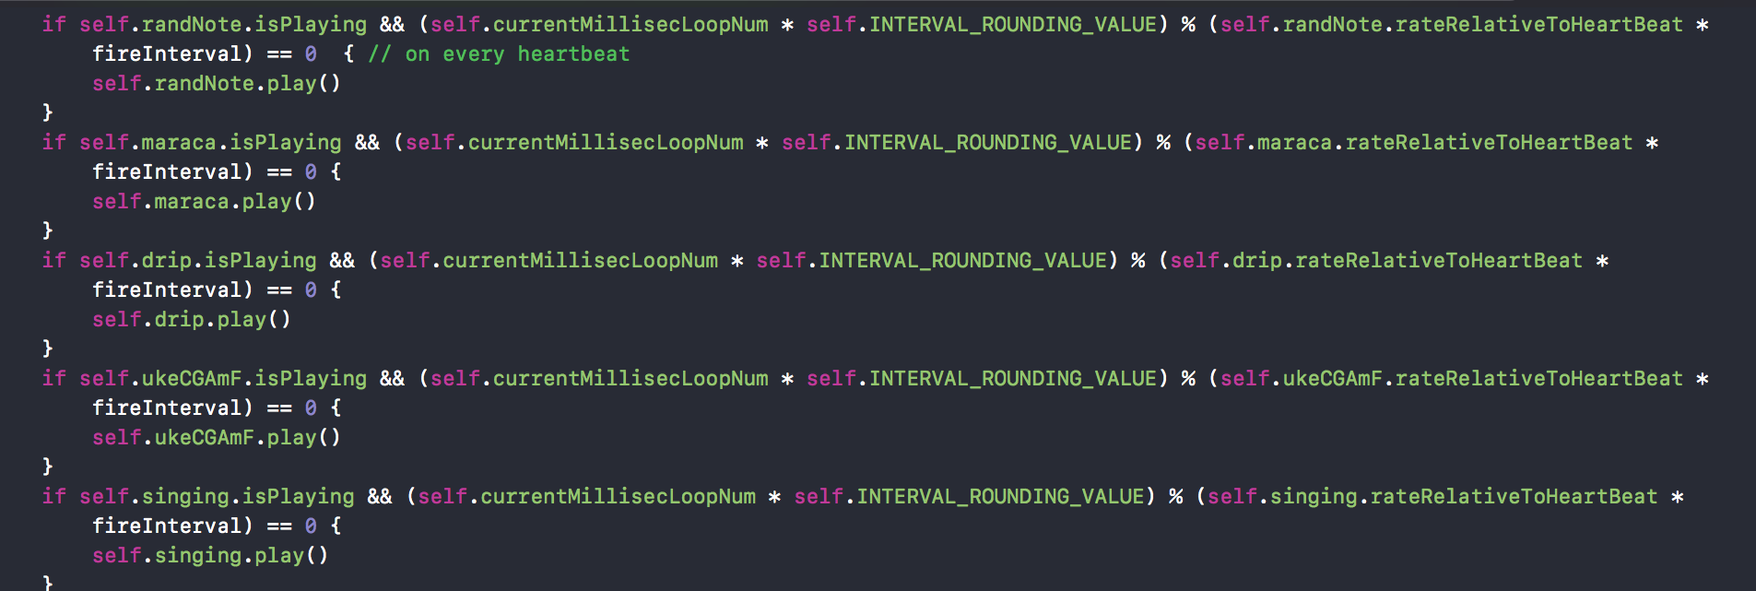
How It Works
…which makes it easy to write/organize the 100 ms timer code block!
(…and so on)
Images: https://www.cultofmac.com/449199/apple-watch-use-heart-rate-sensor-id/, https://blog.propellerlabs.co/upgrading-an-ios-app-from-local-storage-to-cloudkit-59f88f02ad59

Slide 14
QUESTIONS?

