Slide 1
CSE 351 Final Project
Joonyoung Lee (111786158)
Jaekwon Jung (111295850)
Professor. Tripathi

Slide 2
How to deal with missing values?
Drop the column which has too many missing values
Passenger ID, Cabin, Name, Ticket
Fill the missing values
Interpolate the missing values of Age
Fill missing values of Embarked with random values
Fill missing values of Fare with the mean of existing values

Slide 3
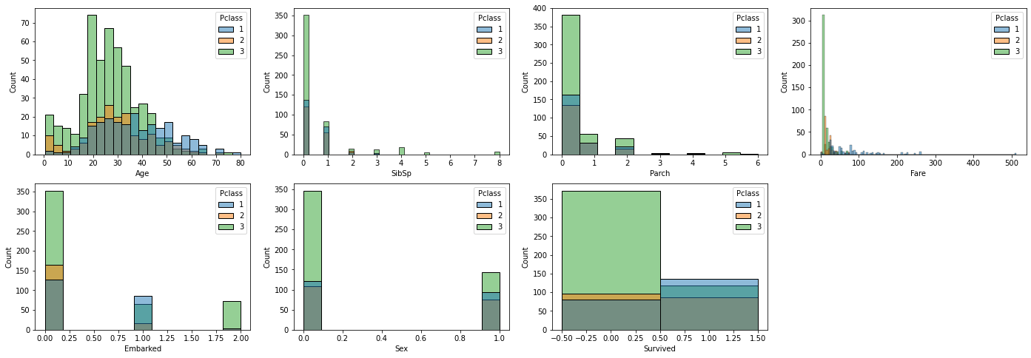
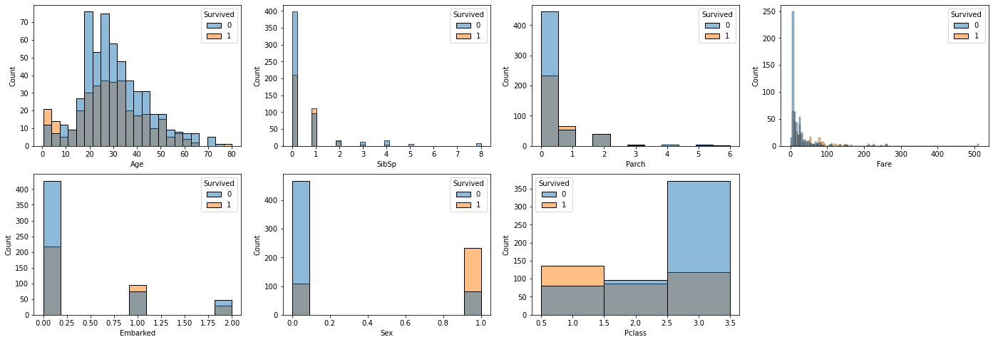
INSTRUCTIONS FOR USE
Plotting each field according to the Pclass Value
To find the relationship between socio-economic status of a person
Distribution of the survival victims in relation to age, gender, Sibsp, Parch, Fare, Embarked, and Plcass

Slide 4
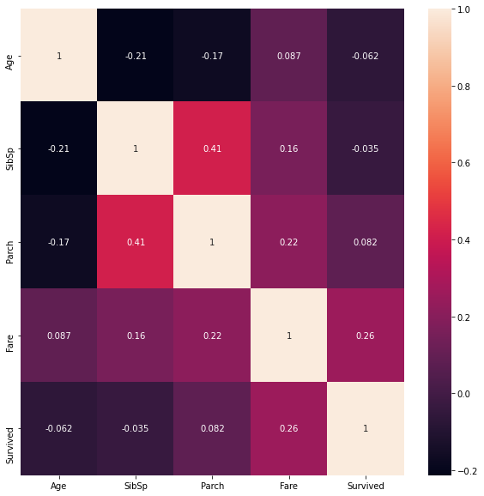
Correlation Matrix
We calculated the
correlation matrix
to check if there are
highly correlated fields.

Slide 5
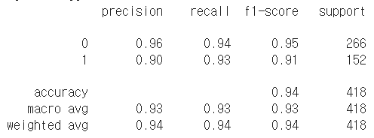
Model 1: Logistic Regression
The advantages of Logistic Regression
Good at handling both qualitative and quantitative variables as independent variables
Good at handling dependent variables with binary class

Slide 6
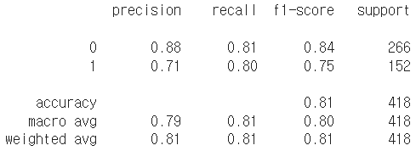
Model 2: Decision Tree
How it works?
It build a tree using the training data. When all the records in each subtree have the same classification label, then the subtree becomes leaf.

Slide 7
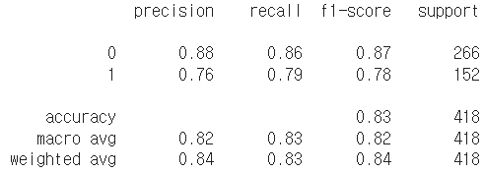
Model 3: Random Forest
How it works?
Random forests are a way of averaging multiple deep decision trees, trained on different parts of the same training set, with the goal of reducing the variance.

Slide 8
Thanks!
ANY QUESTIONS?

