Slide 1
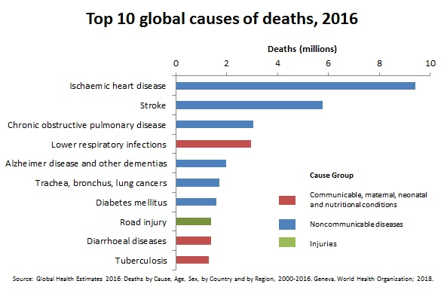
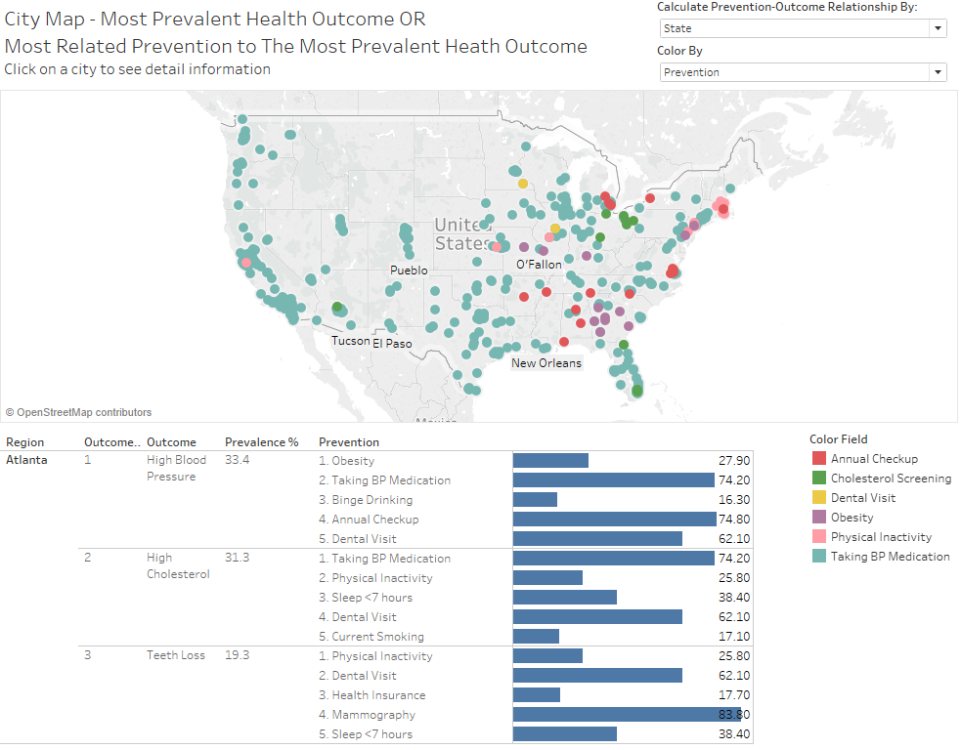
Visualization of relationship between chronic diseases and preventions in 500 US Cities
Bu Qianqian - Myles Lefkovitz - Salim Noorallah Ladak - Tri Nguyen
MOTIVATION
Diseases and health conditions represent 9 of the 10 most common causes of death globally. Of those 10 causes, chronic diseases (non-communicable diseases) represent 6 (blue bars). Understanding of related factors is of utmost importance to effective public health planning. Chronic Diseases
Data Source. Published by the CDC (Center for Disease Control and Prevention)
- Contain prevalence of 13 diseases, 9 prevention practices and 5 unhealthy behaviors in 500 cities at National, State, City, and Census Tract levels.
CSV format, 800,000 rows of data/235MB.
Contain geographic data for each area.
THE DATA
Goals. Study which preventions and behaviors best predict a particular disease at state and national levels.
Processing. Data is cleaned and reformatted in Python, using Pandas and Numpy libraries.
ANALYSIS
Questions
Experiment Design
Algorithms Evaluation
Results
Interpretable Relationship
- Between health outcomes and preventions/unhealthy behaviours?
- Prediction accuracy?
- Which model works best?
- What are the key features?
ML with Scikit-Learn
- Multiple model comparison analysis
- Top feature selection at national and state levels
- Generate output file for visualization
Multiple Regression Models
- Linear regression
- Ridge regression
- Lasso regression
- Support vector regression (SVR)
Linear Relationships
- Found top 5 predictors for each health outcome
- Formulated SVR model with hyperparameter tuning
- Test accuracies averaged 0.89 at national level
VISUALIZATION
INTERACTIVE MAPS
Developed in Tableau.
Show most prevalent diseases in each city/state.
Most related factors to each disease.
Calculation at state and national level.
RESULTS
Best predicting model: Support Vector Regression
Most prevalent diseases: high cholesterol and high blood pressure.
Most important factor: blood pressure medication
Visualization enabling users to explore the findings and make comparison across diseases and cities/states.

