Slide 1

Front-side Rational Technology Sharing
e7d195523061f1c09e9d68d7cf438b91ef959ecb14fc25d26BBA7F7DBC18E55DFF4014AF651F0BF2569D4B6C1DA7F1A4683BD872FC687266AD13265C1DE7C373772FD8728ABDD69AD03
Tianyu| 2026/08/28

Slide 2
AGENDA
The background
Front model
The engine reasoning

Slide 3
01
Development Trends

Slide 4
End-side research conclusions
Conclusion 1 :DensityModelandHighestSM8850Up to8GMemory support3B(int4 2G)-8B(int4 5.5G)Number of Model12GMemorySupport 3B-12B number model, 24G memory support 3B-24B number model, 32G memory support 3B-32B number model. According to the MMLU-Pro rating, Qwen series24 years 9The month launched.72BModel score (71.1) is approximately equal to25The 30B model of Julyscore (78 to 4), approximately equal to26 isMarch of the year.4BModel (76.1), estimated 27 years is equivalent to only a score of the model below 2B.
Conclusion 2 :MOREArchitectural ModelandHighest estimates26 isSupport is available at the end of September.
Conclusion of 3:DFLash2Not supported on the high-end side.andIts core algorithmic ideas and existing supportEaglesimilarly .
Conclusion of 4:FreeTokenOnly supportPCandlimited toAndroidSystem architecture and hardware restrictionsandThe highway side is not supported.

Slide 5
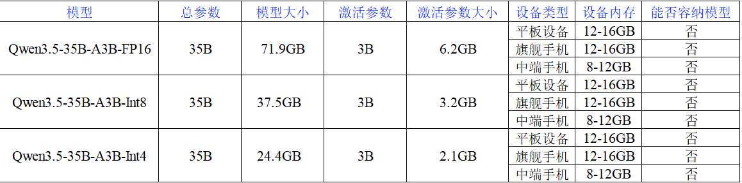
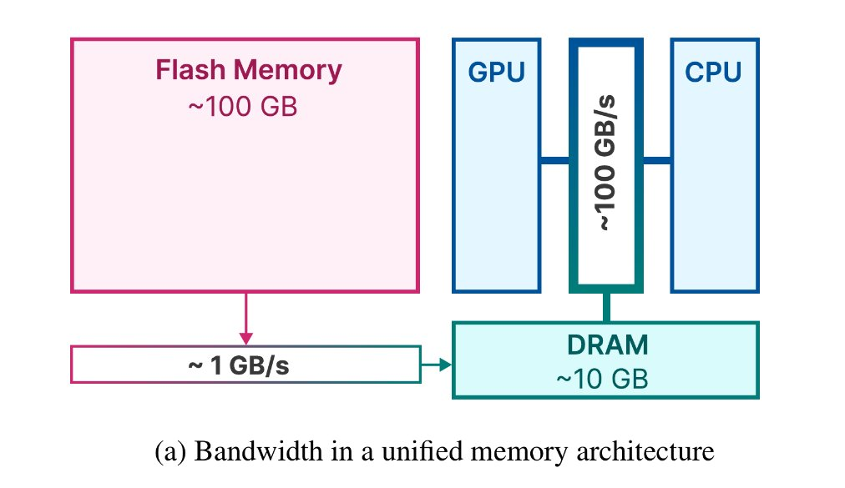
End-side reasoning research development trends
Model side: Small model, Large capacity
With architectural innovation, the end-side small models (3B-8B) have approached the cloud big models in mathematics, reasoning etc. tasks, and have practical value.
byStructure: MoE is born suitable for end side
The combined model (MOREBy rare activation, achieving lower delays and power consumption at equal quantity of parsons, providing ideal architecture for the end side deploymentand .
Terminal side: Hardware and ecological remaining layer
Current phones, tablets NPU/memory broadband and reasoning framework for MoE, dynamic shape support is insufficient, and actual performance is far from released.
Difficulty in implementation of the current tablet.
Unlike PC architecture, the phone, tablet NPU, CPU etc share the same battery, because the current device memory generally does not exceed 16GB, max 32GB, and the smallest MoE model of the Qwen 3.5 (3.6 etc) series (35B-A3B),Unable to fully load to the device memoryand .ThusOnly the expert weight can be placed in external storage and read it again in the device memory when needed. Once activated parameter 3B, the end-side calculation resources are sufficient.
But the process of reasoning requires frequent IO operations, limited to the limitation of UFS4.1 transmission speed (theoretical~2.46GB/s andExamination0.91GB/s35BMoE model is rational on 8850 chipsDecodeSpeed is only 5tok/s.

Slide 6
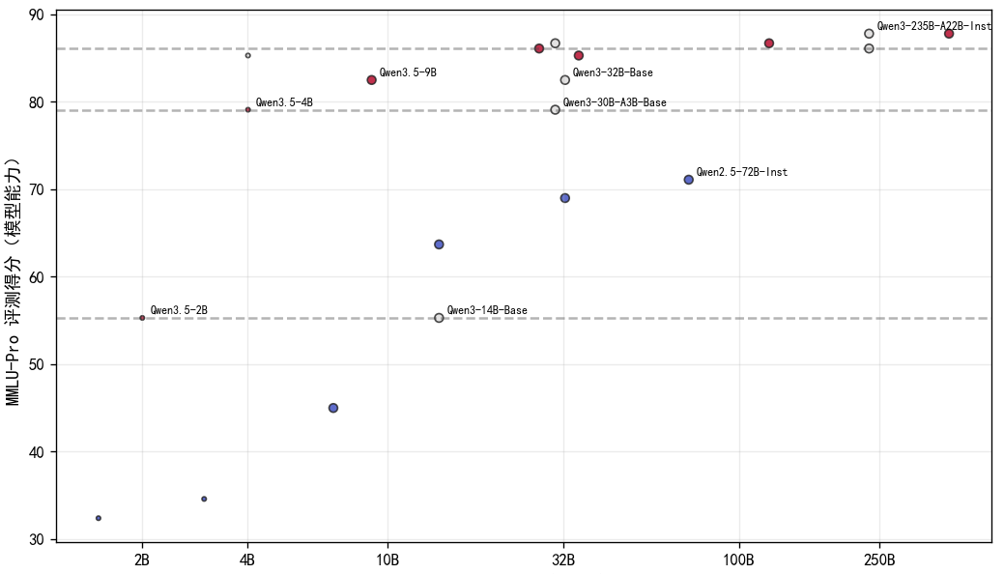
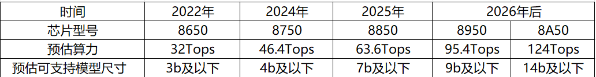
End-side reasoning research development trends
The value of implementation
The small models of Dense architecture and MoE architecture, the capacity of the modernization is increasingly stronger. Take the end-side common 4B-level Dense models. Scores on MLU-Pro, such as Qwen 3.5-4B have overpassed the previous 14B models, and the 72B's Qwen 2.5 models. Expected in the 27 year, the capacity of the 4B model will be stronger, and the ML
With the hardware of mobile devices’ computing and memory, the stronger capacity 14B models are expected to be installed on mobile devices.
Type of equipment | Memory of Equipment | Maximum carried model | Capacity to respond
Phone and Tablet | 32G | (Int8 version of the version) 27B density model; (30.9GB) | AgentWorkflowCode generation etc.
 | 24G | (Int4 version of the version) 27BThe density model; (by 19.5GB) | AgentWorkflowCode generation etc.
 | 16G | (Int8 version of the version) 14BThe Intensity Model (15.68GB of the) | Smart AssistantKnowledge Base Questions
 | 12G | (Int8The version) 9BThe Intensity Model by 0.8 GB | Smart AssistantKnowledge Base Questions

Slide 7
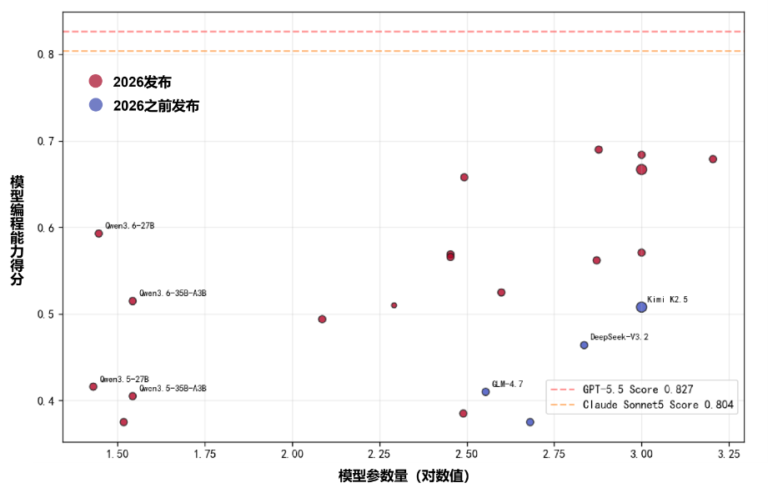
End-side reasoning research development trends
The value of implementation
Open source models are currently using MoE architecture, and the number of vapored versions dropped to 35B level, inProgramming Capacity (Terminal 2.0 bench)Up to 35Bby MoEModelIt has been over 25 years of top open source models such as DeepSeek-V3.2. It is expected that by 2027, the programming capabilities of the 35B MoE model will exceed the current GLM5.1 model, and by 2028, it will reach the current top open source models capacity such as GPT5.5and .
While the current open source MoE model number has no further decline trend, due to its low-calculating load, with further upgrade of device memory, the MoE model with 35B on mobile devices can also be implemented, to meet productivity requirements due to its low-end computing load.
Type of equipment | Memory of Equipment | Maximum carried model | Capacity to respond
Phone and Tablet | 32G | (Int8 version of the version) 35BMoE model | AgentWorkflowCode generation etc.
 | 24G | (Int4 version of the version) 35BMOEModel | AgentWorkflowCode generation etc.

Slide 8
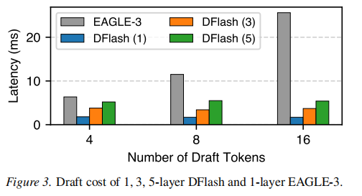
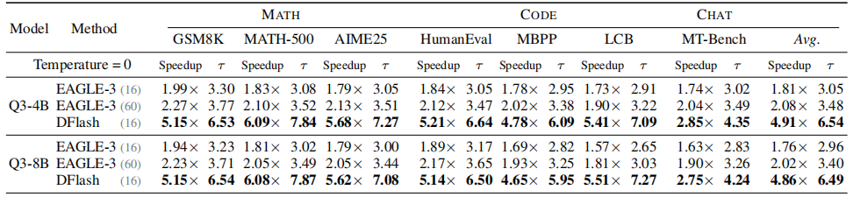
Dflash Series
Performance Summary
DFLashThe algorithms and Eagle algorithms are the estimated decoding algorithms, focusing on rapidly generating candidate sequence using draft models and verified parallel by large models.DFlash acceleration is significantly better than the mainstream method, suitable for density models with the end-sized Qwen 3.5-9b and size below.
Eagle has already been supported on the Qualcomm platform, so Dflash has the possibility of application on the Qualcomm platform. But because the design model requires a spread model architecture, Qualcomm platform may not support the related calculators. Moreover, Dflash’s design model is slightly larger than Eagle’s design model, which accelerates the open source community.For example, the eagle draft model is about 400MB, and Dflash about 1.2G. It will bring a greater load to the end-side device memory.
Comparative Dimensions | DFLash | Eagle
The core principle | Block-based spread and parallel generate drafted symbols | Based on self-return, each project projected roulette
HighestNPUAdaptation status | Not adapted (maybe the calculator supports etc.) | byWorking on Hexagon NPU (HTP)
Performance Profits | Expected speed performance increases by 30% | by

Slide 9
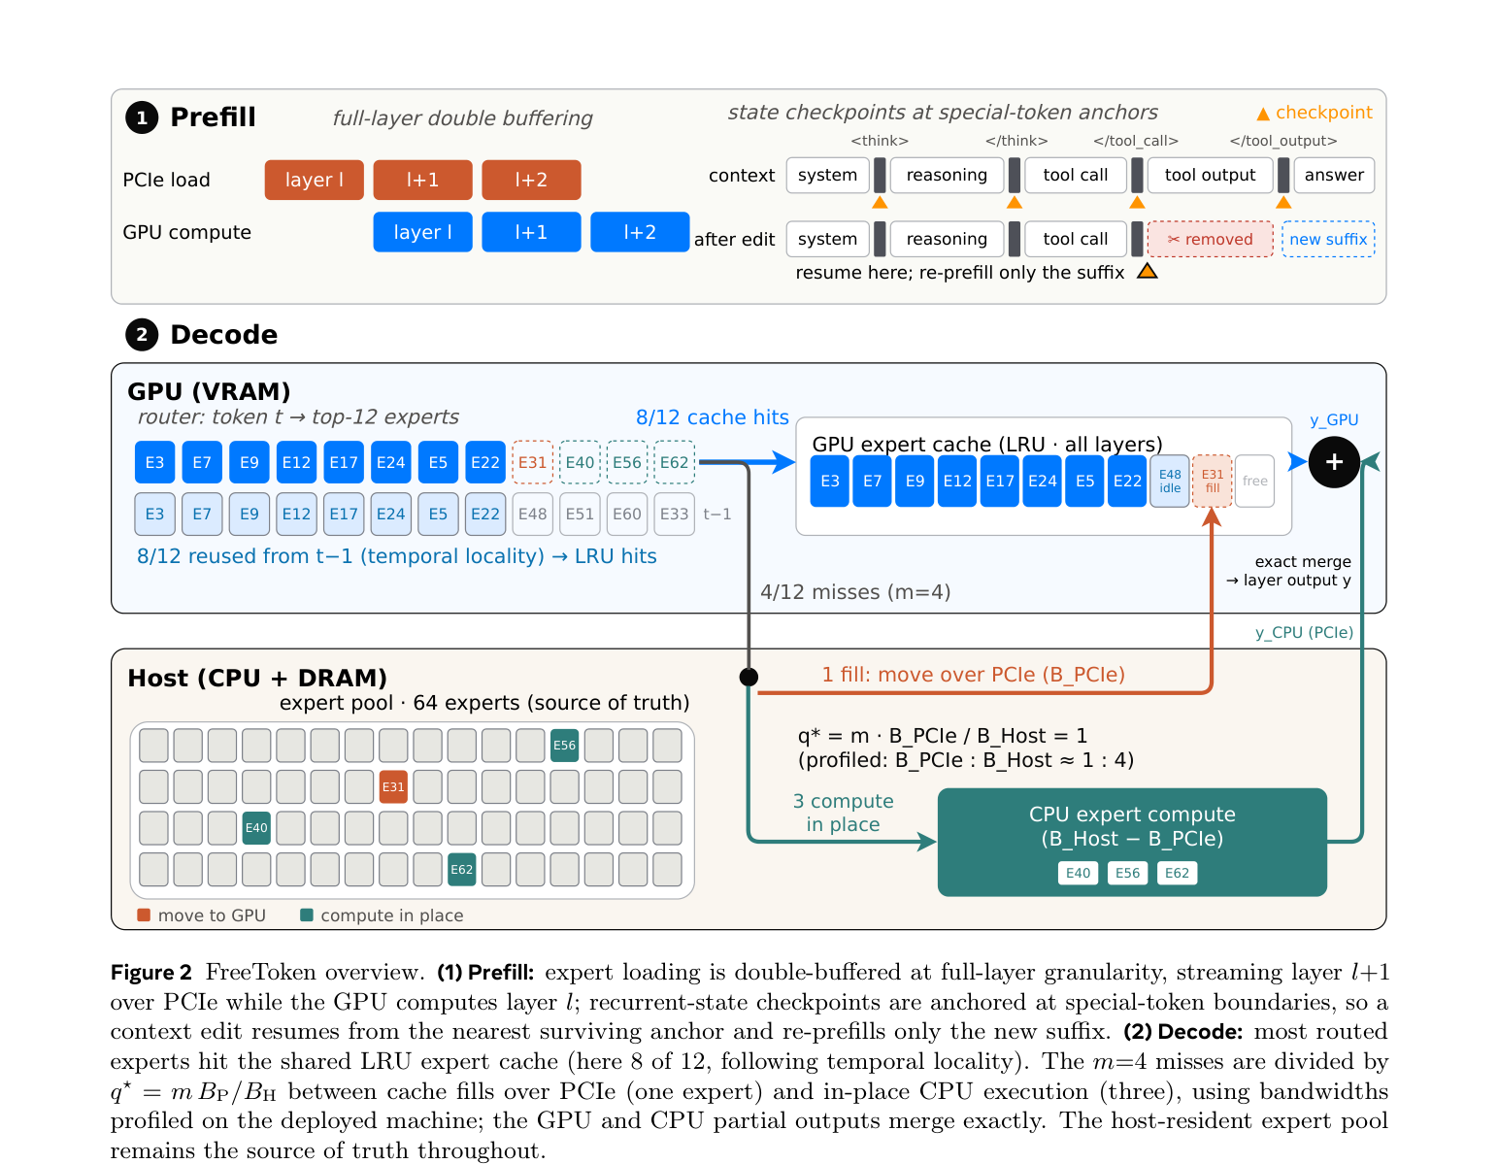
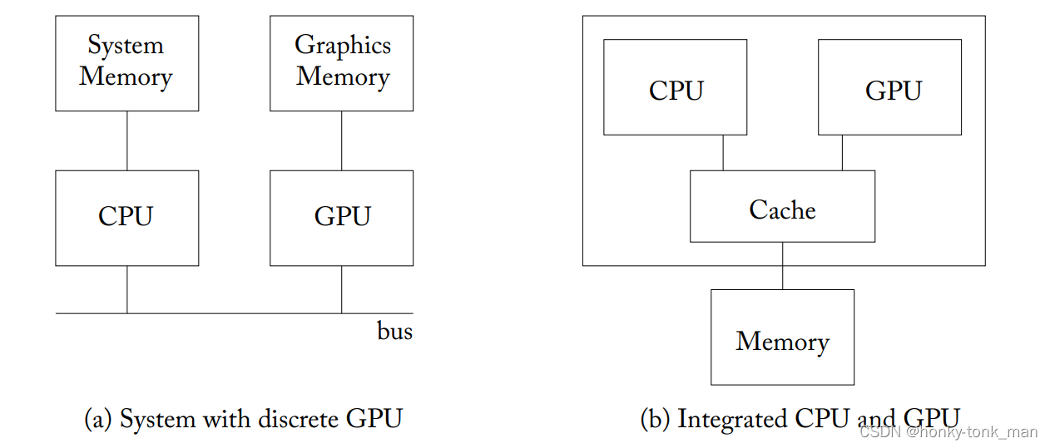
FreeToken
Efficient Edge-NativeMOREServing with Bandwidth Adaptive Execution
Takeaways
Summary
Accelerated core of FreeToken Rational Framework: GPU, CPU, and Memory (HBM) for the Unified Measurement PC PlatformMemory (DRAM) and PCIe resources. Consumer graphics card on PC devices memory>8GB, memory 32-256GB, when reasoning, it can load the expert weight to the memory and by changing the memory resources in real time, optimize the expert weight to the memory and memory distribution, thus accelerate the MoE model reasoning in case MoE model cannot be loaded all to the memory.
Mobile devices for high-tech platforms (telephone, tablets)CPU, NPU, GPU share the same device memory (12-16G), which is completely different from the hardware architecture of the PC, expert weights are stored only in external storage, only loaded to the device memory when needed. Therefore, it is impossible to directly apply FreeToken’s reasonable acceleration strategy to mobile devices.
The calculation strategy can only be applied to the MoE reasoning on mobile devices.
FreeToken Technical Share · 8/8

Slide 10
02
Front model

Slide 11




Advanced model
In the past six months, a number of large models were published.Technology is accelerated.and .
Time | Published Model
2026-02 to 24 | Qwen3.5-35B-A3BandQwen3.5-27B
2026-03 to | Qwen3.5-9BQwen3.5-4BQwen3.5-2B Qwen3.5-0.8B
2026-04-16 | Qwen3.6-35B-A3B
2026-04-22 | Qwen3.6-27B
2026-08 to 14 | Qwen3.8-27B
Time | Published Model
2026-07 to 31 | Deepseek-v4 flash
2026-08 to 13 | Deepseek-v4 Pro
Time | Published Model
2026-06 to 26 | Ornith-1.0-9B Ornith-1.0-35B
2026-08-19 | Ornith-1.5-9B Ornith-1.5-35B-A3B
2026-08 to 20 | Ornith-1.5-9B-MLX Ornith-1.5-35B-A3B-MLX
Time | Published Model
2026-08 to 20 | Qwen3.8-27B-1bit

Slide 12
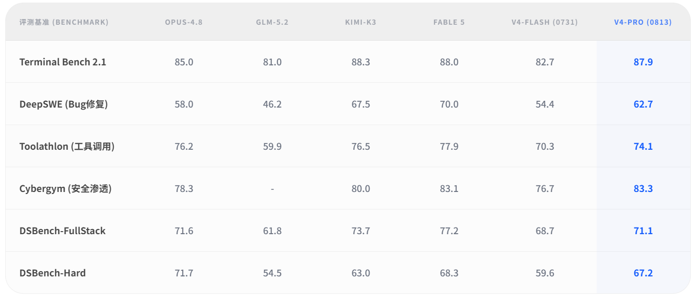
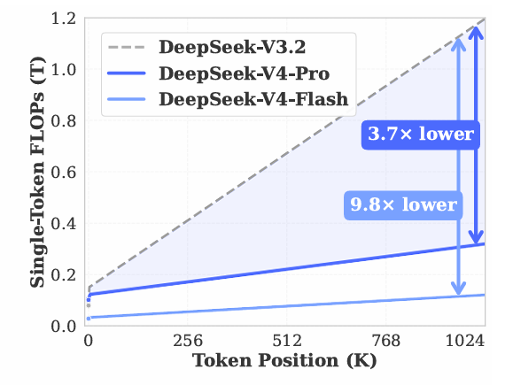
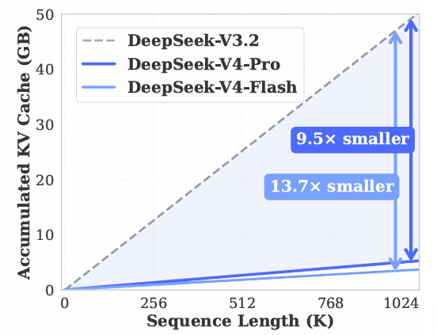
Deepseek Series
DeepSeek-V4Series models adopts MOE architecture,Focus on enhancing the ability of the agent in the production environment, with multiple indicators completely beyond the competitive model.
DeepSeek-V4 Flash versionTotal parameter is 284 billion and activation parameter is 13 billion.Agent on missionAchieving an extreme price ratio,The cost of single task is about 60% lower than GPT-5.6 Luna.
DeepSeek series review results
V4 series considerably decreased costs

Slide 13
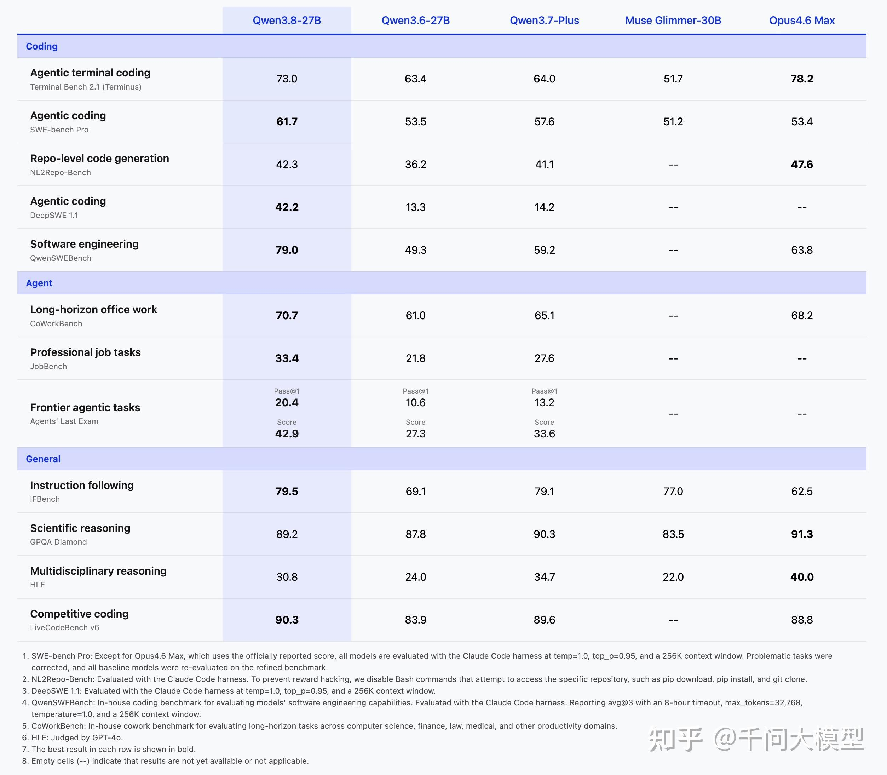
Qwen Series
Since Qwen 3.5 was released in the early half of the year, Qwen also intensely optimized the scenes for Qwen 3.5 models, long-term agents, etc., successively released Qwen 3.6 and Qwen 3.8 series models, with Agent capabilities significantly improved.
The 35B-A3B model of the MOE architecture and 27B density model, as the main-screening model of the Qwen 3.5-3.8 series, haveined advanced levels on programming and Agent capability indicators and exceeded partially closed-source model.
Model | Fp16 version weight | Int8 version weight
Qwen3.8-27B | 55.6GB of | by 30.9GB
Qwen3.6-35B-A3B | 71.9GB of | 5 to 5GB
Qwen3.6-27B | 55.6GB of | by 30.9GB
Qwen3.5-35B-A3B | 71.9GB of | 5 to 5GB
Qwen3.5-27B | 55.6GB of | by 30.9GB
Official Open Source Model Version
Qwen3.8-27B model part test beyond closed source model

Slide 14
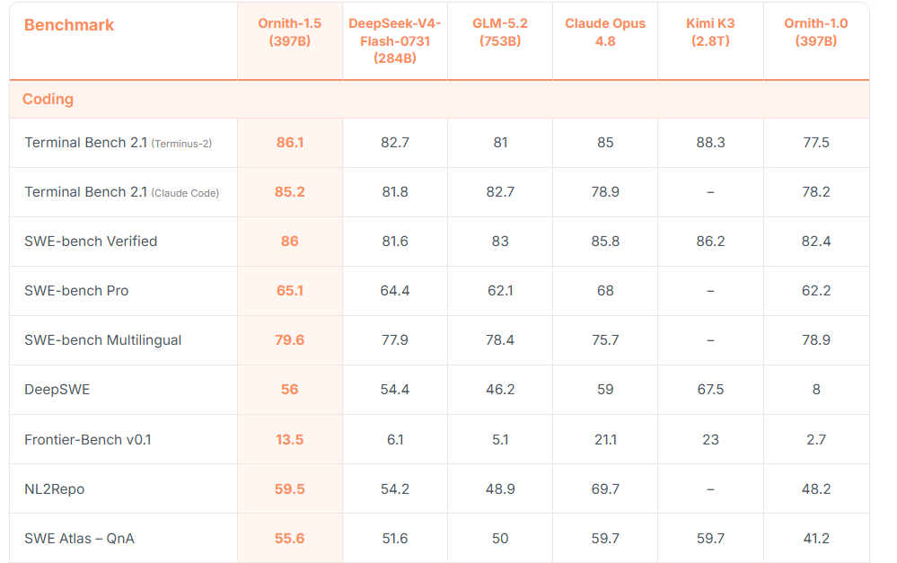
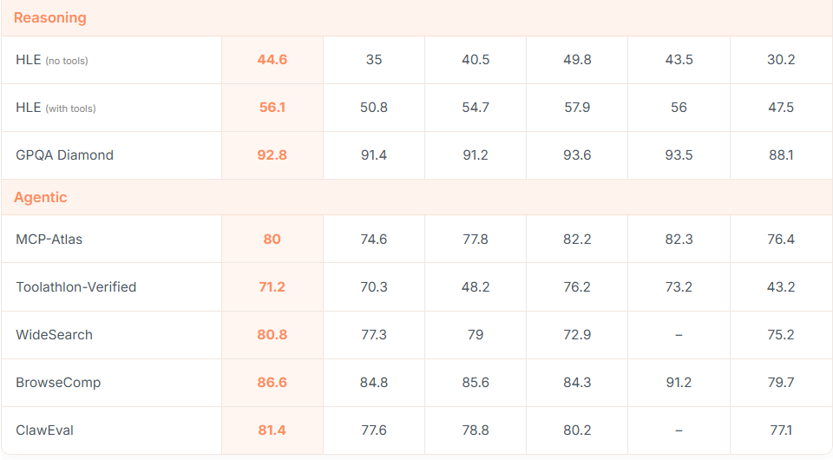
Ornith Series
Ornith is a focus on agent.The coding technical team, based on its self-evolutionary training framework, has since June 2026, released the after-training models of the Qwen 3.5 and Gamma4 based on the Ornith 1.0 and 1.5 series, with 397B model on programming, Agent related test standards.It is better than the leading open source model of the same size.

Slide 15
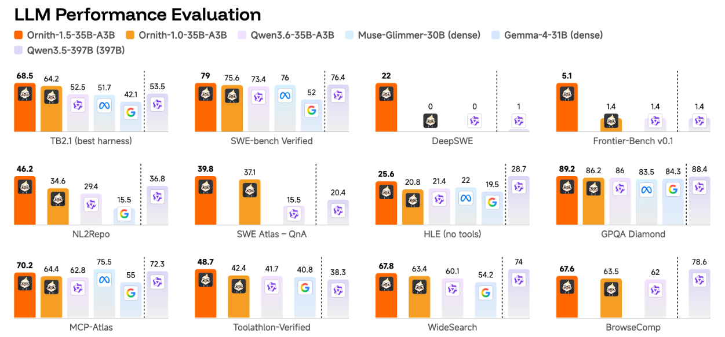
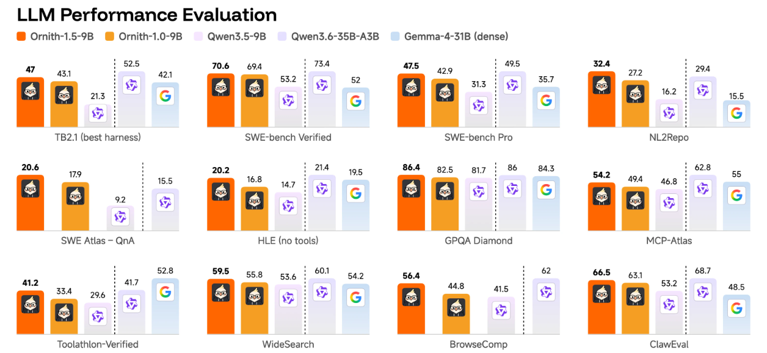
Ornith Series
Ornith also released models of 35B and 9B sizes, which are more suitable for end-side implementation.The model performance is better than the Qwen series of similar sizes, some indicators compared to the larger sizes.
Ornith-1.5-35BSignificant superior to the equivalent in all coding and agent reference tests.Qwen 3.6-35Band It is also far better in terms of smart coding than intensive models.——Gemma 4-31B and Meta's Muse Glimmer-30B (Terminal-Bench 2.1)respectively for68.5 to 43.4 and 51.7; 79.0 to 52.0 and SWE tested 76.0, verified)
The Ornith-1.5-9B, which can be deployed, performs equally excellent, at 47.0 on Terminal-Bench 2.1 and at 70.6 on SWE-Bench Verified. Despite the compact 9B parameter models, the performance can be even better than larger models such as Gemma 4-31B and Qwen 3.6-35B.

Slide 16
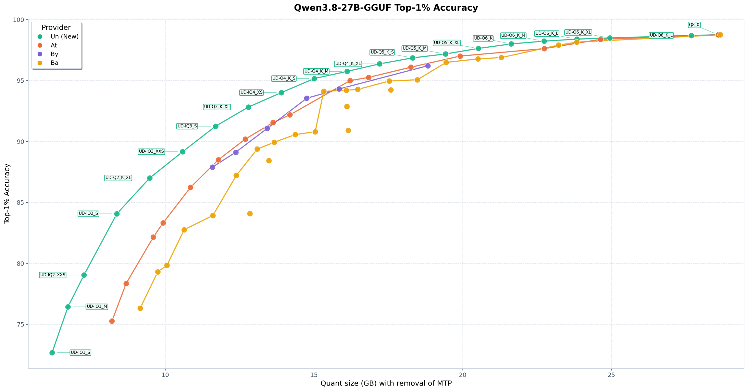
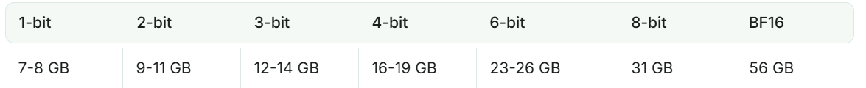
Unsloth Series
UnslothA open source framework designed for large language models, on August 20, the tech team released the quantitative version of Qwen 3.8-27B based on its latest dynamic quantitative technology, which increases top-1% accuracy in the same size compared to other quantitative versions.Simultaneously preserved77% ofOriginal Precisionand .

Slide 17
03
The engine reasoning

Slide 18
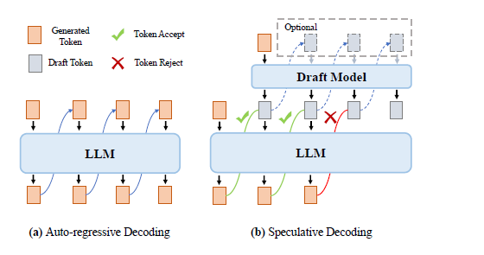
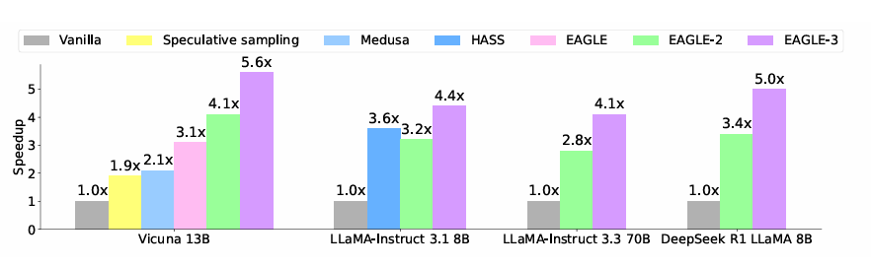
Dflash Series
Technical background
The mainstream LLMs are only token-sequency reasoning due to its self-return architecture characteristics, and lack of mechanisms of parallel reasoning. This makes GPU's calculation difficult to fully exploit the computing power.and .Their
To solve the new and the bottle neck, the assumption decoding algorithm represents by Eagle.andAdopt a small-scale LLM model as a draft model to quickly generate multipletokenThe seriesandThese sequences are verified parallel by the target model. Thus, one reason for the target model can obtain multiple tokens through verified. After using the Eagle algorithm accelerated, in the 8750 chip burst mode,The 3b reasoning speed increased 1.74 times.
Supposed decoding speed
The Decryption Principles

Slide 19
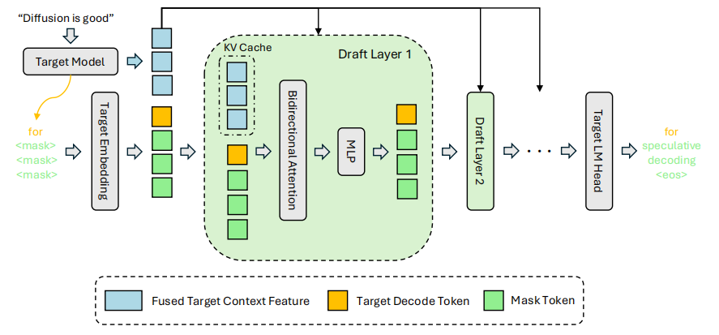
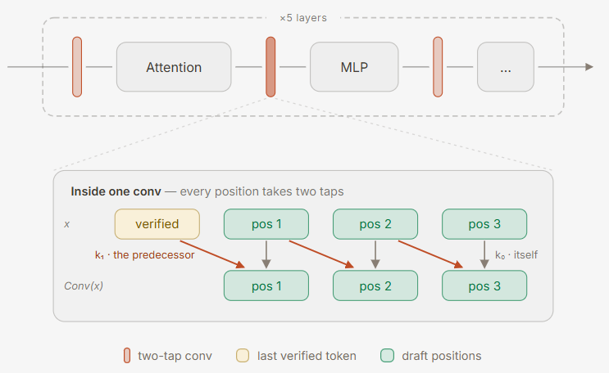
Dflash Series
The Technical Principles
DFLash A block-based spread model.diffusionModel) is a hypothesis decoding method, which uses a small spread model as a draft model, generating multiple tokens in the process of a single forward-to-face reasoning, accelerating the draft generation speed.and .
Due to the lack of causal dependency between tokens generated by the spread model, Dflash2 considers neighboring tokens at the same time in the token selection strategy.consistency, thus select one of the most likely token sequence; at the same time, at Attentionand MLPBetween the sub layers, joining a dynamic volume layer.andIncreasedDFLash The quality of token.
Dflash predicted decoding design
Dflash2 dynamic volume

Slide 20
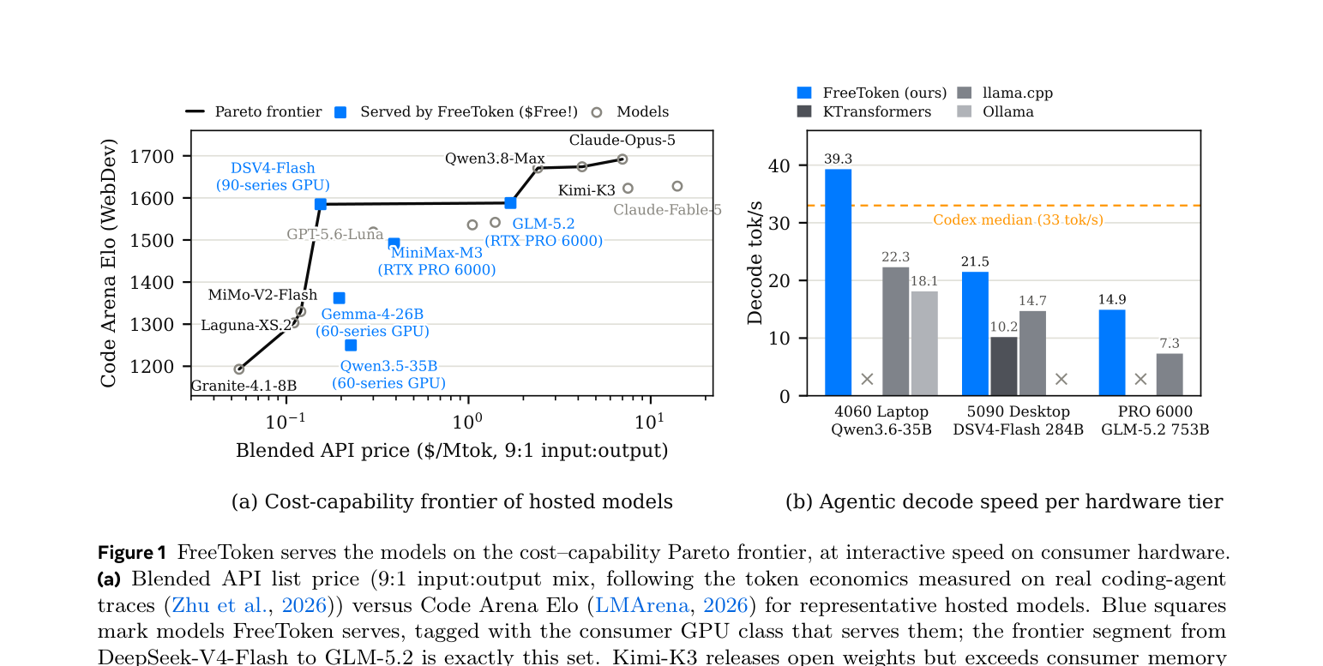
FreeToken
Efficient Edge-NativeMOREServing with Bandwidth Adaptive Execution
FreeTokenUC Berkeley is open source jointly with institutions such as MIT.The end side MORE Specialized whole-storey reasoning system
The core objectives: TakeGPUCPUDRAMPCIeUnified measurements, not only depend on storage capacity.
Key Mechanismand :PrefectDouble sliding, vocal reuse,LRUExpert cache, broadband self-adaptationMediationand .
Experimental coverageand :35Bto753BMOREand8GB laptop GPUto the single card workstation.
753B
284B
39.3 bytokby S
Single RTX Pro6000 is compatible with GLM5.2
RTX5090 Desktop Reason DSV4
8GB RTX4060 Laptop Reason 35B

Slide 21
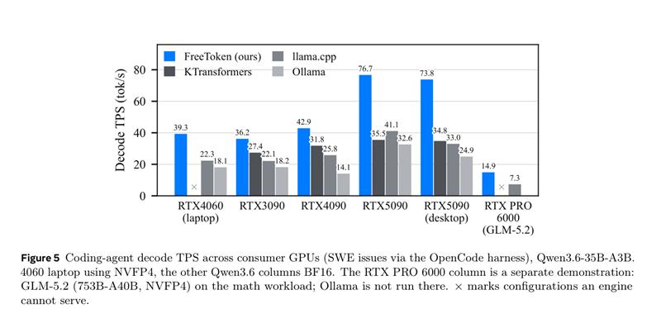
FreeToken
Efficient Edge-NativeMOREServing with Bandwidth Adaptive Execution
Challenges
FreeTokenThe main solutionIn the final reasoning. PrefectDecodeThree realities of change in resources when runningBottle neck
Prefill: Long promptThe huge reason for expenses.
FreeToken's legal map
The following articleInitiatedAll experts activated.and ;DeepSsskV4 FlashFP4The versionExpertWeightby140GB ofbyPCIeTransmission can lead to the head.TokenDelayed to second level.and .
Prefect
Context Edit
Full-Layer
Double buffering
Semantic-Devare
State cache
Decode Hit
Decode Miss
2 Decode:CacheMissRate Decision Delayed
Share LRU
Expert cache
Q★ CPU/GPU
Bandwidth split
ContinuouslytokenLocal route.andBut static place.ExpertCan’t follow in real time.andCausedevery timeMissAll need to be given the expert.Transfer to GPU.
Runtime
Elastic Expert / KV
Memory budget
Over-hardware results
3. Edge:Memory pressure and memory pressureReal time betting
The desktop equipment.VRAM resources are in dynamic change, whileKVCacheGrowth with dialogueSo, in accordance with the storageIn case of error rate and actual VRAMExpertcache with KV cacheThe cutting needs dynamic adjustment.and .
Final objective: Practically available on each machine BP(PCIe) andBH(CPU/DRAM) continuously put the calculation and model status in the most appropriate location.and .
FreeToken Technical Share · 3/8

Slide 22
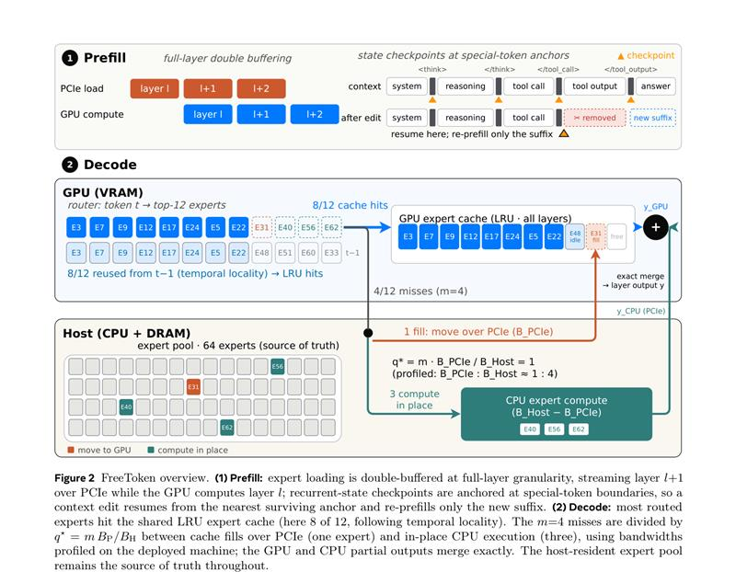
FreeToken
Efficient Edge-NativeMOREServing with Bandwidth Adaptive Execution
Architecture
Main architecture: Full CPU storage, GPU hotspot expert, Miss after transfer by Q★ decision or CPU calculation
CPU Expert Pool
CPU Host Memory Total SavingsRouted Expert Weightandas a source of authority;GPU Cache Only for performance acceleration layer, can be reconstructed at any time as required.andNot affecting the correctness of the model.
GPU Expert Cache
by CompleteLayer ExpertFor the memory of particles, allMOREShare the unitLRUStorage pool; with the help ofTokenLocal time-release of the router, automatically retains current high-frequency experts inWorking Setby
Exact Merge
GPUResponsible for DeathandMoving to expert advanced calculations,CPULocal calculation of the other experts responsible for; two parts of output corresponds Gate The joint agreementandAssurance of the numerical equivalent of the results with the total number of experts
Figure 2: FreeToken Overview
Accuracy: not close, not changing model
Performance: Reduced waiting for PCIe
Engineering: CUDA Graph friendly
End side: Dynamic Resource Adjustment
FreeToken Technical Share · 4/8

Slide 23
FreeToken
Efficient Edge-NativeMOREServing with Bandwidth Adaptive Execution
Prefect
The core principle 1:PrefectHow to put“Transfer Expert“Time to Hide?
Long prompt prefillActivates a lot of experts; FreeTokenFull-layer double bufferingTransmission andGPUCalculation of water flow
Traditional way: Sequential waiting
Semantic-Devare State Cache
Load L
Compute L
Load L + 1
Compute L + 1
Agentin the scene,Thinking, toolOutputIt will be passively removed.and ;FreeToken Set up within the limits of language Recurrently State CheckpointTo make the following editing, you only need to re-calculate the new post, without returning to the starting position.
PCIe transportation
GPU calculation
Waiting again
GPU calculation
FreeToken: Double Water Flow
Why is effective?
GPU calculator L
PCIe load L+1
GPU computing L+1
PCIe load L+2
The following editing usually retains the complete before a certain language limit.The PrefixThis can be effective from the latest. Checkpoint Recovery statusandJust re-calculate new additions. Suffix
Current level calculation
Next Level of Reserve
Uncomfortable switching
Continue to re-plate
Parallel to the leveland :Current layer calculation with the next layer expert pre-replatingandPCIe Transportation is not blocked.GPU
Repeat of the wheel: Falling at the verbal border, restored from the latest checkpoint after editing the above, without repeatPrefect
Direct Profits
Reduced Multi-wheelTTFT of AgentDelayedand ;Avoid the early checkpoint after each tool calling.Re-re-re-re-re-re-re-re-re-re-re-re-re-re-re-re-re-re-re-re-re-re-re-re-re-re-re-re-re-re-re-re-re-re-re-re-re-re-re-re-re-re-re-re-re-re-re-re-re-re-Prefilled
FreeToken Technical Share · 5/8

Slide 24
FreeToken
Efficient Edge-NativeMOREServing with Bandwidth Adaptive Execution
Q★ Policy
The basic principle 2:Cache MissDecisioning Decisioning—— Q★ Routing score determines the expert go toward: high → movingGPULow → ResidenceCPU
Router
Cache Search
Split misses
Contemporary
Merge
Top-K experts
H: cache hits
M: missing
M = F C
Q = F
CPU computing + CPU computing
Exact output
F:Cache Fill Path
C:CPU In-place Path
Q★: Time-consuming two ways with practical testing width balance
Take a partMissExpert AdmissionPCIeMovingGPUcache, inGPUCalculate and keep the service on the basis.and tokens.
Unfortunately, the unfortunate experts cannot be transported.andDirectly inCPU Resident Expert Pool Finish the calculationandOnly will Partitional Output Return to GPUParticipation in the final joint
BP is PCIe expert-transferBandwidth, BHHost-side expert processingThe width of the band; the goal is toGPUTransportation Branch andCPUComputing is done simultaneously.and .
The essence of the distribution strategy is dynamic balance.:PCIe With wide rangeandMore experts are priorized. GPUAccelerated;CPU/DramWhen there is a surplus.andand let CPUDirectly take part of calculations.and .The final goal is to make the two routes parallel and complete at the same time.andAvoid total blockage due to a single resource bottle neck.
BR = max(BH − BP, 0)
TFIL(q) ≈QS/ BPTCPU(m − q) ≈ (m − q)S / (BH − BP)
Q★ ≈ m · BP / BH
FreeToken 技术 sharing · 6/8

Slide 25
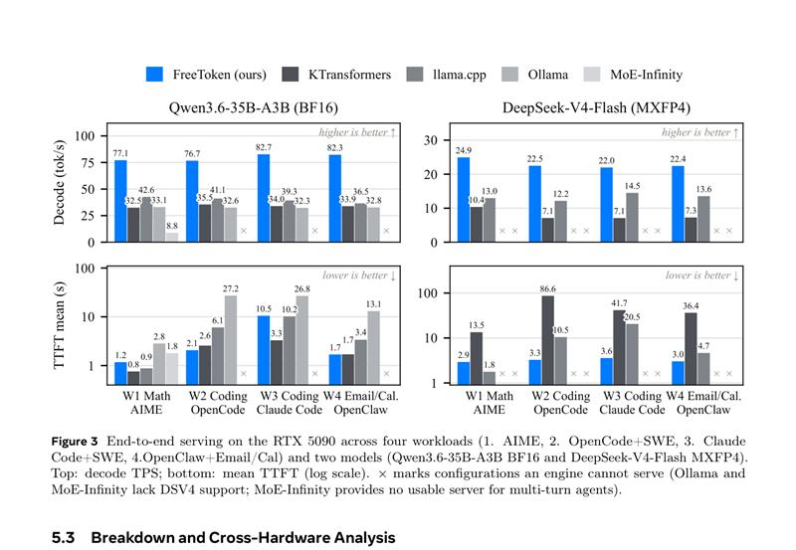
FreeToken
Efficient Edge-NativeMOREServing with Bandwidth Adaptive Execution
Results
Main experiment: RealAgentWorking load faster and stable.
Assessment includesLOVEMathematics and OpenCode/Cloud CodeCode OpenClaw Postal CalendarAgent
77 to 83
22 to 25
Qwen3.6-35B decode tok/s
DSV4-Flash decode tok/s
1.5 to 2.3×
<44s
Over the strongest baseline
worst case TTFT
Decode throughput:Qwen3.6Reaching77 to 83tok/s,DSV4 Flash and FlashReaching22 to 25tokand s.
AgentStability of:FreeToken in three categories.Workload AgentRelativeW1The single-wheel scenes are not more decreased.12 percent of
TFTby:FreeToken All ofworkloadThe worstturnLower than44s; BaselineAt least one.setupOver150s
Meaning of Engineering:AgentFor the end delays affect more than average swelling "as an interactive tool“
Figure 3: RTX 5090Top 4 categories Workload, two types of modelsDecode TPS and TTFT
The conclusion:FreeTokenThe advantage is not single.BenchmarkBut the interaction speed stillins under the long-range text, multi-wheel tool calls, and dynamic text editing.
FreeToken 技术 sharing · 7/8

Slide 26
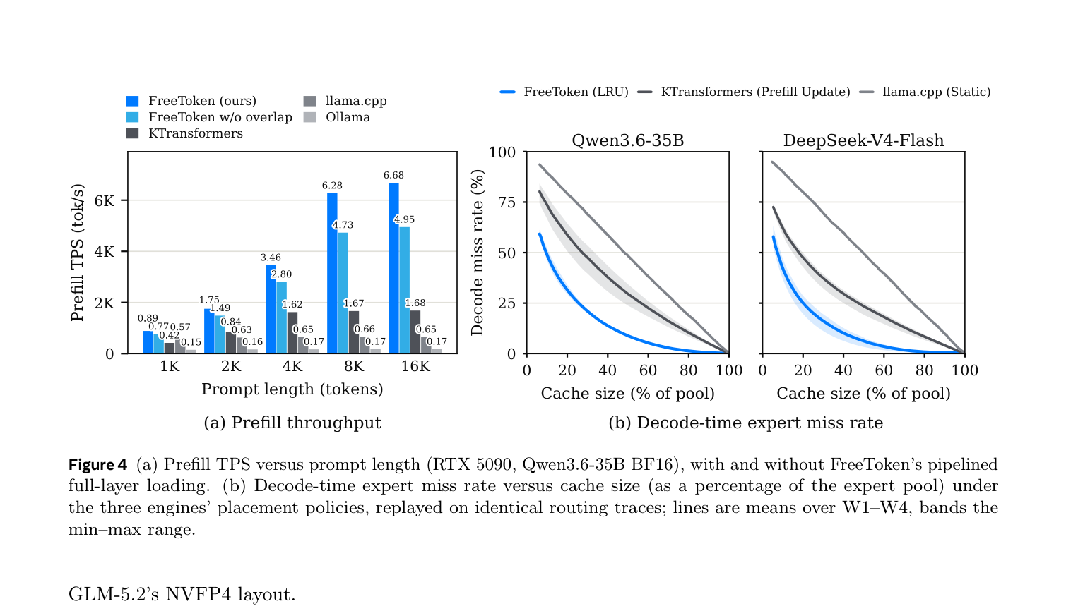
FreeToken
Efficient Edge-NativeMOREServing with Bandwidth Adaptive Execution
Takeaways
FreeToken Revenue from waterproofing. Prefill, LowMissDynamic expert cache, as well as customized adaptive bandwidth of cross-hardware
Figure 4: Prefill TPS with decode-time expert miss rate
Figure 5: Coding-agent decode TPS on different hardware
Prefect Overlap
Expert Locality
Hardware range
System Lessons
16K prompt is about 6.7K tok/s; close overlap at 16K prompt loses about 26%.
LRU is significantly lower than the miss rate of static placement under the same cache capacity.
4060 Laptop to PRO 6000 are available; consumer-class hardware also serve great MoE.
Local AI boundaries are not determined only by hardware, but by how the serving runtime is arranged.
Finally Takeaway:FreeToken We do not change the mathematical results, but rather MORE Consider the system problem “cacheable, portable, parallel, re-installable” and drive each step of measurement using a real-time bandwidth measurementand .
FreeToken Technical Share · 8/8

