Slide 1
MRI Simulation

Slide 2
Here is my (probably flawed) understanding of how MRI works, with figures giving an idea

Slide 3
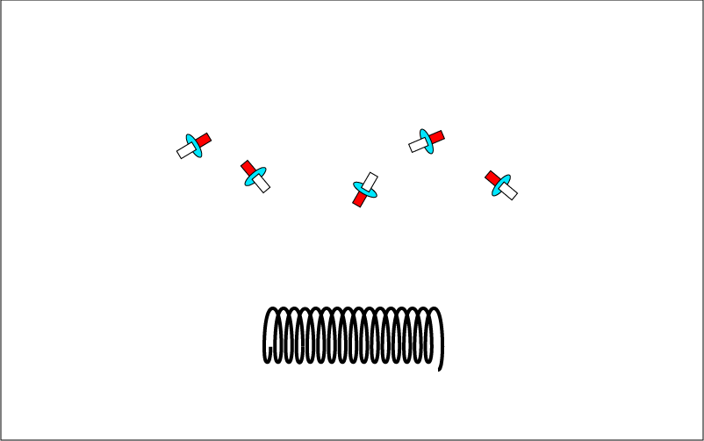
Some small percentage of hydrogen atoms (deuterium atoms) have a net non-zero spin. This gives them a dipole. In normal circumstances, their dipole alignment is random

Slide 4
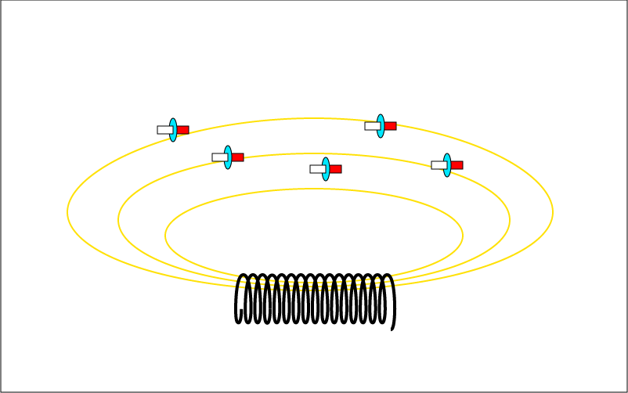
The dipole makes them respond to a sufficiently large magnetic field by aligning with the field.

Slide 5
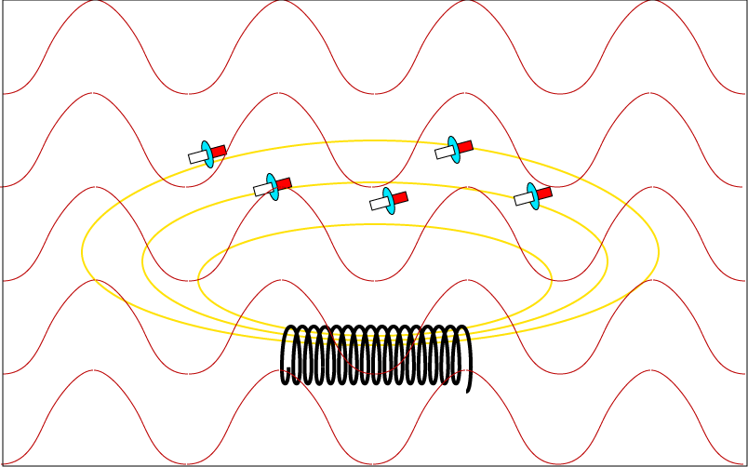
If a hydrogen atom aligned with the field is hit by a photon of a certain energy, it will absorb the photon and got to a higher energy state with different alignment. (The frequency of the photon needed to change the alignment of the hydrogen atom is related somehow to the frequency at which the atom precesses in the presence of the magnetic field.)

Slide 6
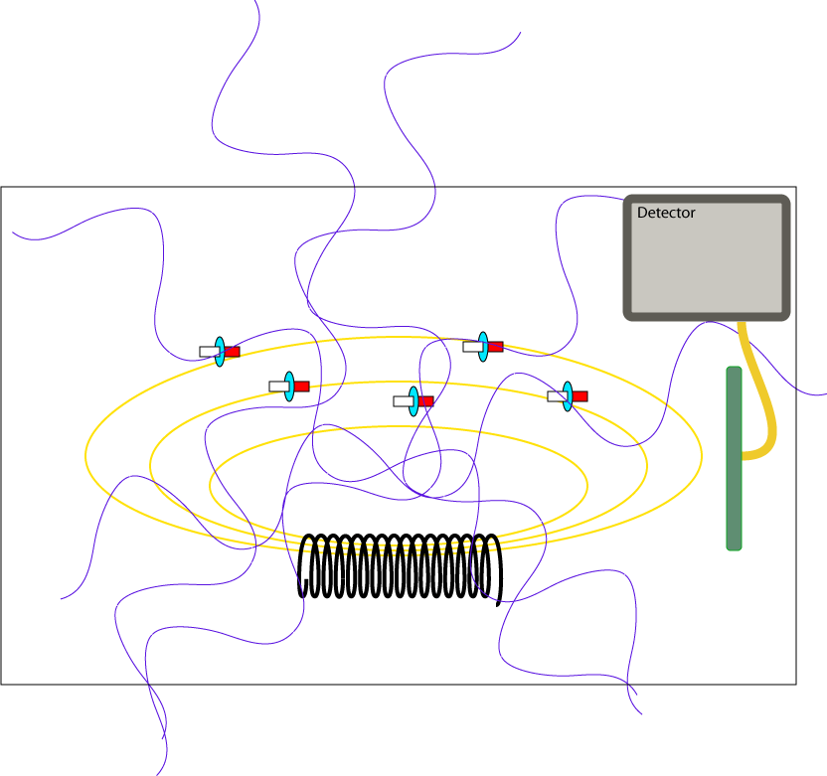
When the atoms are allowed to fall to its earlier, lower energy state, photons with energy equal to the difference between the states is emitted.

Slide 7
The emitted photons are collected by detectors. The number of photons collected is an indication of the number of hydrogen atoms and, by implication, the nature of the material being observed.

Slide 8
Simulation Ideas
Provide controls for
  Strength of the magnetic field
  Frequency of the radio waves/photons that are used to stimulate the deuterium to the higher energy alignment.
  Position and divergence of the stimulating waves/photons.
Add one or more detectors

Slide 9
Nano-scale panel
  Similar to the pictures shown earlier
Micro-scale panel
  Provide selection of objects with different amounts and distributions of hydrogen.
  By manipulating the stimulating waves, build an image of the object on the detector screens.

