Slide 1
Glacier Sim
  Andrea Bair
  Archie Paulson
  Oct 22, 2007

Slide 2
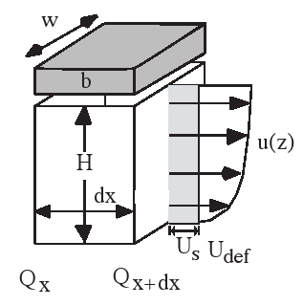
Basic Model
The glacier's thickness versus position and time depend on
  shape of valley floor
  temperature (a linear function of elevation)‏
  precipitation rate (also a linear function of elevation)‏
Temperature and precipitation can be combined to form a function called the mass balance, which equals growth (due to precip.) minus ablation (melt and sublimation). The mass balance gives the rate of change of glacier height per unit time as a function of elevation.
A mass balance which is constant in time results (eventually) in a steady-state glacier. In steady state, the glacier is flowing downhill as it gains ice over its upper half (positive mass balance) and loses ice over its lower half (negative mass balance). The line that divides these two regions is called the “equilibrium line”.
  The velocity of the ice is nonzero at the bottom of the glacier (due to sliding), and increases with vertical height, as shown in the figure at the right. A simple model can be seen at the following website: http://www2.wwnorton.com/college/geo/egeo/flash/18_1.swf

Slide 3
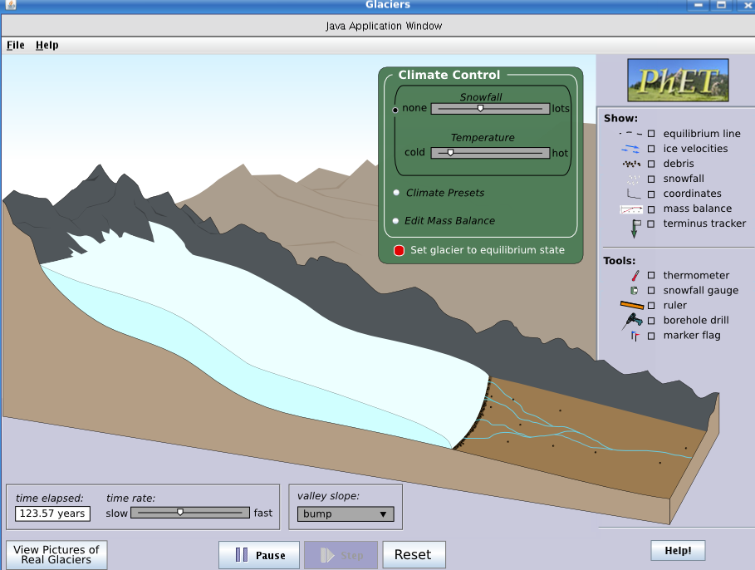

Slide 4
Climate controls explained later
Unimportant background
Glacier thickness varies with animation
This stuff explained later
Glacier terminus moves forward and back according to model
Can open a window with photos of real glaciers to see where approximations are made (eg, hypsometry)‏
Valley floor shape can be “bump” (shown), “linear”, or “simple curve”
Rate of sim-time adjustable
Constant meltwater runoff (animated?)‏
Running time
Moraine (rocks deposited by glacier)‏

Slide 5
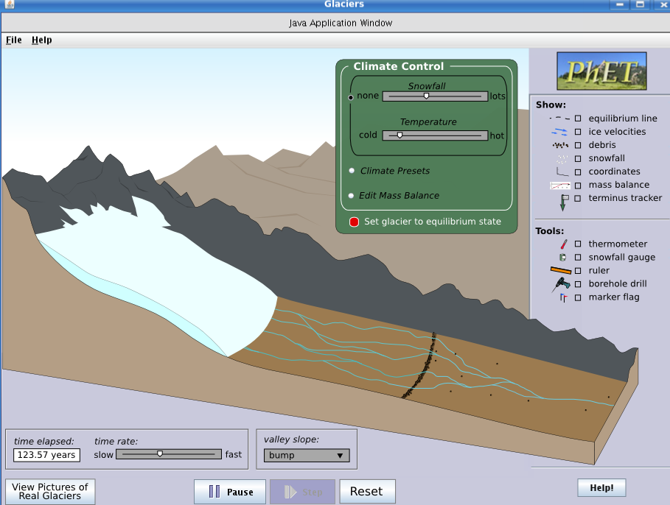
After glacier retreat
Moraine wall left behind

Slide 6
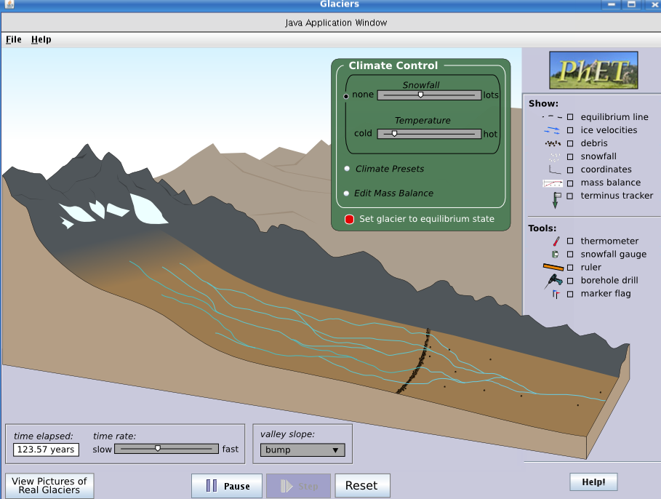
Glacier is now gone.

Slide 7
Climate Controls
The green panel controls climate by one of three methods (selected by radio buttons)‏
  snowfall and temperature controlled independently (previous slides)‏
  climate presets (in drop-down boxes) are selectors for certain values of snowfall & temperature (next slide):
    “time period” can be “modern day” or “last glacial maximum”
    “latitude” can be “equitorial” or “temperate” or “polar”
    “altitude” can be “sea level” or “alpine”
  edit mass balance by entering the three numeric values that are used to describe the function (after next slide):
    altitude of the equilibrium line
    slope of the linear mass balance function
    maximum value of the mass balance
Once a climate control is changed, the glacier can be set to be at the steady-state shape for the current climate by pressing the button next to “Set glacier to equilibrium state.” Otherwise, the glacier will evolve in time until the steady-state is eventually achieved.

Slide 8
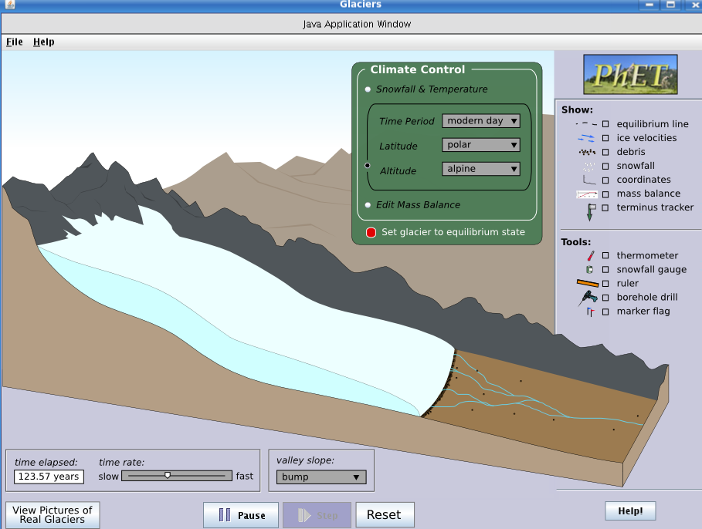
Select the middle button to use preset values for snowfall and temperature according to time epoch, latitude and altitude
To force the glacier to go to the steady-state shape, click this red button

Slide 9
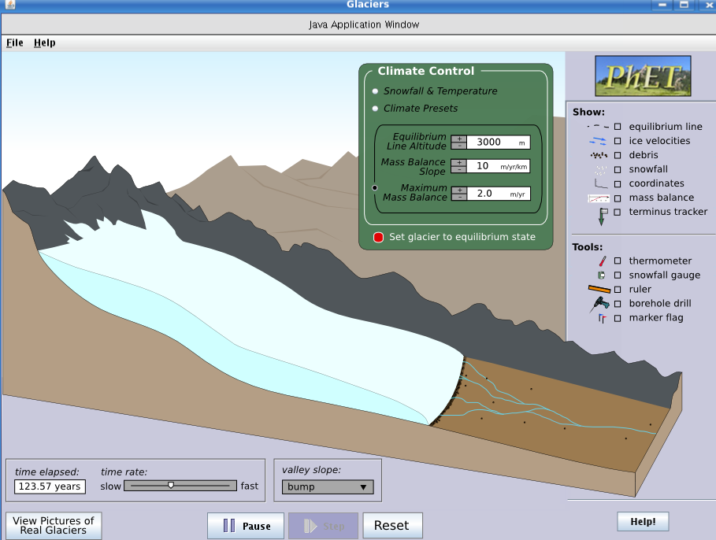
Select the third button to directly edit the mass balance function (which can be described by these three independent values).

Slide 10
“Show” Options
In the “Show” panel, the user can click one or more of the boxes. Results are shown in the slides following this one.
“equilibrium line” shows the altitude of zero mass balance.
“ice velocities” shows a vector field of current ice velocity at all positions within the ice.
“debris” shows rocks which will flow along with the ice velocity and be deposited at the terminus.
“snowfall” will show the animated falling snow above the equilibrium line altitude (ELA).
“coordinates” will show elevation on the vertical axis and distance on the horizontal axis.
“mass balance” will pop up a window that shows the mass balance function.
“terminus tracker” will show an arrow with the current horizontal position and velocity of the glacier terminus.

Slide 11

Velocity vectors of ice flow
Equilibrium Line Altitude (ELA) can be shown

Slide 12

Rocks entrained in ice and riding along on top. The debris moves at the speed of the ice flow.
Rocks deposited at terminus, forming moraine

Slide 13

Snowfall is animated
Snowfall goes no lower than the ELA (no net accumulation below this line)‏

Slide 14

Elevation in km.
Horizontal distance in km.

Slide 15
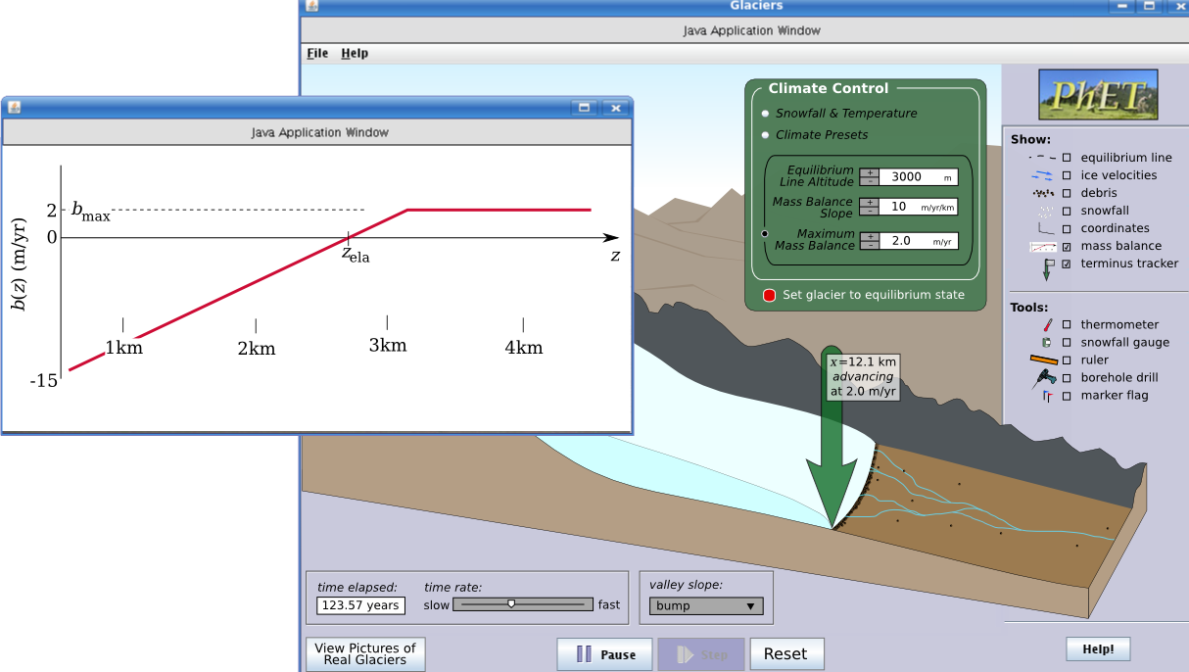
Pop-up window shows the mass balance function.
When “terminus tracker” is checked, a green arrow follows the terminus motion, reporting its x-location and its speed.

Slide 16
“Tool” Options
In the “Tool” panel, the user can click one or more of the boxes. Results are shown in the slides following this one.
“thermometer” gives a temperature-measuring tool. It can be dragged around and reports the atmospheric temperature. It should be excluded from the cross-section region since we don't keep track of ice temperatures.
“snow gauge” looks like a bucket. It can be dragged around and reports the local net snow accumulation.
“ruler” gives a distance-measuring tool.
“marker flag” allows the user to plant flags. On ice the flag will move with the ice flow – this flag will be blue. On the ground a red flag can be planted (to mark the terminus at some time, for example) – this flag can be covered and uncovered by the glacier.
“borehole drill” is a tool to drill vertical boreholes in the ice. It will start out as a vertical column and then deform, showing the differential velocities of the ice flow (see the little figure in the corner of the second slide).

Slide 17
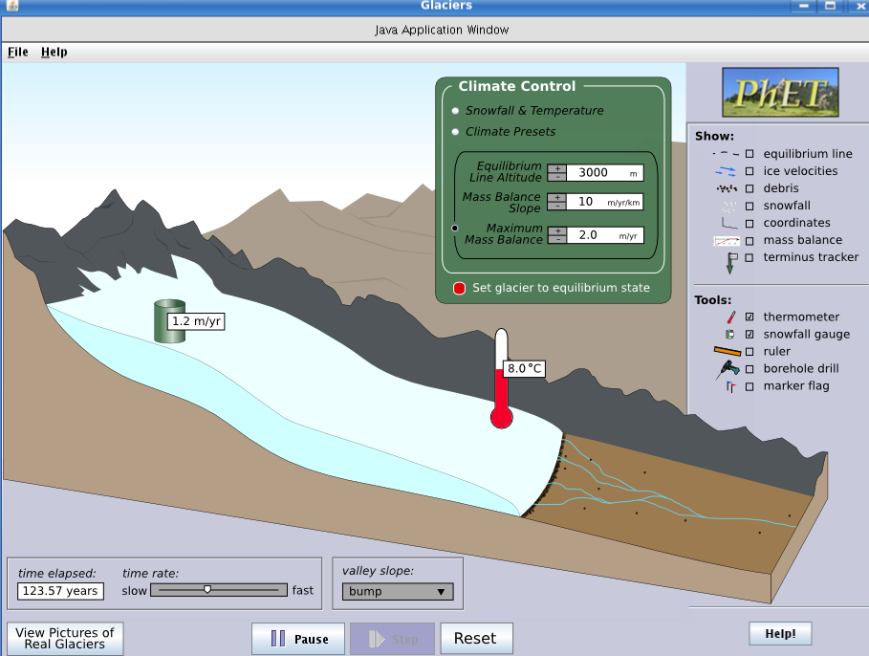
Shows rate of snow/ice accumulation.
Shows local (adiabatic) temperature.

Slide 18
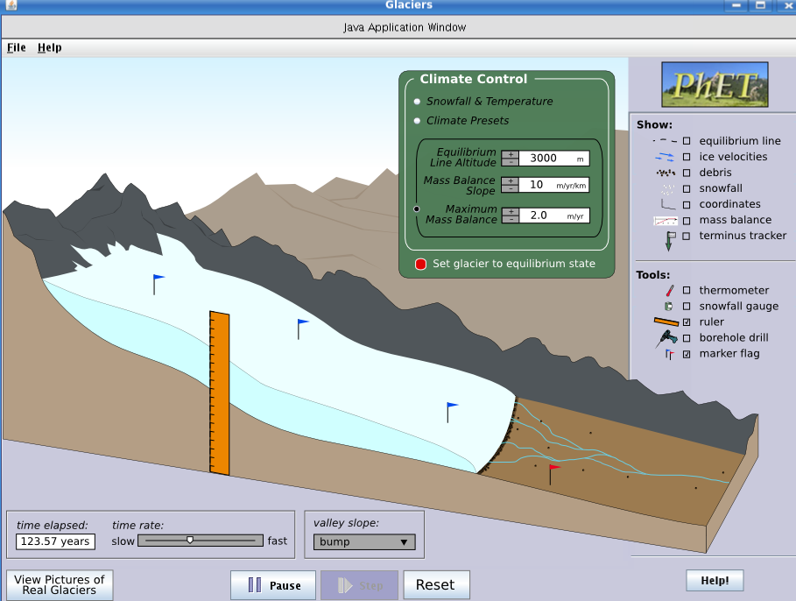
Ruler can be used to measure ice thickness at a given location.
When “marker flag” is checked, clicking will plant a flag (blue on ice, red on ground).
Blue flags move with the ice.
Red flags stay on the ground (can be covered and uncovered by ice).

Slide 19
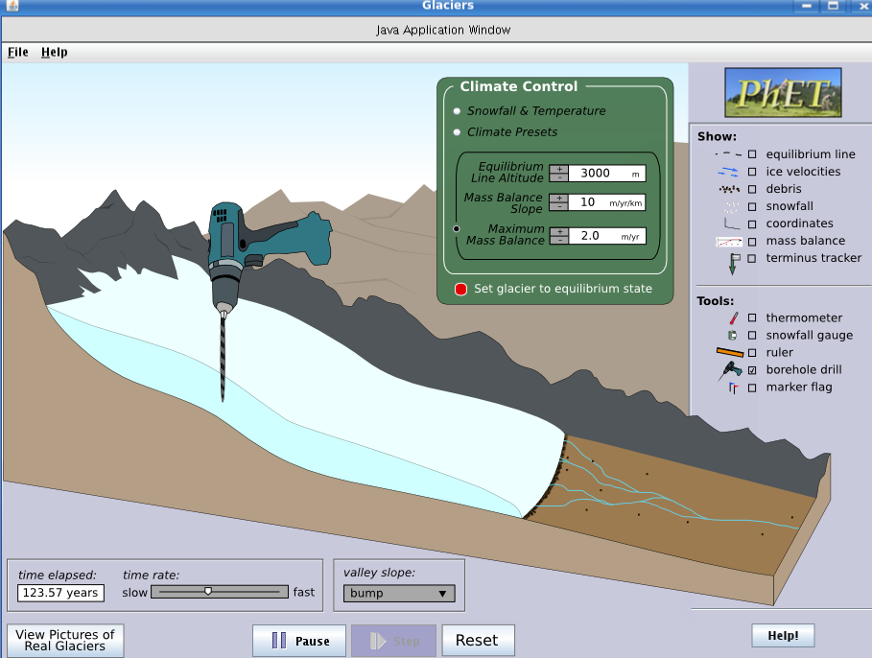
The drill will make a vertical borehole. The hole will then begin to show the shape of the vertical velocity profile of the ice flow.

Slide 20
Other Options (which would be nice)‏
change between the perspective view (is all slides above) to just the side view
zoom in so that the borehole deformation is clearly visible
show age of ice with contour lines (or colors?)‏
velocity vectors could also appear on glacier surface to show lateral variation in flow
marker flags could record the time of planting (for making measurements)‏
climate control should have an option to set a time-dependent history; for example, set a beginning climate and an ending climate (with a time for each), then the snowfall and precip. are interpolated between the end-members

Slide 21
The End
That concludes the sim specification (as it exists so far). The remaining slides include motivations for this sim, including student difficulties, learning goals, and animations that exist on the web.

Slide 22
Student learning difficulties/misconceptions
Glaciers form only where it is very cold, and disappear with warming (not related to amount of snowfall)‏
Glaciers only form at high elevations or latitudes (T control); cannot form near sea level or at low latitudes (perhaps more a problem in Colorado, where most instructor examples are of alpine glaciers).
A glacier is a pile of ice that sits there once it forms; dynamics of ice movement in a “steady-state” glacier not known.
Glacial retreat means that ice is not moving but just melting back, or that the ice is literally moving uphill.
No sense of how long it takes glaciers to form, or change.
More melting (more water) makes a glacier flow faster; thus, increased temperature can make the whole thing slide downhill.

Slide 23
Learning Goals and objectives
Describe how glaciers form, grow, and shrink – specify what environmental conditions lead to each.
  Identify where net ablation (~melting>snowfall) and accumulation (~melting<snowfall) occur in relation to the Equilibrium Line Altitude (ELA).
  Explain or illustrate how glaciers form.
  Describe the most important controls on mass balance in a glacier.
  Analyze the relationship between temperature and the likelihood of snow vs. rain at given parts of a glacier.
Explain how ice moves within a glacier (describe and illustrate the mass balance of a glacier).
  Describe and illustrate how glacial ice moves.
  Qualitatively describe the relationship between the speed of ice flow and with ice thickness, and predict where ice is oldest.
Describe why and how valley glaciers “advance” or “retreat”. When the glacier retreats, does ice move up the glacial valley?
  Compare and contrast motion of ice when a glacier is (1) at equilibruim, (2) advancing, and (3) retreating.
  Compare and contrast climatic conditions leading to glacial (1) equilibruim, (2) advance, and (3) retreat.
Determine how multiple advance-retreat cycles affect the record of glacial moraines (end moraines).
  Describe how end moraines form.
  Discuss how more recent, large advances can impact moraines left by older, smaller advances.
  Given an illustration of 3-4 end moraines, determine the most likely order of their formation and justify your ordering.

Slide 24
Existing Animations
Existing examples of animations for comparison:
http://www2.wwnorton.com/college/geo/egeo/animations/ch18.htm
http://www.uky.edu/AS/Geology/howell/goodies/elearning/module13swf.swf
http://highered.mcgraw-hill.com/sites/0072402466/student_view0/chapter12/animations_and_movies.html

