Slide 1
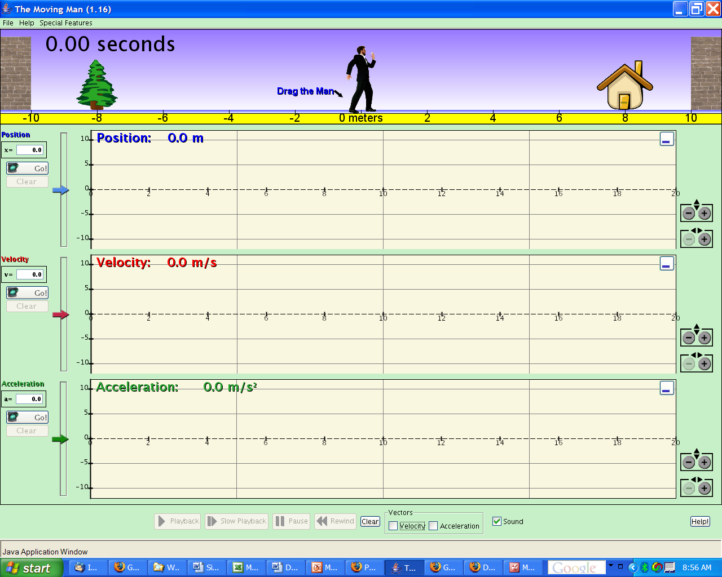
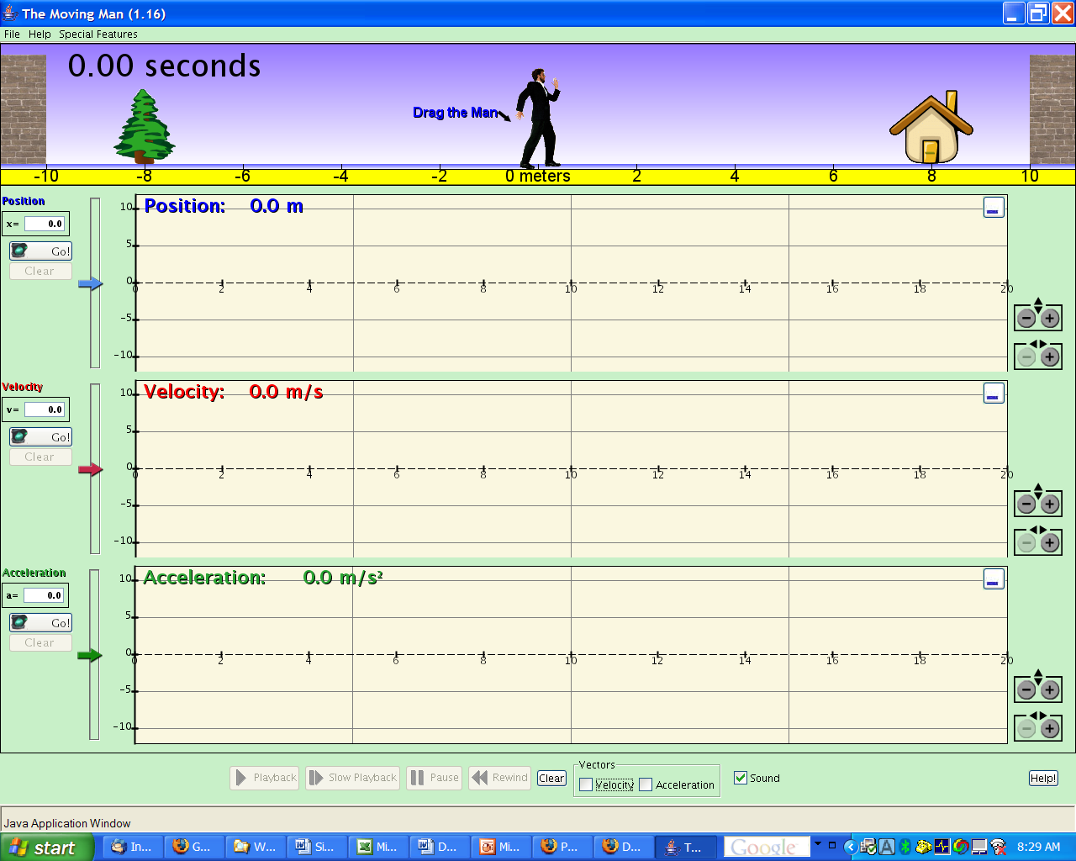
Merry-Go-Girl
v
Side view
Top view
Angular Position, θ
a
θ=0°
Angular Velocity, ω
Show graphs for:
θ,ω,x,y
θ, ω,α
θ,ω,v_{x},v_{y}
θ,α,a_{x},a_{y}
Symbol Key:
θ = Angle
ω = Angular velocity
α = Angular acceleration
x,y = Position
v = Velocity
a = Acceleration
Angular Acceleration, α
Show vectors:
velocity
acceleration
x
x

Slide 2
Learning goals for Merry-Go-Girl:
  To understand the relationships between the rotational and linear components of position, velocity, and acceleration
    θ = θ_{o} + ω t + ½ α t²
    θ = θ_{o} + ω t
    ω = α t
    v = r ω
    a = r α
  To understand the relationships between θ, ω, and α.
  To understand the relationship between θ, x, and y.

Slide 3
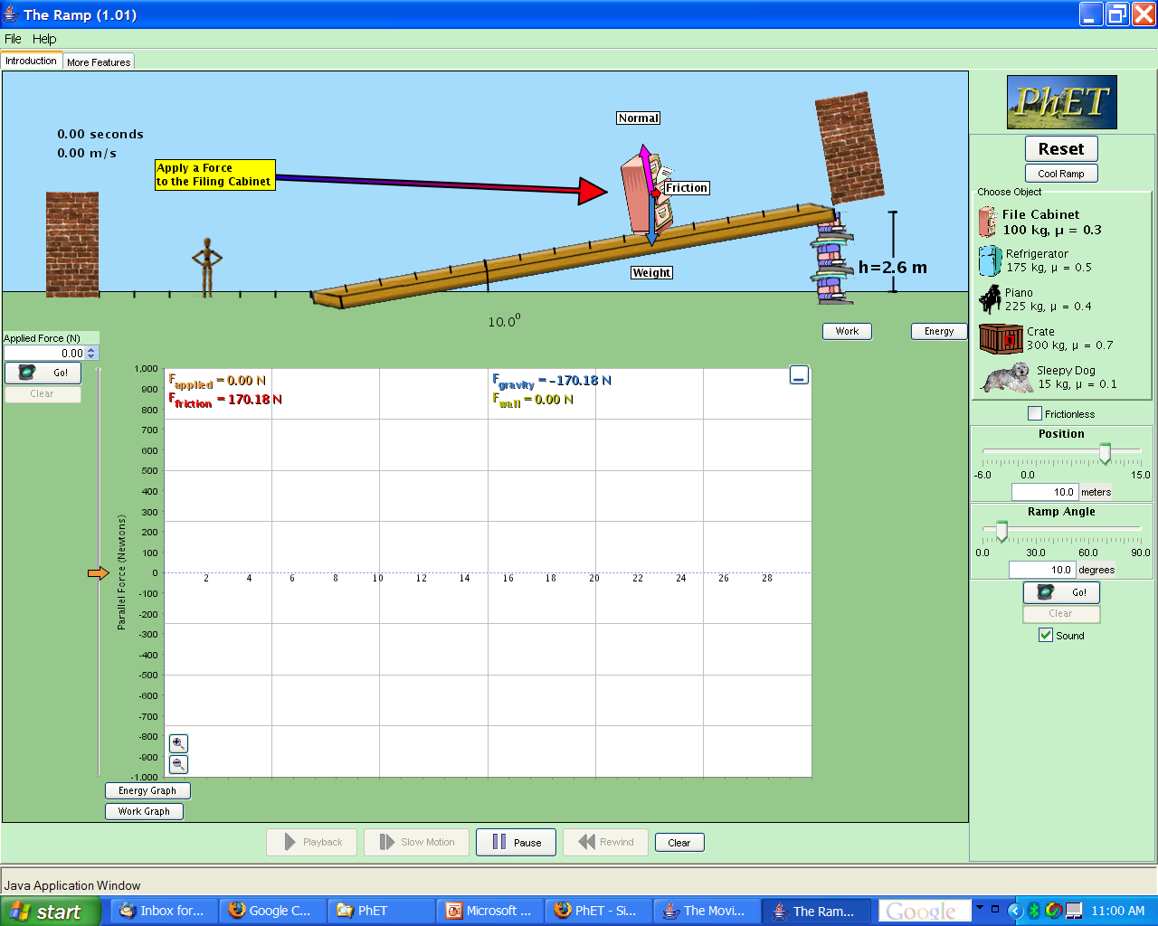
Torque
Tangential Forces
R
r
θ=0°
F_{applied}
Controls
Torques
R = outer radius
r = inner radius
Mass
Force of brake
Allow non-tangential
forces
Show components
Show graphs for:
F,Torque
Torque,α,ω,θ
ω,I,L

Slide 4
Learning Goals for Torque:
  Understand the relationship between the applied force, frictional force (of the brake) and the torque
  Understand the relationship between the radius at which the force is applied and the torque
    Torque = r x F = r F sinθ
  Understand the relationship between torque and the moment of inertia
    Torque = I α
  Understand the relationship between the moment of inertia and the angular velocity (conservation of angular momentum)
    I₁ ω₁ = I₂ ω₂
    L = I ω

