Slide 1
Fourier Analysis Simulation Outline
Draft 2
Sam McKagan
5/4/05

Slide 2
Three Panels
Discrete Fourier Transforms
Discrete to Continuous
Continuous Fourier Transforms
Wave Pulse Shaper

Slide 3
Discrete Fourier Transforms Panel
Learning Goals 1
For all students:
To develop an intuition for how sines and cosines add up to produce arbitrary periodic functions.
To be able to mentally map simple functions between Fourier space and real space.
To gain an intuition for how to describe sounds in terms of sinusoidal waves.
To understand the difference between waves in space and waves in time.
To understand that wavelength and period do not correspond to specific points on the graph but indicate the length/time between two consecutive troughs, peaks, or any other corresponding points.

Slide 4
Discrete Fourier Transforms Panel
Learning Goals 2
For students who have studied math of Fourier transforms:
To become comfortable with various mathematical notations for writing Fourier transforms, and relate the mathematics to an intuitive picture of wave forms.
To understand how the symbols λ, T, k, ω and n in relate to graphs of waves.
To understand that λ & T and k & ω are analogous, but not the same.
To understand the meaning of summation notation.

Slide 5

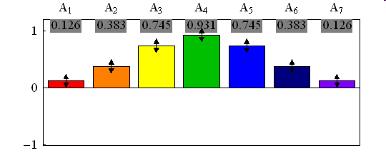
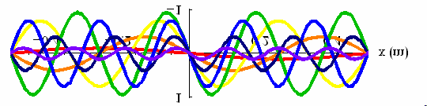



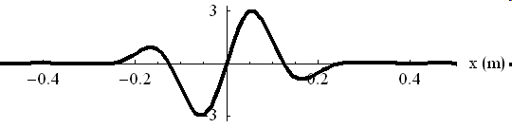
Amplitudes
Show function of:  space  time
◉ space & time
n
Select function:
wave packet
Enter text or move the arrows to change the size of the Fourier components.
◉ Show Wavelength 1
◉ Show Period 1
Components
Number of Components
λ1
5 7 9 11 13 15
Fundamental frequency:
440 Hz
Sum
◉ Play sound
Show sines cosines
Math Mode

Slide 6
Wiggle Me
Wiggle me invites user to “Enter text or move the arrows to change the size of the Fourier components.”
Wendy pointed out that this is a good way to give students a name for the Fourier components so they know what to call them.

Slide 7
Highlights
If user moves mouse over a Fourier component in the Amplitudes or Components graph, that component should get brighter in both graphs and the other components should get dimmer. This makes it easier to see the connection between the graphs and reduces dependence on color.
The color scheme should follow a rainbow, going from red to purple as wavelengths decrease, just like for visible light.

Slide 8
Zoom In/Zoom Out
The zoom buttons were copied out of the Blackbody Radiation sim and should have identical functionality.
User should only be able to control the scale on the horizontal axis.
For the first two graphs, the vertical scale is fixed at -1 to +1.
In the third graph, the vertical axis needs to rescale automatically.

Slide 9
Space, Time, and Space & Time Modes
This simulation has three modes, space, time, and space and time. Space mode is shown. Time mode is identical but all x’s are converted to t’s, k’s to ω’s, and L’s and λ’s to T’s. Space & time looks like space but waves move in time as sin(2πnx/L) → sin(2πnx/L-2πnt/T).

Slide 10
Select Function Option
In addition to changing distribution of amplitudes manually, users may also select from a collection of preset distributions, displayed in a pull-down menu under the option “Select function.”
The option shown here is “wave packet,” but the default option should be “sin wave” where A₁=1 and all other amplitudes are zero.
The other options may include “square wave,” “saw tooth,” and notes for musical instruments, such as “piano,” “guitar,” etc.

Slide 11
Show Wavelength/Period Option
If the user selects “Show Wavelength” in space or space & time mode, a moveable arrow labeled “λ1” appears in the upper right corner of the Components graph. If “Show Period” is selected, a similar arrow labeled “T1” appears in time mode, or a light that flashes every period in space & time mode.
User can change which mode of wavelength or period is shown by typing into the box to the right of the option.
“Show Period” should be grayed out in space mode and “Show Wavelength” should be grayed out in time mode. It is important that they be displayed in this way, rather than simply disappearing, so that it is very explicit that the concept of period simply doesn’t apply to a spatial graph and the concept of wavelength doesn’t apply to a time graph.

Slide 12
Number of Components
User can change fourier components by moving slider. The default number is 7 so that it is not too overwhelming.
The implementation of this is similar to the “spacing between fourier components” slider in the discrete to continuous panel.

Slide 13
Fundamental Frequency
The user can change the value of the fundamental frequency f₁ (=ω₁/2π=1/T₁) either with the slider or by typing in a value. This allows exploration of sounds of varying frequencies.
This option should be grayed out in space mode. There was some discussion of being able to change the fundamental in space mode as well, but this wouldn’t do anything except rescale the graph, and it gets tricky because the meaningful quantity to change in time mode is f, but there is no analog to f in space mode.

Slide 14
Sound and Sines/Cosines
“Play sound” should appear only in time mode. If checked, it should play the sound of the composite wave.
Can toggle back and forth between showing a sum of sines and a sum of cosines.

Slide 15
Math Mode
Because there are two very different audiences for this simulation, one that needs only a qualitative understanding and one that needs a sophisticated quantitative understanding, all the mathematical details are hidden in this mode. The first audience never has to check this box and the second audience can use it to explore the mathematical formalism and notation in depth.
If math mode is checked, the panel looks like:

Slide 16
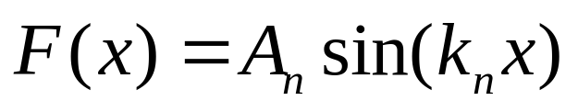
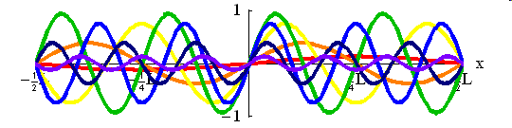
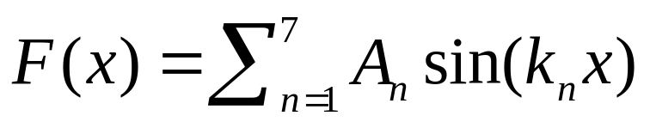
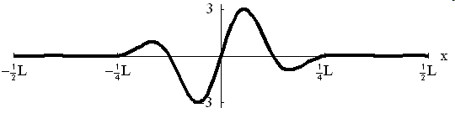
Amplitudes
Show function of:  space  time
◉ space & time
n
Select function:
wave packet
◉ Show Wavelength 1
◉ Show Period 1
Number of Components
λ1
5 7 9 11 13 15
Fundamental frequency:
440 Hz
◉ Play sound
Show sines cosines
Math Mode
Wave number (k) form
Summation notation

Slide 17
Math Mode Pull-Down Menus
There are two pull-down menus in math mode that allow users to change the notation of the equations labeling the graphs and to explore how the various notations compare.

Slide 18
Form of sine waves
Here are the options for the first math mode pull-down menu in both space and time modes:
Space Mode
  Wave number (k) form sin(k_{n}x)
  Wavelength (λ) form sin(2πx/λ_{n})
  Mode (n) form sin(2πnx/L)
Time Mode
  Angular frequency (ω) form sin(ω_{n}t)
  Frequency (f) form sin(2πf_{n}t)
  Period (T) form sin(2πt/T_{n})
  Mode (n) form sin(2πnt/T)

Slide 19
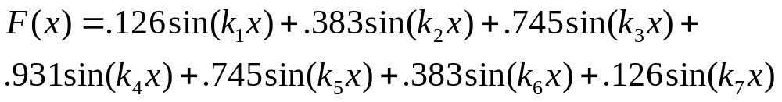
Summation/Expanded Notation
The two options for the second math mode pull-down menu determine the format of the label above the third graph:
Summation notation:
Expanded notation:

Slide 20
Discrete to Continuous Panel
Learning Goals
To develop an intuition for how decreasing the spacing between fourier components increases the spacing between wave packets, so that if you replace the sum with an integral, you have only one wave packet, and you can describe a non-periodic function with a continuous distribution of sines and cosines.
To understand that decreasing the width of a wave packet in real space increases the width in Fourier space and vice versa and to develop a qualitative intuition for the uncertainty principle Δx Δk≈1.

Slide 21
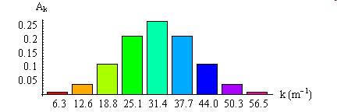
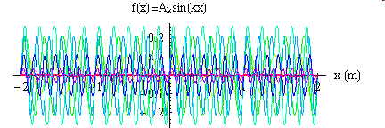

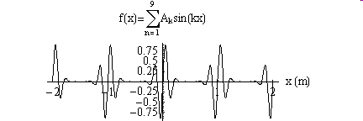
Discrete to Continuous
Show function of:  space  time
◉ space & time
2Δk
Spacing between fourier components:
π/16 π/8 π/4 π/2 π 2π m⁻¹
Width in k space:
Width in x space:
Δx = 0.106 m
Δk = 9.42 m⁻¹
Fundamental frequency:
440 Hz
2Δx
◉ Play sound
Show sines cosines

Slide 22
Spacing between fourier components
You can change the spacing between the fourier components (thereby changing the number of components) with a slider, which snaps to discrete values, rather than ranging continuously, so that the number of components is always an integer multiple of the original value.
Decreasing the spacing by a factor of two changes the screen so it looks like this:

Slide 23
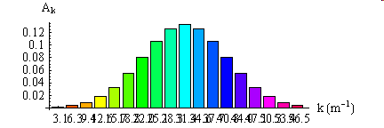
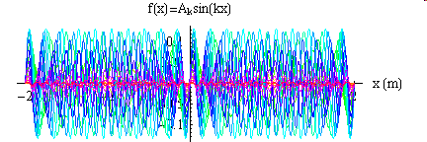

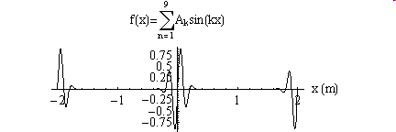
Discrete to Continuous
Show function of:  space  time
◉ space & time
2Δk
Spacing between fourier components:
π/16 π/8 π/4 π/2 π 2π m⁻¹
Width in k space:
Width in x space:
Δx = 0.106 m
Δk = 9.42 m⁻¹
Fundamental frequency:
440 Hz
2Δx
◉ Play sound
Show sines cosines

Slide 24
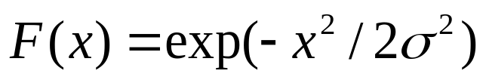
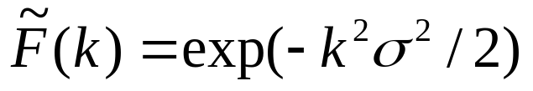
Wave packet widths
Unlike previous panel, this panel shows only wave packets, no other functions. Width of wave functions can be controlled by typing in values for Δx and Δk.
Both wave packets are gaussian, so that if
, then , (or vice versa) and Δx = σ and Δk = 1/σ.
In the case shown here, Δk=3π & Δx=1/3π.
Since Δx & Δk are only half the width of the packet, it seems more intuitive to display 2Δx & 2Δk.

Slide 25
Continuous Fourier Transforms Panel
Learning Goals
To develop an intuition for how continuous fourier transforms work and for what the continuous fourier transforms of various functions look like.

Slide 26
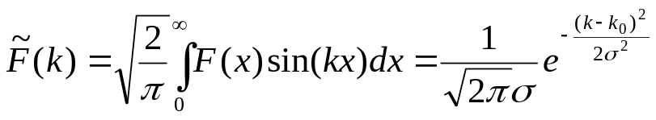
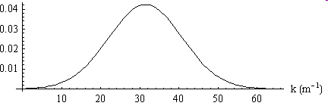
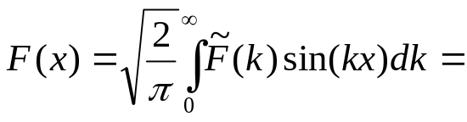
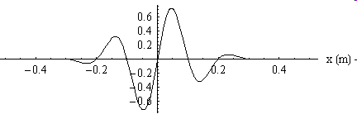
Continuous Fourier Transforms
Show function of:  space  time
◉ space & time
2Δk
Width in k space:
Width in x space:
Δx = 0.106 m
Δk = 9.42 m⁻¹
Enter Function
Fundamental frequency:
440 Hz
2Δx
◉ Play sound
Show sines cosines Complex exponentials

Slide 27
Enter Function
Students should be able to enter any function they like (in a format similar to expression evaluator for Moving Man) for either F(x) or F(k) and the fourier transform will automatically be computed. If the fourier transform is a function that can easily be written down in symbolic form, it should appear, otherwise, leave it blank.

Slide 28
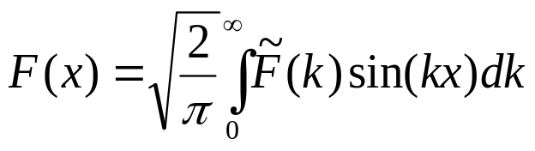
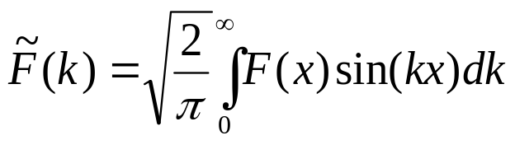
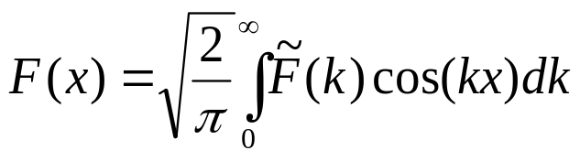

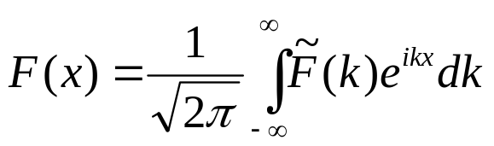
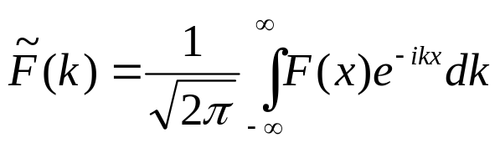
Complex Exponentials
This panel has the option of showing complex exponential transforms as well as sine and cosine transform, since these are more common for continuous transforms.
The kinds of transforms are defined as:
Sin:
Cos:
Exp:

Slide 29
Wave Pulse Shaper Panel
The goal of this panel, from Phil Bucksbaum, is “a pulse shaper with a short pulse going in and a shaped pulse coming out, where the viewer can change the amplitude or phase of any color and see immediately how the pulse shape changes.” This goal is sufficiently different from the other goals that it should have its own panel.
I have not yet worked out how to implement this panel.

