Slide 1
How to Run Vivado HW Manager (any internal/released version) to HW Server on a Win64 PC in XSJ

Slide 2
Summary
How to connect any daily or released version of Vivado HW Manager to a board/HW_SERVER on a Windows PC that is in XSJ in 15 steps/slides? (Which is faster than installing Vivado)
Problem: The only Windows installations of Vivado are on the XCO server and the connection to the XCO server is prohibitively too slow to run Vivado on a Windows PC in XSJ.
Solution A (not practical): Install each version on your local PC, but this takes a long time (>=1 hour) per install.
Solution B:
Locally run the relatively quick-to-start HW_SERVER on your Windows PC from the XCO server Windows installation of the desired Vivado version.
Run the Vivado version on the Linux server farm from the XSJ server installation and connect remotely to your HW_SERVER

Slide 3
Overview of Procedure (in order of steps)
[First, if needed] Install VNC viewer on your local Windows PC
Decide on the Vivado version to run
Run HW_SERVER on your local Windows PC
Start the HW_SERVER from the XCO server Windows installation
Run Vivado in a Linux VNC session
Start a VNC session
Run Vivado on the LSF via the VNC session
Open Vivado Hardware Manager
Remotely connect to the HW_SERVER on your local Windows PC

Slide 4
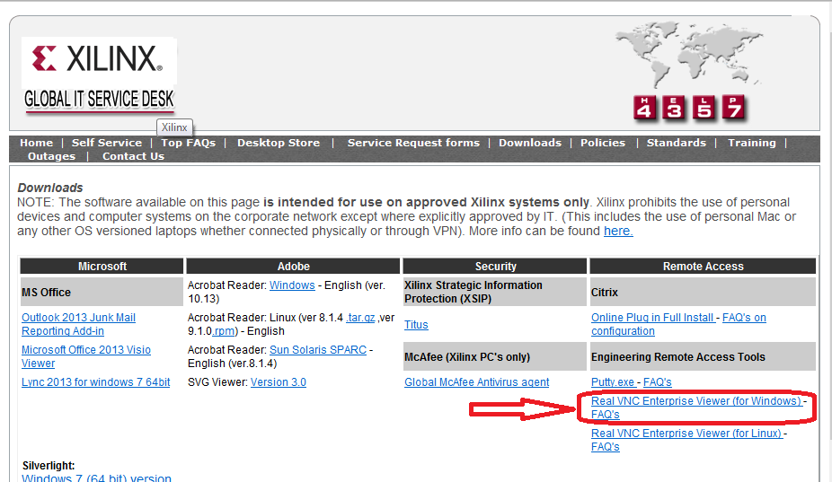
[If Needed] Install VNC on Your Local Windows PC
Go to: http://web/ts/downloads/index.htm
Find and click on the Real VNC Viewer to install
Note: PUTTY terminal .exe is also here for shell/command-line users.

Slide 5
Decide on the Vivado Build/Version to Run CHOOSE: /yyyy.r_<version>/
Vivado installations are found at these sites
XCO server: \\lin.xcoeng2\ifs\test\xbuilds – Windows (nt64) and Linux (lin64)
XSJ server: /proj/xbuilds (\\ppdeng\gdrive\xbuilds) – Linux (lin64) only
Note: You can map a Windows drive to each of the above as needed.
Daily build versions of Vivado are installed in subdirectories with the following nomenclature:
/yyyy.r_daily_build/ for the latest daily build of the planned yyyy.r release
(for example /2016.3_daily_latest/)
Or /yyyy.r_mmdd_b/
where
yyyy = planned release year (e.g. 2016)
r = planned release number (e.g. 1, 2, 3, 4)
mm = month of build (01-12)
dd = day of build (01-31)
b = build number within the day ([first] 1, 2,…[last])
Also, the /released/ subdirectory contains official Vivado released versions

Slide 6
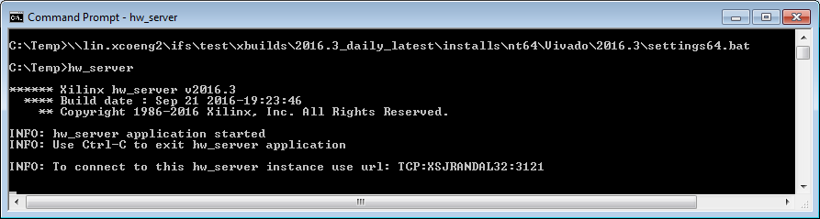
Start HW_SERVER on your Local Windows PC USE: /yyyy.r_<version>/
On your Windows PC, open a Command Prompt window
Establish the settings for running Windows Vivado from XCO installation:
\\lin.xcoeng2\ifs\test\xbuilds\yyyy.r_<version>\installs\nt64\Vivado\yyyy.r\settings64.bat
where yyyy.r_<version> and yyyy.r are the version that you want to run
IMPORTANT: Must be same version as the Vivado version you want to run, to assure connectivity.
Start HW_SERVER:
hw_server
This should take less than 60 seconds to start
The instance URL TCP:hostname:port is important for remotely connecting (later)
Keep this command prompt open. Otherwise, closing the command prompt stops hw_server.

Slide 7
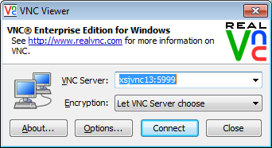

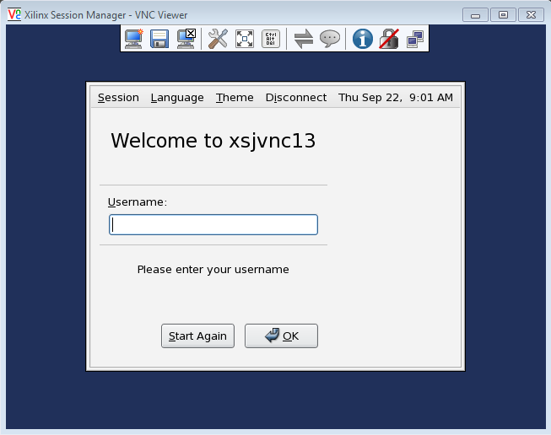
Start a VNC Session – Part 1
Start VNC viewer on your PC
Set the VNC Server to “xsjvnc<N>:5999”
where <N> = a number between 1 and 20
Click the Connect button
In the Xilinx Session Manager
login screen
Enter your Xilinx username and password
For more info and the latest list of VNC servers (xsjvnc<N>:5999), see: http://confluence.xilinx.com/display/ENGCOLLAB/How+to+--+VNC+servers%2C+public

Slide 8
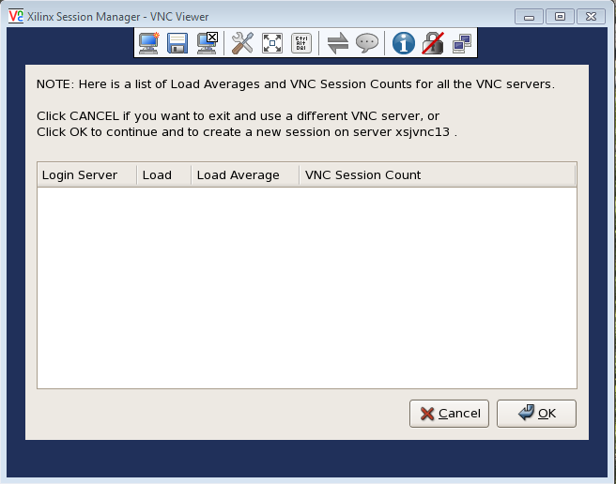
Start a VNC Session – Part 2
After completing the Xilinx Session Manager login, it can take 5 seconds to 60 seconds to see the next screen in the Xilinx Session Manager (depending on the VNC server load):
If the login server list
is empty, then click OK
to create a new session
If the session viewer already has one or more login servers listed, then you already have VNC sessions running and ready to use. If you do not need a new session, remember one of the listed logic servers and click Cancel.

Slide 9
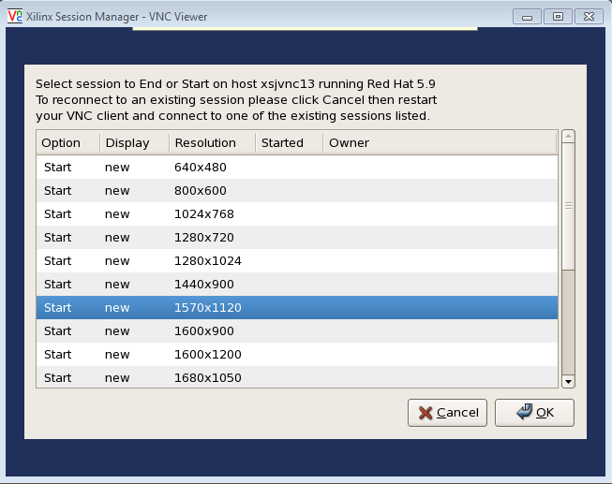
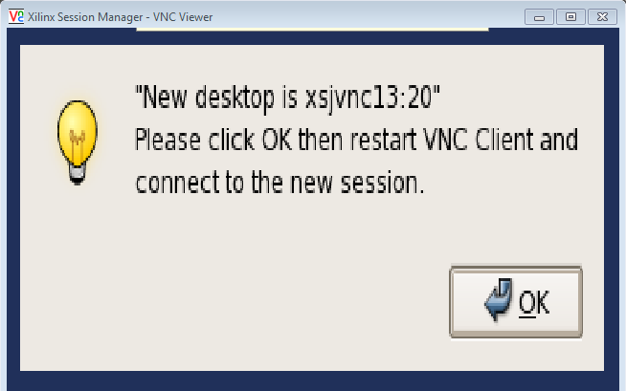
Start a VNC Session – Part 3
For the new session,
select a display size
that fits within your PC display
and click OK
REMEMBER the new desktop
VNC session server address
(In this example it is: “xsjvnc13:20”.)
Click OK, and the VNC viewer
automatically closes.
Note: If you forget the address, restart VNC viewer
and connect to xsjvnc<N>:5999 (xsjvnc13:5999 for
this example) to view the list of running VNC sessions.

Slide 10
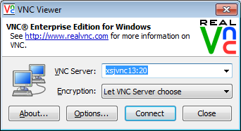
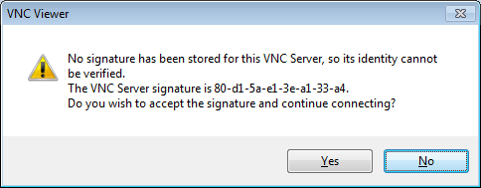
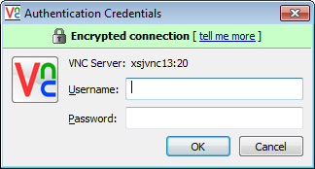
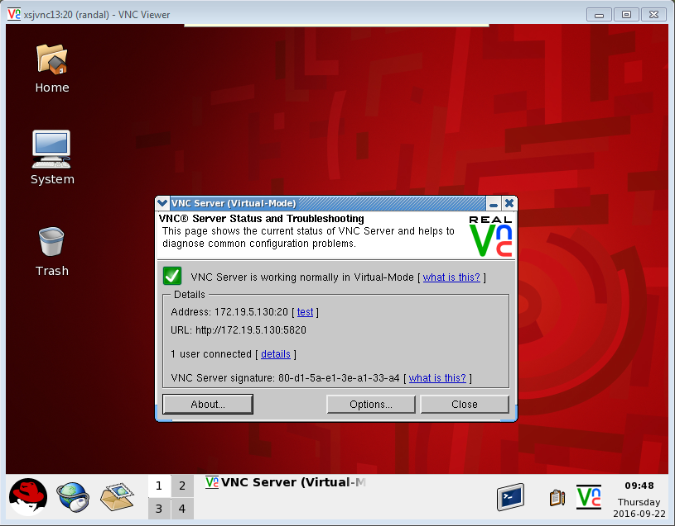
Connect to Your VNC Session
Start VNC viewer on your PC
Set the VNC Server to your VNC session server
In this example, set the VNC Server to the newly created xsjvnc13:20
Click Connect
Accept the signature
Login with your Xilinx username and password
You should see your session desktop

Slide 11

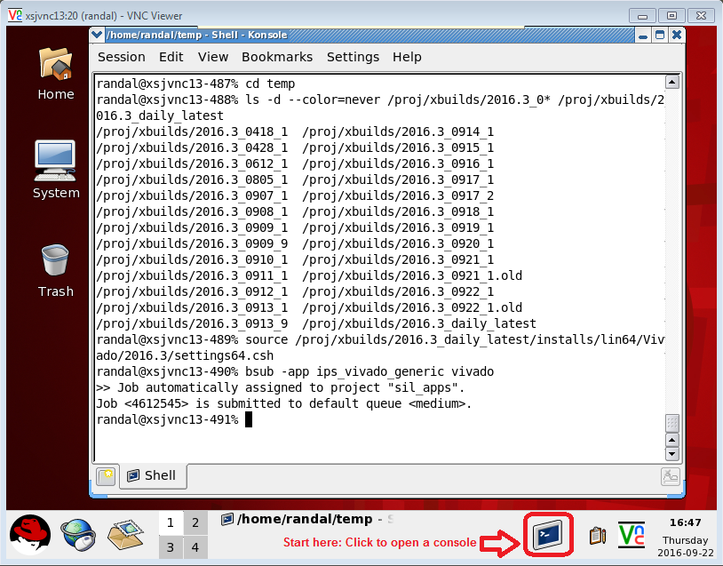
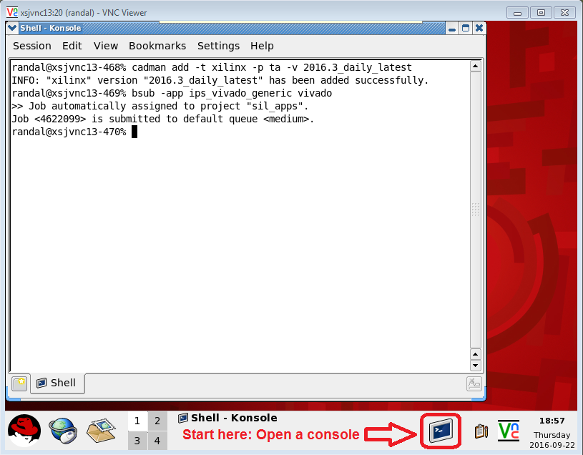
Run Vivado on the LSF via the Linux VNC Session USE: /yyyy.r_<version>/
Click on the console icon to a console window, and then
Setup your environment to run the XSJ Vivado installation by one of the following
cadman add -t xilinx -p ta –v yyyy.r_<version>
or
source /proj/xbuilds/yyyy.r_<version>/installs/lin64/Vivado/yyyy.r/settings64.csh
where yyyy.r_<version> is the version chosen from slide 5, e.g. 2016.3_daily_latest.
Launch Vivado via: “bsub -app ips_vivado_generic vivado”
Note: More info about LSF/bsub: http://confluence.xilinx.com/pages/viewpage.action?pageId=12431314

Slide 12
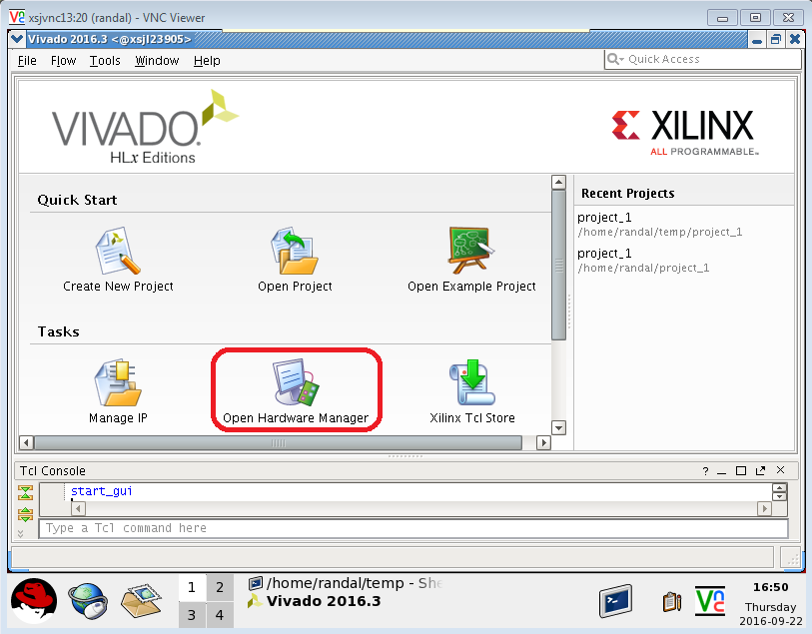
Connect Vivado to HW_SERVER – part 1
In the Vivado VNC session, click Open Hardware Manager

Slide 13
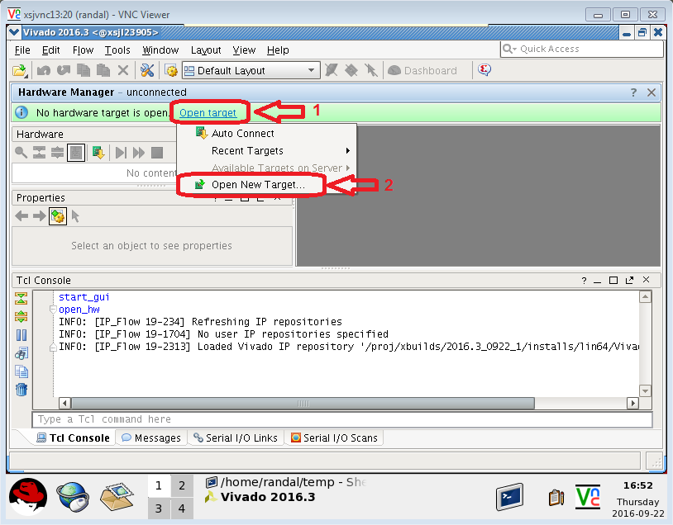
Connect Vivado to HW_SERVER – part 2
Open New Target via these two steps:

Slide 14
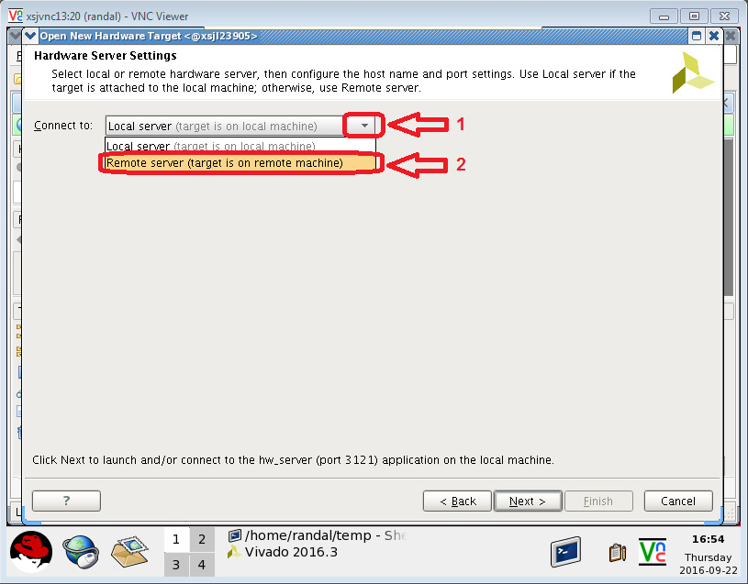
Connect Vivado to HW_SERVER – part 3
Click Next in the Open New Hardware Target wizard to the following page, and select connect to Remote Server via the following two steps
and click Next

Slide 15
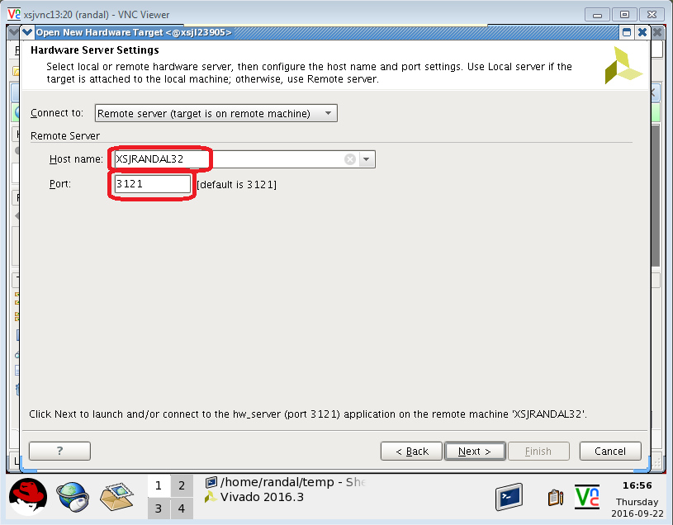
Connect Vivado to HW_SERVER – part 4
Enter your hostname and port from your hw_server instance (see slide 6) and click the Next buttons through Finish button
After the last
Finish button
click, Vivado
should be
connected
to your local
hw_server
DONE!

Slide 16
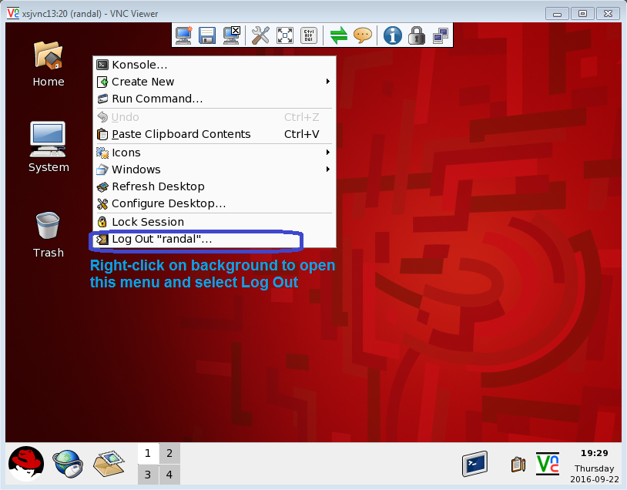
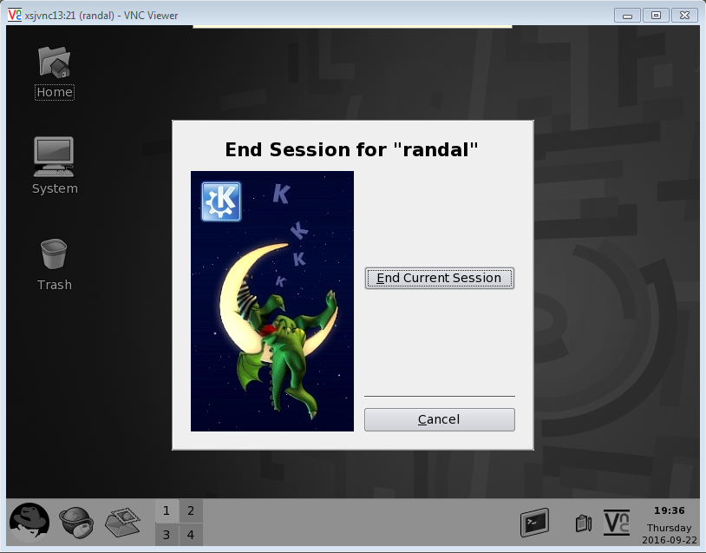
Log Out to End the VNC Session
After quitting Vivado, right-click in the background of the VNC desktop, click on Log Out, click on End Current Session in the next dialog window, and close the window

