Slide 1
Predicting if a college basketball player will be drafted to the NBA
By Tyler Evans, Princeton Duarte, AJ Marstall & Emily Andrews

Slide 2

Cleaning the Data
NOTE:
To change images on this slide, select a picture and delete it. Then click the Insert Picture icon
in the placeholder to insert your own image.

Slide 3
Cleaning the Data
Add your first bullet point here
Add your second bullet point here
Add your third bullet point here

Slide 4
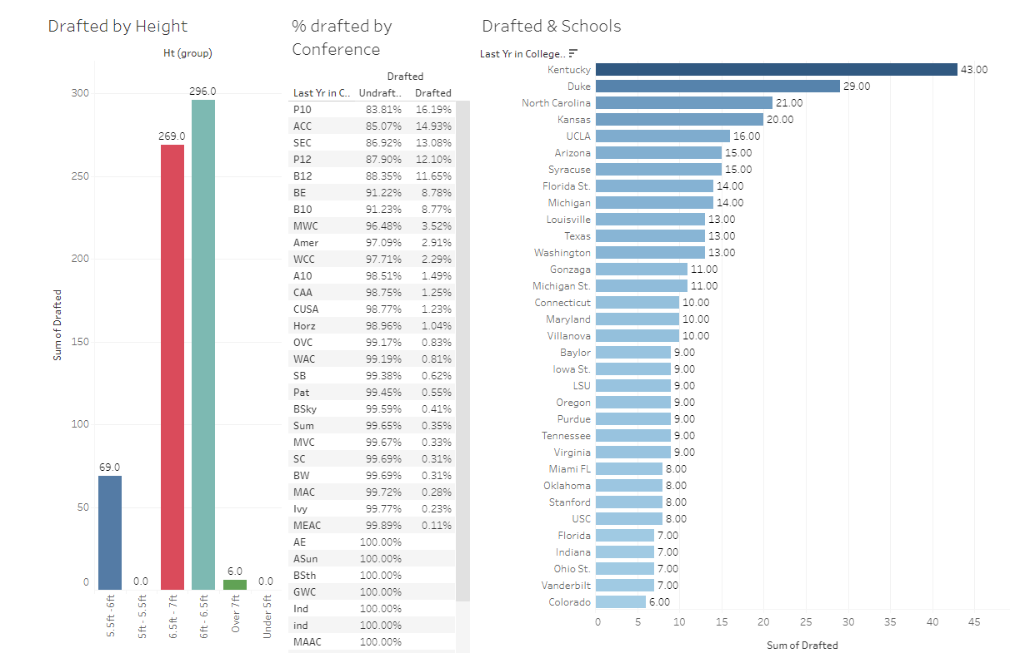
The possibility of being drafted using stats on School, height, and Conference.
Kentucky tends to have the most drafted players in the data we found. And the School with the second most drafted players was Duke which had 14 fewer players drafted than Kentucky.
Drafted players' heights typically are between six feet to seven feet (No surprise there). And sorry no one under five feet five inches was drafted.
Conferences with the schools associated as “Blue Bloods Schools” (Kentucky, Duke, North Carolina, Kansas, and UCLA) tends to have more drafted players than any other Conferences.

Slide 5
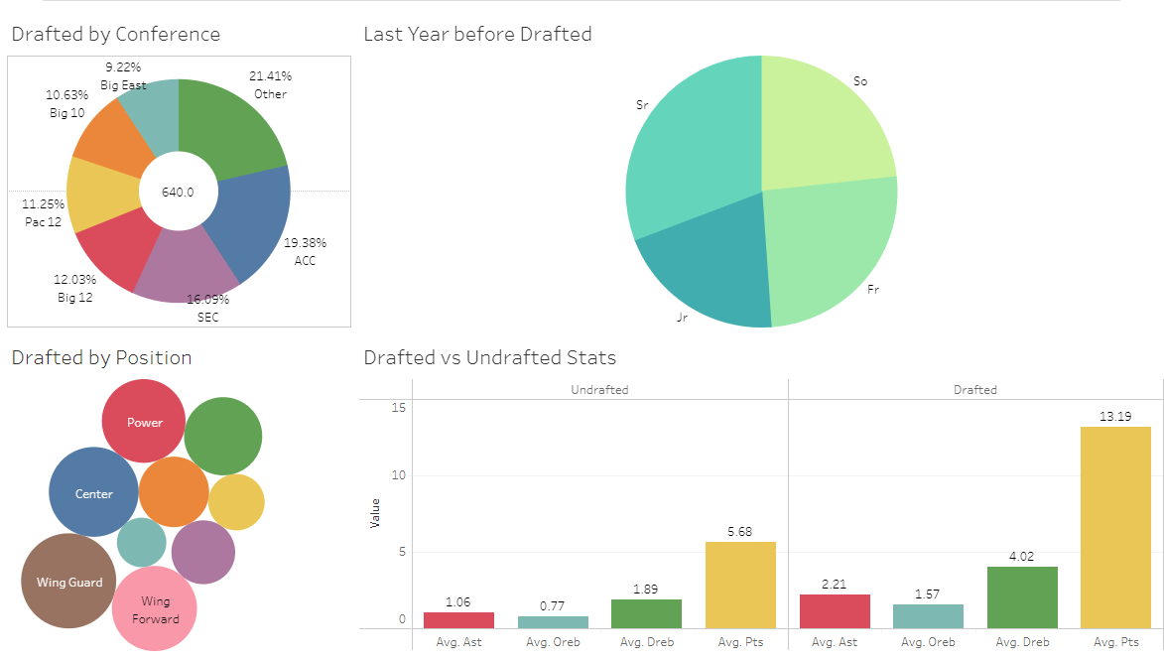
Stats that did not help to determine if a player will be drafted
Although Schools and Conferences do help in determining whether a player gets drafted. Of the 640 players, the chart shows the spread across all conferences.
The position a player was in college did not contribute to a player being drafted.
The last year they played in college before being drafted did not contribute to a player being selected.
As for stats that most fans associate with basketball: points scored, assists, and rebounds. There was a slight difference in the average between undrafted and drafted players.

Slide 6
Machine Learning
First bullet point here
Second bullet point here
Third bullet point here
Class | Group 1 | Group 2
Class 1 | 82 | 95
Class 2 | 76 | 88
Class 3 | 84 | 90

Slide 7
Lessons Learned
With unlimited time what would we change?

Slide 8
Questions??

