Slide 1




Slide 2
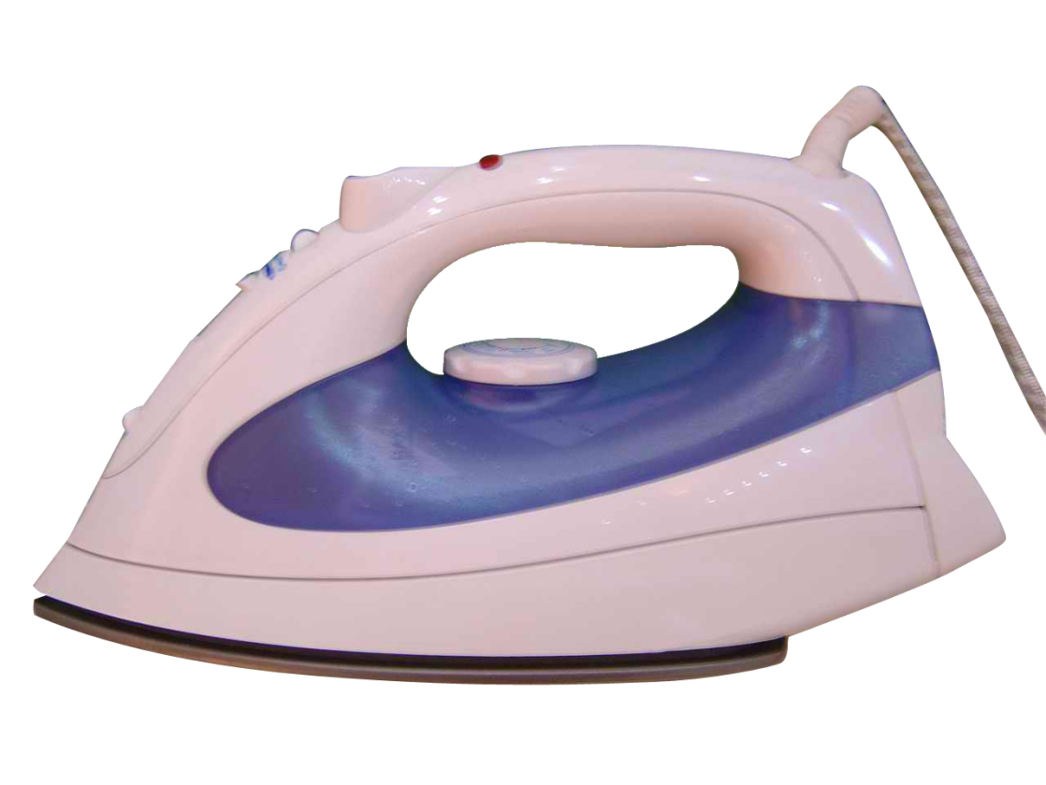


Slide 3
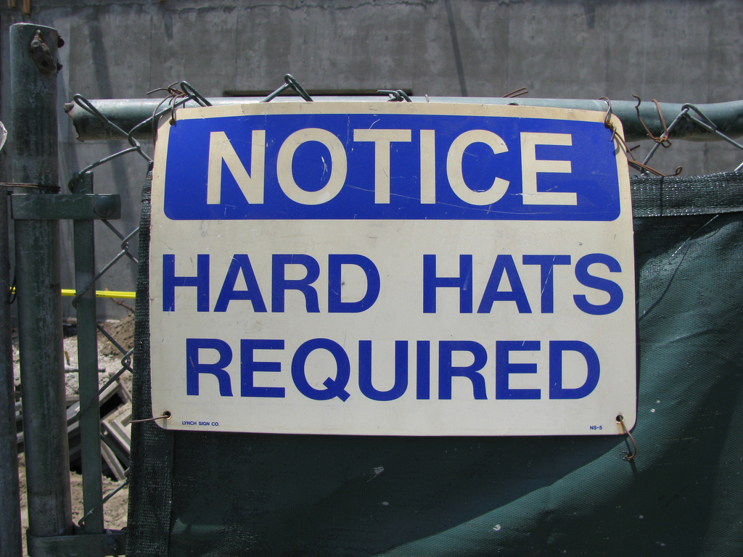

Slide 4
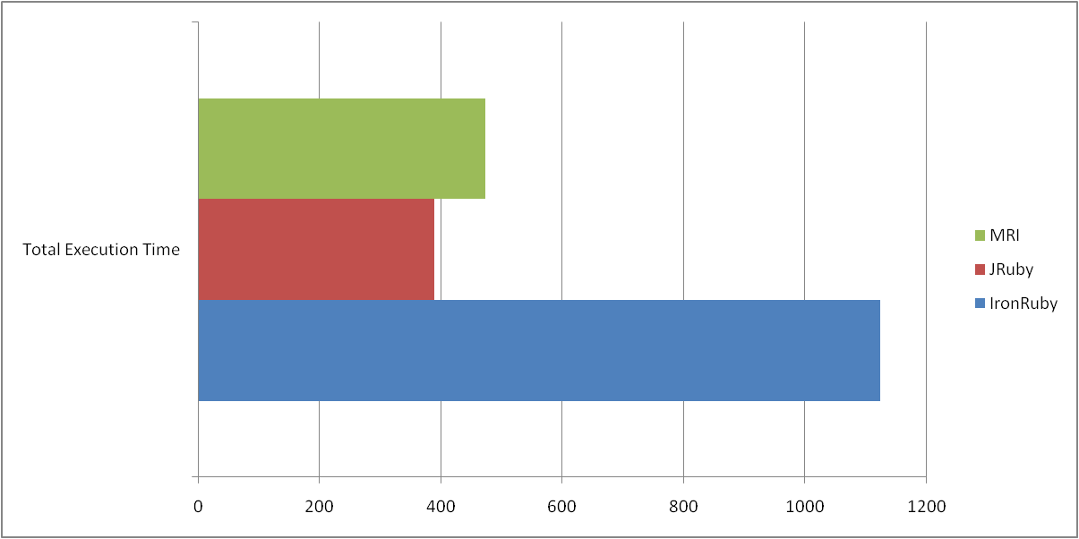

Slide 5
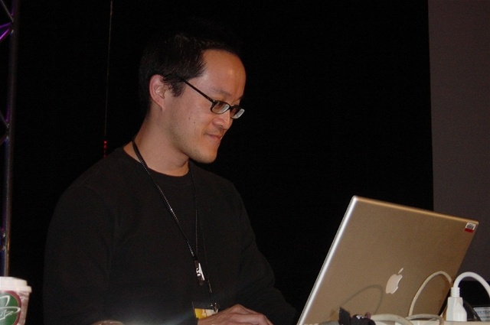
“ 1.Our primary goal is to run real Ruby programs.
2. Our next goal is excellent .NET Interop
Note that this is a priority list. Given limited resources 1) trumps 2). “
John Lam

Slide 6



Slide 7


Slide 8



Iron Ruby Wiki: http://www.ironruby.net
RubyForge: http://rubyforge.org/projects/ironruby
John Lam’s Blog: http://www.iunknown.com
Jimmy Schementi’s Blog: http://blog.jimmy.schementi.com/
IRC: irc.freenode.net/#ironruby

Slide 9

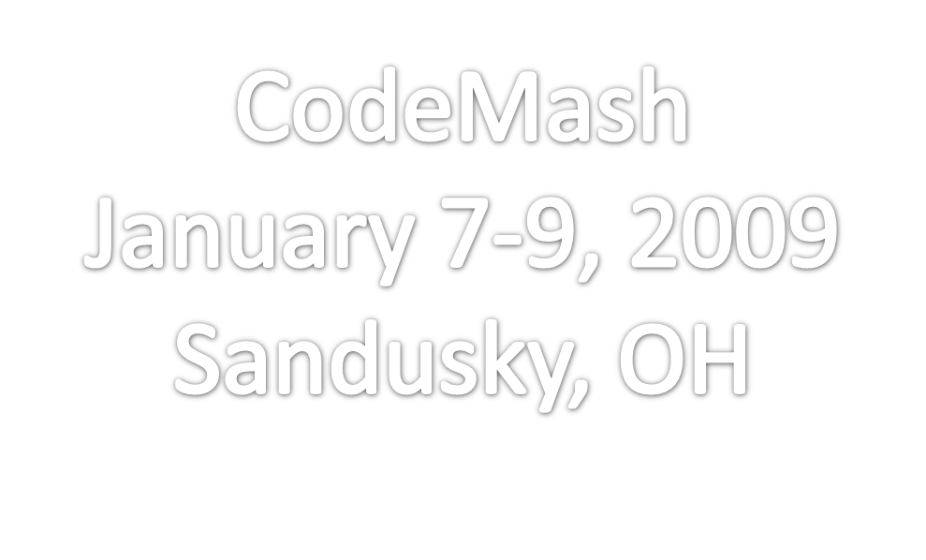


Slide 10
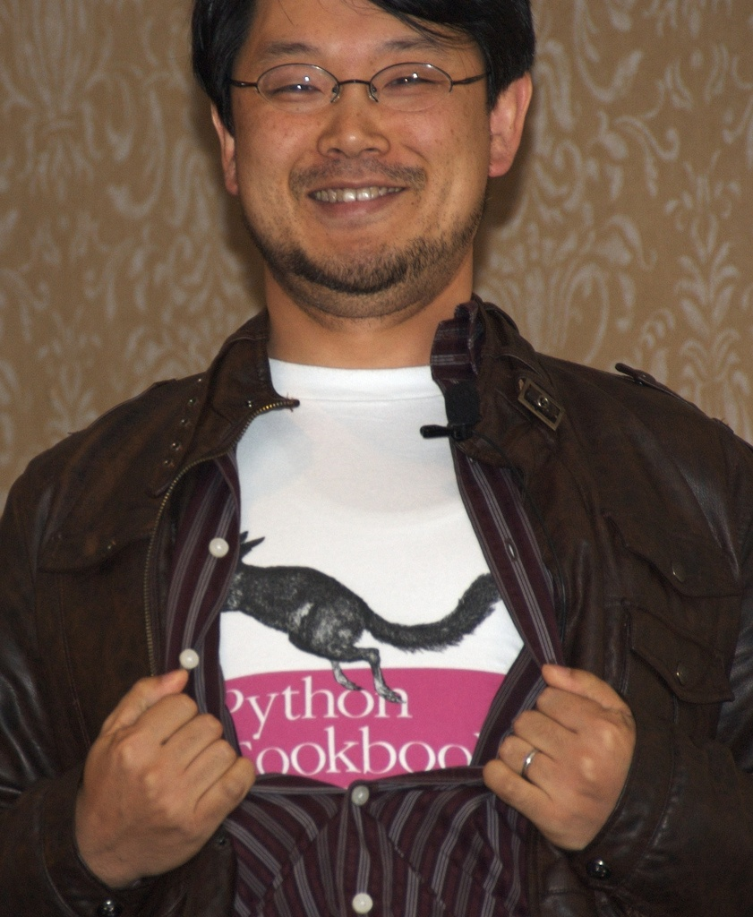
Name:
Michael Letterle
Twitter:
TheProkrammer
Blog: http://blog.prokrams.com
Email:
michael.letterle@gmail.com

