Slide 1
…
PE[0,0]
PROC[0,0]
PE[0,1]
STO1[0,0]
PE[0,2]
PROC[0,1]
PE[0,3]
STO1[0,1]
…
PE[1,0]
STO2[0,0]
PE[1,1]
STO3[0,0]
PE[1,2]
STO2[0,1]
PE[1,3]
STO3[0,1]
…
PE[2,0]
PROC[1,0]
PE[2,1]
STO1[1,0]
PE[2,2]
PROC[1,1]
PE[2,3]
STO1[1,1]
…
PE[3,0]
STO2[1,0]
PE[3,1]
STO3[1,0]
PE[3,2]
STO2[1,1]
PE[3,3]
STO3[1,1]
…
…
…
…

Slide 2
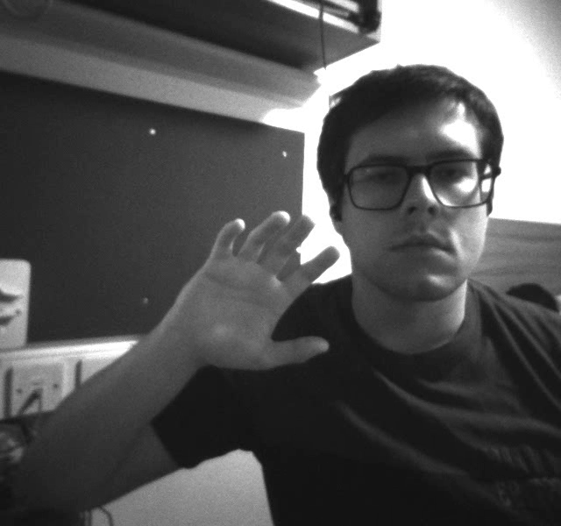
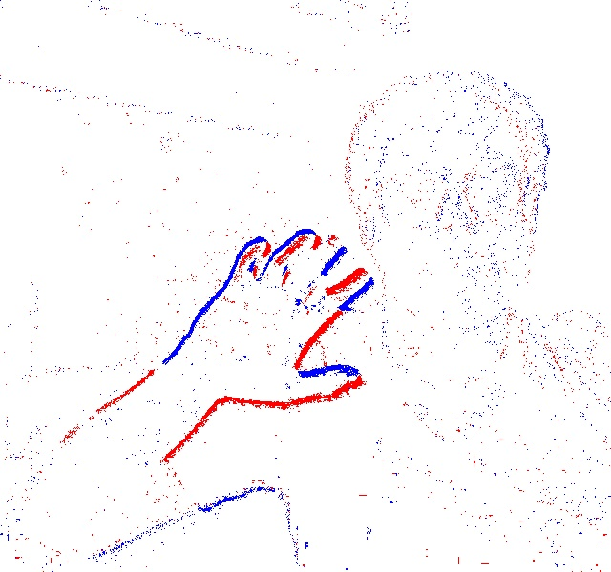
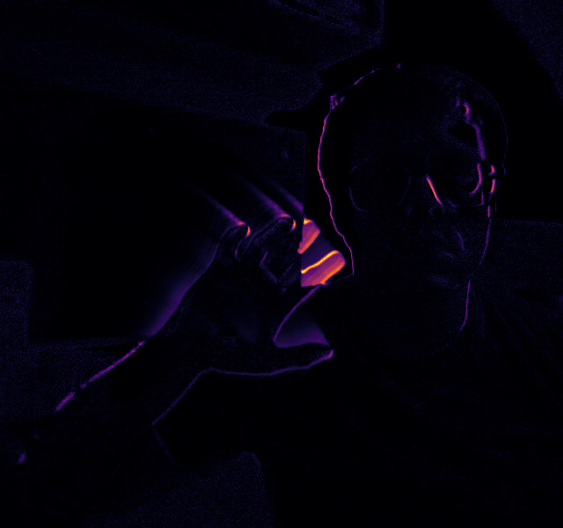
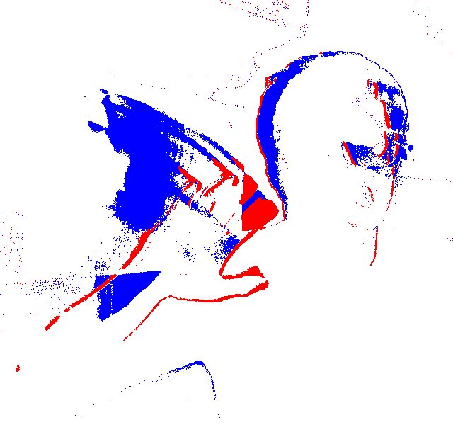
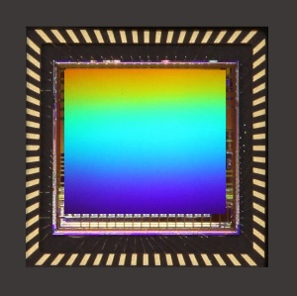
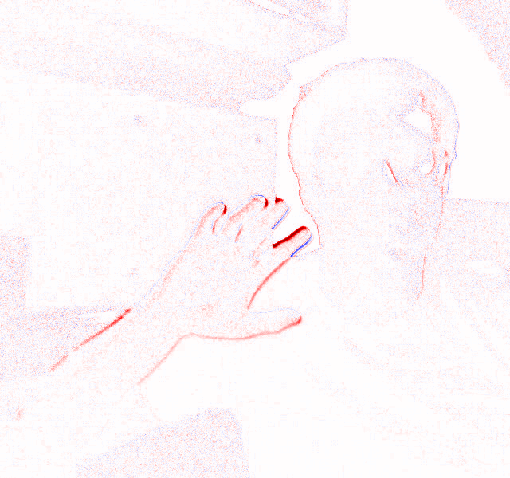
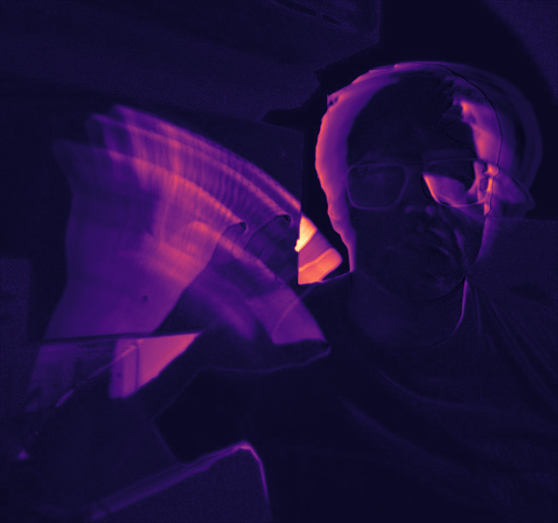
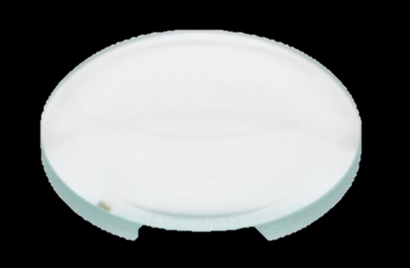
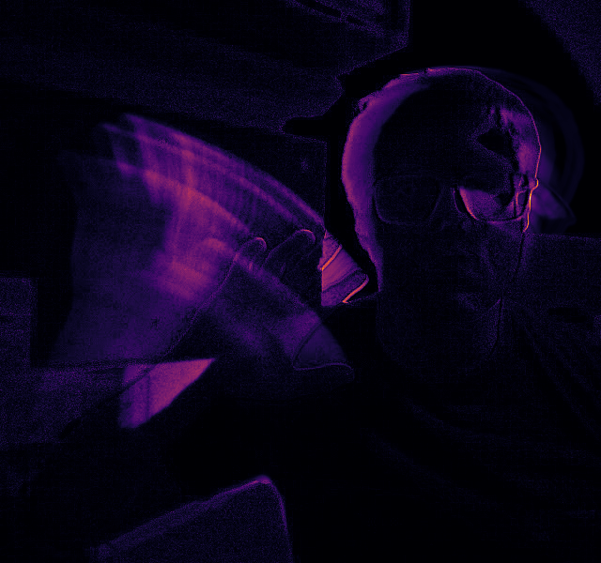
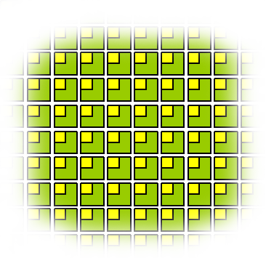
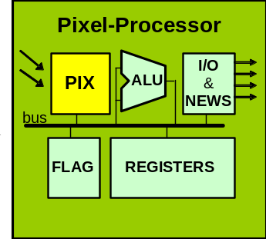




a)
b)
DVS
e)
Neural Network
x,y,p,t
Silicon Retina
f)
Compare
a)
$$V_{LIF}^{+}$$
d)
c)
$$I_{OPL}$$
$$V_{BIP}$$
e)
Neural Network
$$V_{LIF}^{−}$$

Slide 3
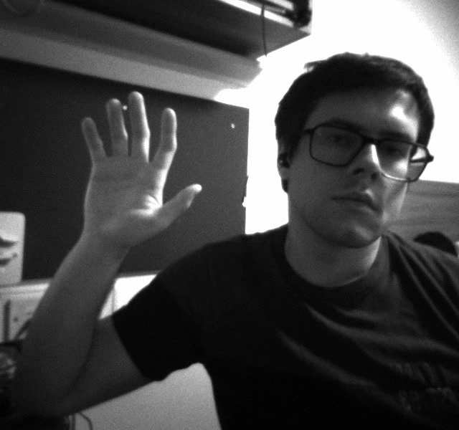
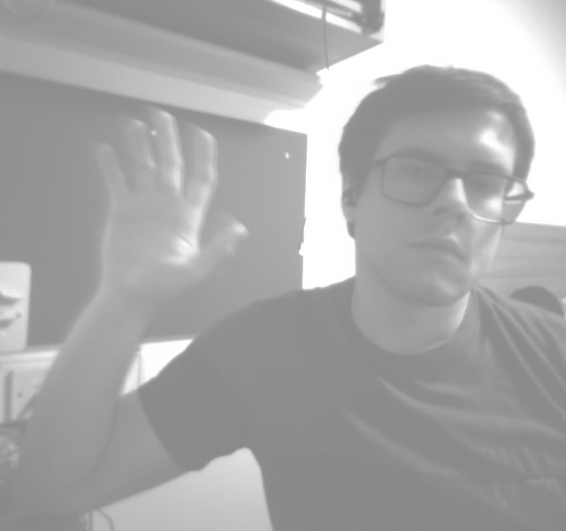
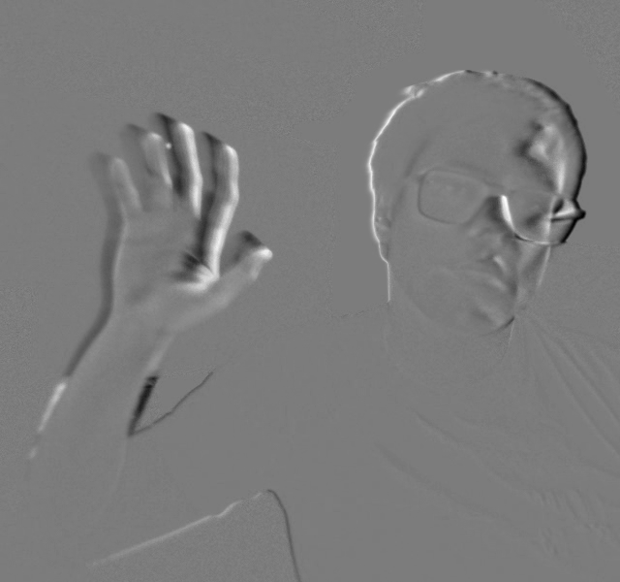
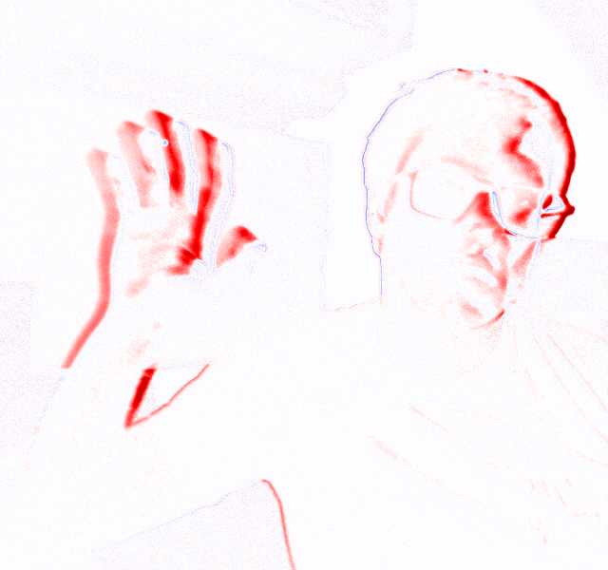
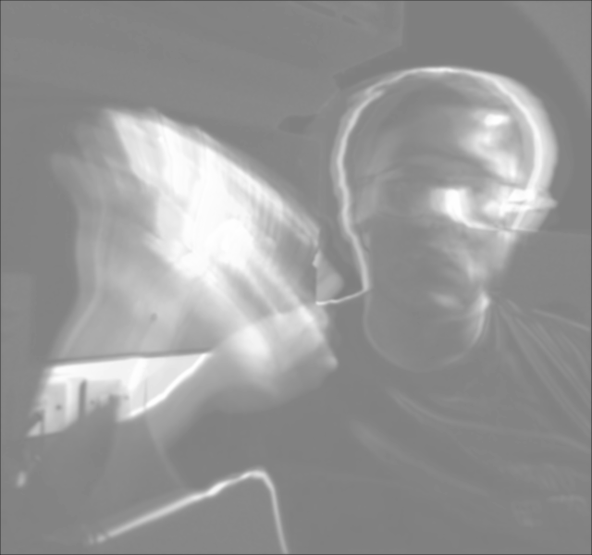
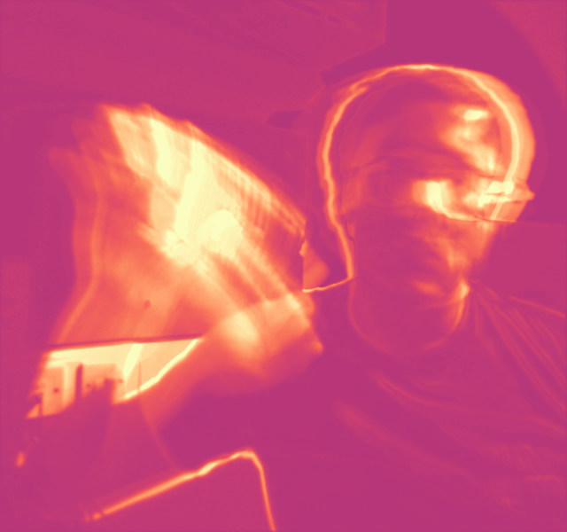
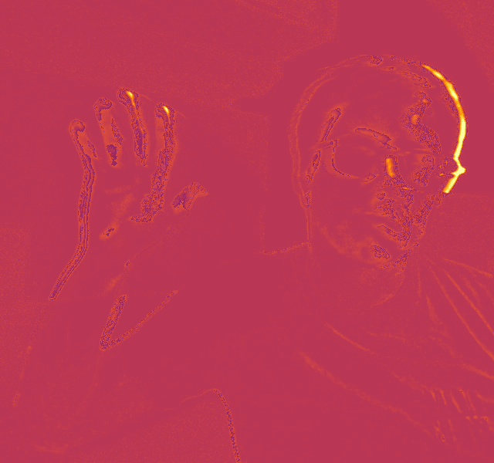
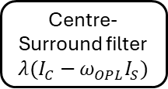
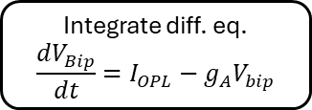

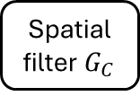
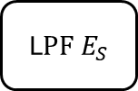
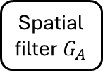



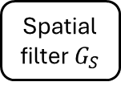
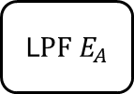
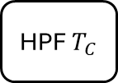

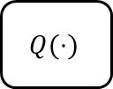

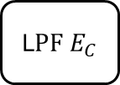
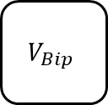
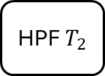
Outer Plexiform Layer (OPL)
Contrast Gain Control
Spiking Behaviour
Models photoreceptors and horizontal cells
Models Bipolar Cells
Models Retinal Ganglion Cells
Centre current computation
$$I_{OPL}$$
$$I_{gang}$$
Leaky
Integrate
Neurons
Image
Capture
Spatial
filter $G_{C}$
L$PF E_{C}$
HPF$T_{C}$
$$I_{C}$$
Centre-Surround filter
$$λ(I_{C}−ω_{OPL}I_{S})$$
Integrate diff. eq.
$$\frac{{dV}_{Bip}}{dt}=I_{OPL}−g_{A}V_{bip}$$
HPF$T_{2}$
$$N(⋅)$$
$$I_{s}$$
$$g_{A}$$
Spatial filter$G_{S}$
L$PF E_{S}$
$$Q(⋅)$$
L$PF E_{A}$
Spatial
filter $G_{A}$
Surround current computation
$$V_{Bip}$$

