Slide 1
Transforming Domain Models to Efficient C# for the Danish Pension Industry
by Holger Borum and Morten Tychsen Clausen
Innovation Fund Denmark (7076-00029B)

Slide 2



Danish Companies and Pension Schemes
Average Rate Products
Market Rate Products

Slide 3
The Danish Pension Industry
4,773 bn. DKK
Other Assets
Other Liabilities
Bonds
Reserve for Market Rate Products
Reserve for Average Rate Products
Stocks and Investments
Assets
Liabilities

Slide 4

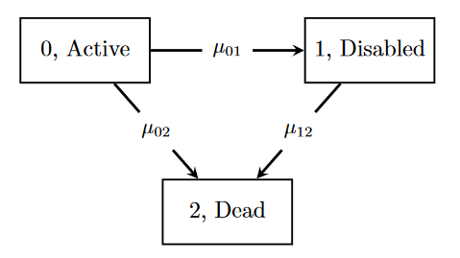








Projections and Optimisations
2022
2122
1. Sacrifice Precision
Source: Alexander Sevel Lollike, Projections in Life Insurance and the Equilibrium Approach to Utility Optimization
2. Improve Efficiency
4+4+4+4 or 4²

Slide 5
Projection Platform
Projection Platform

Slide 6
Example: Deposit Rate (MAL)
fun CalculateDepositRate( interestGroup : Interest
, reserve : Float
, guaranteedBenefit : Float
, riskMargin : Float) =
let technicalInterestRates =
map p1 in interestGroup.Policies:OneStatePolicy
with CalculateTechnicalInterestRate1(p)
end +
map p3 in interestGroup.Policies:ThreeStatePolicy
with CalculateTechnicalInterestRate3(p3)
end
let technicalReserves = map p in interestGroup.Policies with Util.getPolicyReserve(p) end
let totalDeposits = sum(technicalReserves)
in
if totalDeposits == 0 then
average(technicalInterestRates)
else
let totalInterestOfDeposits = Util.dotProduct(technicalInterestRates, technicalReserves)
let marketValueAdjustment = Util.atLeastZero(guaranteedBenefit + riskMargin - totalDeposits)
let unscaledRate = interestGroup.Param.DividendScalingFactor * (reserve - marketValueAdjustment)
+ totalInterestOfDeposits
in
bound(unscaledRate / totalDeposits, -0.3, 0.3)
end
end

Slide 7
Transformation of Type Unions
public interface OneStatePolicy_ThreeStatePolicy
{
Policy Child { get; set; }
}
data Policy
{
Child : Policy
}
data OneStatePolicy extends Policy
{
Child : ThreeStatePolicy
}
data ThreeStatePolicy extends Policy
{
DeathIntensity : Float
InvalidIntensity : Float
}
public class OneStatePolicy
: Policy, OneStatePolicy_ThreeStatePolicy
{
private ThreeStatePolicy _Child;
public new ThreeStatePolicy Child
{ get { return _Child;}
set { _Child = value;
base.Child = value;}
}
}

Slide 8
Transformation of Type Filtering
data Policy
{
Child : Policy
}
data OneStatePolicy extends Policy
{
Child : ThreeStatePolicy
}
data ThreeStatePolicy extends Policy
{
DeathIntensity : Float
InvalidIntensity : Float
}
public class TypeSpan_OneStatePolicy_ThreeStatePolicy
: IEnumerable<OneStatePolicy_ThreeStatePolicy>
{
private OneStatePolicy[] OneStatePolicy;
private ThreeStatePolicy[] ThreeStatePolicy;
public TypeSpan_OneStatePolicy Filter_OneStatePolicy()
{
return new TypeSpan_OneStatePolicy(OneStatePolicy);
}
/* Remaining Filters and enumeration omitted. */
}

Slide 9
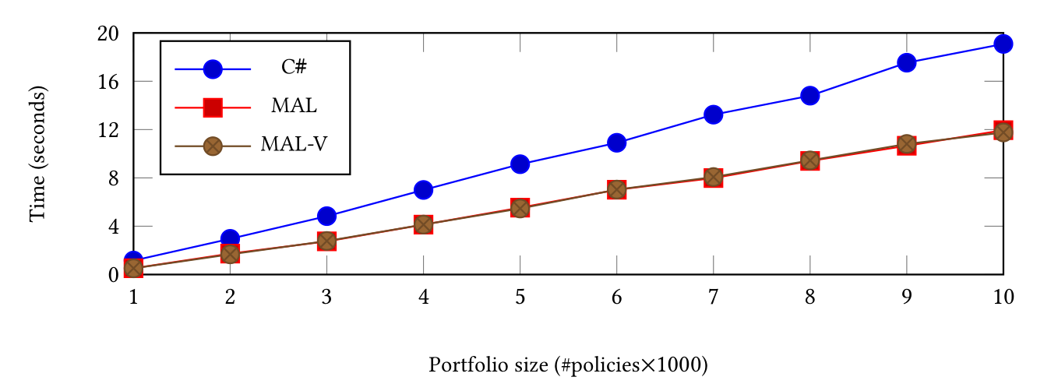
Development Benchmarks

Slide 10
Observation 1
Observation 1. The execution time of all solutions scales linearly in the number of policies

Slide 11
Observation 2
Observation 2. For all number of policies, the solution generated from an MAL program is faster than the C # solution with a speedup factor of approximately 1.3×

Slide 12
Observation 3
Observation 3. We cannot find any difference in the execution time of code generated with and without vectorisation

Slide 13
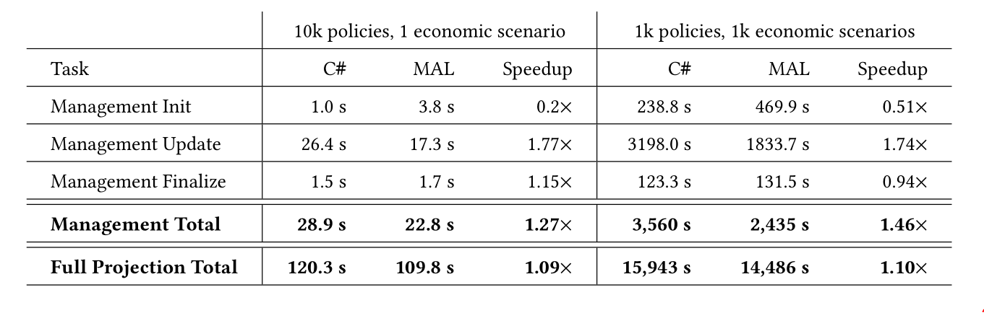
Production Benchmarks

Slide 14
Conclusion
An identification of specification patterns pervasive in management action specifications.
Implementation strategy for generating code from these specifications with C # as target language.
Positive results that show a speedup when benchmarking generated code against comparable handwritten code.
Negative results that do not show a speedup for loop vectorisation.

