Slide 1

Android Introduction
Maxim Leykin (maxim.leykin@gmail.com)

Slide 2

Course Information
Agenda:
Android Introduction
Activity Lifecycle
Intents & Intent Filters
Resources & UI creation & Material Design
Storages & Content Providers & Permissions
Multithreading & Networking
Power Management & Optimization
Debugging & Profiling
Maps & Sensors
Push notifications via FCM
What’s new in Android 8/9?
Kotlin language overview
Android Auto & Wear & Things overview
Trainer: Maxim Leykin
Delivery Manager, EPAM (www.epam.com)
E-Mail: maxim.leykin@gmail.com

Slide 3
Specifics of mobile devices and mobile development

Slide 4
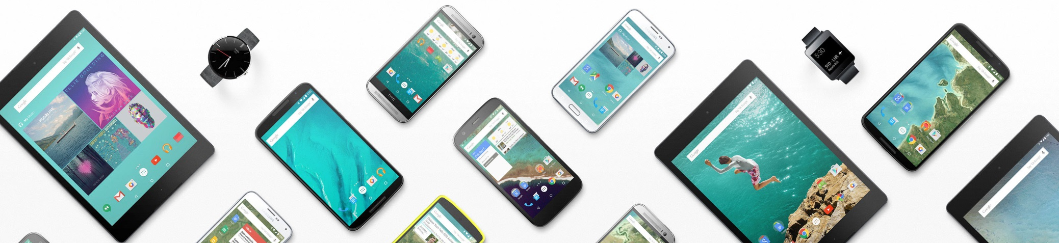
Mobile devices specifics
Less powerful CPU & GPU
Less amount of memory and storage
Smaller screen sizes
Network connectivity may be unstable and slow
Network transfer may cost money
Limited battery capacity
Huge variety of devices from numerous vendors

Slide 5

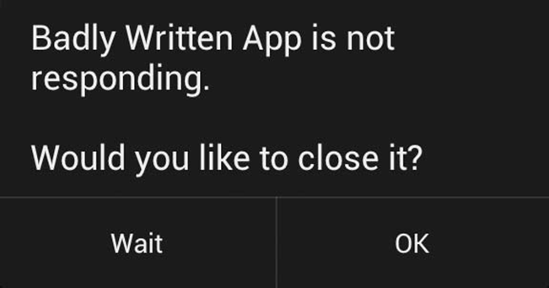
Mobile development specifics
Optimize code by size and speed
Consider different screen sizes
Consider possible connectivity loss
Think about battery usage and charges
Keep app responsiveness

Slide 6
Android Platform

Slide 7
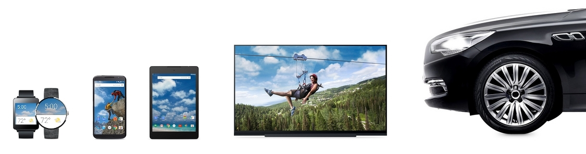
What is Android?
Android is a mobile operating system developed by Google, based on the Linux kernel and designed primarily for touchscreen mobile devices such as smartphones and tablets. In addition to touchscreen devices, Google has further developed Android TV for televisions, Android Auto for cars, and Android Wear for wrist watches, each with a specialized user interface. Variants of Android are also used on notebooks, game consoles, digital cameras, and other electronics.
You can create application for Android using Java and Kotlin directly, C/C++ via Android NDK, HTML5/JavaScript using special frameworks like ReactNative, C# using Xamarin.
Official: www.android.com

Slide 8
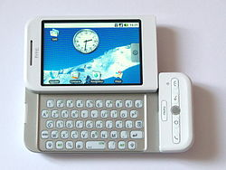
Who develops Android?
Originally developed by Android Inc. (Andy Rubin, Rich Miner, Nick Sears, Chris White), which was bought by Google in 2005.
Later, Google initiated foundation of Open Handset Alliance (OHA), which supports and maintains platform currently.
The HTC Dream (also known as the T-Mobile G1 in the United States of America and parts of Europe, and as the Era G1 in Poland) is a smartphone developed by HTC. First released in September 2008, the Dream was the first commercially released device to use the Linux-based Android operating system
Google Inc. www.google.com
Open Handset Alliance www.openhandsetalliance.com

Slide 9
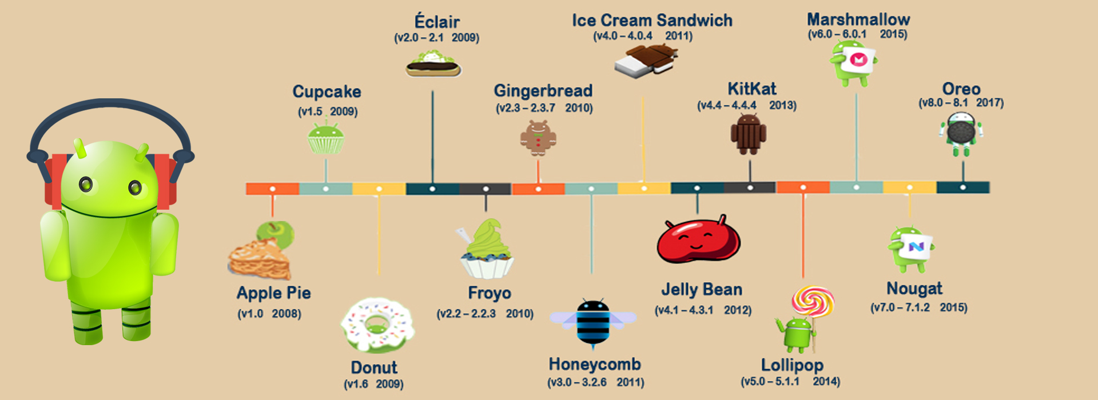

Versions of Android
Android 9.0 Pie
(official release Aug, 2018)

Slide 10
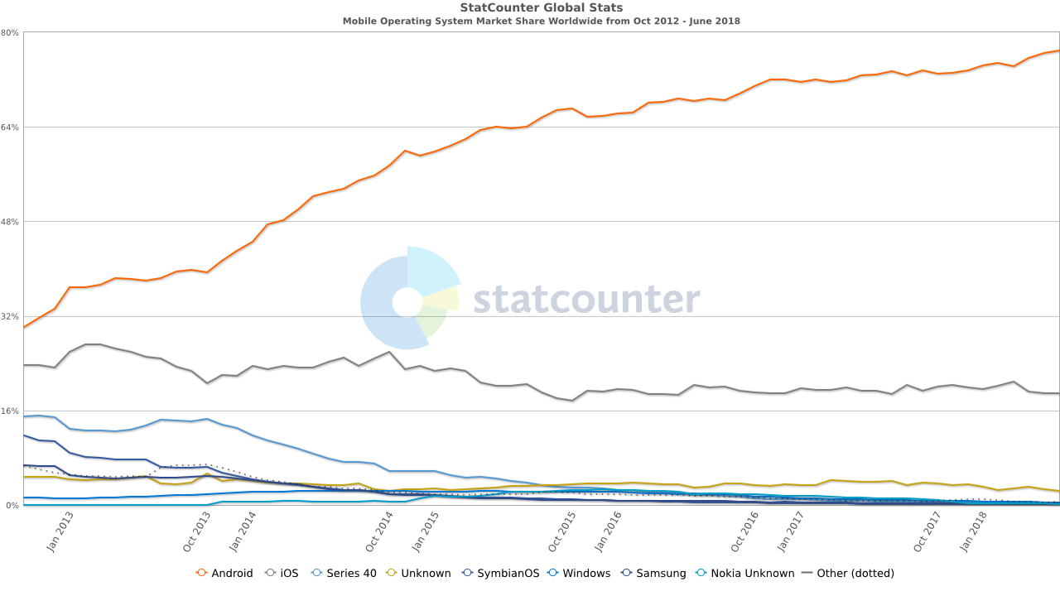
Android Market Share
http://gs.statcounter.com/os-market-share/mobile/worldwide/#monthly-201210-201806

Slide 11
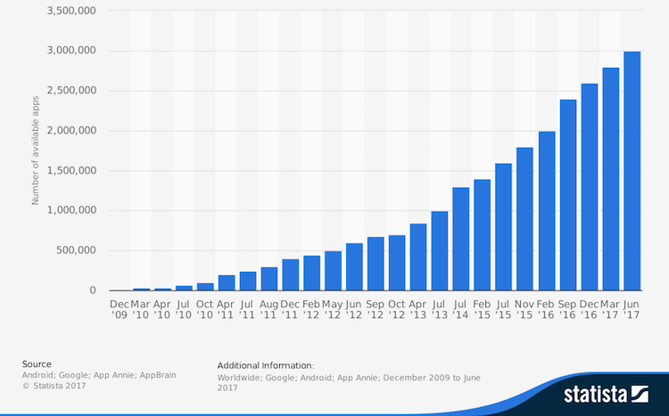
Google Play
Google Play (former Android Market) — online marketplace powered by Google which allows to download and purchase Android applications.
Google Developer License costs $25 and allows to publish both free and paid apps on Google Play. App developers will get 70% from app price, 30% go for billing , hosting, taxes. Google has no profit from Google Play.

Slide 12


Android Pros and Cons
Open-source model
Wide adoption
Hundreds of Vendors
Thousands of Devices
Billions of Applications
Used in automotive, healthcare, wearables, Consumer Electronics
Compatibility Issues
Delays or problems with platform updates
Insufficient level of security

Slide 13
Key Platform Features

Slide 14
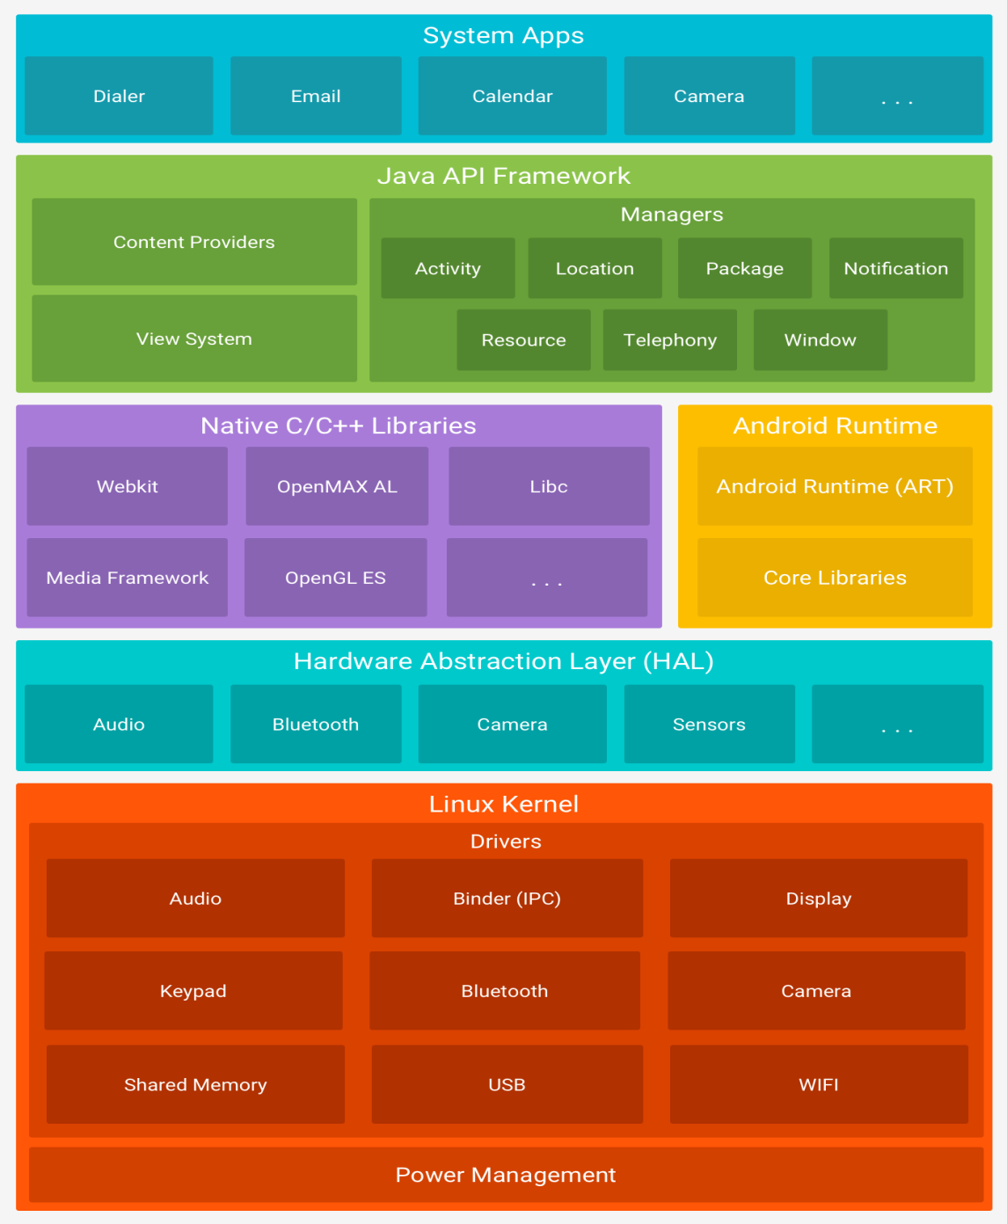
Android Architecture

Slide 15

Android Architecture
The Linux Kernel
The foundation of the Android platform is the Linux kernel. For example, the Android Runtime (ART) relies on the Linux kernel for underlying functionalities such as threading and low-level memory management. Using a Linux kernel allows Android to take advantage of key security features and allows device manufacturers to develop hardware drivers for a well-known kernel.
Hardware Abstraction Layer (HAL)
The hardware abstraction layer (HAL) provides standard interfaces that expose device hardware capabilities to the higher-level Java API framework. The HAL consists of multiple library modules, each of which implements an interface for a specific type of hardware component, such as the camera or bluetooth module. When a framework API makes a call to access device hardware, the Android system loads the library module for that hardware component.

Slide 16
Android Architecture
Android Runtime
For devices running Android version 5.0+ (API level 21), each app runs in its own process and with its own instance of the Android Runtime (ART). ART is written to run multiple virtual machines on low-memory devices by executing DEX files, a bytecode format designed specially for Android that's optimized for minimal memory footprint. Build toolchains, such as Jack, compile Java sources into DEX bytecode, which can run on the Android platform. Some of the major features of ART include the following:
Ahead-of-time (AOT) and just-in-time (JIT) compilation
Optimized garbage collection (GC)
Better debugging support, including a dedicated sampling profiler, detailed diagnostic exceptions and crash reporting, and the ability to set watchpoints to monitor specific fields
Prior to Android version 5.0 (API level 21), Dalvik was the Android runtime. If your app runs well on ART, then it should work on Dalvik as well, but the reverse may not be true.

Slide 17
Android Architecture
Android also includes a set of core runtime libraries that provide most of the functionality of the Java programming language, including some Java 8 language features, that the Java API framework uses.
Native C/C++ Libraries
Many core Android system components and services, such as ART and HAL, are built from native code that require native libraries written in C and C++. The Android platform provides Java framework APIs to expose the functionality of some of these native libraries to apps. For example, you can access OpenGL ES through the Android framework’s Java OpenGL API to add support for drawing and manipulating 2D and 3D graphics in your app. If you are developing an app that requires C or C++ code, you can use the Android NDK to access some of these native platform libraries directly from your native code.

Slide 18
Android Architecture
Java API Framework
The entire feature-set of the Android OS is available to you through APIs written in the Java language. These APIs form the building blocks you need to create Android apps by simplifying the reuse of core, modular system components and services, which include the following:
A rich and extensible View System you can use to build an app’s UI, including lists, grids, text boxes, buttons, and even an embeddable web browser
A Resource Manager, providing access to non-code resources such as localized strings, graphics, and layout files
A Notification Manager that enables all apps to display custom alerts in the status bar
An Activity Manager that manages the lifecycle of apps and provides a common navigation back stack
Content Providers that enable apps to access data from other apps, such as the Contacts app, or to share their own data
Developers have full access to the same framework APIs that Android system apps use.

Slide 19
Android Architecture
System Apps
Android comes with a set of core apps for email, SMS messaging, calendars, internet browsing, contacts, and more. Apps included with the platform have no special status among the apps the user chooses to install. So a third-party app can become the user's default web browser, SMS messenger, or even the default keyboard (some exceptions apply, such as the system's Settings app).
The system apps function both as apps for users and to provide key capabilities that developers can access from their own app. For example, if your app would like to deliver an SMS message, you don't need to build that functionality yourself—you can instead invoke whichever SMS app is already installed to deliver a message to the recipient you specify.

Slide 20
CPU Architecture and License Info
Supported CPU Architectures:
32- and 64-bit: ARM architectures
x86 and x86-64
MIPS and MIPS64
Licensing:
Kernel – GPL v2
Other parts – Apache Software License v2
Copyright [yyyy] [name of copyright owner]
Licensed under the Apache License, Version 2.0 (the "License");
you may not use this file except in compliance with the License.
You may obtain a copy of the License at
http://www.apache.org/licenses/LICENSE-2.0
Unless required by applicable law or agreed to in writing, software distributed under the License is distributed on an "AS IS" BASIS, WITHOUT WARRANTIES OR CONDITIONS OF ANY KIND, either express or implied. See the License for the specific language governing permissions and limitations under the License.

Slide 21
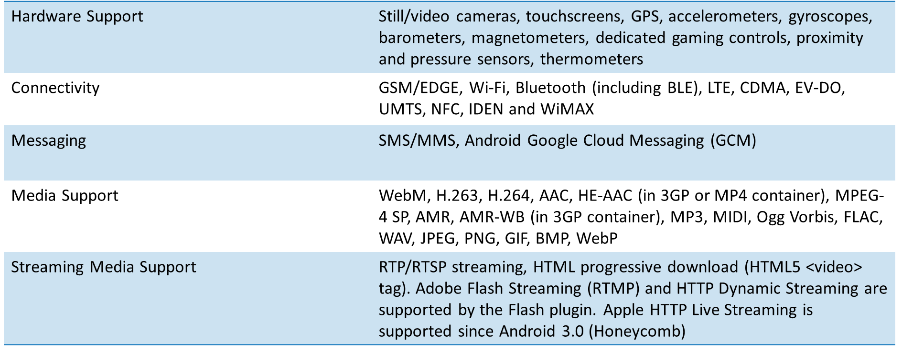
Main Features of Android

Slide 22
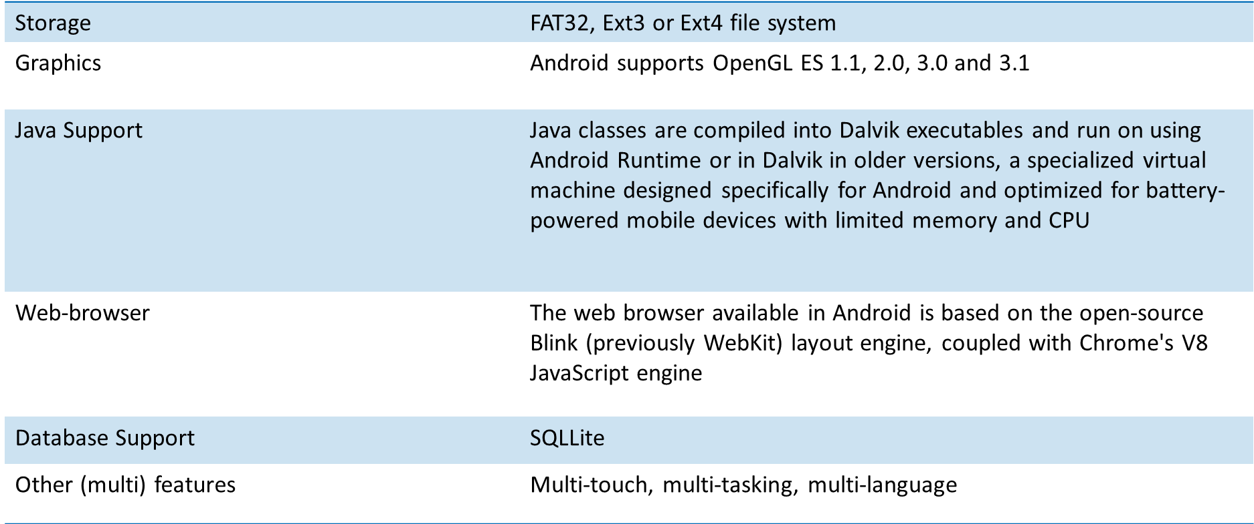
Main Features of Android

Slide 23
Tools for Android Developer

Slide 24
Tools
Mandatory:
Java2 SDK 1.6 или выше
http://www.oracle.com/technetwork/java/javase/downloads/index.html
Android Software Development Kit
https://dl.google.com/android/repository/sdk-tools-windows-3859397.zip
Recommended:
Android Studio (includes Android SDK)
https://developer.android.com/studio/index.html
USB Driver for Windows
https://developer.android.com/studio/run/win-usb.html?hl=ru

Slide 25
References
Mark Murphy. The Busy Coders Guide to Android Development
Reto Meier. Professional Android Application Development.
Bill Phillips, Chris Stewart, and Kristin Marsicano. Android Programming: The Big Nerd Ranch Guide
Official Android Training materials
http://developer.android.com/training/index.html
https://www.udacity.com/courses/android
Android API Guides
http://developer.android.com/guide/components/index.html
API Reference
http://developer.android.com/reference/packages.html

Slide 26
Hello, Android!

Slide 27
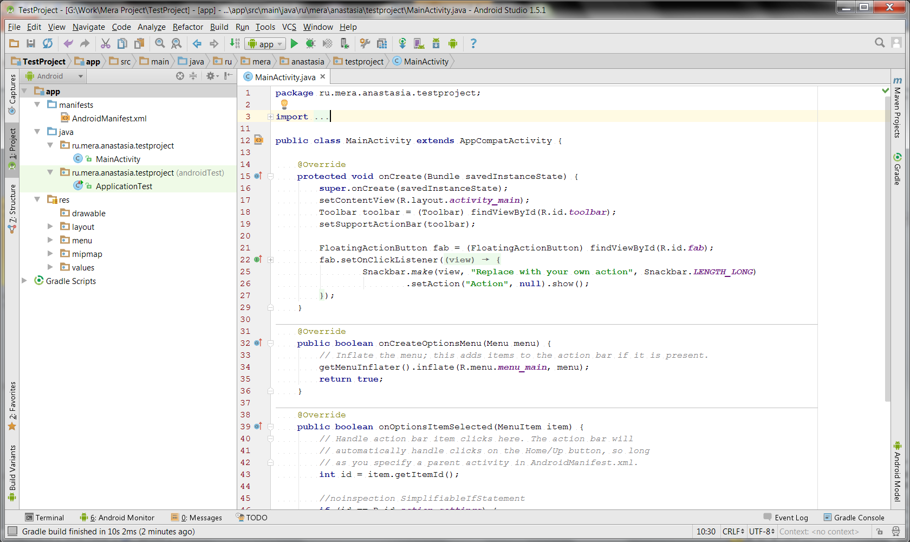
Project Structure
App Description
Source code
Unit - tests
Resources
Build - scripts

Slide 28
AndroidManifest.xml
It names the Java package for the application. The package name serves as a unique identifier for the application.
It describes the components of the application, which include the activities, services, broadcast receivers, and content providers that compose the application. It also names the classes that implement each of the components and publishes their capabilities, such as the Intent messages that they can handle. These declarations inform the Android system of the components and the conditions in which they can be launched.
It determines the processes that host the application components.
It declares the permissions that the application must have in order to access protected parts of the API and interact with other applications. It also declares the permissions that others are required to have in order to interact with the application's components.
It lists the Instrumentation classes that provide profiling and other information as the application runs. These declarations are present in the manifest only while the application is being developed and are removed before the application is published.
It declares the minimum level of the Android API that the application requires.
It lists the libraries that the application must be linked against.

Slide 29
AndroidManifest.xml
<?xml version="1.0" encoding="utf-8"?> <manifest xmlns:android="http://schemas.android.com/apk/res/android" package="com.example.mleykin.helloworld"> <application android:allowBackup="true" android:icon="@mipmap/ic_launcher" android:label="@string/app_name" android:supportsRtl="true" android:theme="@style/AppTheme"> <activity android:name=".MainActivity"> <intent-filter> <action android:name="android.intent.action.MAIN" /> <category android:name="android.intent.category.LAUNCHER" /> </intent-filter> </activity> </application> </manifest>

Slide 30
activity_main.xml
<?xml version="1.0" encoding="utf-8"?> <RelativeLayout xmlns:android="http://schemas.android.com/apk/res/android" xmlns:tools="http://schemas.android.com/tools" android:id="@+id/activity_main" android:layout_width="match_parent" android:layout_height="match_parent" android:paddingLeft="@dimen/activity_horizontal_margin" android:paddingRight="@dimen/activity_horizontal_margin" android:paddingTop="@dimen/activity_vertical_margin" android:paddingBottom="@dimen/activity_vertical_margin" tools:context="com.example.mleykin.helloworld.MainActivity"> <TextView android:layout_width="wrap_content" android:layout_height="wrap_content" android:text="@string/hello_world" /> </RelativeLayout>
strings.xml
<resources> <string name="hello_world">Hello, Android!</string> <string name="app_name">Test Project</string> </resources>

Slide 31
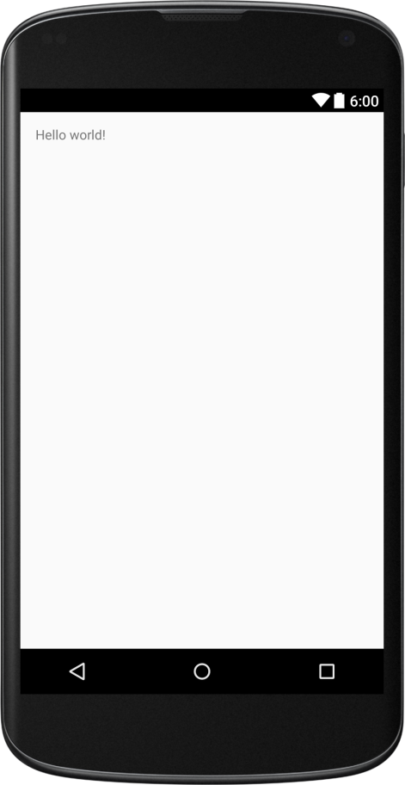
activity_main.xml
package com.example.mleykin.helloworld; import android.app.Activity; import android.os.Bundle; public class MainActivity extends Activity { @Override protected void onCreate(Bundle savedInstanceState) { super.onCreate(savedInstanceState); setContentView(R.layout.activity_main); } }
Sample: HelloAndroid

