Slide 1
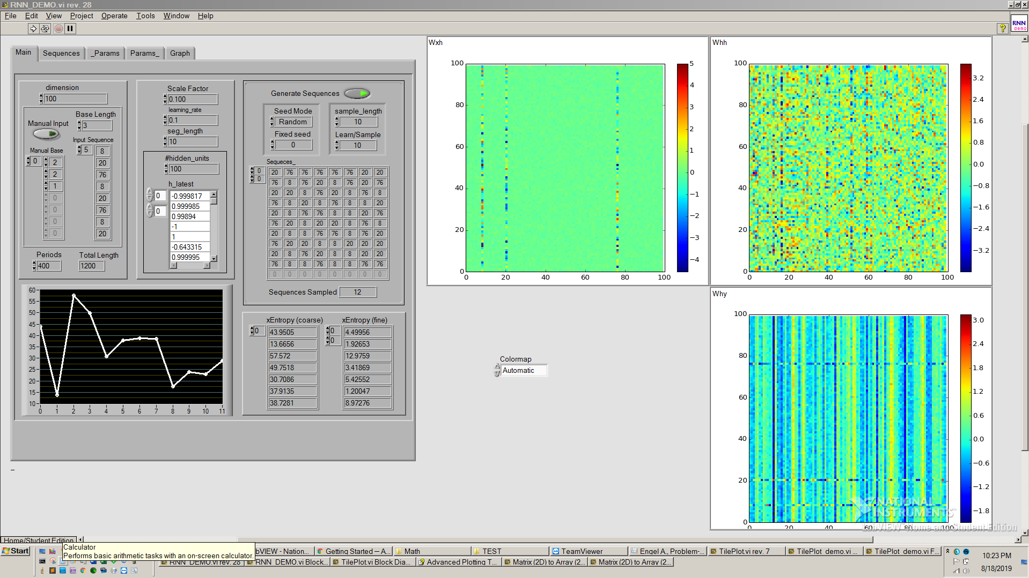
8
20
76
76
20
8

Slide 2
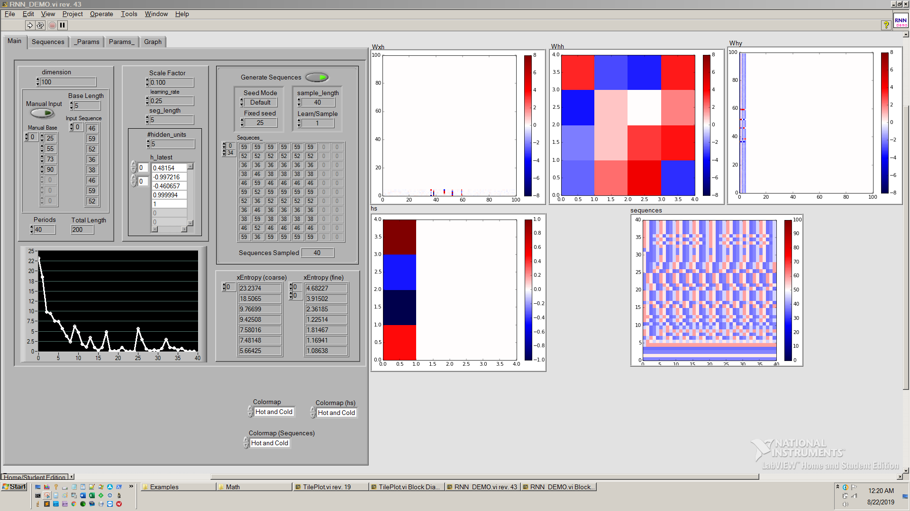
final few sequences match input sequence. look at xentropy as generated sequences become more and less accurate

