Slide 1

Recommender Systems: Content-based Systems & Collaborative Filtering
Note to other teachers and users of these slides: We would be delighted if you found this our material useful in giving your own lectures. Feel free to use these slides verbatim, or to modify them to fit your own needs. If you make use of a significant portion of these slides in your own lecture, please include this message, or a link to our web site: http://www.mmds.org
Mining of Massive Datasets
Jure Leskovec, Anand Rajaraman, Jeff Ullman Stanford University
http://www.mmds.org

Slide 2
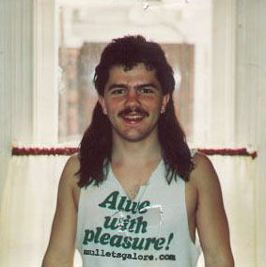
Example: Recommender Systems
Customer X
Buys Metallica CD
Buys Megadeth CD
Customer Y
Does search on Metallica
Recommender system suggests Megadeth from data collected about customer X

Slide 3










Recommendations
Examples:
Search
Recommendations
Items
Products, web sites, blogs, news items, …

Slide 4
From Scarcity to Abundance
Shelf space is a scarce commodity for traditional retailers
Also: TV networks, movie theaters,…
Web enables near-zero-cost dissemination of information about products
From scarcity to abundance
More choice necessitates better filters
Recommendation engines
How Into Thin Air made Touching the Void a bestseller: http://www.wired.com/wired/archive/12.10/tail.html
Notes:
In 1988, a British mountain climber named Joe Simpson wrote a book called Touching the Void, a harrowing account of near death in the Peruvian Andes. It got good reviews but, only a modest success, it was soon forgotten. Then, a decade later, a strange thing happened. Jon Krakauer wroteInto Thin Air, another book about a mountain-climbing tragedy, which became a publishing sensation. SuddenlyTouching the Void started to sell again.
Random House rushed out a new edition to keep up with demand. Booksellers began to promote it next to their Into Thin Air displays, and sales rose further. A revised paperback edition, which came out in January, spent 14 weeks on theNew York Times bestseller list. That same month, IFC Films released a docudrama of the story to critical acclaim. NowTouching the Void outsells Into Thin Air more than two to one.
What happened? In short, Amazon.com recommendations. The online bookseller's software noted patterns in buying behavior and suggested that readers who liked Into Thin Airwould also like Touching the Void. People took the suggestion, agreed wholeheartedly, wrote rhapsodic reviews. More sales, more algorithm-fueled recommendations, and the positive feedback loop kicked in.

Slide 5
Types of Recommendations
Editorial and hand curated
List of favorites
Lists of “essential” items
Simple aggregates
Top 10, Most Popular, Recent Uploads
Tailored to individual users
Amazon, Netflix, …

Slide 6
Formal Model
X = set of Customers
S = set of Items
Utility function u: X × S → R
R = set of ratings
R is a totally ordered set
e.g., 0-5 stars, real number in [0,1]

Slide 7
Utility Matrix
Avatar
LOTR
Matrix
Pirates
Alice
Bob
Carol
David

Slide 8
Key Problems
(1) Gathering “known” ratings for matrix
How to collect the data in the utility matrix
(2) Extrapolate unknown ratings from the known ones
Mainly interested in high unknown ratings
We are not interested in knowing what you don’t like but what you like
(3) Evaluating extrapolation methods
How to measure success/performance of recommendation methods

Slide 9
(1) Gathering Ratings
Explicit
Ask people to rate items
Doesn’t work well in practice – people can’t be bothered
Implicit
Learn ratings from user actions
E.g., purchase implies high rating
What about low ratings?

Slide 10
(2) Extrapolating Utilities
Key problem: Utility matrix U is sparse
Most people have not rated most items
Cold start:
New items have no ratings
New users have no history
Three approaches to recommender systems:
1) Content-based
2) Collaborative
3) Latent factor based
Today!

Slide 11
Content-based Recommender Systems

Slide 12
Content-based Recommendations
Main idea: Recommend items to customer x similar to previous items rated highly by x
Example:
Movie recommendations
Recommend movies with same actor(s), director, genre, …
Websites, blogs, news
Recommend other sites with “similar” content

Slide 13
Plan of Action
Item profiles
likes
build
recommend
match
Red
Circles
Triangles
User profile

Slide 14
Item Profiles
For each item, create an item profile
Profile is a set (vector) of features
Movies: author, title, actor, director,…
Text: Set of “important” words in document
How to pick important features?
Usual heuristic from text mining is TF-IDF (Term frequency * Inverse Doc Frequency)
Term … Feature
Document … Item

Slide 15
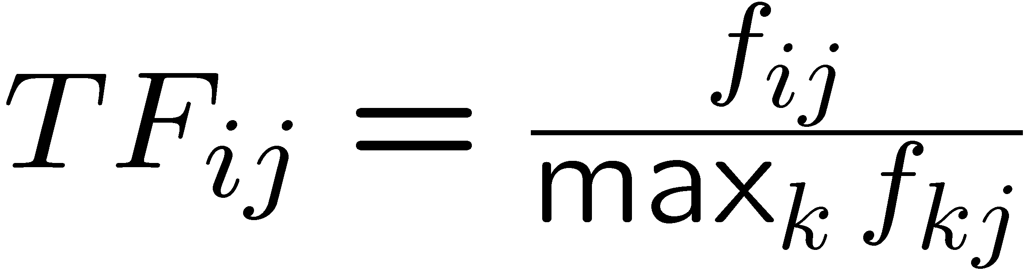
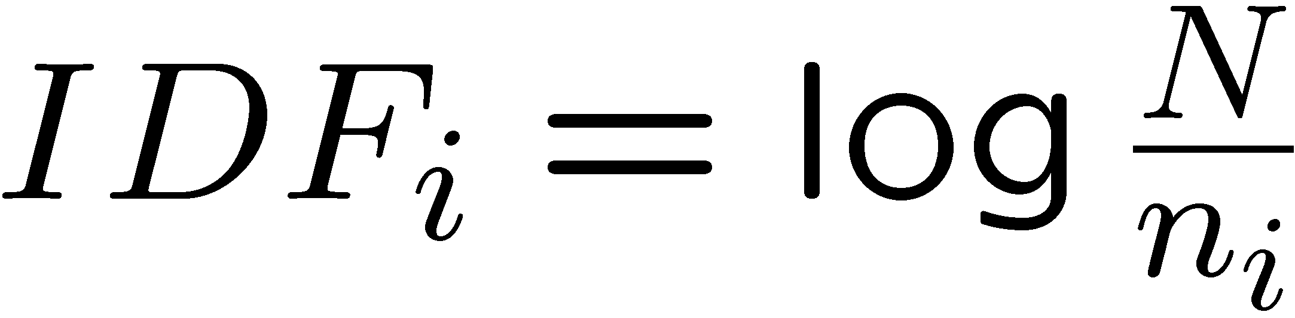
Sidenote: TF-IDF
f_{ij} = frequency of term (feature) i in doc (item) j
n_{i} = number of docs that mention term i
N = total number of docs
TF-IDF score: w_{ij} = TF_{ij} × IDF_{i}
Doc profile = set of words with highest TF-IDF scores, together with their scores
Note: we normalize TF to discount for “longer” documents

Slide 16
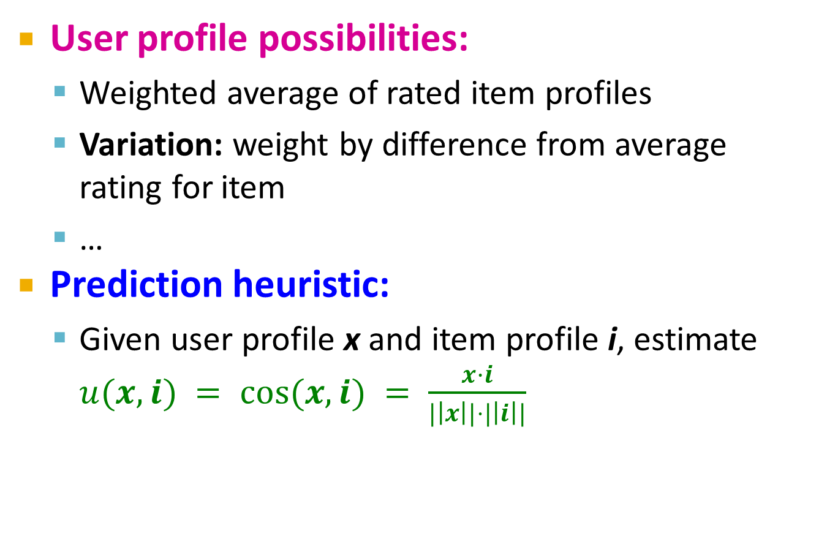
User Profiles and Prediction
User profile possibilities:
Weighted average of rated item profiles
Variation: weight by difference from average rating for item
…
Prediction heuristic:
Given user profile x and item profile i, estimate $u(x,i) = cos⁡(x,i) = \frac{x·i}{|\left|x\right||⋅|\left|i\right||}$

Slide 17
Pros: Content-based Approach
+: No need for data on other users
No cold-start or sparsity problems
+: Able to recommend to users with unique tastes
+: Able to recommend new & unpopular items
No first-rater problem
+: Able to provide explanations
Can provide explanations of recommended items by listing content-features that caused an item to be recommended

Slide 18
Cons: Content-based Approach
–: Finding the appropriate features is hard
E.g., images, movies, music
–: Recommendations for new users
How to build a user profile?
–: Overspecialization
Never recommends items outside user’s content profile
People might have multiple interests
Unable to exploit quality judgments of other users

