Slide 1
IBM Innovate 2010 QM-1510A
Michael Freeman
Applications Development Analyst, Lender Processing Services
mlfreeman@gmail.com
Latisha Aguilar
Applications Development Manager, Lender Processing Services
lzaguilar@gmail.com

Slide 2
Agenda
Why are GUI testing applications unstable?
How can we minimize the impact of these issues?
Eclipse Tips (and Demo)
Helper Code Demo
Feel free to ask questions at any point.

Slide 3
Why are GUI testing applications unstable?
Timing differences from run to run
New version changes
General Windows insanity

Slide 4
Timing Differences From Run To Run
CPU speed differences on RFT boxes
Available RAM differences on RFT boxes
Other background apps running on RFT boxes
e.g. AV on one box vs no AV on another
e.g Terminal Services sessions (on server Windows systems)
e.g. Eclipse open vs RFT from command line
Network issues
Application server CPU load
Network traffic
Webapps: JavaScript processing time
Notes:
Timing differences from run to run
CPU speed differences on RFT boxes
Available RAM differences on RFT boxes
Other background apps running on RFT boxes
e.g. AV on one box vs no AV on another
e.g Terminal Services sessions (on server Windows systems)
e.g. Eclipse open vs RFT from command line
Network issues
Application server CPU load
Network traffic

Slide 5
New Version Changes
UI Changes, both visible and invisible
Visible: new buttons / fields / etc
Invisible: developer refactoring causes existing objects to change properties
Business Logic changes
New application behavior
Bugs
e.g. Regression in webapp leads to browser JavaScript error alert
Notes:
New version changes
UI Changes, both visible and invisible
Visible: new buttons / fields / etc
Invisible: developer refactoring causes existing objects to change properties
Business Logic changes
New application behavior
Bugs
e.g. Regression in webapp leads to browser JavaScript error alert

Slide 6
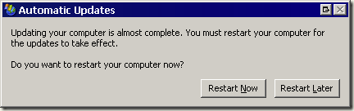
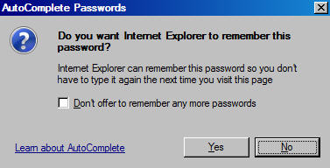
General Windows Insanity
Dialogs that may not have been configured to not appear
Automatic Update reminders
Browser dialogs (e.g. AutoComplete, et al.)
Notes:
Automatic Updates dialog popping up on top of everything
Browser dialogs such as autocomplete
GUI events failing to occur for no apparent reason
e.g clicks not registering
e.g characters getting dropped for no reason when RFT tries to type something

Slide 7
General Windows Insanity
GUI events failing to occur for no apparent reason
Clicks not registering
Characters getting dropped for no reason when RFT tries to type something

Slide 8
How can we minimize the impact of these issues?
6 basic rules we follow at LPS to make our RFT scripts as stable as possible
One overall idea: Our RFT scripts are development projects.

Slide 9
Rule #1: Work surgically
Grab your TestObjects at the last possible second before you need them
Work on them as quickly as possible.
Release them as soon as you can.

Slide 10
TestObject Grabbing
Don’t map…find() instead.
Maps store unnecessary information and depend on information that isn’t really beneficial.
Maps can’t be merged easily. They are complex XML documents.
When you find(), try not to find() from RootTestObject.
It’s slow, relatively…but it is faster than it used to be.
If you must, put .class as the first property in your subitem.
We found that made a 75% speed up in find timings.

Slide 11
Acting Quickly
Do all possible computations before find().
Compute things to type in, look up data, whatever.
This ensures you’re ready to go once objects are found.
Once you have the object, you should work on it and release it before trying to do anything else or work with any other objects.

Slide 12
Cleanup
Unregister everything. Manage your objects.
If you wrap your code in try-catch blocks, put your unregister() calls inside finally blocks so no matter what they will run.
Example: TestObject[] objects = null; try { objects = someObject.find(atDescendant(“prop1”, “val1”, “prop2”, “val2”)); //do something } catch (Exception e) { //log an error } finally { unregister(objects); // ensure objects will always get unregistered. }
RationalTestScript.unregister() doesn’t care if it gets passed a null reference. It won’t throw a NullPointerException.

Slide 13
Rule #2: Wrap up everything inside functions
Ensures consistency, reuse, and clarity of driver script.
Consistency:
Calling one function guarantees same actions always happen and same things always get logged.
Reuse:
You’re only writing a given action / group of actions once.
Clarity:
login(username, pass); is easier to read than userName.setText(username); password.setText(password); loginButton.click();

Slide 14
Rule #2: Wrap up everything inside functions
Exception handling is easy now.
Try-catch blocks are all relatively small and specific
Error messages become useful.
You can leverage do-while loops to help ensure actions happen (call the function repeatedly until something changes)
Works around the general Windows insanity mentioned earlier
Consider making generic wrappers for generic FT actions (e.g. public static int click(GuiTestObject gto, Object…args) wraparound for GuiTestObject.click())
If you develop and use these you can have consistent exception handling and logging for every widget you encounter everywhere

Slide 15
Rule #2: Wrap up everything inside functions
Sometimes you have to wrap up actions in multiple layers.
Single action wrappers around actual FT actions
Widget-specific wrappers around single action wrappers
Screen wrappers around commonly used groups of widget wrappers
App-wide wrappers around common screen wrappers
Notes:
click() (like previous slide)
clickLoginButton()
login() (like previous slide)
fillOutOrder()

Slide 16
Rule #3: Use regular expressions when possible
This gives you leeway if things change slightly (e.g. layout shifts but functionality is the same)
Many web app frameworks have patterns to their UIs
You can exploit this to make operations on multiple objects easier

Slide 17
Rule #4: Pick only a minimal set of properties when defining your objects
Some properties are less likely to change than others
.class will always be there in every domain, every object
Don’t be afraid to go to your developers and insist they add properties to help you. If they do this, they will probably end up helping themselves out also in the end.

Slide 18
HTML domain suggestions for properties to use in find()
.class
.id
.name
.className (sometimes)
.value (rarely)
.text (if all else fails)
If you’re really lucky on a HTML domain app every important field will have a <label for=”field id”>field name</label> element near it.
Notes:
Remember manual referral!

Slide 19
Rule 5: Centralize data so changes only have to be done once.
For webapps, don’t code URLs for environments directly in to your code.
Create a single central Java enum (or at worst a Hashtable) mapping Environment Names to URLs…then address everything by that env name.
Notes:
For webapps, don’t code URLs for environments directly in to your code. Create a single central Java enum (or at worst a Hashtable) mapping Environment Names to URLs…then address everything by that env name.

Slide 20
Rule 5: Centralize data so changes only have to be done once.
Example: public enum Environments { Dev(“http://dev”), QA(“http://qa”), Production(“http://prod.com”); private Environments(String URL) { this.URL = URL; } private String URL = “”; public String getURL() { return this.URL; } } public void testMain(Object[] args) { Environments env = Environments.valueOf(args[0].toString()); RationalTestScript.startBrowser(env.getURL()); }
Notes:
For webapps, don’t code URLs for environments directly in to your code. Create a single central Java enum (or at worst a Hashtable) mapping Environment Names to URLs…then address everything by that env name.

Slide 21
Rule 5: Centralize data so changes only have to be done once.
The script on the previous slide is now 100% immune to changes in URLs of app environments
This is superior to RFT’s startApp() function because you can leverage the Environments enum in other ways
Enums are a standard Java structure
startApp depends on a config file that isn’t inside your project. This makes moving code to another machine a chore.
Notes:
For webapps, don’t code URLs for environments directly in to your code. Create a single central Java enum (or at worst a Hashtable) mapping Environment Names to URLs…then address everything by that env name.

Slide 22
Rule 6: Databases are your friend
JDBC == Good
Enables much more control over the testing process
Decrease need for data pools
Why have a static data pool that has to be updated when you can just look stuff up?
Allows you to check data at multiple points along the testing process
A nice value add to many projects
More stable than the recommended approach of automating a database client app GUI

Slide 23
Breakpoints
Eclipse offers nice breakpoint functionality
On Class Load
On Method Load
On Specific Exception Being Thrown
On Any Uncaught Exception Being Thrown
On Any Caught Exception Being Thrown
Conditional Breakpoints
Break only when a code snippet is true
Break only when the result of a code snippet changes
Unconditional (aka normal) breakpoints
Breakpoints are your friend

Slide 24
Detail Formatters
Detail Formatters
When in a debug view, Eclipse will let you see all the relevant variables at that spot in execution. It normally calls toString() to render their contents when you click on one. RFT TestObjects have a toString() method that outputs information that is useless to probably everyone except the original developers. Eclipse will let you supply a blob of code to run the object through as a temporary replacement toString().

Slide 25
Refactor Menu
Refactor menu will save you tons of time in most code reorganizations.
It can move and rename classes, methods, and variables and automatically update all impacted code for you.
You can add or remove arguments from methods with it and automatically update all impacted code with the new method signature.
It even works with source control providers like Clearcase or Subversion so all you have to do is use Refactor -> Something and then Commit/Check In and your changes are in and still compiling…all with no more than a few mouse clicks.

Slide 26
Code Demo
We have developed a large library of code to smooth over a lot of the quirks in automation.
Now I’m going to demonstrate some of it.

Slide 27

Eclipse Breakpoints 101
And
Useful RFT Helper Routines

Slide 28
IWindow Code
From IBM’s docs: “Provides access to the native window management system; any use of this interface is likely to be platform specific.”
It has its uses.
It is extremely fast at finding things on screen.
It works in places normal TestObjects don’t.
It enables reuse that mapped TestObjects don’t.

Slide 29
IWindow Code Demo
This script will open a browser to Google News and open a print dialog.
Controlling the print dialog through IWindow objects is far faster than controlling it through TestObjects (if you even can)
Attempts to dynamic find() the print dialog always failed on numerous test machines.
Recording the dialog did work, but it produced something specific to the AUT. The print dialog (and others) are actually part of Windows Common Controls, so having one library to handle it no matter where it appears is ideal.

Slide 30
Playback Monitor Demo
This next demo shows basic control over the RFT playback monitor.
We created this class because we weren’t satisfied with the amount of information that RFT normally shows to us.
We can display any custom message we want.

Slide 31
Object Map Demo
This next demo shows how to manipulate an RFT object map file in code.
This bypasses the usual RFT approach of adding poorly named protected functions to the script helper (e.g. html_subform_ctrl())
These functions can load an object from a map by either its #id or its #name property.

Slide 32
General Script Demo
This final script is a simple generic demo of how we tend to organize things.
The driver script calls upon various classes. Typically each class is one screen or page.

Slide 33


Slide 34

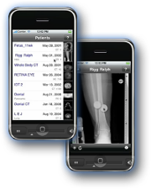
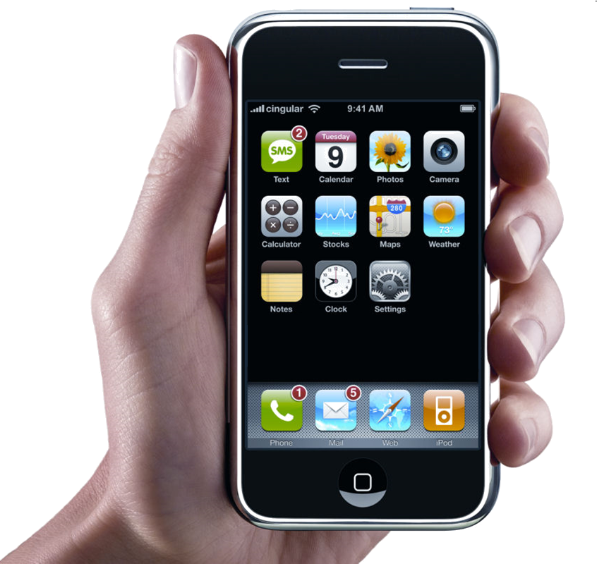
Daily iPod Touch giveaway
SPONSORED BY
Complete your session surveys online each day at a conference kiosk or on your Innovate 2010 Portal!
Each day that you complete all of that day’s session surveys, your name will be entered to win the daily IPOD touch!
On Wednesday be sure to complete your full conference evaluation to receive your free conference t-shirt!

Slide 35

www.ibm.com/software/rational
© Copyright IBM Corporation 2010. All rights reserved. The information contained in these materials is provided for informational purposes only, and is provided AS IS without warranty of any kind, express or implied. IBM shall not be responsible for any damages arising out of the use of, or otherwise related to, these materials. Nothing contained in these materials is intended to, nor shall have the effect of, creating any warranties or representations from IBM or its suppliers or licensors, or altering the terms and conditions of the applicable license agreement governing the use of IBM software. References in these materials to IBM products, programs, or services do not imply that they will be available in all countries in which IBM operates. Product release dates and/or capabilities referenced in these materials may change at any time at IBM’s sole discretion based on market opportunities or other factors, and are not intended to be a commitment to future product or feature availability in any way. IBM, the IBM logo, Rational, the Rational logo, Telelogic, the Telelogic logo, and other IBM products and services are trademarks of the International Business Machines Corporation, in the United States, other countries or both. Other company, product, or service names may be trademarks or service marks of others.

