Slide 1
IBM Innovate 2010 QM-1992A
Latisha Aguilar
Applications Development Manager
lzaguilar@gmail.com
Michael Freeman
Applications Development Analyst
mlfreeman@gmail.com
Lender Processing Services, Inc.
based in Jacksonville, FL

Slide 2
Why We Chose Rational Functional Tester for Automated Testing
About LPS
Each of the 50 top financial institutions in the country uses at least one of LPS’ products and/or services
LPS Desktop POC
Tool Requirements
Critical Design Choices and their impacts
Recommendation
Project Organization
Notes:
About LPS:
Lender Processing Services (LPS) is the nation's leading provider of mortgage processing services, settlement services, mortgage performance analytics and default solutions. The company's high-performance technology, data and services empower lenders and servicers by providing them with the solutions they need to achieve their business goals and succeed in today's competitive marketplace. A majority of the 50 largest U.S. banks rely on LPS' comprehensive offerings and award-winning services and support to power their businesses and sharpen their competitive edge.
About LPS Desktop
LPS Desktop is a scalable enterprise workflow management application used by banks, attorneys, servicers.
Consists of 5 asp.net web applications
Process Management
Invoice Management
Document Content Management
Loss Mitigation
Tax Management

Slide 3
LPS Desktop POC
Criteria for Success
Reliability
Maintainability
Speed
Project Details
Large test bed ~ 16,000 test cases
Complexity
Maturity
Notes:
Project Details
Large test bed ~ 16,000 test cases in LPS Desktop
Complexity factors
integrates with many other applications
lots of databases
extremely configurable
Maturity
Already in production
6 wk release cycles with regular hot fixes

Slide 4
Criteria |  | Rank (1 to 3, with 3 being best)
 | Area | HP QuickTest Professional | IBM Rational Functional Tester | MS Visual Studio 2008
Requirements
 | Record and Playback | 2 | 3 | 1
 | Integration with Other Tools | 2 | 3 | 1
 | Language of Tool | 1 | 3 | 2
 | Domain Support | 2 | 3 | 0
 | Stability of Tool | 2 | 3 | 1
 | Object Map Files | 2 | 3 | 0
 | Use of Dynamic Finds | 1 | 3 | 0
POC Results/Compatibility with AUT
 | Ease of Scripting | 2 | 3 | 0
 | Ease of Maintenance/Reusability | 2 | 3 | 0
 | LOE to Automate | 2 | 3 | 0
 | Speed/Performance of Tool | 3 | 2 | 0
Support
 | External Support (Updates/Service Packs) | 2 | 2 | 1
Reporting
 | Reporting and Metrics | 3 | 2 | 0
Longevity and Market Share
 | Maturity/Longevity | 2 | 2 | 0
 | QA Software Market Share | 3 | 2 | 0
Resource Experience
 | Ramp Time | 2 | 3 | 0
Price
 | Perpetual License + 1yr Support | 2 | 3 | 0
 | Test Lab Manager | 0 | 2 | 0
 | SaaS Offering | 2 | 0 | 0
TOTALS |  | 37 | 48 | 6
RANK |  | 2 | 1 | NA
Notes:
Most important features/requirements
Language of tool
Technologies and platforms supported
Longevity and Market Share
Test Object Management
Audience
Source Control

Slide 5
Critical Feature – Technology Support
Technology |  | QTP | RFT | VS 2010 | Selenium
Custom Controls |  | Yes | Yes | Yes | Web Only
Windows | Windows Forms | Yes | Yes | Yes | No
 | WPF | Yes | Yes | Yes | No
 | Win32 | Yes | Yes | Best efforts with known issues | No
 | MFC | Yes | Yes | Best efforts with known issues | No
Web | Html | Yes | Yes | Yes | Yes
 | Ajax | Yes | Yes | Yes: IE 7/8, Limited: FF3 | Yes
 | Silverlight | Yes* | No | No | Yes*
 | Flex | Yes* | Yes | No | Yes*
 | Flash | Yes* | No | No | Yes*
 | Dojo | Yes* | Yes | No | Yes*
 | GWT | Yes* | Yes | No | Yes*
 | Web Services | Yes* | Yes | Yes | Yes
Other | Java | Yes* | Yes | No | No
 | .Net | Yes* | Yes | No | No
 | VB | Yes* | Yes | No | No
 | SAP | Yes* | Yes | No | No
 | Siebel | Yes* | Yes | No | No
 | Sybase | Yes* | No | No | No
 | Powerbuilder | Yes* | Yes | No | No
 | Terminal-based | Yes* | Yes* | No | No
 | Oracle | Yes* | Yes | No | No
 | PeopleSoft | Yes* | No | No | No
Notes:
What application technologies are supported?
Are custom UI controls supported?
QTP 10
Domains Included: Standard Windows applications, Web objects / Applications, ActiveX controls, Visual Basic applications
Domains supported through add-ins: Java, NET, Oracle, PeopleSoft, SAP, Siebel, Stingray, Terminal Emulator, VisualAge Smalltalk, Web Services
VS 2010
Fully Supported: IE7/8 – HTML/AJAX, Windows Forms 2.0+, WPF 3.5+, Windows Win32 , MFC
Partial Solution: FF3 – HTML/AJAX, Dynamics (Ax), SharePoint, Silverlight, Citrix/Terminal Services, Office Client Apps
Currently no support and none planned for now. Opportunity for partners: IE 6, Chrome/Opera/Safari, Flash/Java, SAP
RFT 8.1
Included domains support Java, HTML, .NET, Windows, SAP, Siebel, AJAX, Sybase PowerBuilder, Visual Basic, Terminal-based, and Flex applications
SDK Proxy support, extend automated functional testing support for your application's user interface controls.

Slide 6
Critical Feature - Audience
What audience is the tool intended?
Implications
Notes:
Test Case Categories
(for all examples, assume the AUT is http://www.google.com/finance )
Test Cases that any tool or approach will work
Example: Quote Search
Launch application
Enter company code in quote search input textbox
Click Get Quotes
Wait for browser
Validate company data appeared
Test Cases that require addition of logic
Reasons logic is needed
1. Conditional Statements, iteration, logging and reporting of test results, error handling,
particularly unexpected errors, database communication, re-execution of failed tests, screenshot
capture of test failures
Example: Validate market summary
1. Launch application
2. Validate Market Summary table appears at the top with the following properties:
Column 1: Dow, S&P 500, Nasdaq in that order
Column 2: Current Value
Column 3: point change relative to opening
Column 4: % change relative to opening
Test Cases that require usage of 3rd party APIs
Example: My Portfolio exports to CSV
Launch application
Sign in
Click My Portfolio
Click download to spreadsheet link
Save file to disk
Validate contents
Test Cases whose ROI is not worth the effort
Example: CD burning, some image validation, some PDFs.
Test Cases that are not possible to automate
Scan, Fax, some printing
Team recommendation: 1 experienced automation engineer and remainder entry level engineers (ideally college grads and CS interns)

Slide 7
Critical Feature- Language
Language
Flexibility
How flexible is the language?
How flexible is the tool’s API
3rd Party APIs
Version support (evolving or in maintenance mode)
Summary by Tool
QTP uses VBScript
VS can be used in c# or VB.net
RFT can be used in Java or VB.net
Notes:
VBScript:
1. OO nature is fake (no inheritance or overloading)
2. No real data types, everything in VBScript is a variant. Implications: error prone, more dirty work (lots of if variant is a subtype checks)
Extremely limited error handling
Scope (global variables in function libraries not supported, must be defined in tests)
Unable to find any 3rd party API’s
RFT in Java Mode
Flexibility
Objected Oriented languages are better suited for automation because they represent the problem domain more accurately.
Inheritance is the capability of a class to use the properties and methods of another class while adding its own functionality.
More code reuse
Polymorphism (overriding, overloading)
Abstract
3rd Party APIs
Apache (Commons, HTTPClient, POI, PDFBox, Log4J)
Java.net (TrueZip)
JTDS
Oracle Sun (JavaMail)
Version support (evolving)
Yes, Java is evolving with technology; Java 7 is due fall 2010

Slide 8
Critical Design Choices - IDE
An integrated development environment (IDE) is a software application that provides comprehensive facilities to computer programmers for software development.
An IDE normally consists of:
A source code editor
Auto-Complete, Code Assist
Navigation (outline, breadcrumbs)
A compiler and/or an interpreter
Build automation tools
A debugger
Breakpoints, Call stack, expressions, watch variables
Source Control
Add-ins / Plug-ins

Slide 9
Critical Design Choices - IDE
Summary by Tool
QTP is built on a proprietary IDE
Many limitations
Only one script can be open at a time along with an unlimited number of function library files
Spy window is a pop-up dialog that blocks all other input
Auto-complete scope is limited to only the built-in QTP functions
Code base navigation abilities are severely lacking
Missing refactoring capabilities
Syntax checker is poor; many errors not reported until runtime
Limited support for documentation of code base
RFT –
In Java mode Eclipse is used
In VB.net mode Visual Studio is used
Notes:
QTP is built on a proprietary IDE
Many limitations
Only one script can be open at a time along with an unlimited number of function library files
Spy window is a pop-up dialog that blocks all other input
Auto-complete scope is limited to only the built-in QTP functions
Code base navigation abilities are severely lacking
Two ways to view function library – all functions in a flat list or sorted by file
Find All References
Missing refactoring capabilities
If you need to make a change to a popular function you have to manually scour your code base to make sure you’ve updated it everywhere. If you miss a spot you will not find out until runtime.
Syntax checker is poor; many error not reported until runtime
No mouse-over capability to read function comments
RFT –
In Java mode Eclipse is used
In VB.net mode Visual Studio is used
RFT’s IDE limitations
In debug perspective, the expression must use the full class name
RFT’s IDE Strengths
Eclipse if full featured IDE
Plenty of add-ins available
Language support: Perl, PHP, Ruby, Python
Code Checker (useful for enforcing standards and consistent code formatting which leads to easier merges)
Mylyn

Slide 10
Critical Design Choices – Test Object Management
There are two methods to find AUT controls
Without a Map
According to IBM help pages “The search is based on name/value pairs representing properties of the TestObject or TestObjects you are looking for. The search can either be global, or limited to children of a parent TestObject”
QTP’s variant is called descriptive programming and it has limitations
Hard to control find scope – all or nothing
Map
Notes:
RFT exposes more properties to use as search criteria than QTP.
QTP’s list is fixed. RFT will let you search for anything it can pick up at runtime.

Slide 11
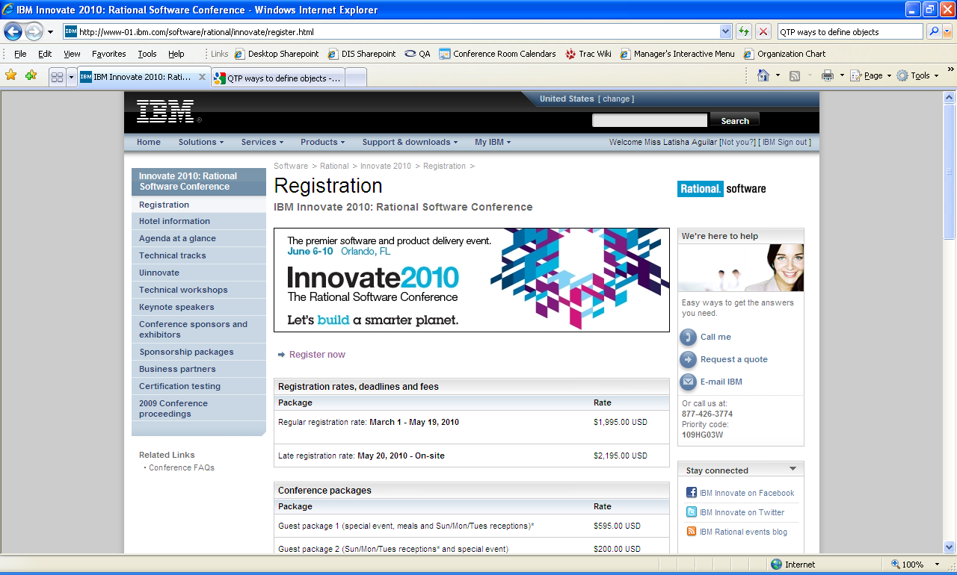
Critical Design Choices – Test Object Management
Suppose we want to find the “Register Now” link
Notes:
Suppose we want to find the “Register Now” link
What information is needed to find the link?
How much information does each tool capture to find link?

Slide 12
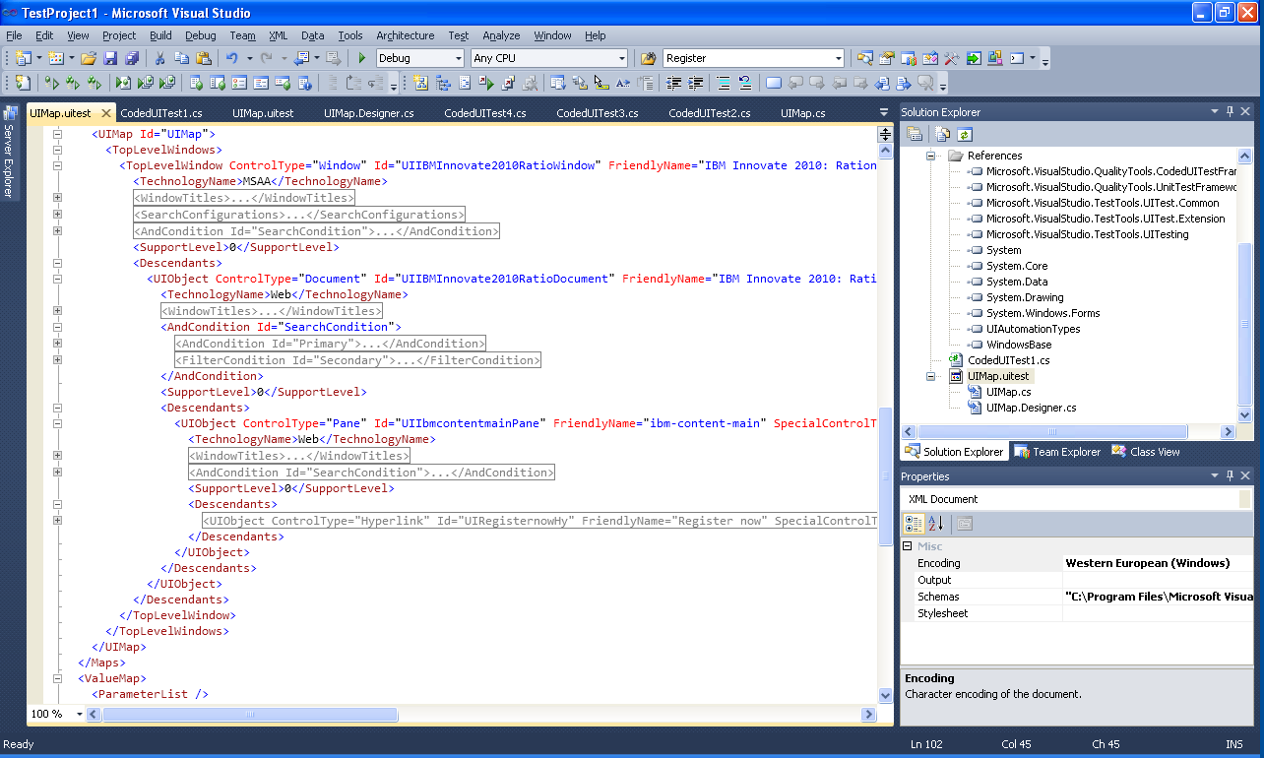
Critical Design Choices – Test Object Management
HtmlHyperlink uIRegisternowHyperlink = this.UIIGoogleWindowsInternWindow.UIIBMInnovate2010RatioDocument.UIIbmcontentmainPane.UIRegisternowHyperlink;
Object Definitions in VS 2010
Notes:
HtmlHyperlink uIRegisternowHyperlink = this.UIIGoogleWindowsInternWindow.UIIBMInnovate2010RatioDocument.UIIbmcontentmainPane.UIRegisternowHyperlink;
Uses XML to capture recording
Configuration node
Execution
Map Objects

Slide 13
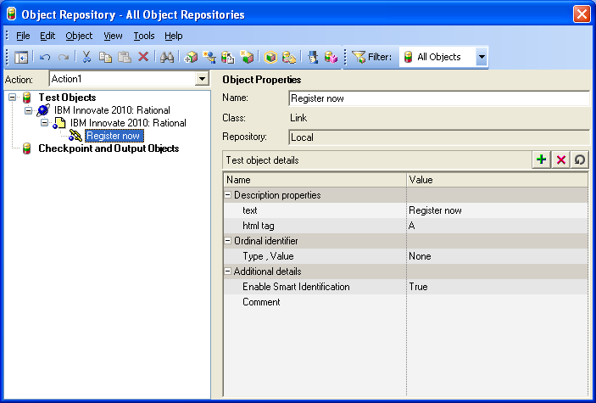
Critical Design Choice – Test Object Management
Object Repository in QTP
Notes:
So 3 objects are needed to find link
browser -> page -> link
For web applications, typically 2 objects definitions are needed to find an item – browser window and desired object but for some reason QTP
Requires the page to be specified. If the page was removed from the hierarchy, the Register Now link would not be found.
Miscellaneous thoughts on QTP Test Objects
Uses Smart Identification, http://qtpfaq.wordpress.com/2007/08/28/what-is-smart-identification/
Offered out of the box browser sync functionality

Slide 14
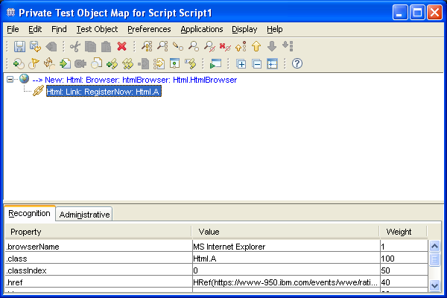
Critical Design Choices – Test Object Management
Dynamic Test Object feature removes the parent hierarchy from object definition. End result is cleaner maps with fewer test objects to maintain
Maintenance Tip: Associate as few properties as possible with each test object. The more test objects in the map the higher likelihood of something breaking.
Test Object Map in RFT

Slide 15
Recommendation: Project Organization
Tip: Maximize code reuse, separate AUT code from Common code
Use Two Projects
Common project
AUT project

Slide 16
Recommendation - Project Organization - Common
Common’s purpose is to ensure that repeated activities are done once and properly.
What do we mean by properly?
Thorough exception handling, flexible logging, and consistent return types
Why is it needed?
Avoid writing boilerplate code
Keep engineer’s focus on what provides value
Offers a consistent and reliable foundation for AUT library
Why is it worth the effort?
Can be reused across projects and organizations
LPS usage of common
spans two organizations and 14+ projects
the application domains were mix of Html, Flex, .Net, Win32
Libraries used Sun JRE 6, Apache Projects, RFT API

Slide 17
Snapshot of LPS’ popular common packages
common.io.file.*
CSV
common.io.network.*
SMTP
Excel
Html
PDF
Word
XML
JDBC
HTTP
common.rft.*
Web
152 actions (click, type, select, isEnabled, etc)
Flex
.Net
Win32
OutlookMailbox
FTP
common.lang.*
DateTime
Math
Reflection
Regex
StringFunctions
ListFunctions
MapFunctions
ArrayFunctions
common.system.*
Printer
CommandExecutor
COM
Notes:
Libraries used Sun JRE 6, Apache Projects, RFT API
Apache (Commons, HTTPClient, POI, PDFBox, Log4J)
Java.net (TrueZip)
JTDS
Oracle Sun (JavaMail)

Slide 18
Recommendation - Project Organization - AUT
AUT Library purpose is to build a model of the user interface. Typically one java class per screen or wizard
Key Objectives
Combine actions from Common into keywords (methods) that represent business components or workflow
Define AUT Objects
AUT Workflow: purpose is to assemble keywords into a single test scenario (Functional Test Script).
Key Objectives
Define the data that should be used (environment, login information, etc)
Call the appropriate keywords to build a work flow
Log the test scenario execution
Notes:
AUT Library Recommendations
Declare script independence from AUT architecture changes
Define db information, app server information, URLs, once and refer to entries by friendly environment names such as Production, QA, Dev, etc.
Take the time to comment each keyword (method) - this is critical in determining what is available for reuse and how to use it.
Especially in applications that are configurable leverage the database to supply data based on the test case prerequistes instead of using predefined data
See <TODO Add class name> for example usage
AUT Workflow Recommendations
Before you begin scripting, know your script requirements!
What environment(s) will the script need to run against?
Does it need to run with different data sets?
All of the above might affect the workflow of the script. As not all environments may have the same functionality.

Slide 19
Recommendation - Test Object Usage
Find Test Object
Perform some action or retrieve some property from test object
Catch Exception or errors
Log result of action (optional)
Release test object
Perform some action or retrieve some property from test object
Catch Exception or errors
Log result of action (optional)
Dynamic Find
Find handled by Object Map
Reliability Tip: Increase stability and reduce memory leaks by wrapping up the entire find, act, and release cycle for common actions.

Slide 20
Recommendation - Project Organization: Test Object Actions
Tip: Layering provides consistency in actions
Domain
Flex
Web
Project
.Net
Screen
Standardized Interface
Java
SAP
Win32
Common
AUT
Notes:
Automation is brittle and must evolve with the following:
Operating system versions, updates
Automation tool updates, library
AUT technology versions
AUT enhancements, re-configuration
Impacts of OO language
- inheritance
- polymorphism

Slide 21
Recommendation - Project Organization
Tip: Maximize code reuse, separate AUT code from Common code
Use Two Projects
Common project
AUT project
AUT WORKFLOW
AUT LIB
Common
Notes:
How well will your model survive?
Software life cycle
- consider after a project goes into maintenance mode and resources are trimmed

Slide 22

Notes:
Author Notes:
Optional IBM Rational “Questions” Breaker Slide

Slide 23

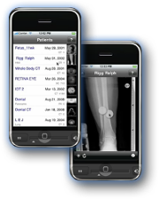

Daily iPod touch giveaway
SPONSORED BY
Complete your session surveys online each day at a conference kiosk or on your Innovate 2010 Portal!
Each day that you complete all of that day’s session surveys, your name will be entered to win the daily IPOD touch!
On Wednesday be sure to complete your full conference evaluation to receive your free conference t-shirt!
Notes:
Daily iPod Touch giveaway sponsored by Alliance Tech
Each time you complete a session survey, your name will be entered to win the daily IPOD touch!
Complete your session surveys online each day at a conference kiosk or on your Innovate 2010 Portal!
On Wednesday be sure to complete your full conference evaluation to receive your free conference t-shirt!

