Slide 1
An Empirical Evaluation of Foundation Models
for Multivariate Time Series Classification
Pinar Sungu Isiacik, Thach Le Nguyen, Timilehin Aderinola, Georgiana Ifrim
pinar.sunguisiacik@ucdconnect.ie
School of Computer Science
University College Dublin, Ireland
Notes:
In here talk about why you cont with channel dependency definitions. Becauseee, FMs process channels inteply

Slide 2
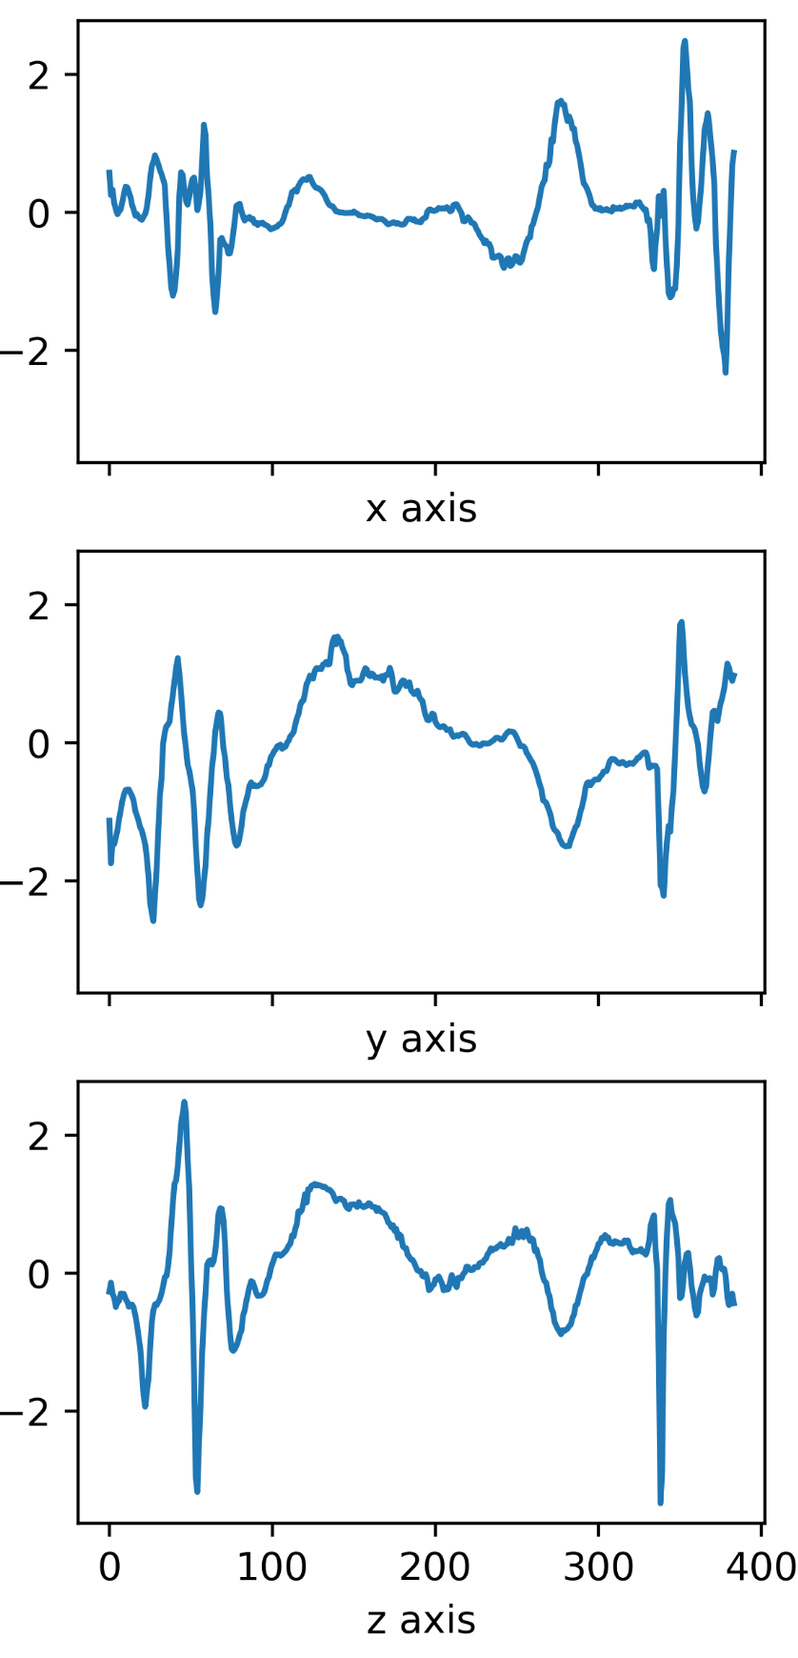
Counter Movement Jump
This paper:
An empirical evaluation of how foundation models handle channel dependencies in multivariate time series classification tasks
Spoiler: they don’t!
Source: https://tinyurl.com/5e3v32e6
Source: https://tinyurl.com/24a5m9w4

Slide 3
Channel Dependency
Channel dependency refers to the necessity of using multiple channels for successful classification, not just statistical correlation between channels
Strong dependency: Classification is difficult using any single channel alone
Weak dependency: A single channel contains sufficient discriminative information

Slide 4
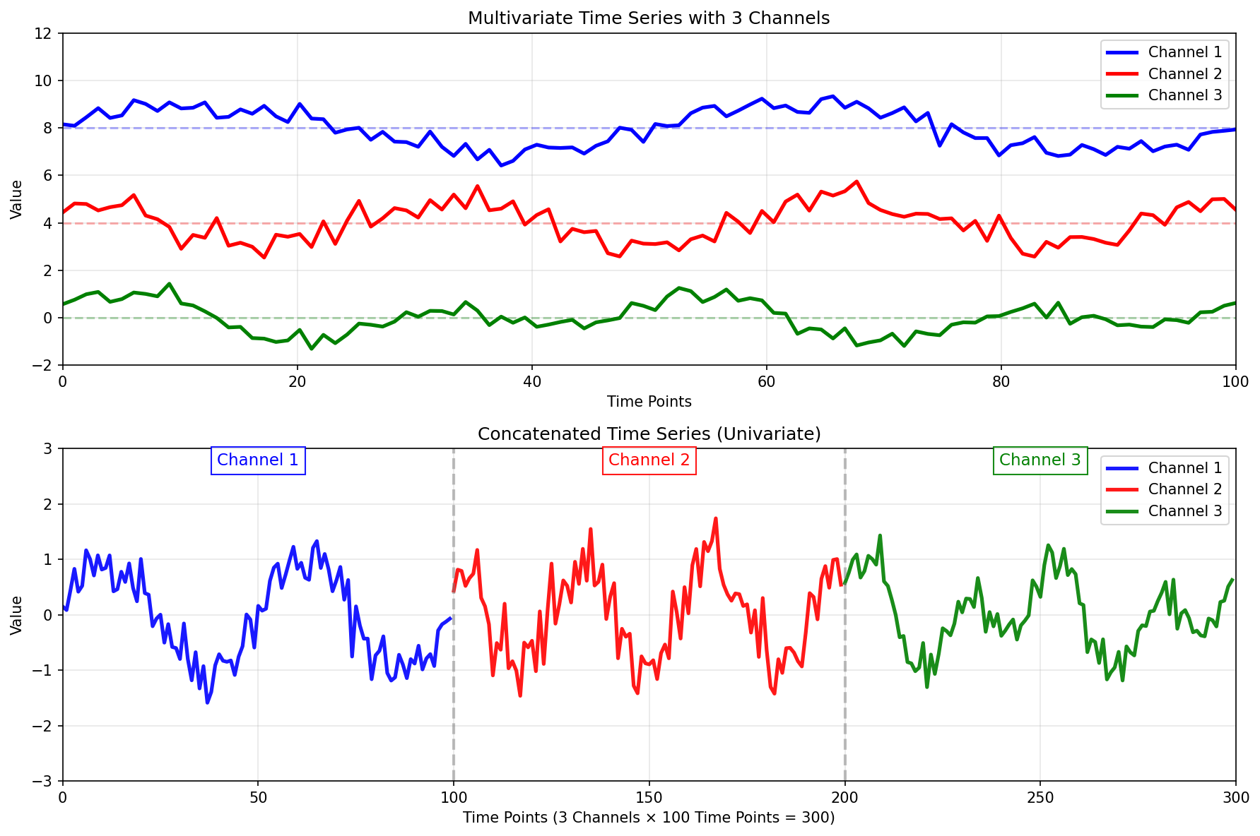

Slide 5
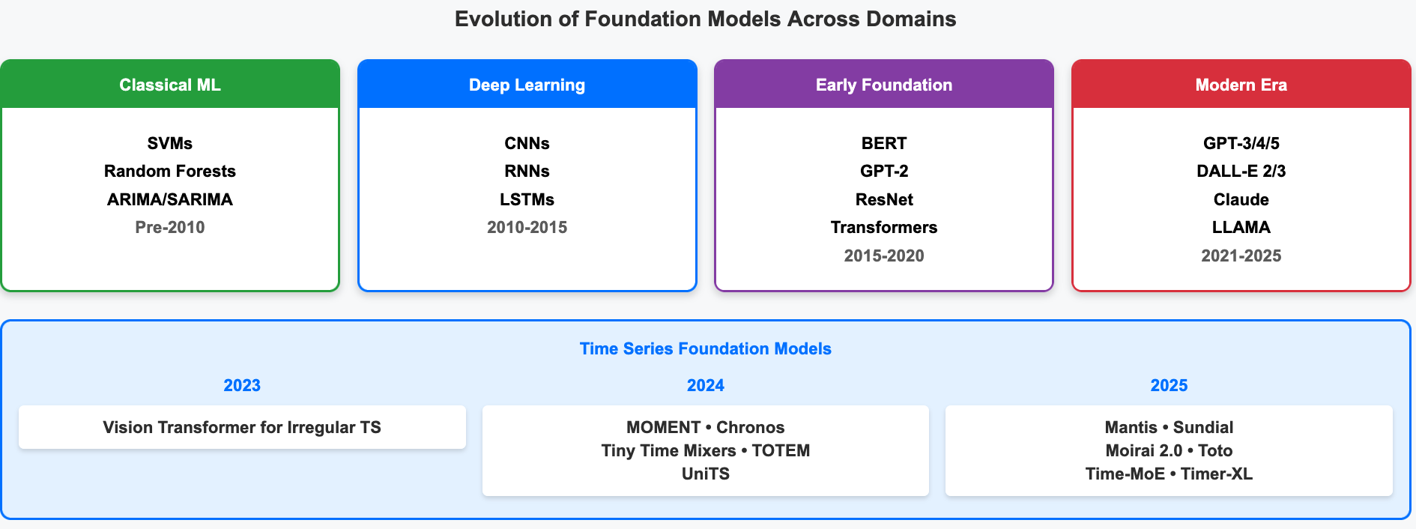
‹#›

Slide 6
The Challenge: Inter-Channel Dependencies
Current Limitation
Critical Gap
Research Focus
Foundation models process channels independently, limiting their ability to capture cross-channel patterns.
Inter-channel relationships are crucial in domains like human exercises, health
Evaluating how effectively foundation models capture dependencies between different channels or variables.

Slide 7



Foundation Model Approaches
Tokenization-based
Patch-based
Shape-based
Convert continuous values to discrete tokens (Chronos)
Segment time series into fixed-length subsequences (OneFitsAll, aLLM4TS, MOMENT, Mantis)
Represent through abstract shape features (VQShape)
All approaches process channels independently, reducing complexity from O((L·C)²) to O(C·L²) but missing critical cross-channel interactions

Slide 8
Tokenization-based
Convert continuous values to discrete tokens (Chronos)

Slide 9
Patch-based
Segment time series into fixed-length subsequences (OneFitsAll, aLLM4TS, MOMENT, Mantis)

Slide 10
Shape-based
Represent through abstract shape features (VQShape)

Slide 11
Evaluation Datasets
Counter Movement Jump (CMJ)
Synthetic (SYNTH)
Military Press (MP)
Accelerometer data
(3 channels)
Motion capture data
(8 or 50 channels)
Designed dataset
(8 channels)
Weak channel dependency: class distinctions primarily in y-channel
Strong channel dependency: requires minimum 4 channels
Strong channel dependency:
features in only 2 random channels (requires min 2 channels)

Slide 12
Experimental Results
Method Category | Method | CMJ (Weak) | MP8 (Strong) | MP50 (Strong) | SYNTH (Strong)
Time Series Specific | ROCKET | 0.950 | 0.743 | 0.793 | 0.861
 | QUANT | 0.933 | 0.696 | 0.740 | 0.964
 | MiniRocket | 0.944 | 0.741 | 0.787 | 0.882
Deep Learning | InceptionTime | 0.905 | 0.832 | 0.781 | 0.691
 | ConvTran | 0.866 | 0.804 | 0.570 | 0.930
Foundation Models | Mantis (best) | 0.955 | 0.697 | 0.773 | 0.929
 | MOMENT | 0.855 | 0.489 | 0.662 | 0.768
 | Chronos (best) | 0.927 | 0.467 | 0.287 | 0.513
 | aLLM4TS (best) | 0.872 | 0.689 | 0.472 | 0.505
 | VQShape (best) | 0.920 | 0.659 | 0.368 | 0.671
 | One-fits-all | 0.866 | 0.644 | 0.266 | 0.672
Best 2
Worst 2

Slide 13
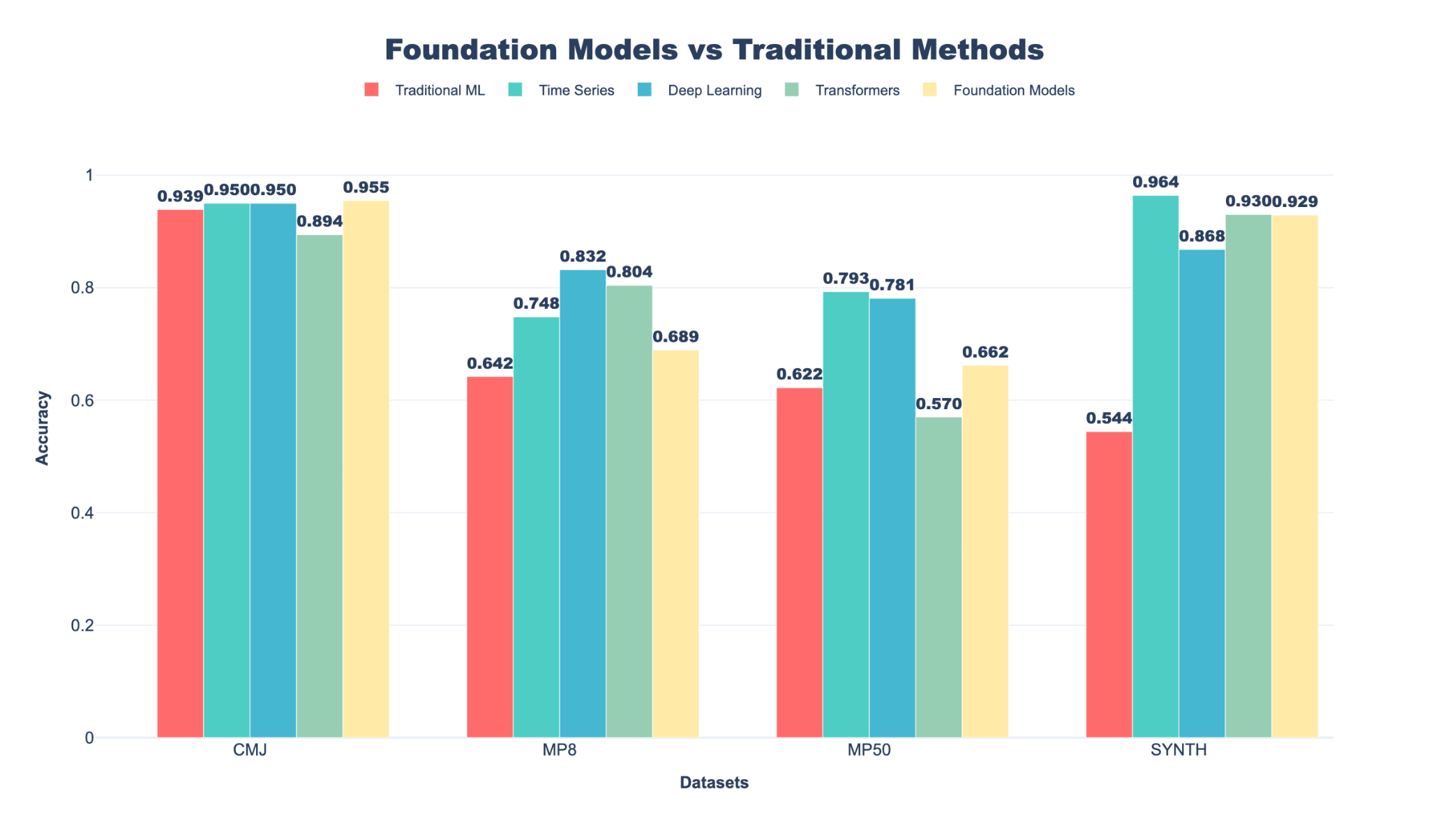

Slide 14
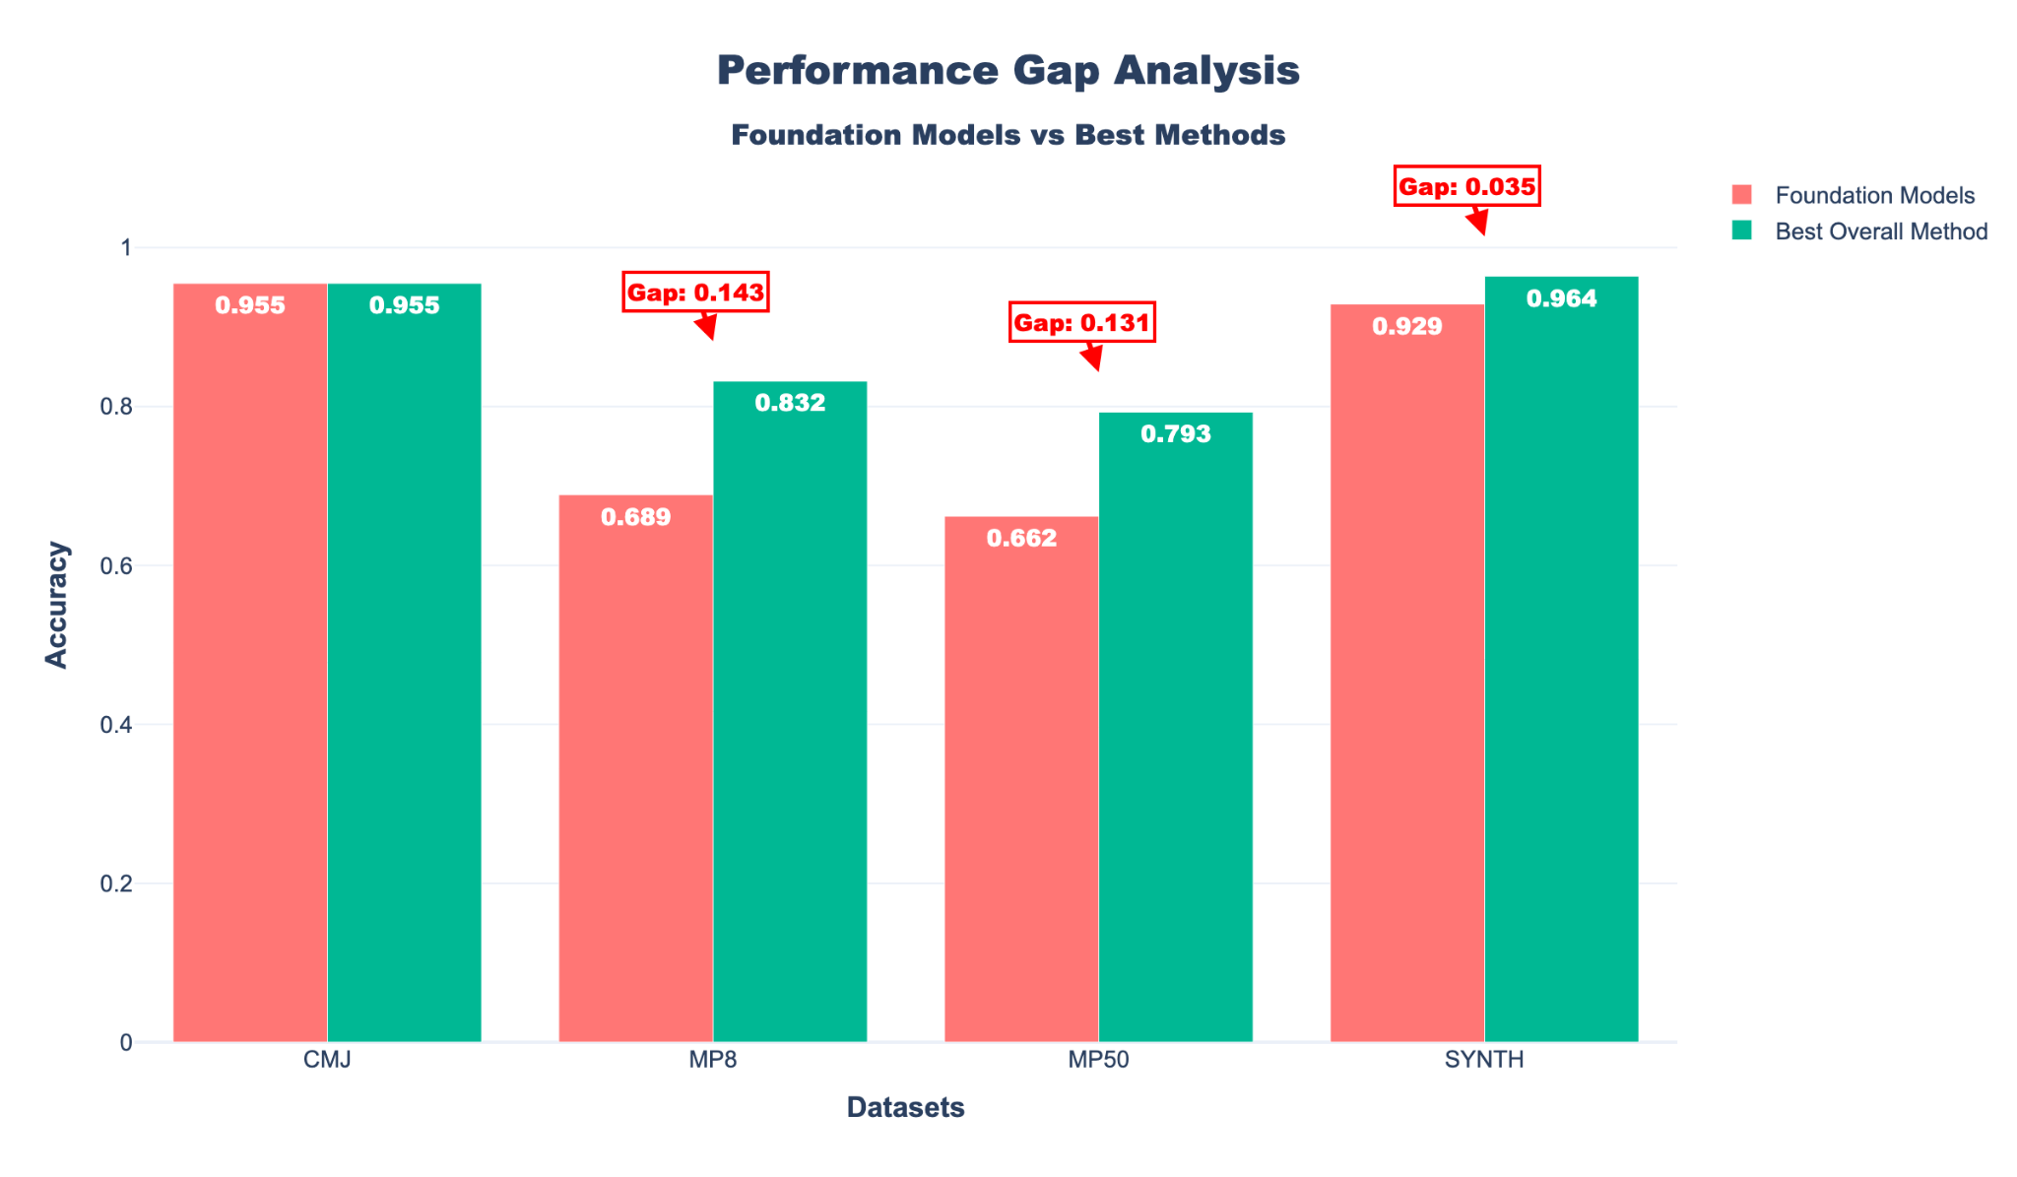

Slide 15
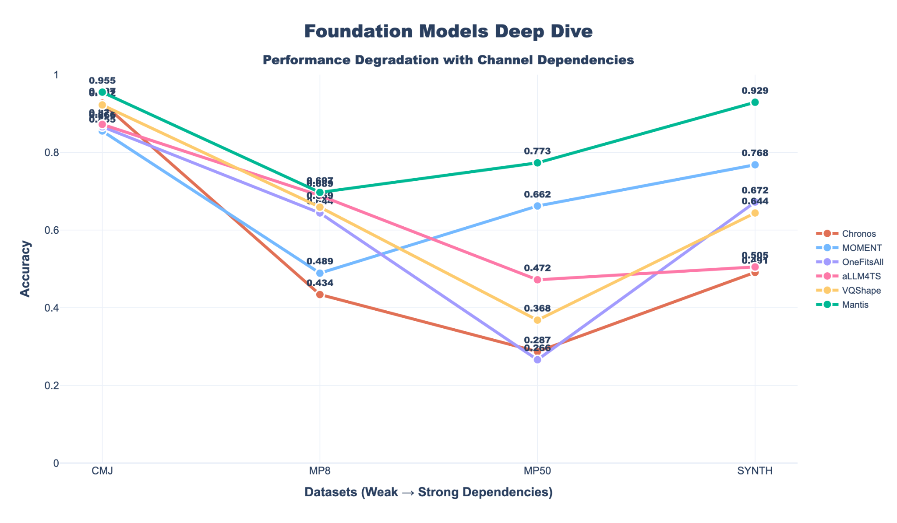

Slide 16
COMPUTATIONAL REALITY CHECK:
Mantis
MiniRocket
Accuracy (MP50)
77.3%
Accuracy (MP50)
78.7%
Fine-tuning Time
Hours
Training Time
4.86 sec
VS
Model Complexity
Very High
Model Complexity
Low
Has channel adapters (PCA, SVD)
33x faster with adapters but still slower & process channel independently
No adapters needed, inherently fast and efficient & considers inter-channel dependencies.
Key Takeaway:
Even with adapters, Mantis requires more resources while achieving lower accuracy than time series specific methods

Slide 17
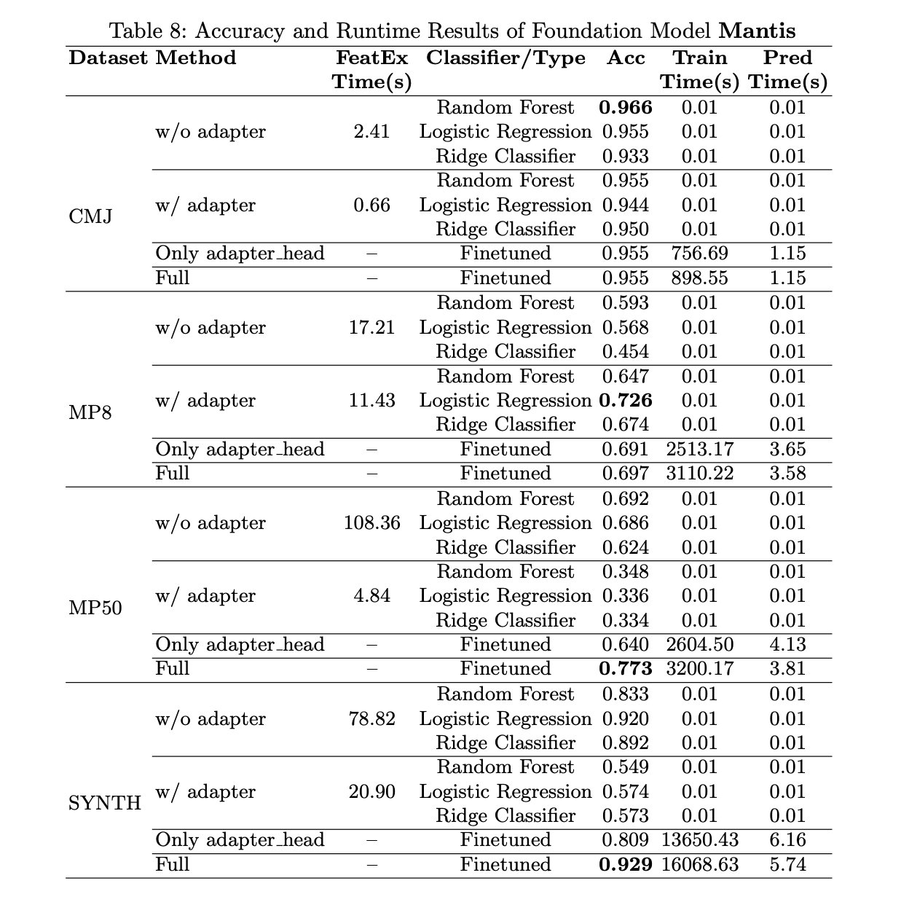

Slide 18
Key Research Findings
Many foundation models process channels independently
Time series specific methods consistently outperform foundation models on complex datasets
Foundation models fail as data complexity increases. They gain efficiency by ignoring channels O(C·L²) vs O(L·C)²) but lose accuracy on complex tasks
"Bigger" doesn't mean "better" for time series. Domain-specific approaches still lead when data relationships matter
Future foundation models need channel-aware architectures and cross-channel attention mechanisms to compete with specialized methods

Slide 19
Future Directions
Data Representation
Hybrid Architectures
Develop an efficient and effective mapping from multivariate to univariate
Combine foundation models with channel-aware components
Channel-Aware Pre-training
Develop objectives that explicitly model inter-channel relationships
Critical need for channel-aware architectures and more effective strategies for modeling inter-channel relationships in foundation models

Slide 20

Thank you!
Open code and data
https://github.com/mlgig/FM4MTSC

