Slide 1


Synthetic data – Privacy
Qinyi Liu
28th April
Generative AI for Synthetic Data in Learning Analytics: Opportunities, Methods, and Challenges

Slide 2
Questions ?
If the data is synthetic (fake), why should we worry about privacy?

Slide 3
Bridge from Utility Talk
Utility asks:
Can synthetic data support useful analysis?
Privacy asks:
Can synthetic data expose real people or sensitive information?

Slide 4
Bridge from utility talk
Key point:
Useful data often preserves patterns. But those same patterns may carry privacy risks.

Slide 5
Agenda
Scenario
3 types of privacy risks
How to evaluate privacy in synthetic data
”safe enough” take-away
Lab activity

Slide 6
Scenario: an unusual student
Meet “Student A”
Student A:
logs in at 3 AM almost every day
failed two courses in a row
suddenly scored very high on one exam
enrolled in a very niche course
"This is not a name, nor is it an ID number. But it is a very unique learning trajectory."

Slide 7
Scenario: an unusual student
Privacy risk comes from patterns, not just identifiers.
Examples of identifiers:
name
email
student ID
Examples of patterns:
rare course combination
unusual login behavior
grade trajectory
demographic subgroup
Notes:
In learning analytics, much sensitive information is not written out directly, but rather revealed through behavioral patterns.

Slide 8
Three types of privacy risks
Memorization risk
The model may "remember" real individuals.
In simpler terms:
Generative models don't just learn patterns; sometimes they also memorize answers.

Slide 9
Three types of privacy risks
Memorization risk
The model may "remember" real individuals.
Learning analytics example in synthetic data:
a rare student trajectory appears almost unchanged
a rare subgroup profile is reproduced
an outlier record appears again in synthetic form

Slide 10
Three types of privacy risks
Re-identification risk
Even without a name, a person can be identified through a combination of characteristics.
For example:
Age + Courses + Grades + Login Time
This could be more revealing than a name.

Slide 11
Three types of privacy risks
Re-identification risk
A person may be recognized through a unique combination of features.
This risk is particularly high in small classes, special courses, and among minority groups.

Slide 12
Three types of privacy risks
Attribute inference risk
Others might infer sensitive information about real students from synthetic data.

Slide 13
Three types of privacy risks
Attribute inference risk
Even if a student is not directly identified, sensitive information may be inferred.
Examples:
learning difficulty
mental health concern
disability status
socioeconomic background
dropout risk
language background

Slide 14
Three types of privacy risks
Attribute inference risk
Even if a student is not directly identified, sensitive information may be inferred.
Sometimes the problem isn't 'I know who you are,' but rather 'I can infer that you belong to a high-risk or vulnerable group.'

Slide 15
Then how to evaluate synthetic data in privacy?
How similar is synthetic data to real data? (distance-based evaluation)
What can an attacker actually do? (attack-based evaluation)

Slide 16
Distance-based methods
Are the distributions very similar?
Are rare patterns preserved?
Are individual records too close?

Slide 17
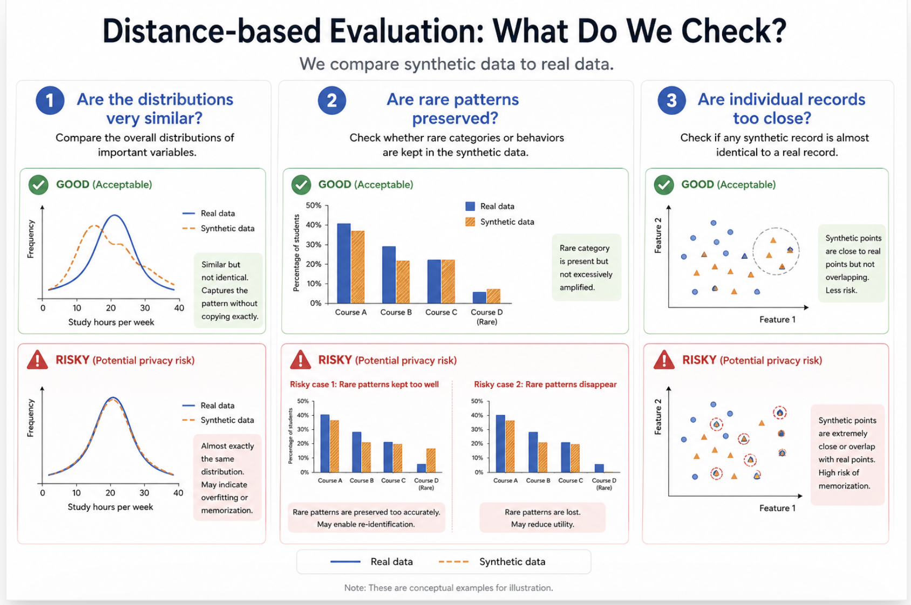

Slide 18
Distance-based methods
Common simple metrics:
Nearest neighbour distance
Average similarity score
Duplicate / exact match rate

Slide 19
Distance-based methods
Common simple metrics:
Nearest neighbour distance: For each real student, we look for the most similar synthetic student.
“How close is the closest synthetic twin?”

Slide 20
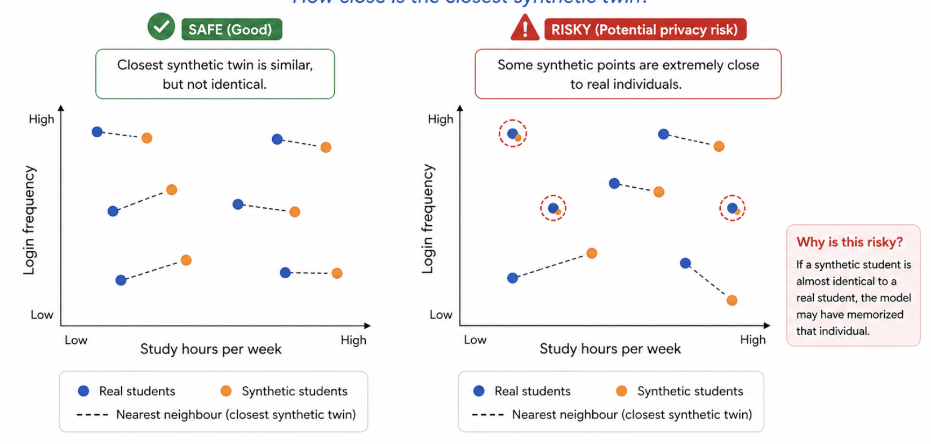
Nearest neighbour distance

Slide 21
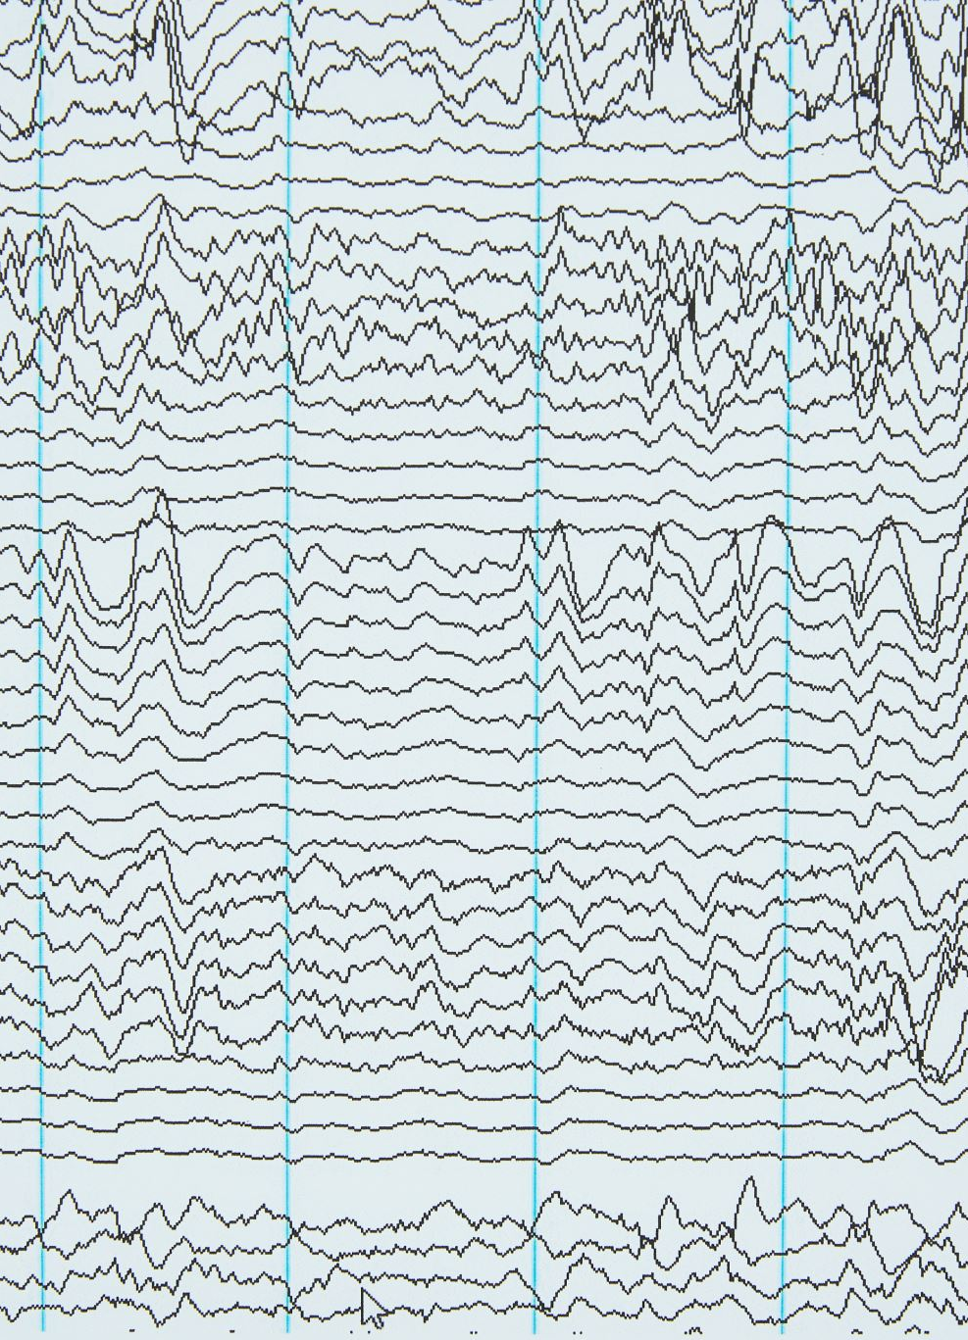
Distance-based methods
Common simple metrics:
Similarity score: We measure how similar the overall data is.
distributions
patterns
correlations
“How similar do the two datasets look overall?”

Slide 22
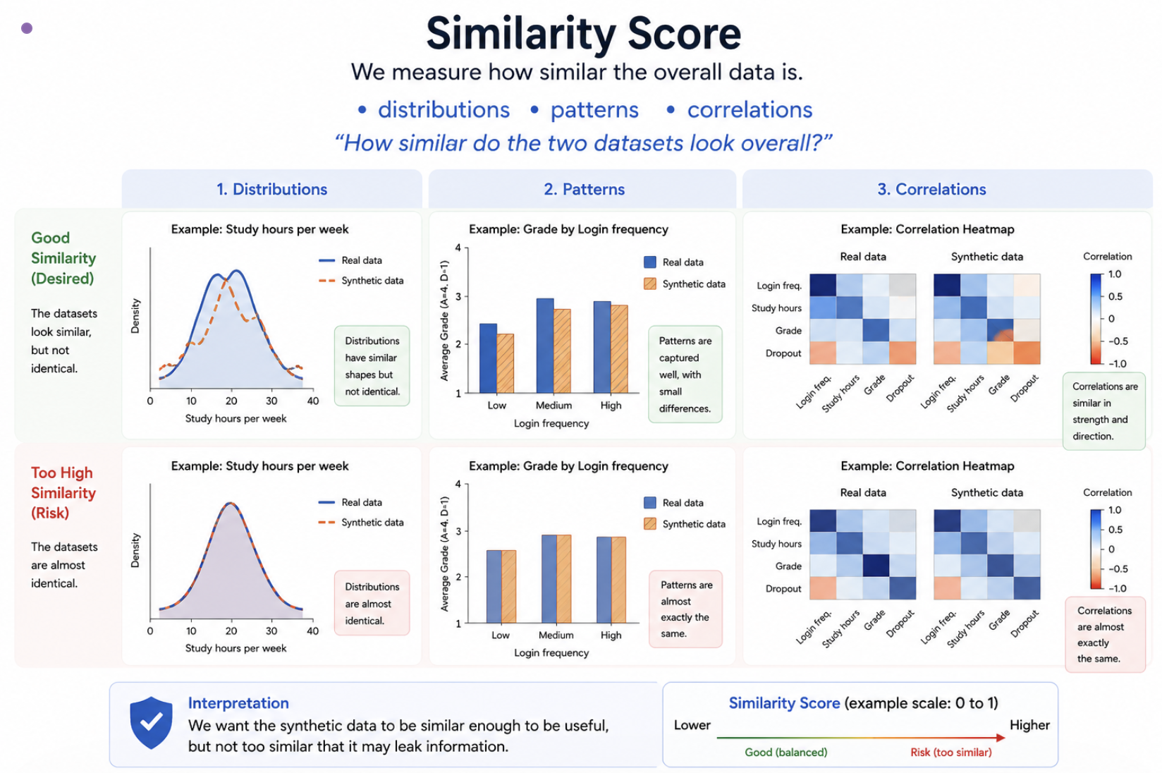

Slide 23
Distance-based methods
Common simple metrics:
Exact match / duplicate rate: Do any synthetic rows exactly match real rows?
👉 If: Exactly identical data exists
→ 🚨 A very obvious risk
“Did we accidentally reproduce real individuals?”

Slide 24
Attack-based evaluation
“What can someone actually infer?”
Common evaluation attacks:
Membership inference
Attribute inference
Re-identification attempts

Slide 25
Membership inference
Can we tell if a specific student was in the original dataset?
An attacker obtains a student's data. The question is: Is this person in the training data?
“Was this person in the dataset?”

Slide 26
Attribute inference
Can we guess sensitive attributes from the data?
Examples, Predicting from behavior: dropout risk, learning difficulty
“Can we guess something sensitive about a student?”

Slide 27
Re-identification attempts
Can we link synthetic data back to real individuals?
matching patterns
combining features
“Can we connect synthetic data back to real people?”

Slide 28
In summary
Approach | What it checks | Example metric
Distance-based | similarity | nearest neighbour
Attack-based | inference risk | membership inference

Slide 29
Safe enough?
Ask yourself three things before using synthetic learning data:
Who could be harmed?
What could be inferred?
How will the data be used?

Slide 30
Safe enough?
Questions | What to ask
Who could be harmed? | Individual students? Small subgroups? Vulnerable learners?
What could be inferred? | Grades? Risk status? Disability? Mental health? Background?
How will it be used? | Teaching demo? Research sharing? Model training? Policy decision?

Slide 31
Lab Activity
Student dataset (real)
ID | Age | Course | Login freq | Study hours | Grade | Dropout
---------------------------------------------------------------------
1 | 19 | Computer Sci | High | 15 | B | No
2 | 22 | Mathematics | Low | 5 | D | Yes
3 | 21 | Biology | Medium | 10 | C | No
4 | 23 | Philosophy | Very Low | 2 | A | No
5 | 20 | Computer Sci | Very High | 25 | A | No

Slide 32
Lab activity
Based on the dataset above, generate 20 synthetic students. Keep patterns realistic, but do not copy any individual.
👉 goal：
Generate synthetic student data AND evaluate if it is “safe enough”

Slide 33
Task part 1 – generate synthetic data
No coding required, use ChatGPT (or any LLM)
Prompt example (for reference):
“Generate a synthetic dataset of 20 students with columns following the same pattern but not exactly the same.”
Very important: “Make the data realistic but not identical to real individuals.”

Slide 34
Task Part 2 — Distance-based Evaluation
Question: Is your synthetic data too similar?
Look for:
Do you see any rows very similar to ID 4?
Are rare combinations repeated?
Are patterns like “low login → dropout” preserved?

Slide 35
Task 3 – define a scenario
Example scenario
Scenario A — Teacher | Scenario B — Researcher | Scenario C — External party
A teacher uses the dataset to identify at-risk students. | A researcher uses the dataset to study dropout patterns. | An external organization gets access to the dataset.
What decisions might the teacher make? | What conclusions might they draw? | What could they infer about student groups?
Could students be unfairly labeled? | Could these conclusions be misleading or sensitive? | Could this affect certain populations?

Slide 36
Task part 4 – decision
Is your dataset safe enough?
Consider the 3 questions for your synthetic dataset
Who could be harmed?
What could be inferred?
How will the data be used?
The three questions are based on your Hypothetical Scenario

