Slide 1
Team Name : Back Benchers
Team Members:
Gautam
Sanjay Singh
Inder barthwal

Slide 2
Introduction
The project is from the Healthcare, where our main focus is on predicting the type of “CANCER” , which is the second leading cause of death globally. Our model can predict with 90% accuracy that whether the tumor is Benign or Malignant which help in the early diagnosis.

Slide 3
What is cancer?
Cancer is a generic term for a large group of diseases that cause and affect any part of the body.
Cancer is the rapid creation of abnormal cells that grow beyond their usual boundaries, and which can then invade adjoining parts of the body and spread to other organs.

Slide 4
Tumor
A tumor is a mass or lump of tissue that may resemble swelling. Not all tumors are cancerous, but it is a good idea to see a doctor if one appears.

Slide 5
Benign and malignant
Benign: These are not cancerous. They either cannot spread or grow, or they do so very slowly. If a doctor removes them, they do not generally return. Premalignant: In these tumors, the cells are not yet cancerous, but they have the potential to become malignant. Malignant: Malignant tumors are cancerous. The cells can grow and spread to other parts of the body

Slide 6
How are tumors diagnosed?
If you discover a new or unusual lump on your body, see your doctor as soon as possible.
Sometimes, though, you may not know you have a tumor. It may be found during a routine screening or checkup, or during a test for some other symptom.
After a physical exam, your doctor may use one or more imaging tests to help confirm a diagnosis, such as:
X-ray
ultrasound
CT scan
MRI

Slide 7
Blood tests are another common way to help with diagnosis. But a biopsy is the only way to confirm the presence of cancer.
A biopsy involves removing a tissue sample. The location of the tumor will determine whether you need a needle biopsy or some other method, such as colonoscopy or surgery.
The tissue will be sent to a lab and examined under a microscope. Your doctor will receive a pathology report. This report will tell your doctor whether the tissue that was removed is benign, precancerous, or malignant.

Slide 8
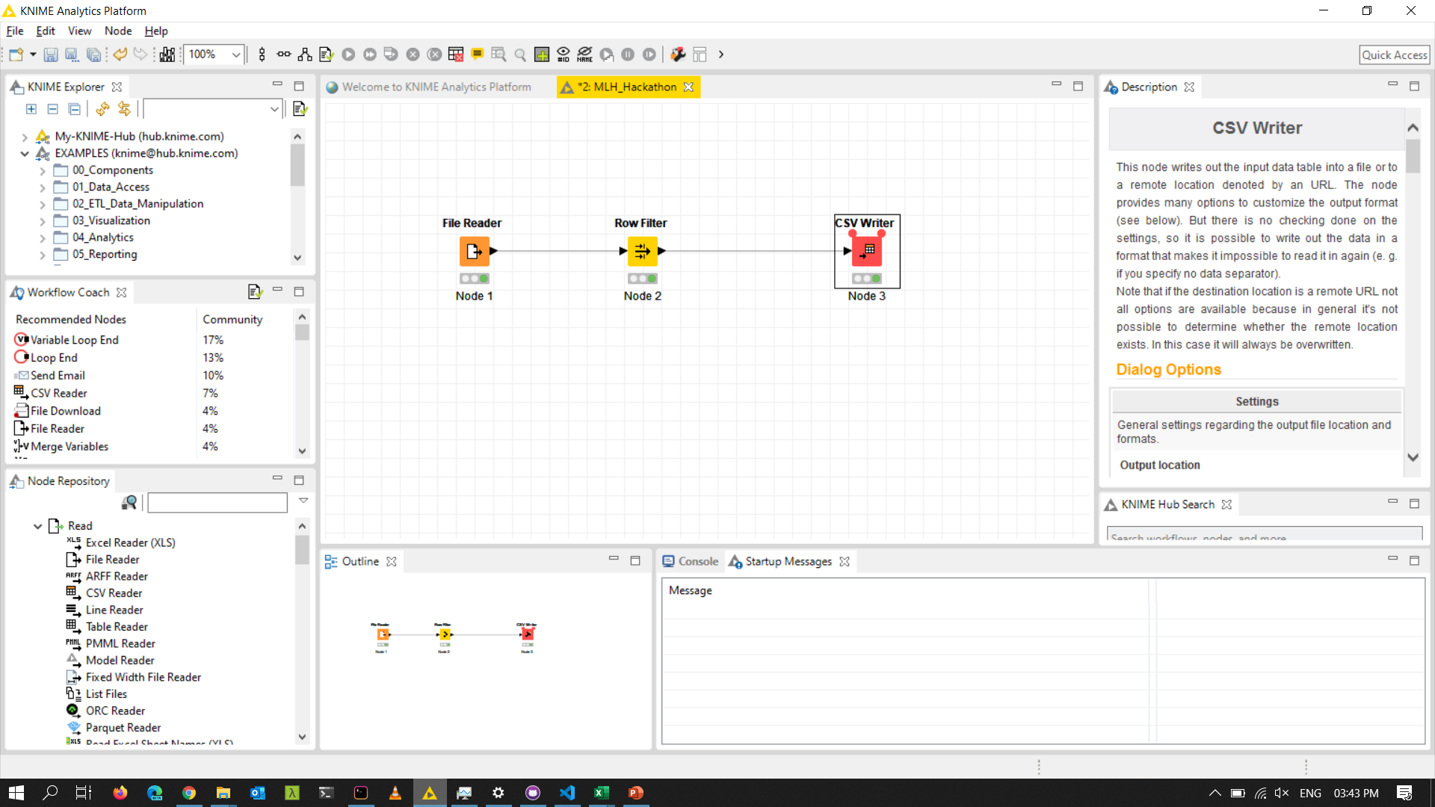
Knime WorkSpace

Slide 9
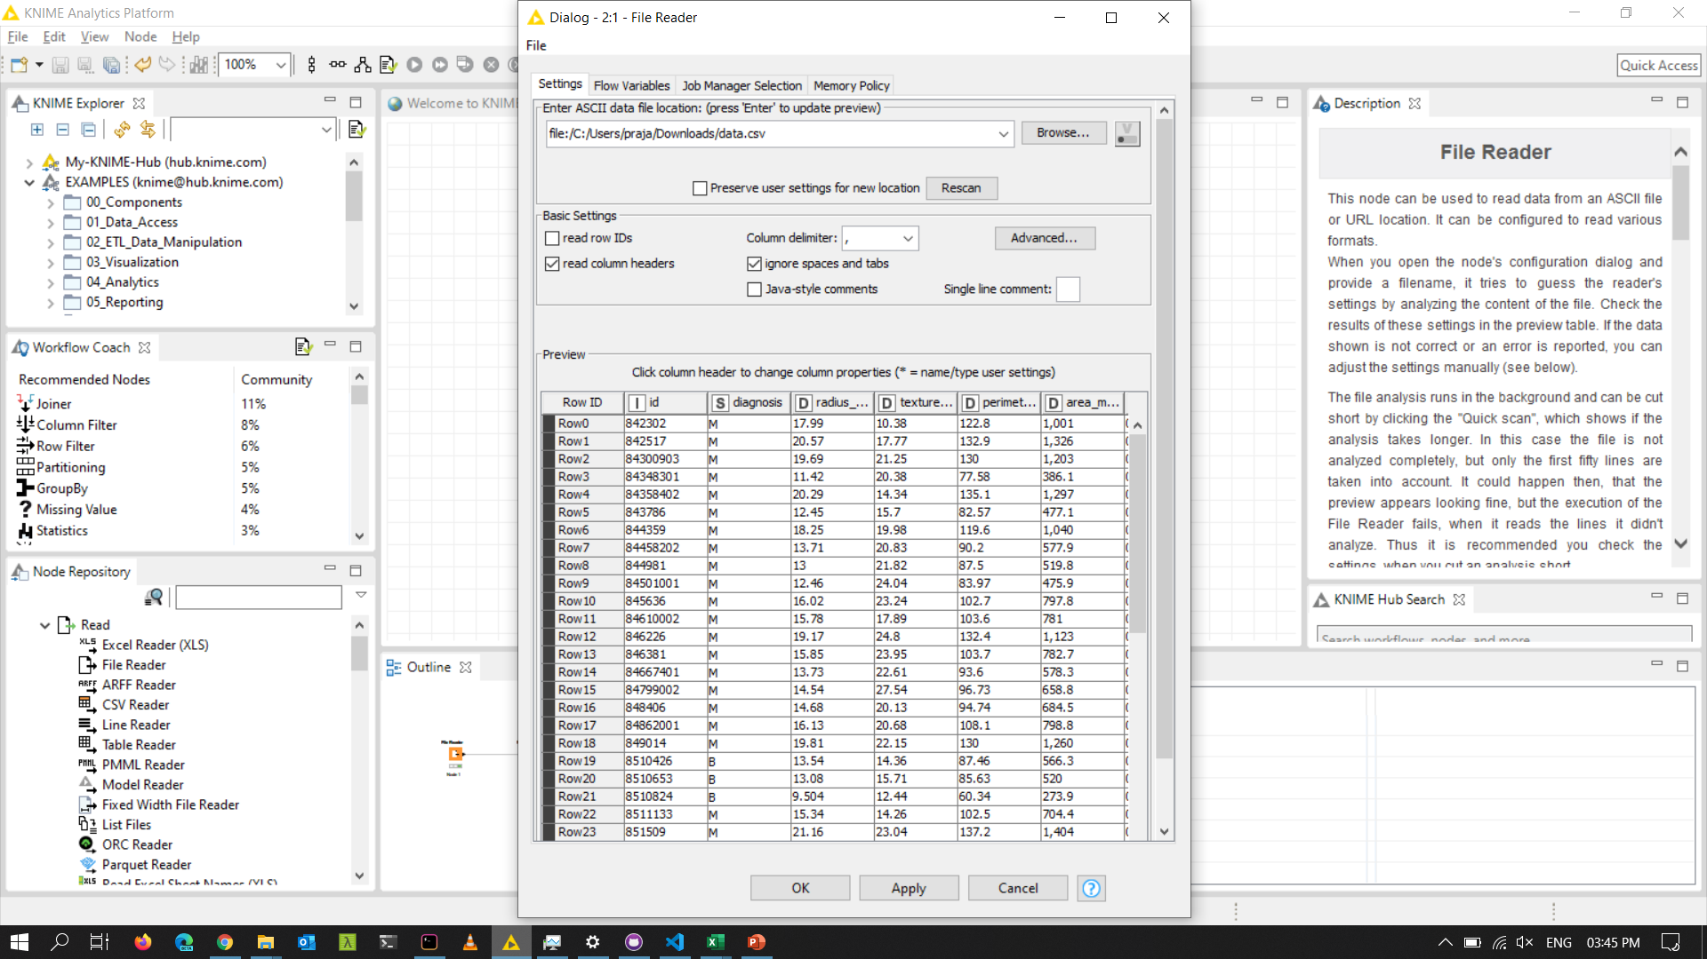
Configuration

Slide 10
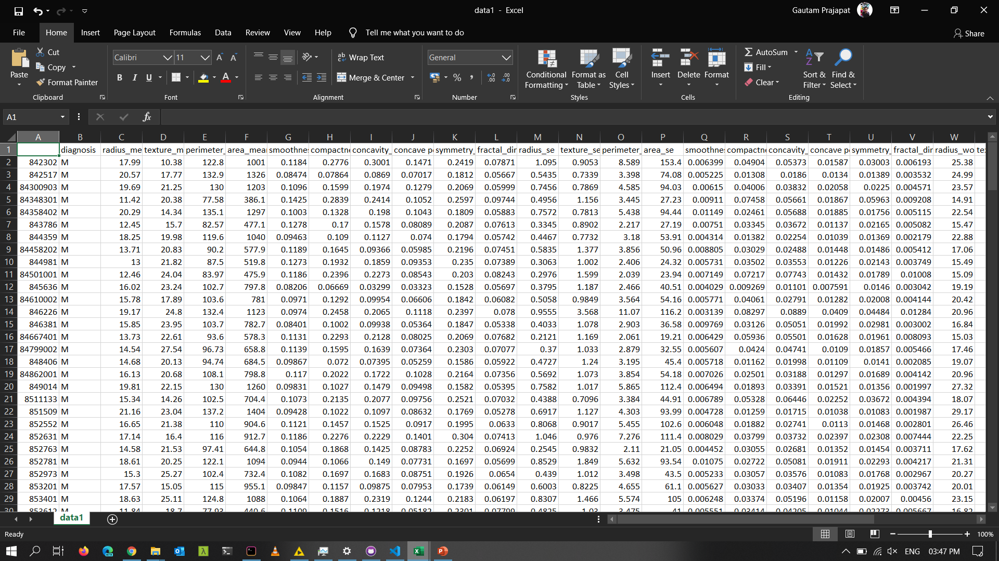
Output Dataset

