Slide 1
Forecasting Stock Price Using Machine Learning Technique
Md Tanvir Rahman
143000410
School of Science, Engineering & Technology
East Delta University, Chittagong,Bangladesh
Supervisor: Mohammad Nazim Uddin, PhD

Slide 2
Contents of the presentation
Introduction
Background
Objective
Machine Learning Algorithm
Multiple linear Regression
Random Forest Regression
SVM Regression
KNN Regression
Predicting future Stock Market
Architecture
Stacking Model
Experimental Evaluation
Experimental Design
Data set
Cross Validation
Result Analysis
Comparison in accuracy
conclusion

Slide 3
Introduction
Stock market is an important part of the economy of a country. The stock market play a pivotal rule of the growth of the industry and the commerce of a country that will eventually affects the economy of a country to a great extent.
The reason for me to choose this field because stock market is an emerging sector of any country of the world and Many people directly involved to this sector and it is important both industry and the investors point of view.
Make accurate and Successful prediction in the stock market future price can give significant profit in the competitive finance market

Slide 4
Objectives
Identify the factor affecting share market
Generate the pattern from large set of data of stock market
To predict an approximate value of share price
Comparing between prediction techniques and opining on them.

Slide 5
Machine Learning Algorithm
We use four machine Learning Algorithm a part of the system architecture
Multiple Linear Regression
SVM Regression
KNN Regression
Random Forest Regression

Slide 6
Multiple Linear Regression
Multiple Linear regression is the most common form of linear regression for predictive analysis .Multiple Linear regression is used to explain the relationship between one continuous dependent variable and two or more independent variables .The equation we used for this is
Y = β₀ + β₁x₁ + β₂x₂ + …+ β_{n}x_{n} (1)
For our study we used equation(1) to make the prediction

Slide 7
SVM Regression
Support Vector Machine follows the concept of hyper-planes In simple words, a line is drawn between the observations in a graph in such a way that it has the maximum possible distance from the sets of data points as it cuts through between them. That line is the hyper-plane and the equation that defines the line is called a hyper-plane equation. We take the input and we first mapped into a m-dimensional feature space using some fixed mapping and then linear model(in the feature space) using f(x,w) mathematical notation,the linear model is given by g(x) denotes a non linear transformation and b is the bias.

Slide 8
KNN Regression
K nearest neighbors is an algorithm that's stores all available cases and predict the numerical target based on distance function has been used in statistical and pattern recognition.
A simple implementation of KNN is to calculate the average of the numerical target of the K nearest neighbors. We use this equation of calculating Euclidian distance
dist ( A , B)= √ ∑(x_{i} − y_{i})/2m (4)

Slide 9
Random Forest Regression
Random forest (or random forests) is associate ensemble classifier that consists of the many decision trees and outputs the class by individual trees .The equation we are using is
g(x)=f₀(x)+f₁(x)+f₂(x)+…………..(2)
where the final model g is the sum of the base model f_{i} .each model is a separate decision tree .all the models are constructed independently using a sub-sample of data

Slide 10
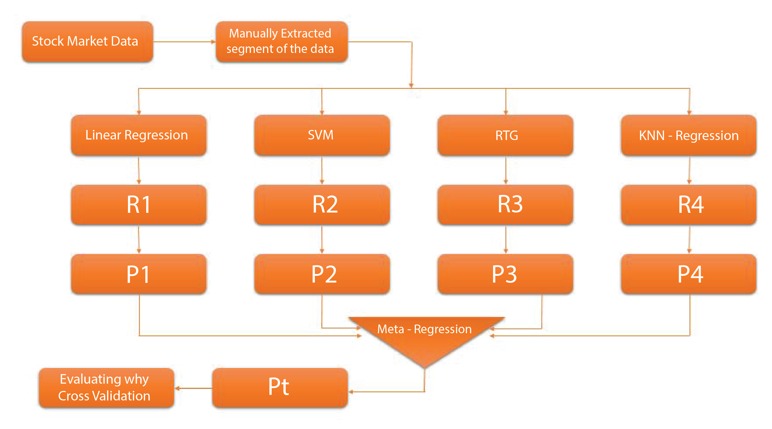
Predicting future stock market price
FIG 1: Predicting future stock price

Slide 11
Stacking Model
Stacking is performed using these algorithm. Stacking is concerned with combining multiple classifiers generated by different learning algorithms L₁,....L_{n} on a single data set S, which is composed by a feature vector
S_{i} = (X_{i},Y_{i}) (5)
The stacking process can be broken into two phases:
Generate a set of base-level regression model C₁,...,C_{n}.In this case we made four regression model Linear Regression, Knn regression,Support Vector regression and Random Forest Regression Where
C_{i}=L_{i} (S) (6)
Train a Secondary classifier to combine base level classifier

Slide 12
Contd.
The training data of the secondary Classifier comes from the primary prediction of the base-level regression model.
C_{ik} =L_{k}( S) (7) [ where k=1,…...n]
The training data of the secondary Classifier comes from the primary
prediction of the base-level regression model.
Then the learned classifier are used to generate predictions
Y_{ki}=C _{ki} ( x_{i} ) (8)

Slide 13
Experimental Design
The data used in our research system was collected from Quandl which is a platform for financial data.
In our study, we used the following attributes
Adjusted Close price
Volatility
Percentage change
Adjusted open price
Adjusted Volume
The data of 2004 to 2016 were used to predict the Stock price of the year 2017 to 2018

Slide 14
Contd.
In our study, we used the following software
Python (interpreted and objected oriented programming language)
Anaconda (specialized version for python for data science and machine learning)
Scikit-learn
Pandas (for data manipulation)
Matplotlib (for graphical representation)

Slide 15
Datasets
The data used in our research system was collected from Quandl which is a platform for financial data.
In our study, we used the following data set
Microsoft Corporation (MSFT) Stock Prices, Dividends and Splits
Nike Inc. (NKE) Stock Prices, Dividends and Splits
Intel Corporation (INTC) Stock Prices, Dividends and Splits
International Business Machines Corporation (IBM) Stock Prices, Dividends and Splits
The Walt Disney Company (DIS) Stock Prices, Dividends and Splits
Cisco Systems Inc. (CSCO) Stock Prices, Dividends and Splits
Coca-Cola Company (The) (KO) Stock Prices, Dividends and Splits
Apple Inc. (AAPL) Stock Prices, Dividends and Splits

Slide 16
Cross Validation
It is mandatory to validate the stability of machine learning model .we need some kind of assurance that our model has got most of the patterns from our data correctly .and it is not picking up too much noise or in other words its low on bias and variance
We use cross validation (Holdout) method to find how well the model predict the unseen data and the find the accuracy of the prediction and then compare with other method accuracy
In this method we remove a part of the training data and using it to get the prediction on the rest of the data .then the error estimation tells how our model doing with the unseen data and the accuracy of the prediction

Slide 17
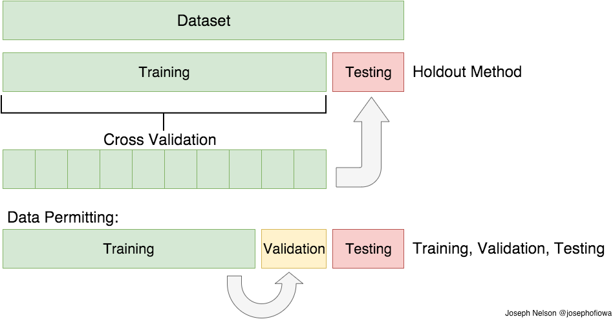
Cross Validation

Slide 18
ACCURACY OF PREDICTION
ACCURACY BASED ON CROSS VALIDATION
COMPANY | LINEAR REGRESSION | KNN REGRESSION | SVR | RANDOM FOREST REGRESSION | PROPOSED METHOD
GOOGLE | 87.9% | 89.18% | 74.32% | 88.6% | 90.72%
APPLE | 92.2% | 91.4% | 91.0% | 93.4% | 94.8%
MICROSOFT | 91.4% | 91.4% | 91.4% | 91.4% | 91.4%
IBM | 73.6% | 71.3% | 77.8% | 78.4% | 80.8%
NIKE | 94.0% | 94.9% | 95.05% | 92.9% | 96.8%

Slide 19
Conclusion
After interpreting the results of this study, it could be concluded that:
Our proposed stacked model have attained highest accuracy among all the other models.
If we only concerned for the best possible correlation coefficient .it might be difficult or impossible to find a single algorithm that perform as good as our proposed stacked model

Slide 20
THANK YOU

