Slide 1

A Neural Network Approach to Predict Stock Performance
Mrutunjaya
Rahul
Pandey
Goutam

Slide 2

Presentation Outline
Introduction
Problem Description
Motivation
ECNN
Evaluation
Empirical study
Test Results
Conclusion

Slide 3

Introduction
Trading is the process of buying and selling of financial instruments
Stock market
  market for the trading
  one of the most important sources for companies to raise money
  allows businesses to go public, or raise additional capital for expansion

Slide 4
Incentive
Predicting stock performance is a very large and profitable area of study
Many companies have developed stock predictors based on neural networks
This technique has proven successful in aiding the decisions of investors
Can give an edge to beginning investors who don’t have a lifetime of experience

Slide 5
Problem Description
Collect a sufficient amount of historical stock data
Using the data train a neural network
Once trained, the neural network can be used to predict stock behavior

Slide 6
Time Series Analysis Vs NN
TS - Instructions and rules are central
TS – A Mathematical formula define the dynamics
NN - Don't perform according to preset rules. Learns from regularities and sets its own rules
NN – Not described explicitly in mathematical terms

Slide 7
Benifits with NN
Generalisation ability and robustness
Mapping of input/output
No assumptions of model has to be made
Flexilbilty

Slide 8

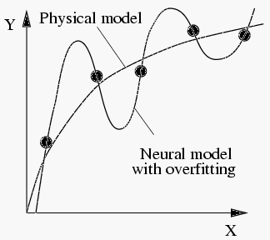
Drawbacks with NN
Black-box property
Overfitting
Expertise for choice of input
Training takes a lot of time

Slide 9
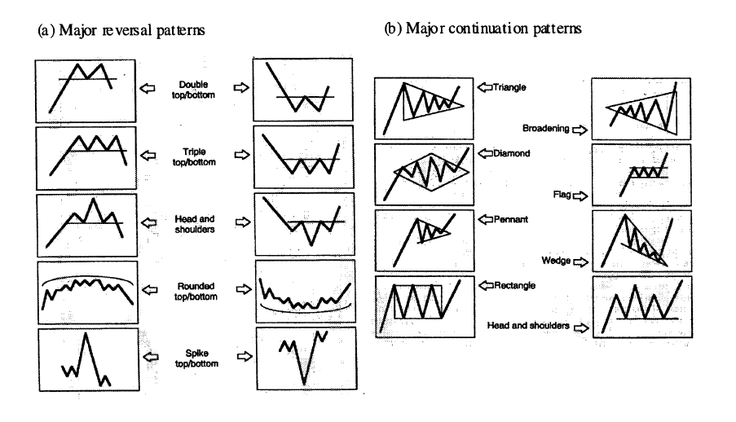
Motivation
Stock Prediction is more or less like Pattern Recognition
NN is a power tool for Pattern Regnition

Slide 10
Other Reasons
Stock data is highly complex and hard to model, therefore a non-linear model is benecial
A large set of interacting input series is often required to explain a specfic stock, which suites neural network

Slide 11
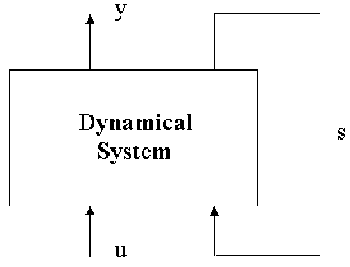
Error Correction Neural
Networks(ECNN)
The idea is to use the previous model error as additional information to the system
Recurrent system is described as
s_{t} = f (s_{t-1} , u_{t} ) state transition
y_{t} = g (s_{t}) output equation

Slide 12

Developing ECNN
Functions f and g are not specied, y_{t} is the computed output and s_{t} describes the state.
s_{t} = f (s_{t-1} , u_{t} , y_{t-1} - y_{t}^{d} )
y_{t} = g (s_{t} )
y_{t}^{d} is observed data
f and g can be stated as

Slide 13

Adding NN Role
We implement a NN
s_{t} = N(s_{t-1} , u_{t} , y_{t-1}-y_{t-1}^{d} ; v )
y_{t} = N(s_{t} ; w)
Now optimisation problem is
We apply an activation function
s_{t} = tanh(As_{t-1} + Bu_{t} + D(Cs_{t-1}-y_{t-1}^{d} ))
y_{t} = C (s_{t} )

Slide 14

Final ECNN
weights v = {A, B , D} and w = {C }
A and DC could code the autoregressive structure, so non-linearity is added
s_{t} = tanh(As_{t-1} + Bu_{t} + D tanh(Cs_{t-1}-y_{t-1}^{d} ))
y_{t} = C (s_{t} )
New optimisation problem is

Slide 15
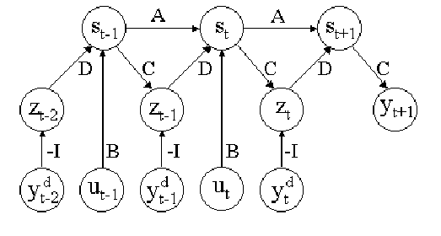
Overview of ECNN
The ECNN offers forecasts based on the recursive structure (matrix A), the external forces (matrix B ) and the error correcting part (matrices C and D). The error correcting part can also be viewed as an external input similar to u_{t} .

Slide 16
Learning Algorithm
We use back-propagation technique
w_{k+1} = w_{k} + d_{k}
d_{k} - search direction and   learning rate
We use vario-eta algorithm in which we give a weight specific factor  is related to each weight

Slide 17
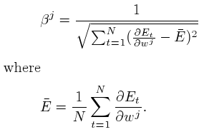
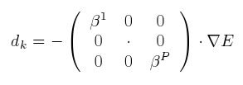
Vario-Eta Algorithm
 is defined as
 is defined as
 is defined as
If p weights are in the network, d_{k} is given by

Slide 18
Stopping Criteria
How many epochs?
Two paradigms - late and early stopping
During learning the progression is monitored and training is terminated as soon as signs of overfitting appear
Advantage - the time of training is relatively short
Downside - hard to know when to stop

Slide 19
Error Function
We have to be aware of outliers in data
Outliers typically appear when the economic or political climate is unstable or unexpected information enter the market
The ln cosh (.) error function is
(1/a) ln cosh(a(o_{i}-t_{i} )
o_{i} - the response from output neuron i and t_{i} - the corresponding target
a[3,4] is suitable for financial application

Slide 20
Evaluation
A performance method in itself is not sufficient for a satisfying evaluation.
Benchmark is a different algorithm used
for comparison.

Slide 21
Benchmarks
A good prediction algorithm should outperform the naive algorithm, i.e. predicted value of stock in next time step is same as the present value.
Naive algorithm is a direct consequence of Efficient Market Hypothesis which states that the current market price is an assimilation of all information available therefore no changes of future changes can be made.

Slide 22
Terms
R^{k}_{t} is the k-step return at time t.
The predicted k-step return at time t is given by capped R^{k}_{t}.
sign(x) gives the sign of the x.

Slide 23



Performance measures
Hit Rate - accounts the number of times direction of the stock is same
as predicted
Return of investment – takes into account the sign and the quantity of actual return
Realised Potential – shows
how much of the total
movement algorithm
successfully identifies.

Slide 24
Empirical Study
Well traded stocks with a reasonable spread are considered.
Certain time invariant structures are identified and learnt quickly so in latter part of the training some weights are frozen.
Occurance of invariant structures was more evident in weekly rather than daily structures.

Slide 25
Data series
Closing price y
Highest price during the day y_{H} .
Lowest price during the day y_{L} .
Volume V , the total amount of stocks traded during the day.

Slide 26
Training procedure
Data was divided into 3 subsets Training set, Validation set, Generalization set.
Weights were initialized uniformly in the range [-1,1].
After training waights associated with the best performance in the Validation set were selected and applied to Generalization set to get final results.

Slide 27
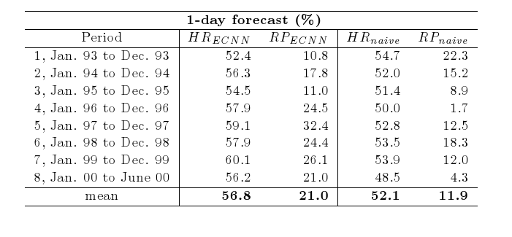
Some Test Results....
One day forecast of Swedish stock Exchange

Slide 28
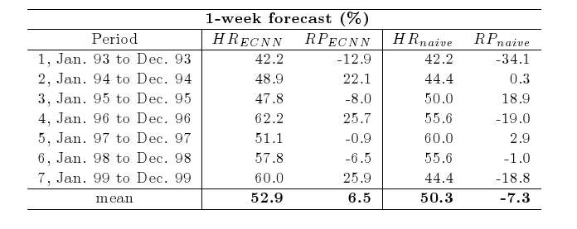
some Test Results cont....
weekly forecast

Slide 29
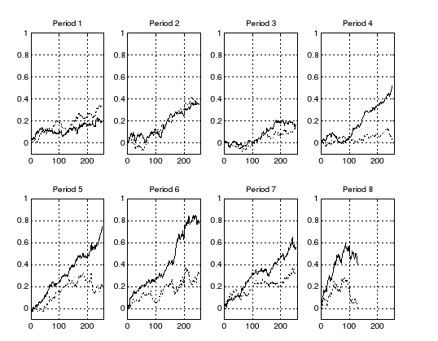
Some Test Result cont...
Daily Prediction

Slide 30

success and failures...
Adventage
Neural network can be trained with a very large amount of data. Years, decades, even centuries
Able to consider a “lifetime” worth of data when making a prediction
Completely unbiased
Disadvantages
No way to predict unexpected factors, i.e. natural disaster, legal problems, etc.

Slide 31

Conclusion ....
No human or computer can perfectly predict the volatile stock market
Under “normal” conditions, in most cases, a good neural network will outperform most other current stock market predictors and be a very worthwhile, and potentially profitable aid to investors
Should be used as an aid only!

Slide 32
Bibliography..
Stock Prediction - A Neural Network Approach - Karl Nygren,KTH,2004
Using Neural Networks to Forecast Stock Market Prices - Ramon Lawrence, 2004
Neural Networks Applications in Finance : A Pratical Introduction –C.R.Krishnaswamy Erika W. Gilbert and Mary M. Pashley

Slide 33
Warning ...
Stock values are subjected to market risks
please read the offer document carefully
before investing

Slide 34
Thank you

