Slide 1
ROS Examples

Slide 2
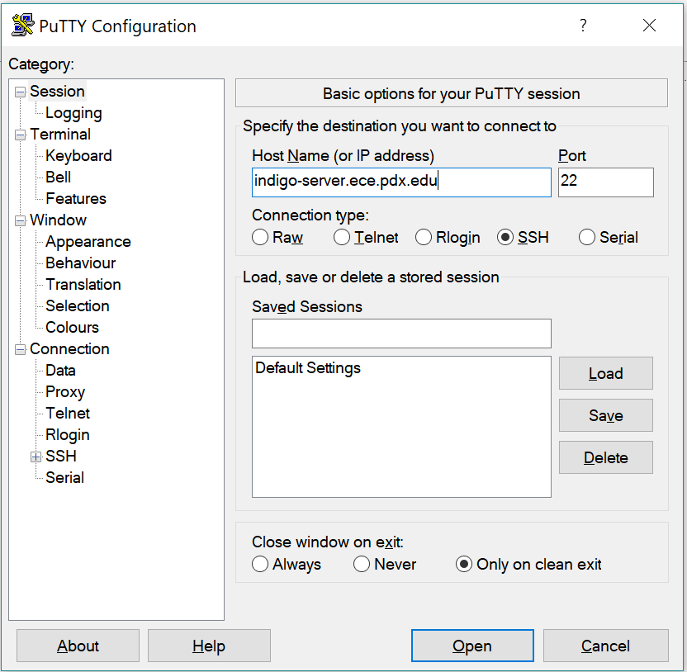
SSH into the ros-server

Slide 3
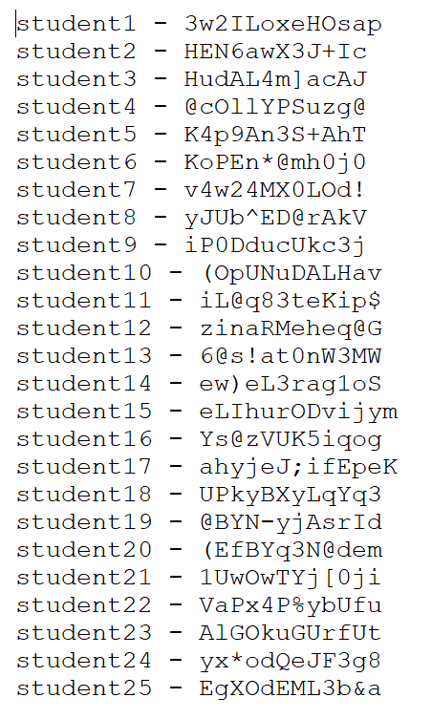
Username and Passwords:

Slide 4

Subscriber Node

Slide 5
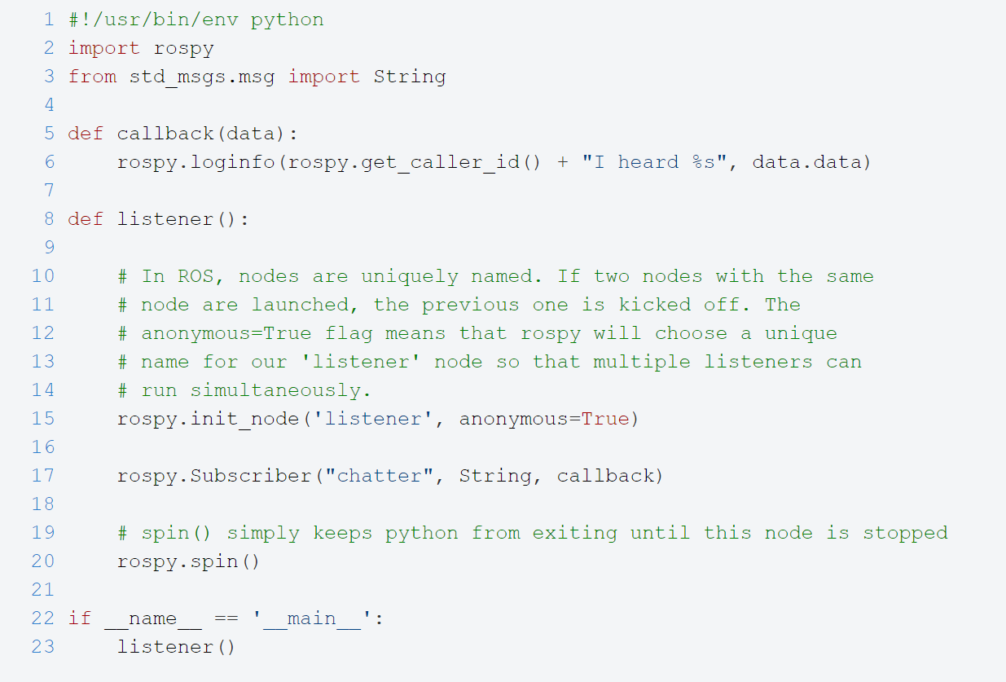

Slide 6
Publisher Node

Slide 7
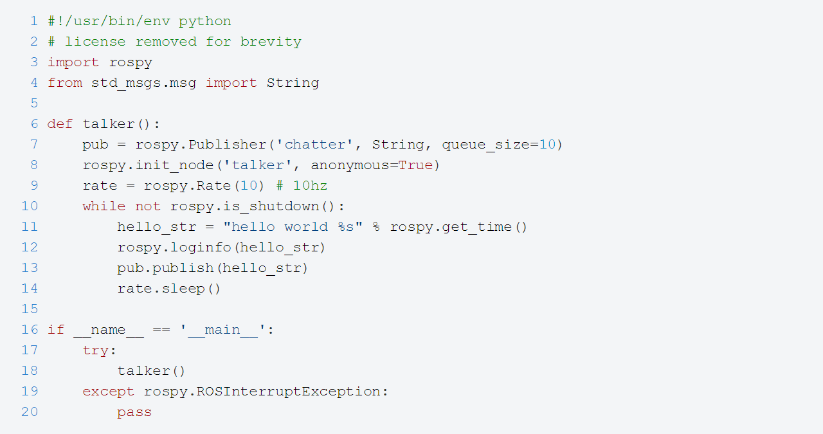
Publisher Node

Slide 8
Telephone
Student1
Student2
Student n
Student1
Student 2
Student n
First_Topic
Student1
Student2

Slide 9
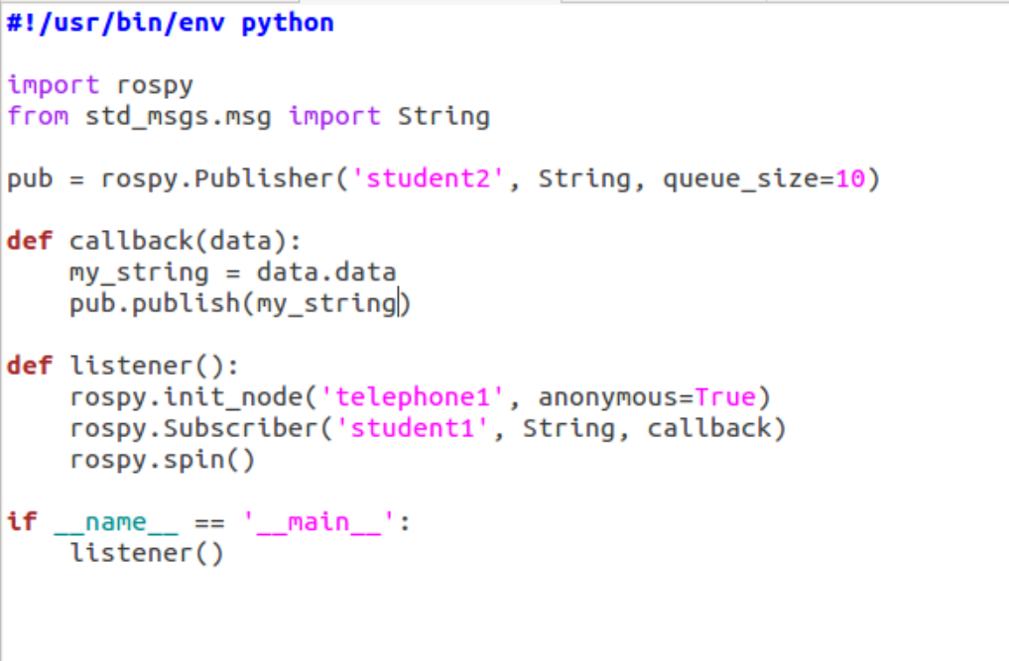

Slide 10
Telephone
Sum
Student2
Student n
Student1
Student 2
Student n
x
Student1
Student2

Slide 11
Calculator
Sum 1
Sum 2
Sum 3
Student1
Student1
Student1
x
y
x
y
x
y

Slide 12
ROS Launch
roslaunch is a tool for easily launching multiple ROS nodes locally and remotely
It also allows you to set parameters on the Parameter Server.
How to run a launch file:
roslaunch package_name file.launch

Slide 13
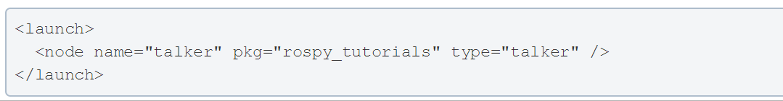
Simple ROS Launch File

Slide 14
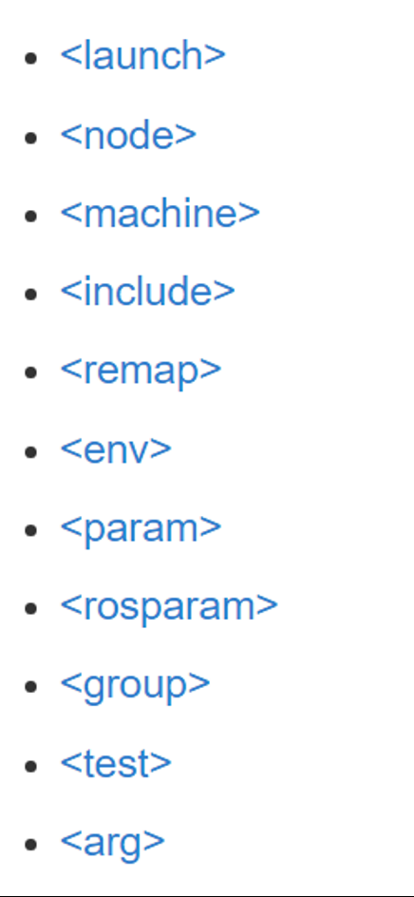
Launch file xml tag references

Slide 15
Launch File

