Slide 1

ECE 410-510 Intelligent Robotics 3
PhD. Husnu Melih Erdogan – Electrical & Computer Engineering
herdogan@pdx.edu Teaching Assistant

Slide 2


Prolog + Python

Slide 3
Prolog

Slide 4
What is Prolog?
Prolog is a high-level logical programing language
Invented in early 70s’
Interpreters are freely available
Different than usual programming languages
Declerative – Not Procedural
Recursion – No Loops
Relations – No Functions
Unification

Slide 5
Basic Idea of Prolog?
Describe the situation
Ask a question
Prolog:
Logical deduces new facts about the situation we described
Gives us its delectations back as answers

Slide 6
Applications of Prolog
Intelligent data base retrieval
Natural language understanding
Expert systems
Specification language
Machine learning
Robot programming
Automated reasoning
Problem solving

Slide 7
Applications of Prolog
Prolog used to program natural language interface in International Space Station
Parts of IBM’s Watson QA supercomputer were coded in Prolog
https://www.cs.nmsu.edu/ALP/2011/03/natural-language-processing-with-prolog-in-the-ibm-watson-system/

Slide 8
Prolog Review
A prolog program (database, knowledge base) is a collections of clauses.
There are two types of clauses facts and rules.

Slide 9
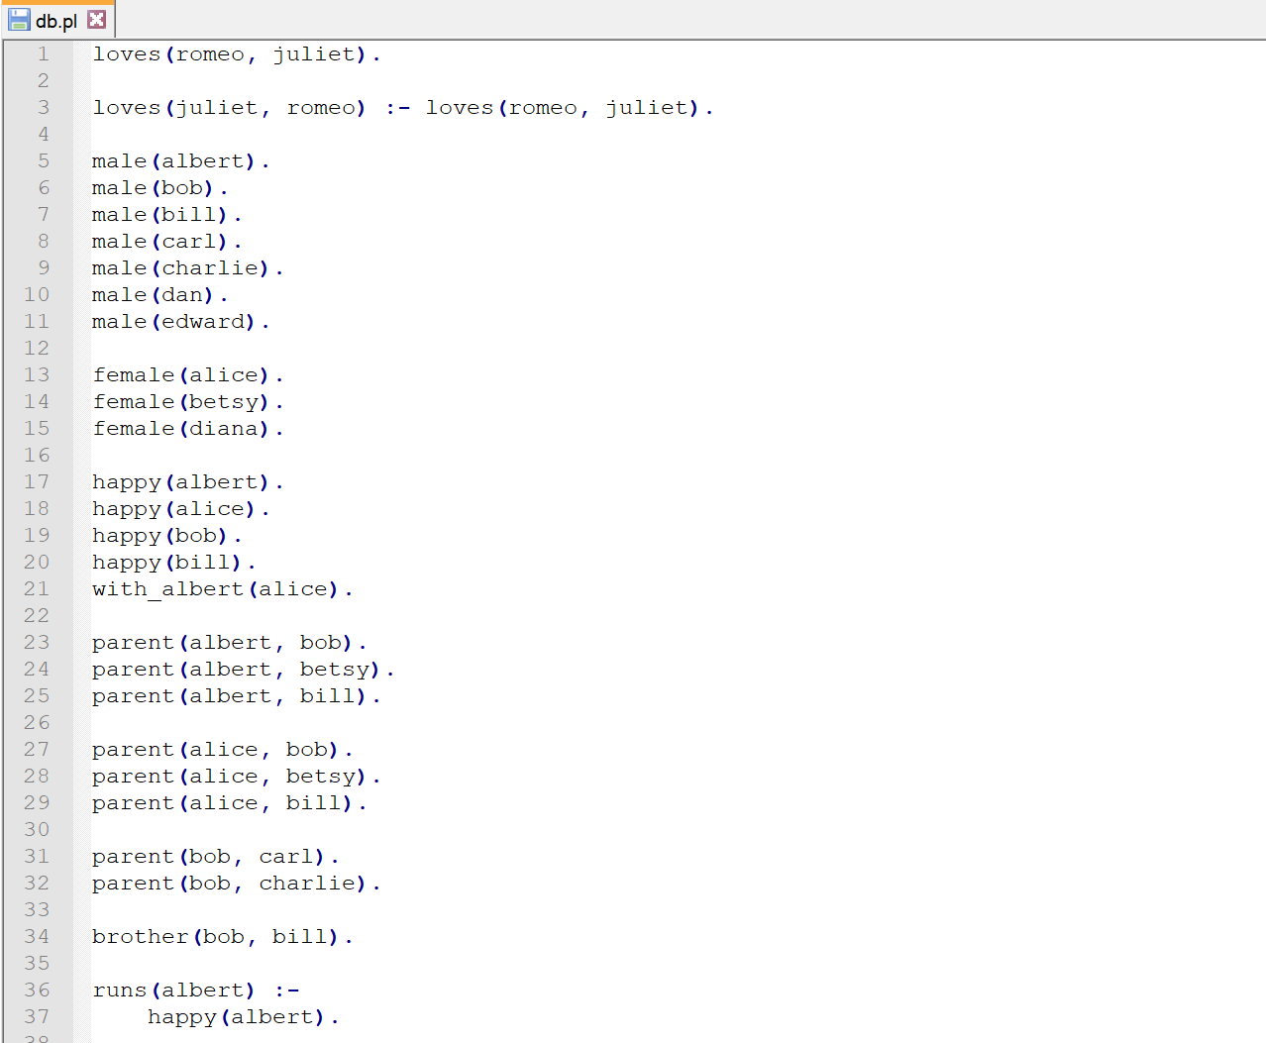
Knowledge Base - Database
All facts and rules are sorted in a file called knowledgebase/database.
.pl is file extension.

Slide 10
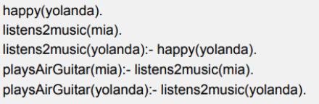
Clauses
A clause can be a facts or a rule.
The end of a clause is marked with a full stop.

Slide 11
Facts
Indicates a statement that is true.
Starts with a predicate and includes atoms(constants) and ends with a full stop.
Predicate (atom-constant).
Example:
male(marek).
male(john).
female(jane).
female(sara).
parent(marek, sara)
parent(jane, sara)

Slide 12
Rules
Can be considered as an extension of a facts with added conditions.
Head is a fact and body can be facts and rules.
Head :- Body.
Head is true if Body is true.
likes(john, jane).
likes(jane, john).
friends(john,jane) :- likes(john,jane), likes(jane,john).

Slide 13
Variables
Variables are used to indicate the same elements in case the precise name of an element is currently not known, unimportant.
Variable names start with an upper-case letter.
male(marek).
male(john).
female(jane).
female(sara).
female(X).
male(Y).

Slide 14

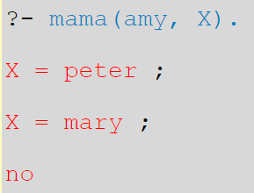
Goals and Queries
The purpose of submitting a goal is to find out whether the statement represented by the goal is true according to the knowledge database.
The purpose of submitting a query is to find values to substitute into the variables in the query such that the query is satisfied.

Slide 15
Installation Steps
Python 2.7 - https://www.python.org/download/releases/2.7/
SWI-Prolog - http://www.swi-prolog.org/download/stable
Add SWI-Prolog's bin directory ``C:\Program Files\swipl\bin`` to environment variables
Pyswip - https://code.google.com/archive/p/pyswip/downloads
Restarts your console

Slide 16
PySWIP
PySWIP is a python module which allows us accessing SWI-Prolog’s foreign language interface using Python.
It is free
Easy to use

Slide 17
Example – Step 1
First import the library and create an object called p
from pyswip import Prolog
p = Prolog()

Slide 18
Example – Step 2
Define facts and rules.
p.assertz('car(vw_beatle)’)
p.assertz('car(ferrari)’)
p.assertz('car(hyundai)’)
p.assertz('bike(harley_davidson)’)
p.assertz('red(ferrari)’)
p.assertz('red(vw_beatle)’)
p.assertz('blue(hyundai)’)
p.assertz('(fun(X) :- red(X), car(X))')

Slide 19
Example – Step 3
Find and print solutions of queries and goals.
print list(p.query('car(X)’))
print list(p.query('fun(Y)'))

Slide 20
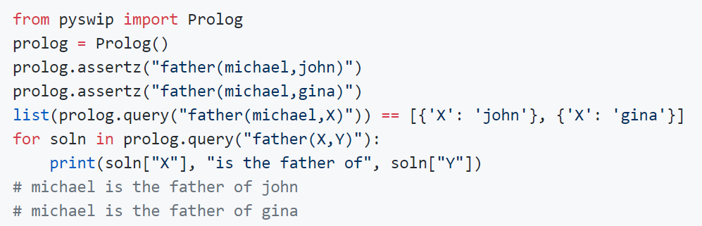
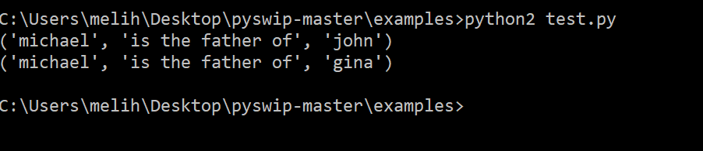
Test 1 – Create rules and facts

Slide 21
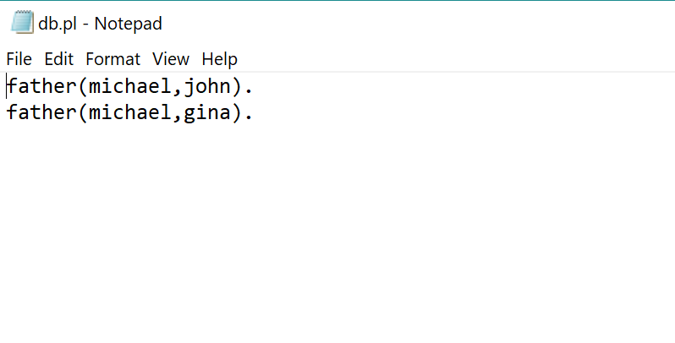
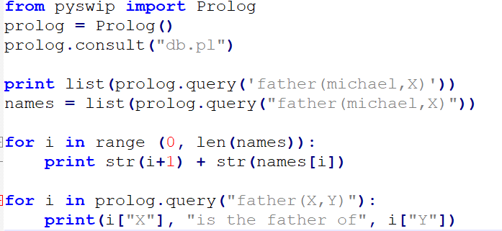
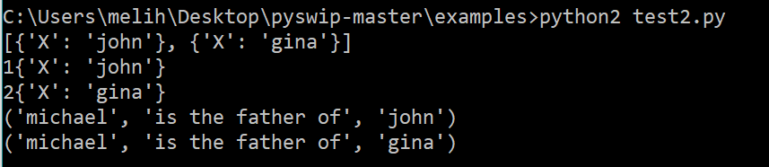
Test 2 – Import a database

Slide 22
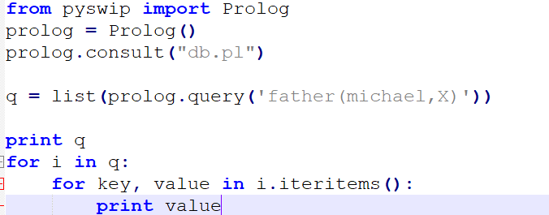
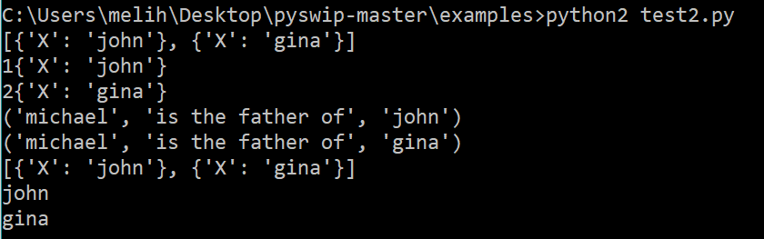
Test 2 – prolog.query

Slide 23

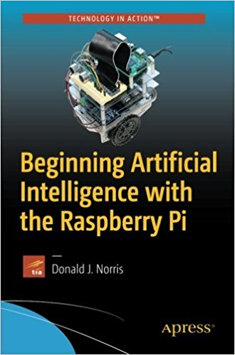
Books
https://www.goodreads.com/book/show/2054765.PROLOG
https://www.amazon.com/Beginning-Artificial-Intelligence-Raspberry-Pi/dp/1484227425

Slide 24
Resources
http://www.cse.unsw.edu.au/~billw/cs9414/notes/prolog/intro.html
https://kodethon.github.io/2017/04/06/prolog-in-kodethon.html
https://www.youtube.com/watch?v=SykxWpFwMGs
http://www.ablmcc.edu.hk/~scy/prolog/index_e.htm
https://athena.ecs.csus.edu/~logicp/prolog.html
http://yuce.tekol.net/2009/pyswip-facts-and-rules/
https://github.com/yuce/pyswip

