Slide 1
Car dealership management system
Kelly Greyling
Meng Li

Slide 2
background
The purpose of the Car Dealership Management System is to provide:
fluidity in the day to day functions
accuracy in order processing
ease in information retrieval (exporting / printing)
Problems solved are:
Input errors (PreviewTextInput)
Missing information (data validation)

Slide 3
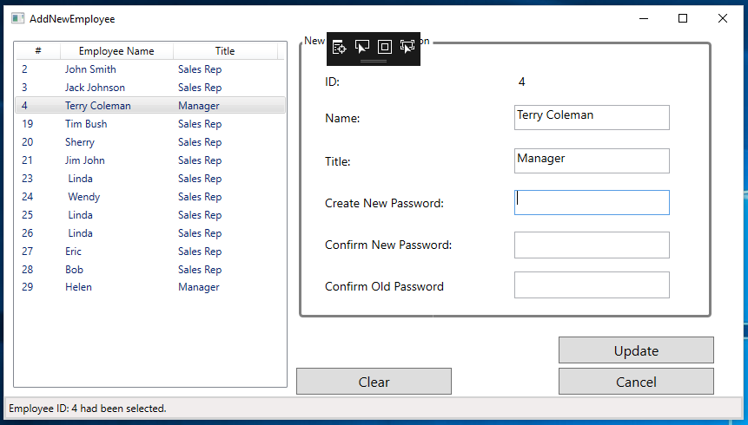

Main features overview
Employees can be added / updated
Employees can export orders, customers, and inventory as pdf or csv
Employees can print orders

Slide 4
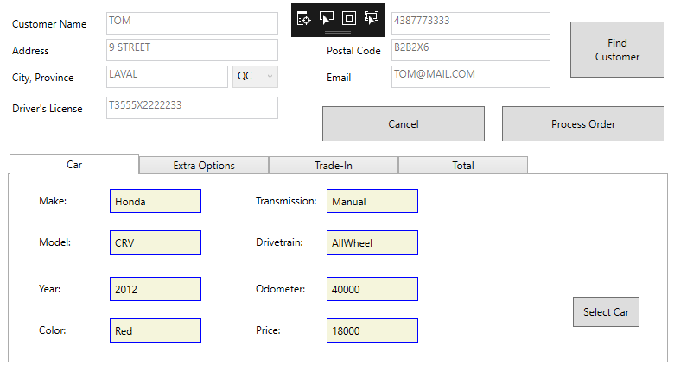
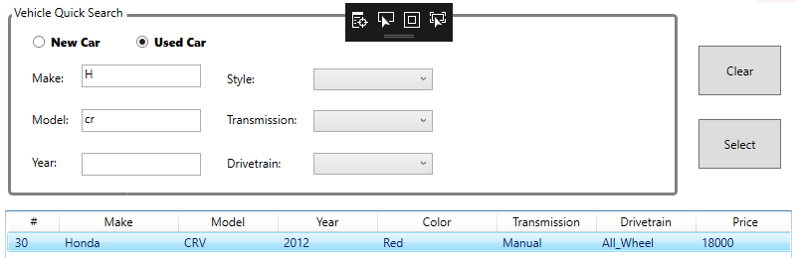
Main features overview
Auto-population for vehicle and customer information when creating orders.
Quick search options for filtering customers and vehicles.
Real-time inventory tracking for vehicles bought (trade-in) and sold.

Slide 5
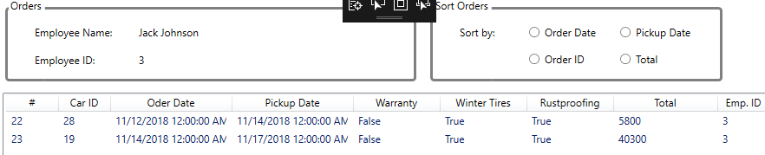
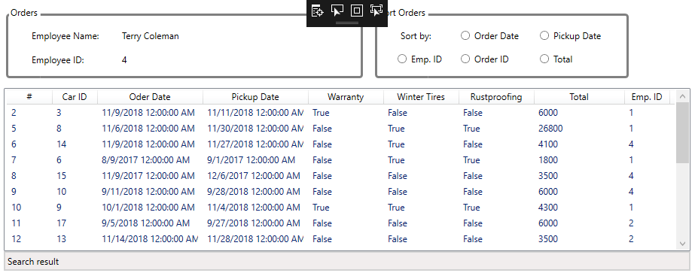
Main features overview
Employees can only access their orders.
Managers and Supervisors have access to all orders.

Slide 6
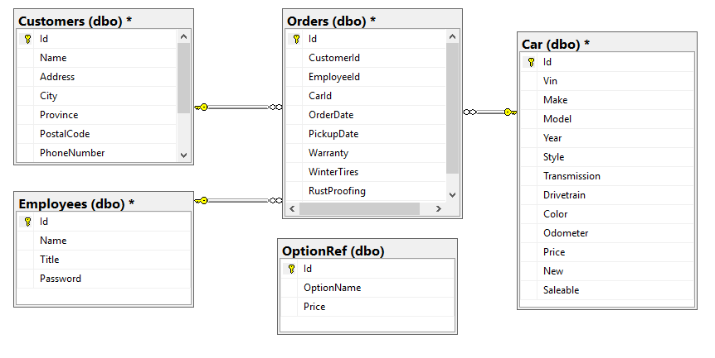
Challenges and solutions
Database Structure

Slide 7
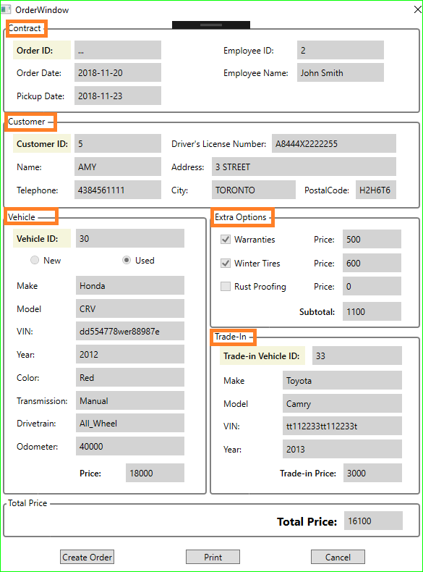
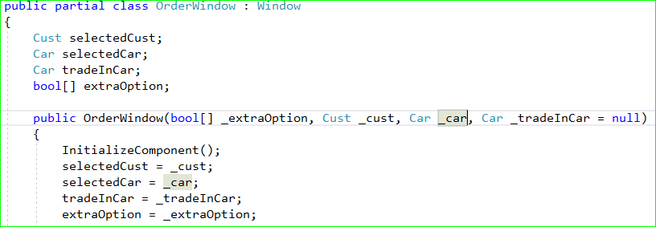
Challenges and solutions
Collecting all relevant information, user can create an order.

Slide 8
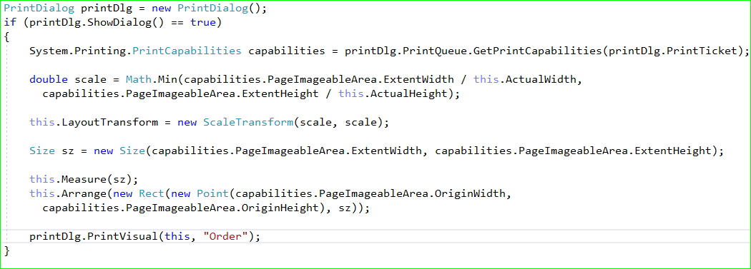
Challenges and solutions
Order printing

Slide 9

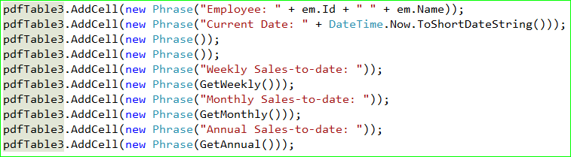
What we learned – Export to PDF
Using iTextSharp
Generate table
Add data

Slide 10
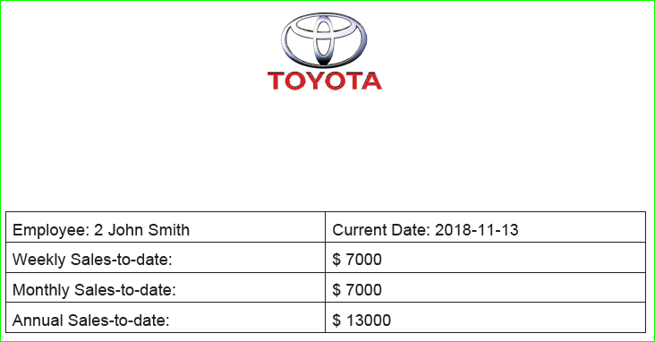
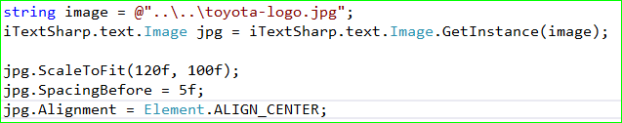
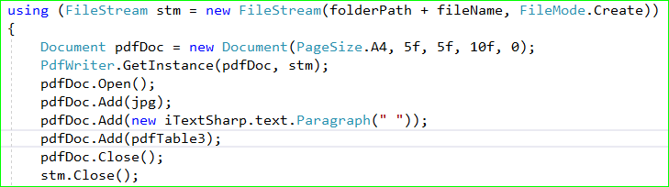
What we learned – Export to PDF
Using iTextSharp (continue)
Insert image
Design the layout of PDF file

Slide 11
Future work
Optimize the database
In Order table, add one more “OrderStatus” property, which can mark the finished order and unfinished order
Make the User interface more friendly
Add picture of car

Slide 12
Summary
Access control by different user
User account register and password reset
Sales data stats and export to PDF or CSV
User can add, edit and search customer, vehicle inventory
User can create and print the order

