Slide 1
ProjectDb
A Key Value Storage Library
Lieyang Chen
Mengwen Li (ml4643)
Shengtan Mao (sm4954)
https://github.com/mli9502/ProjectDb

Slide 2
Introduction

Slide 3
Measurements
Main features of Database:
writing - .set()
removing - .remove()
reading - .get()
Supports randomly generated data
Supports reading data from csv

Slide 4
Data for Benchmark
Key value pairs stored in a vector
Randomly generated
0, 1, 2, … as keys
randomly generated string as values
Trending YouTube Video Statistics
video ID as keys
video title as values

Slide 5
Benchmark Description
7 Tasks:
fill sequential / random
overwrite
delete sequential / random
read sequential / random

Slide 6
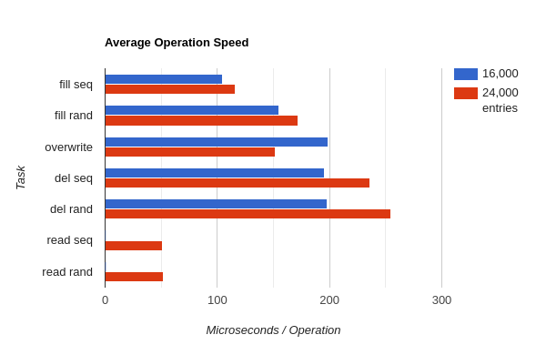
Benchmark: Randomly Generated
First configuration
2 mb in memory
250 kb index block
Slower for more entries
Fill faster than delete
Sequential faster than random
Overwrite?

Slide 7
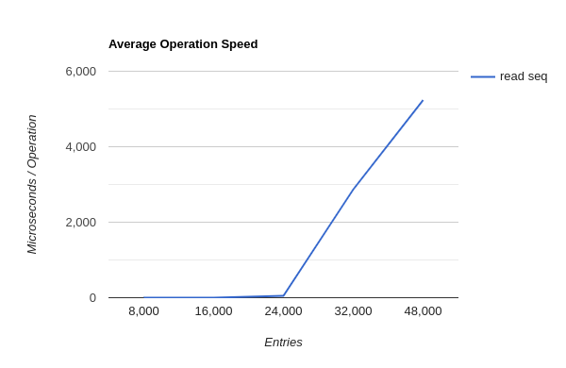
Benchmark: Read
Fast for low numbers
Slow when data size > 2 mb
values: 100 characters
2.4 mb for 24,000 entries
Have to search disk?

Slide 8
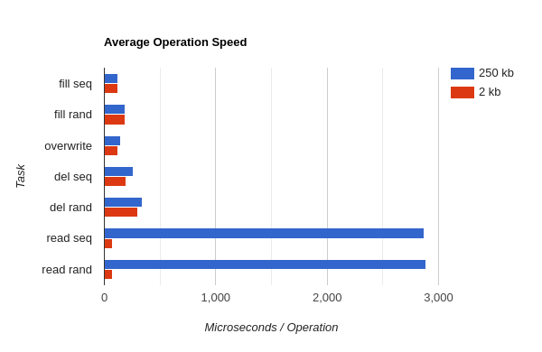
How to Solve This?
32,000 entries
Second configuration
2 mb in memory
2 kb index block
Much faster read
Similar performance otherwise

Slide 9
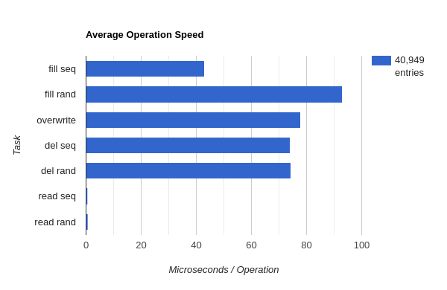
Benchmark: Trending YouTube Video Statistics
Example:
2kyS6SvSYSE
“WE WANT TO TALK ABOUT OUR MARRIAGE”
Using the first configuration
Smaller value sizes

Slide 10
Further Benchmarks
Comparison with LevelDB
Flush to disk
More configurations

